Slide 1

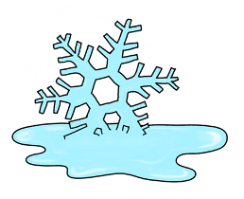
TSMM The Terrestrial Snow Mass Mission
Benoit Montpetit on behalf of all the TSMM team at Environment and Climate Change Canada, Canadian Space Agency and Natural Resources Canada
NASA Community Snow Meeting – Aug. 14, 2024 – Boulder, CO, USA

Slide 2
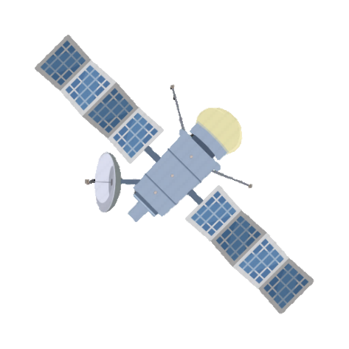









7 Ways Snow Mass Information From Space
Will Benefit Canadians
STREAMFLOW FORECASTING
Better understanding of snow melt can improve situational awareness and preparedness for flood events due to changing river flow
WATER RESOURCE SECURITY
Management of water from snow melt is important to ensure water availability for human consumption and to maintain healthy aquatic ecosystems
AGRICULTURAL PLANNING & FOOD SECURITY
Water from snow safeguards food security by providing essential moisture and mitigating drought risks
HYDROPOWER & CLEAN ENERGY
Information on snow melt is a strategic requirement to support hydropower generation, a vital economic commodity and key pillar to achieving a net zero energy system
HABITAT MONITORING
Keystone wildlife populations of economic and social value, such as caribou, are influenced by snow distribution and properties
NUMERICAL WEATHER PREDICTION
Snow mass measurements can reduce errors in medium-range weather forecasts
INFRASTRUCTURE
Snow mass observations can be used to improve disaster resilience and protect the build environment through improved flood forecasting and snow load assessments

Slide 3
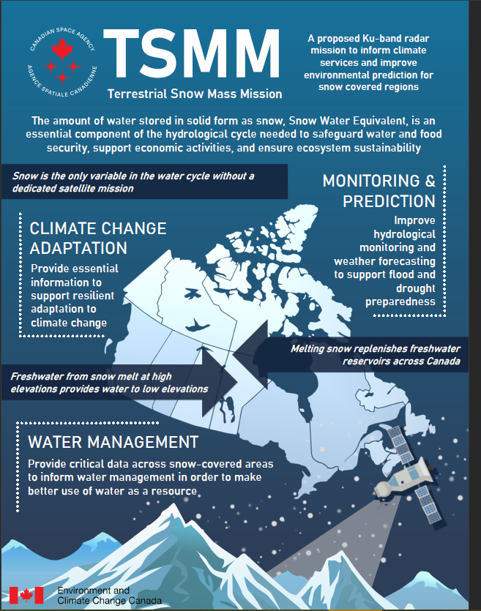
Terrestrial Snow Mass Mission
First and only satellite EO mission to continuously monitor snow nationally and globally … because water availability and security matters to Canadians everywhere
ECCC and the Canadian Space Agency have partnered on the development of the Terrestrial Snow Mass Mission since 2015
TSMM will deliver the first Ku-band radar measurements from space, which will be used to map snow mass (the amount of water stored in solid form by snow) at 500m resolution, across all of Canada, updated weekly
TSMM-derived snow mass will be used at ECCC to inform analysis of freshwater availability in a changing climate and improve streamflow prediction
Many other sectors require snow mass information, including agriculture, hydropower, and municipal water resource management
Climate change is altering freshwater supply across Canada, including seasonal snow cover, and so understanding impacts on water availability is essential for adaptation planning

Slide 4



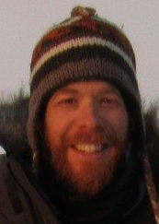
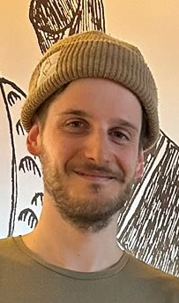

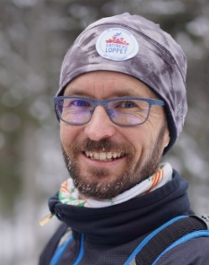
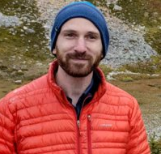


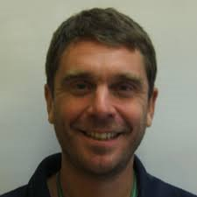


TSMM Science Team
Chris Derksen: Mission PI
Benoit Montpetit: SWE Retrieval Science Lead
Julien Meloche
Vincent Vionnet: Land Surface Modelling Science Lead
Nicolas Leroux
Marco Carrera: Data Assimilation Science Lead
Courtney Bayer
Franck Lespinas
Mike Brady: Data and IT Infrastructure Science Lead

Slide 5
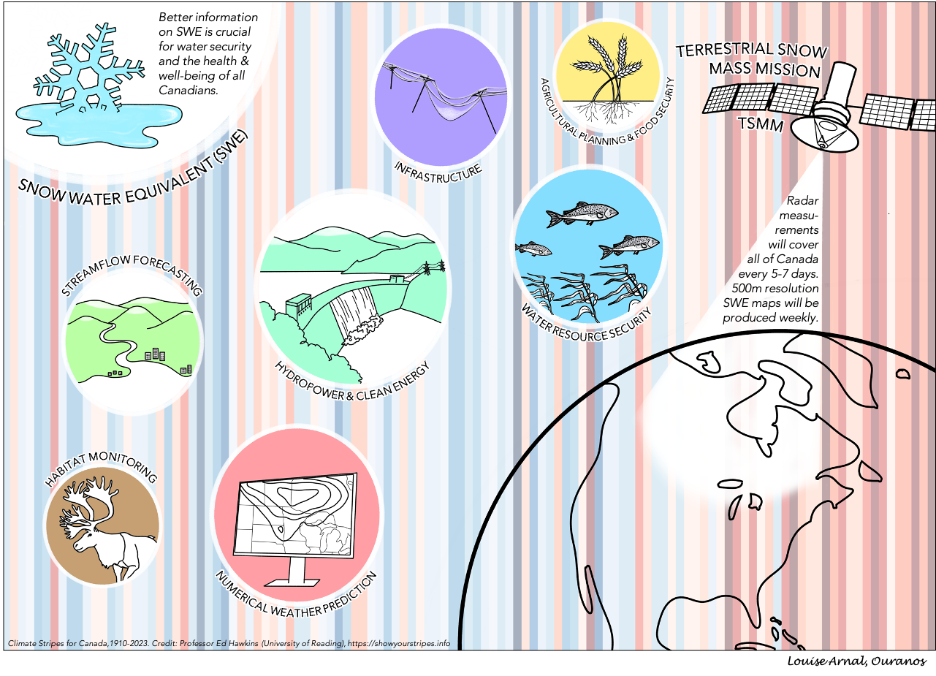
TSMM Support Team
Mission Management Team
Jean Bergeron (CSA): Mission Manager
Fauve Strachan (CSA): Project Manager
Mission Policy Support Teams
ECCC
CSA
Mid-Stream Support Teams
ECCC
NRCan
CSA
ECCC Senior Management
Nathalie Morin: DG of ASTD
Marc D’Iorio: ADM of S&T
Jean-François Tremblay: DM
ECCC Economic Research Unit

Slide 6
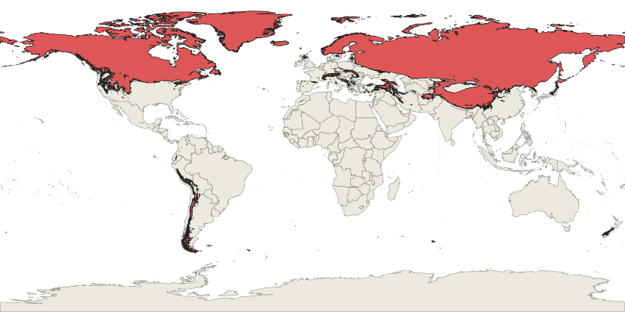
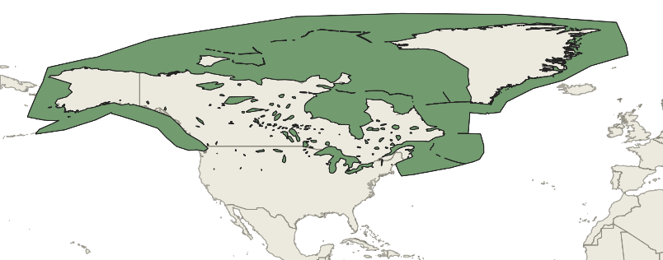
Technical Concept
Characteristic | Mission Design | Comments
Frequencies | Dual-band operation, 13.5 and 17.25 GHz | Maximize SWE retrieval capability and snow microstructure characterisation
Polarizations | VV; VH | Dual-pol mitigates effects of horizontal layering in the snowpack; cross-pol allows detection of high ocean winds
Ground Resolution | 500 x 500 m | Significant improvement over current 25 km SWE products
Number of Looks | >4 | Multi-looking to enhance radiometric quality
Incidence Angle Range | 25° - 55° | SWE retrieval performance likely to be poorer at shallow and steep incidence angles
NESZ – 13.5 GHz | <-26 dB (VV & VH) | Low NESZ ensures sensitivity to SWE (dry snow), and detection of wet snow cover with weak backscatter
NESZ – 17.2 GHz | <-25 dB (VV & VH)
Azimuth and Range DTAR | <-20 dB | Typical DTAR to adequately control ambiguities
Radiometric stability | <0.5 dB | Required temporal consistency of observations
Radiometric accuracy | 1 dB | Enables accurate retrieval of SWE
‘Pathfinder’ mission with a specific cost cap: advance innovation and prove scientific viability
Single-aperture dual-frequency Ku-band antenna (13.5/17.25 GHz)
500 m nominal resolution across 250 km swath = coverage of Canada every 5-7 days; 50 m mode across 30 km swath
SAR-on duty cycle of ~25%
Mission duration: at least three winter seasons

Slide 7
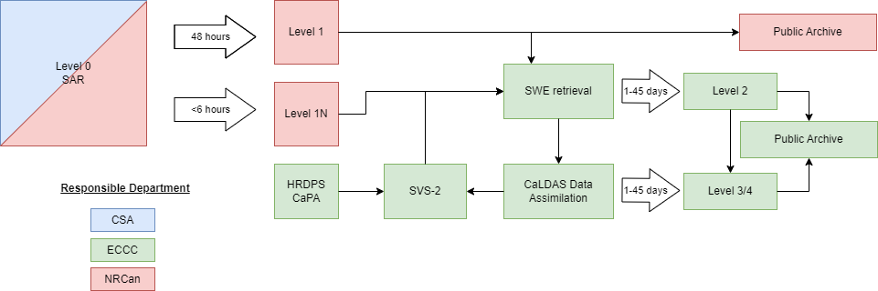
SAR/SWE Product Generation
SAR products
Science-to-operations mission
Run on same system as operational system
Lower priority than operational sensors
All open/free access L1 data
SAR public archive includes:
SAR pre-processing (calibration/geocoding/reprojection)
CEOS SAR ARD
Imagery over snow covered areas
SWE products
Science-to-operations mission
Run on parallel system identical to operational system
Lower priority than operational systems
All open/free access data
Includes SWE algorithm codes
L2: SWE from L1 swath
L3: Standardized gridded weekly L2
L4: Merged L3/models, gap filled, flagged
Products available over Canada+Transboundary watersheds

Slide 8
Science Readiness

Slide 9
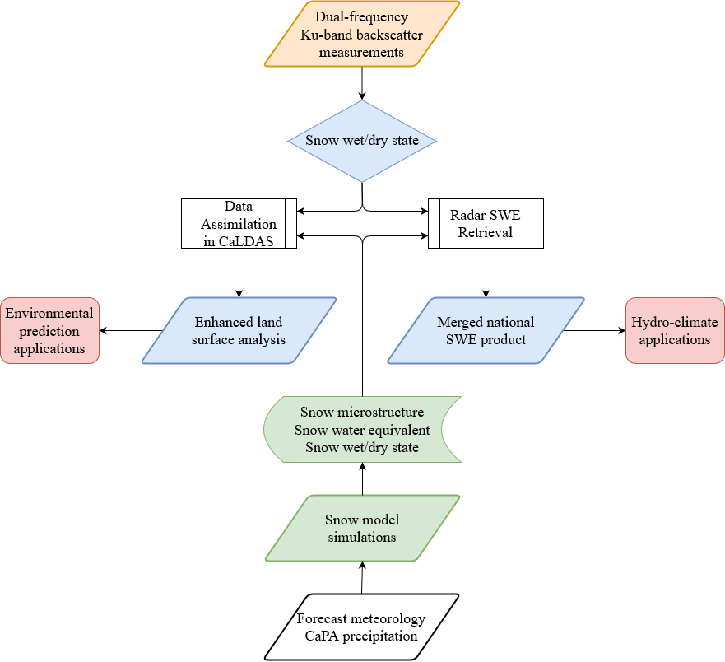
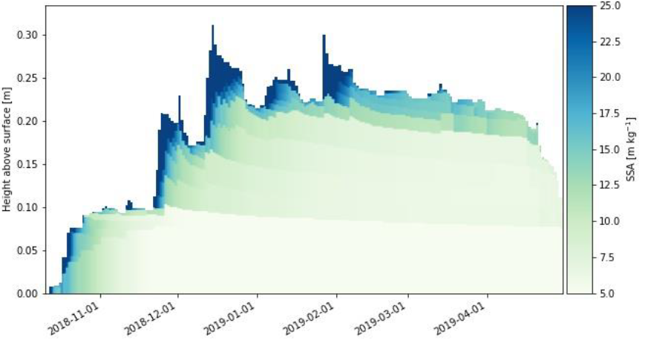

Terrestrial Snow Mass Mission Analysis Approach
Snow wet/dry state algorithm and product development (500m)
Assimilation with the Canadian Land Data Assimilation System (CaLDAS)
Snow water equivalent algorithm and product development (500m)
SVS-2/Crocus snow model simulations
to deliver SWE and microstructure first guess
HRDPS meteorological forcing (2.5 km) + precipitation analysis
We are in the process of applying field campaign data and the mission simulator to demonstrate the viability of all five components of this approach

Slide 10
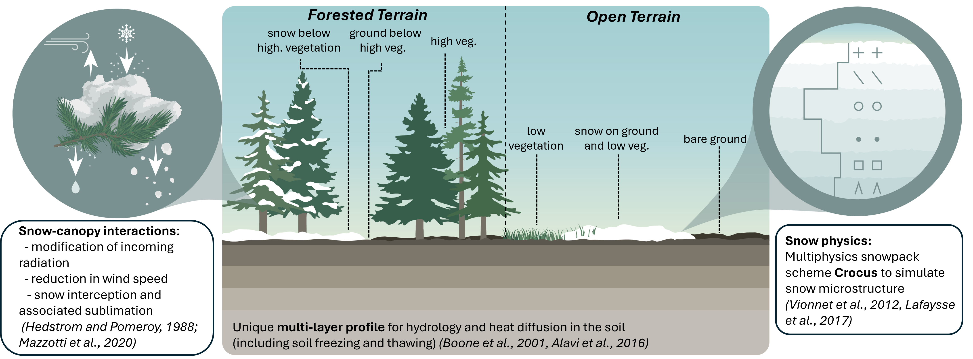
Soil Vegetation and Snow (SVS) Version 2
Main objective: enhancing snow simulations in land surface model in support of spaceborne snow missions
Vionnet et al. (2024, in prep)

Slide 11
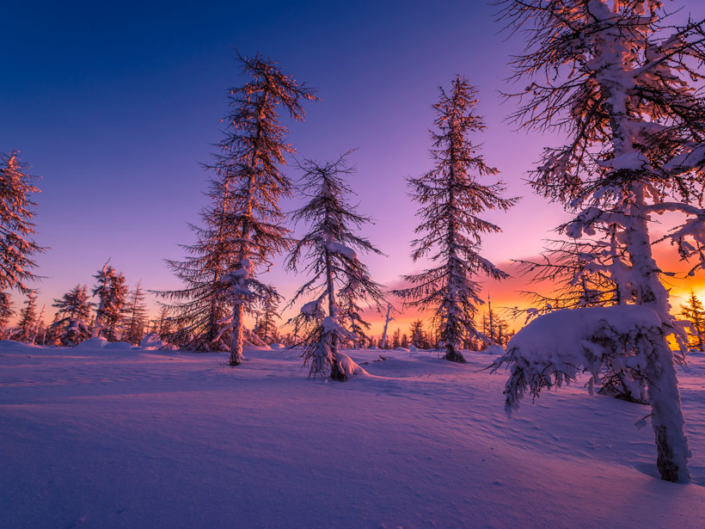

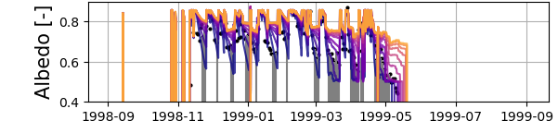
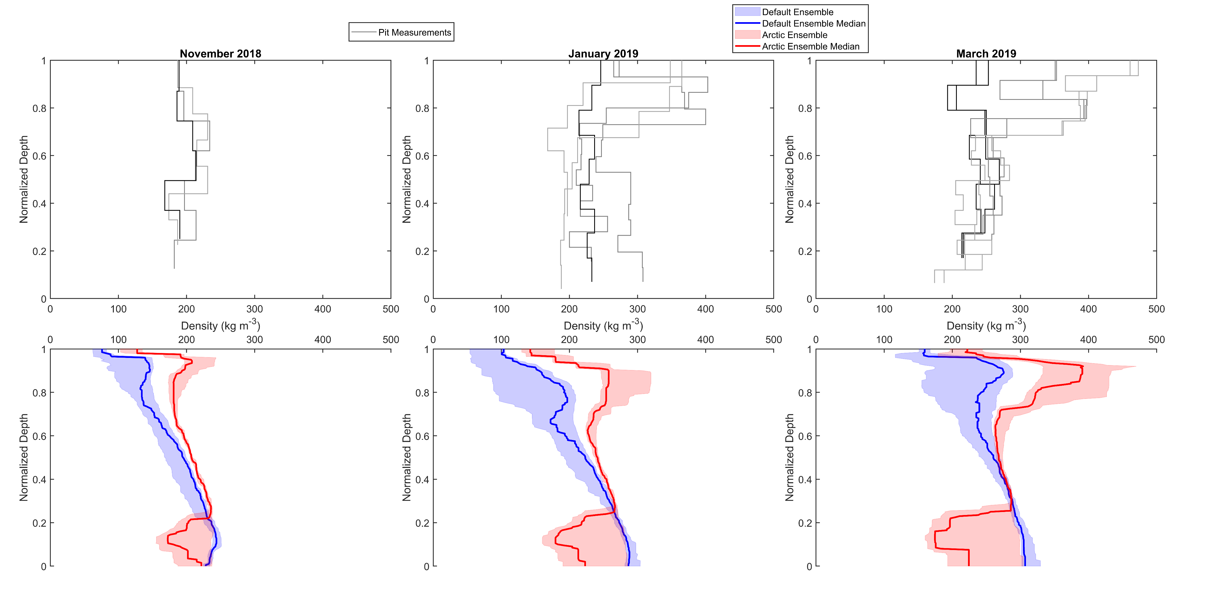
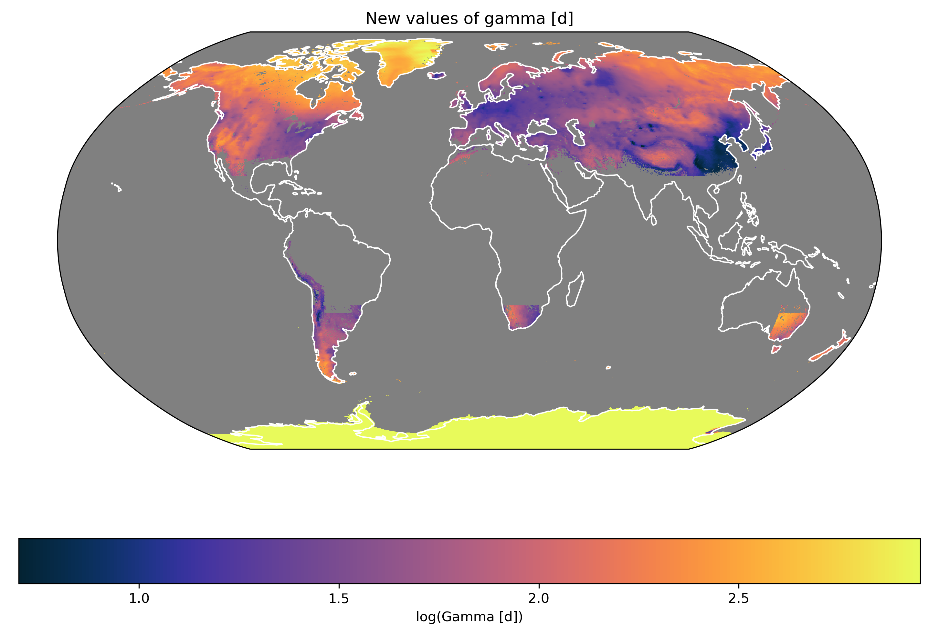
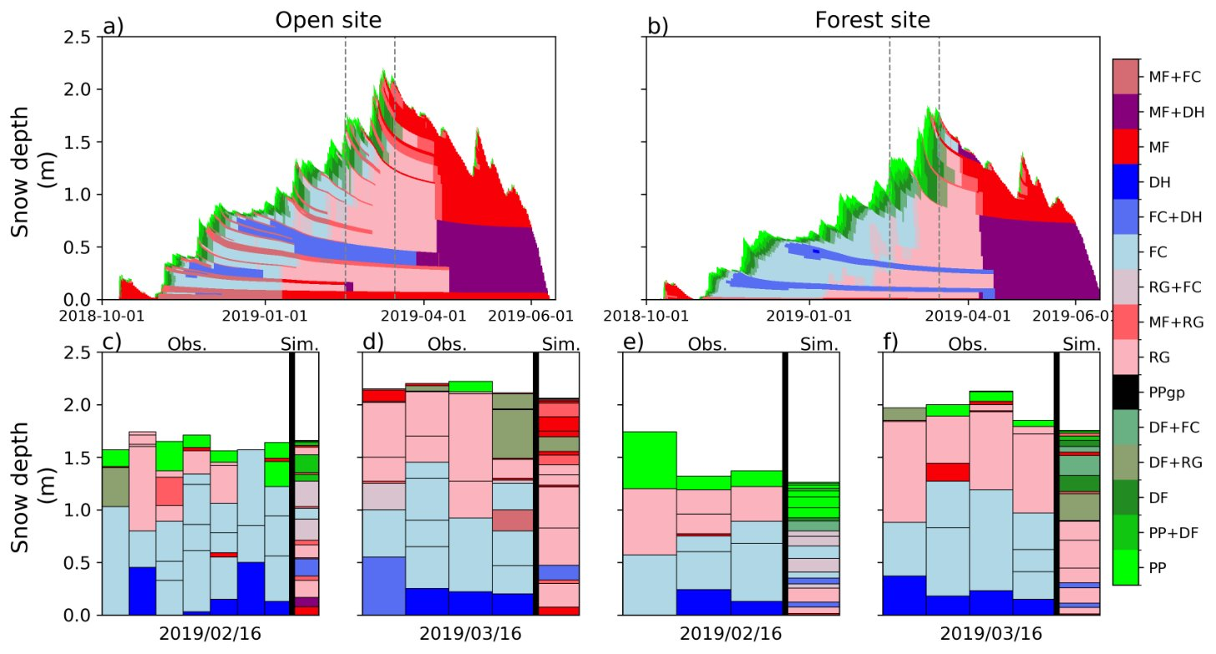
Soil Vegetation and Snow (SVS) Version 2
Enhanced parametrizations to simulate snowpack properties across large domains
Revised canopy model for the simulation of snowpack properties in sparse forests
Gaillard et al (2024) TC Discussion
Woolley et al( 2024) TC Discussion
Improved albedo parameterization accounting for the spatial variability of light-absorbing particle deposition on snow
New parametrizations dedicated to the simulation of Arctic snow properties (effects of wind and basal vegetation)

Slide 12
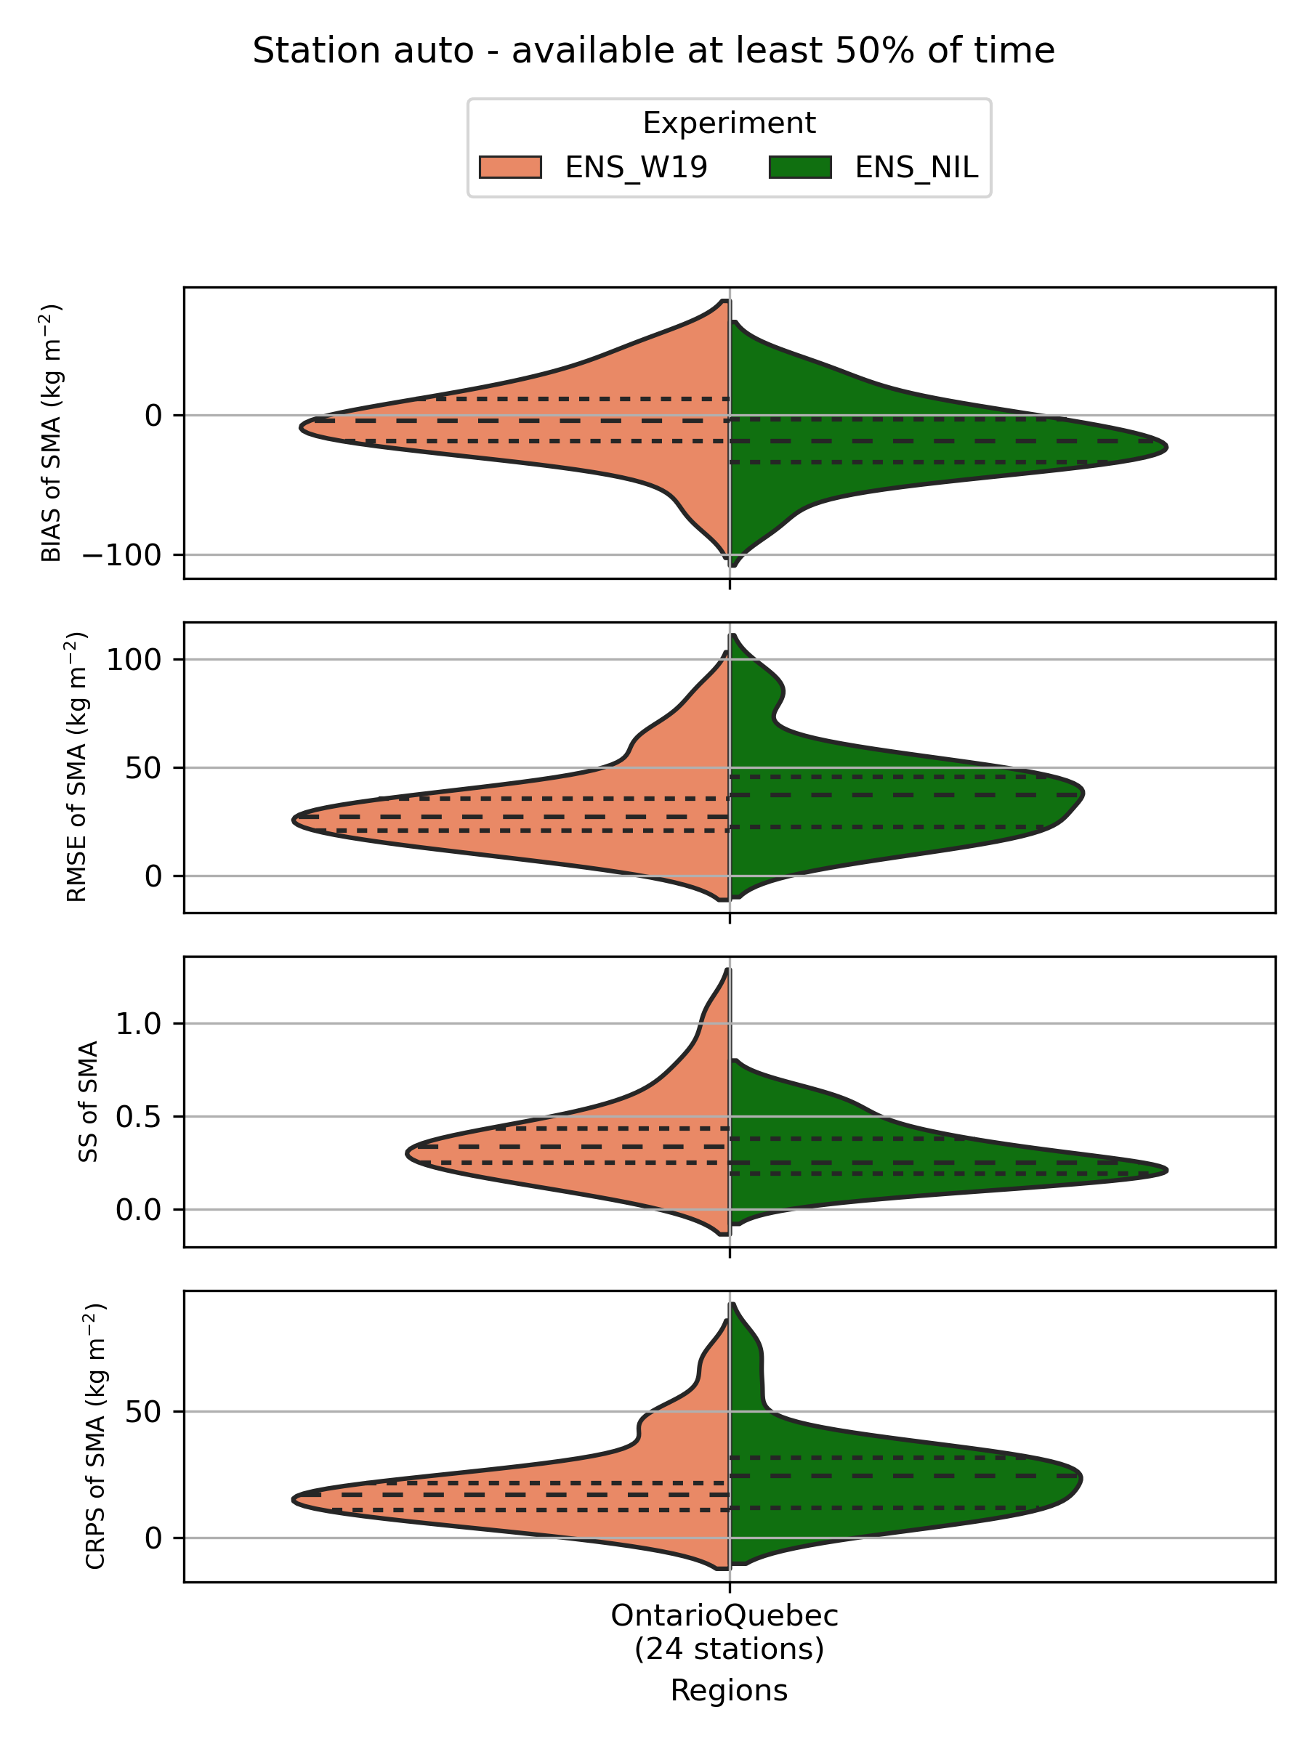
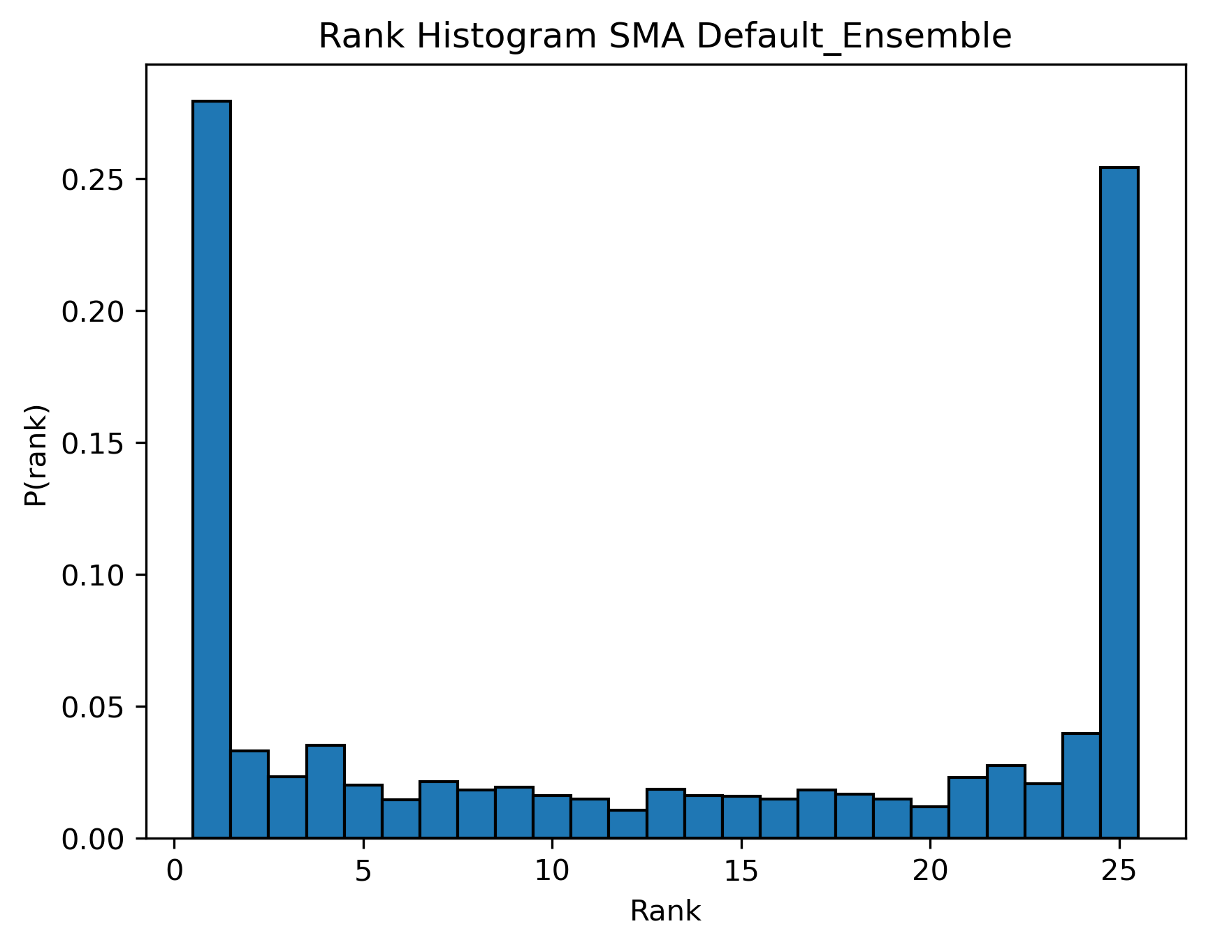
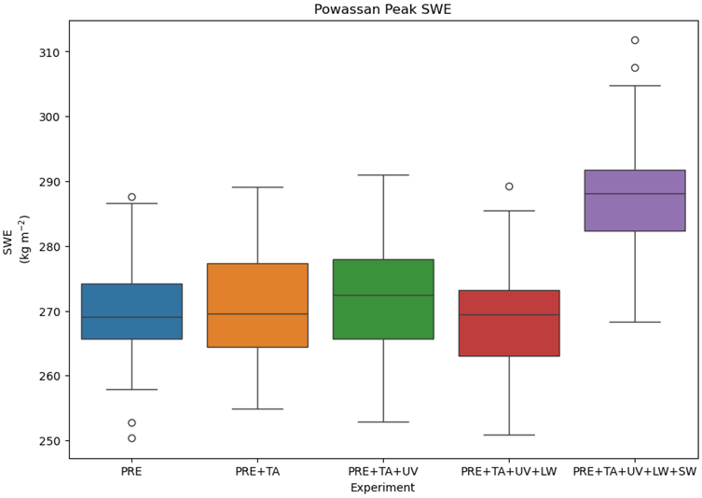
Canadian Land Data Assimilation Scheme (CaLDAS)
Improve the snow ensemble configuration for valuable forecasts
Conducting point scale experiments to determine ensemble sensitivity and best assimilation methods to be implemented in CaLDAS (in MuSA; Alonso-González et al., 2022)
The current CaLDAS ensemble is under-dispersive for SWE and snow depth outputs
Experimenting with modifying perturbation methods & precipitation phase partitioning for improved snow outputs
Notes:
GMD - The Multiple Snow Data Assimilation System (MuSA v1.0) (copernicus.org)

Slide 13
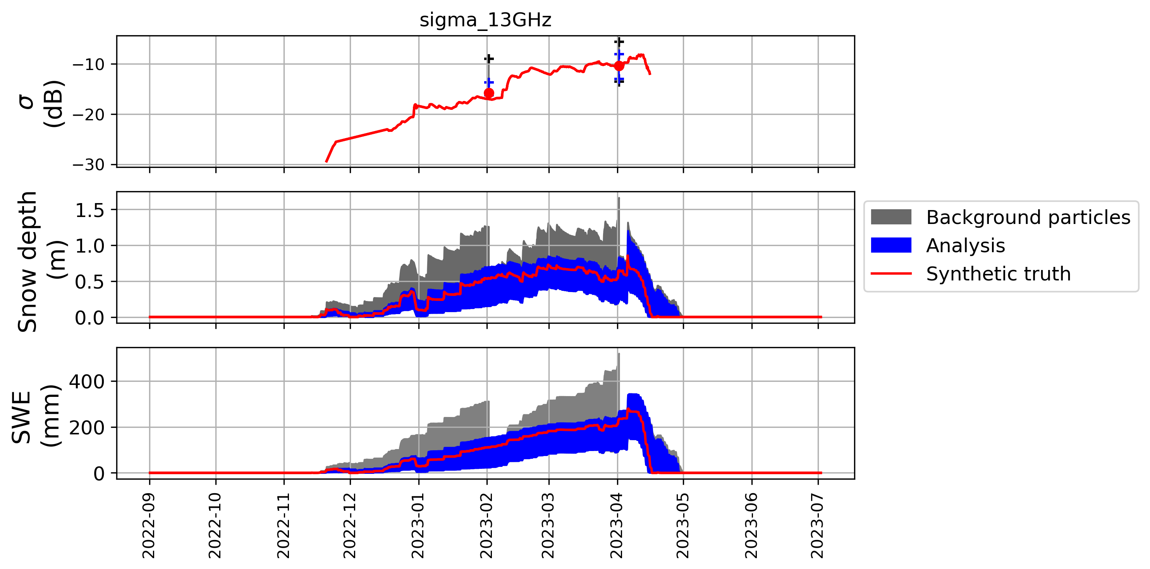
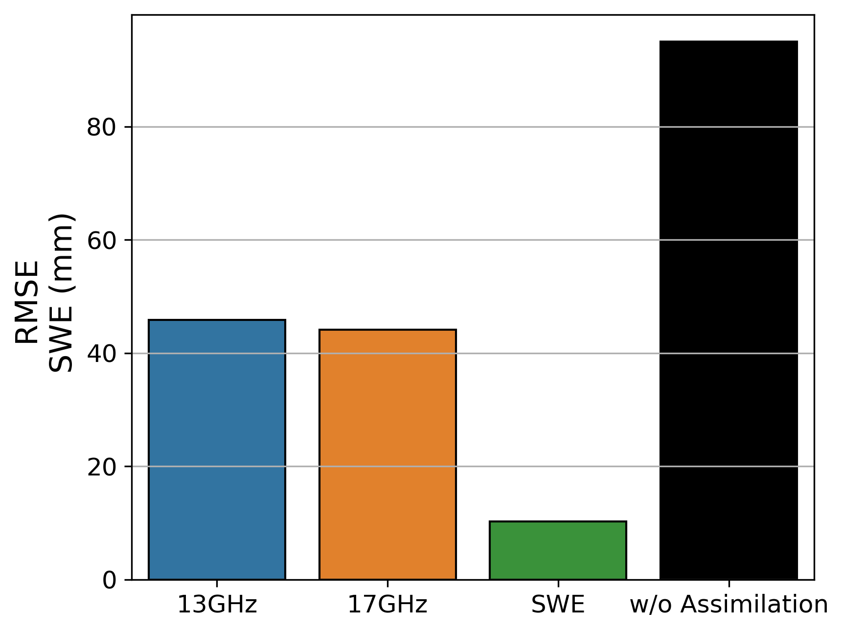
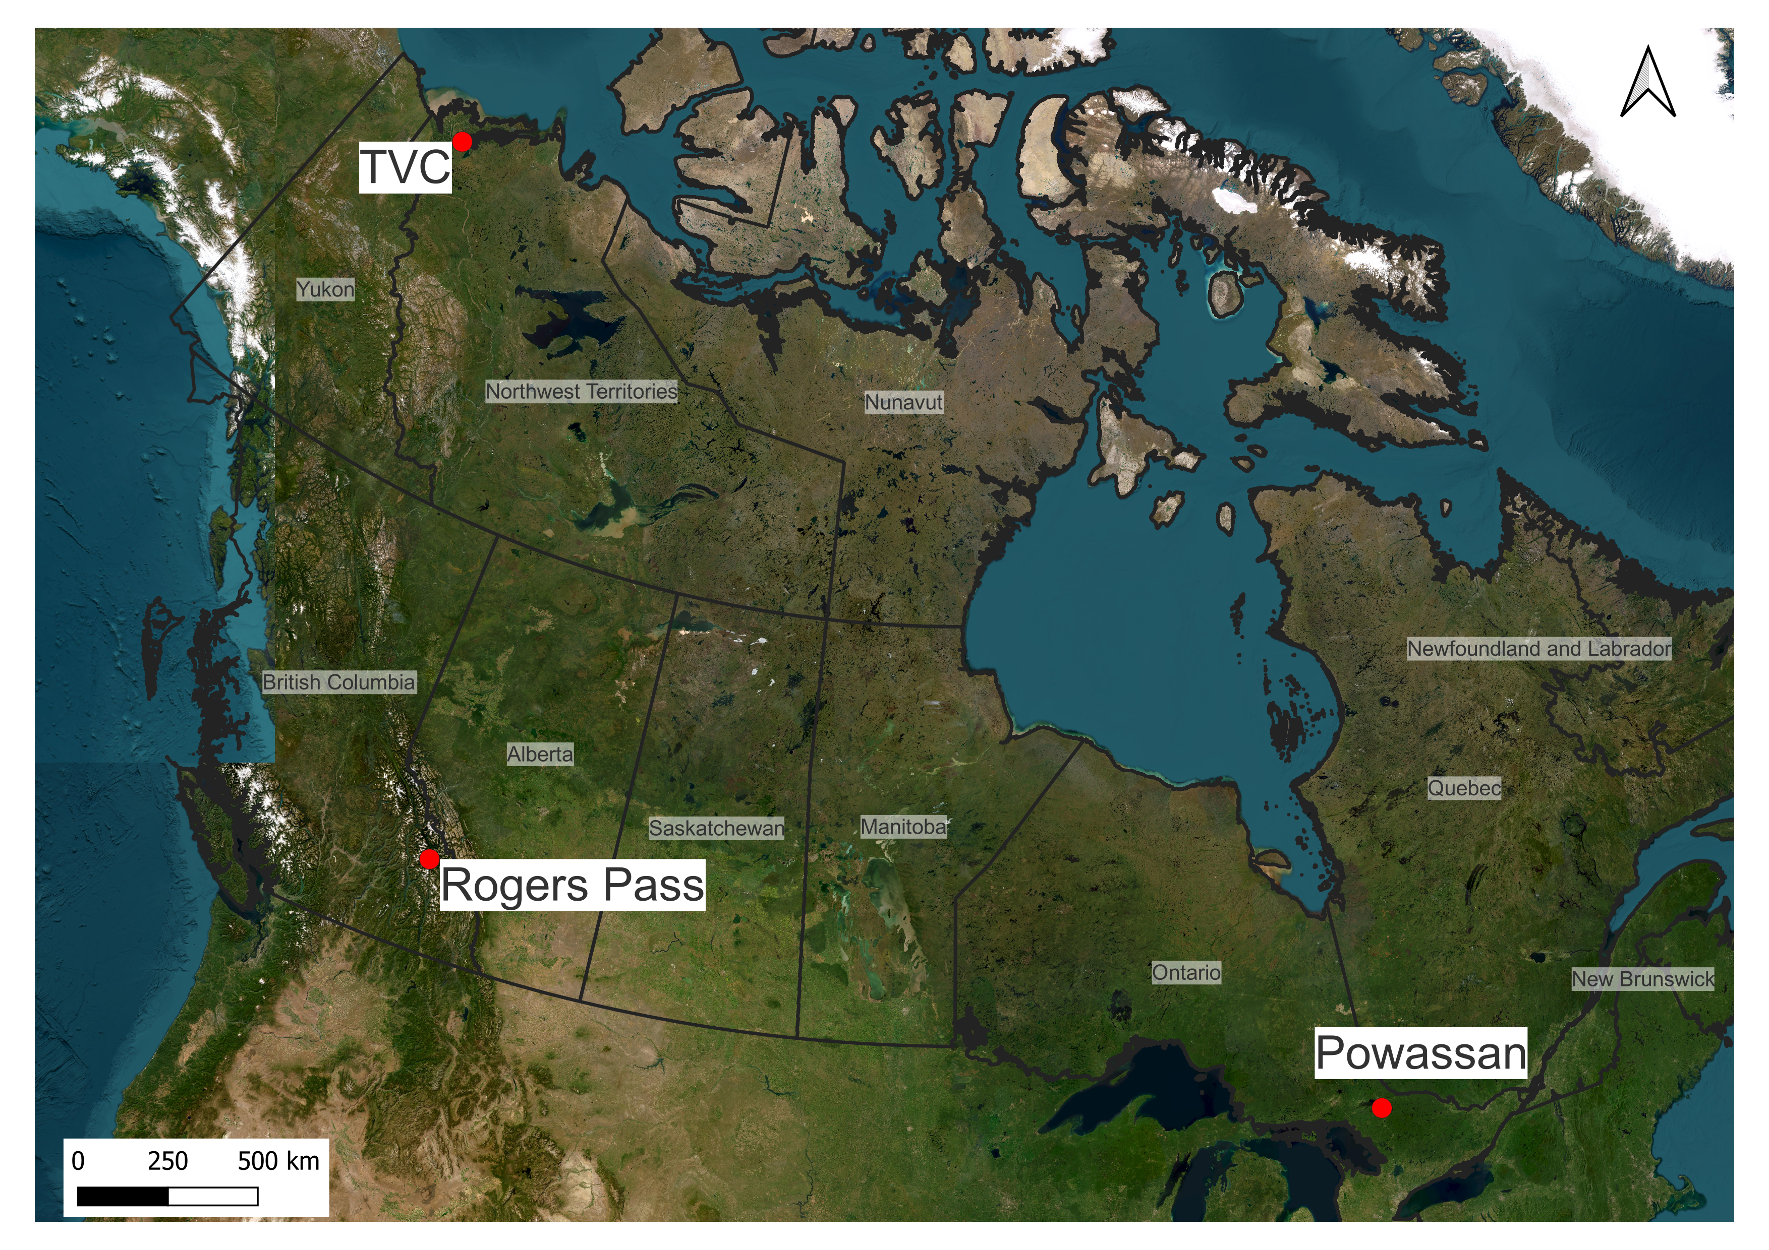
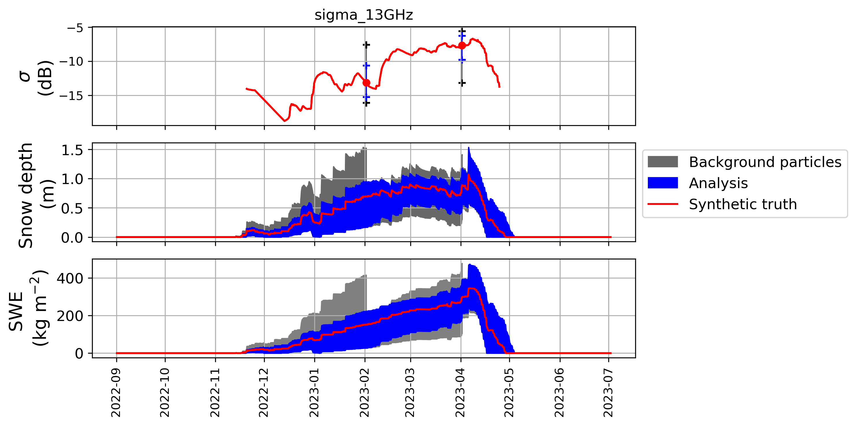
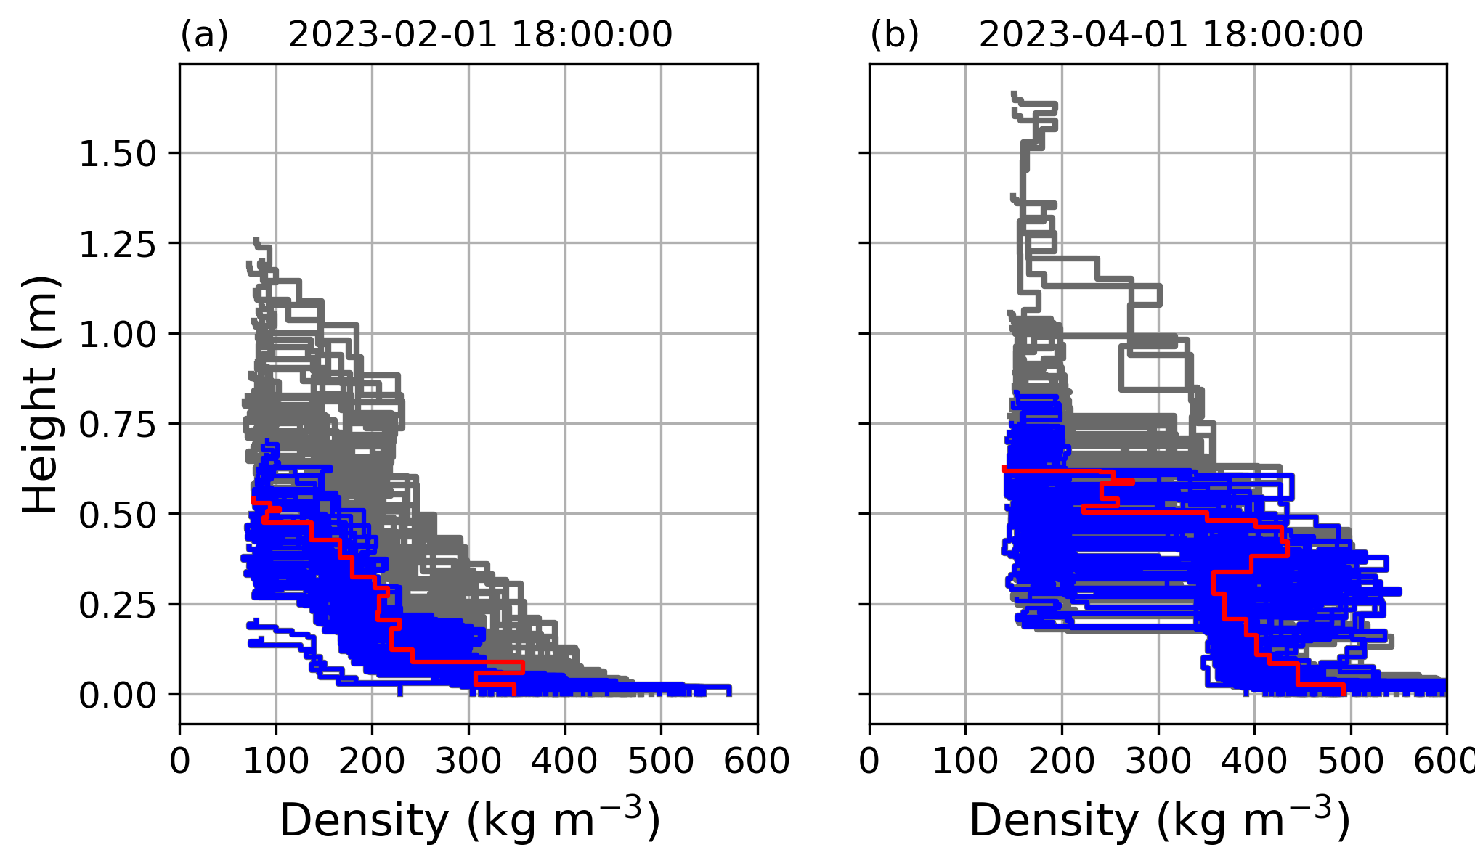
Data assimilation with MuSA/SVS2
Experimenting with assimilating different observations into SVS2 at point scale
Extracting observations from the synthetic truths
Comparing the assimilation of different variables
Incorporating SVS2 into the Multiple Snow Data Assimilation System (MuSA)
Vertical density profiles:
Assimilation using the particle filter method
Assimilation of backscatters at 13 GHz, 17 GHz, and SWE
Impact on bulk SWE and snow vertical properties
Synthetic experiments at 3 locations spanning different climates

Slide 14
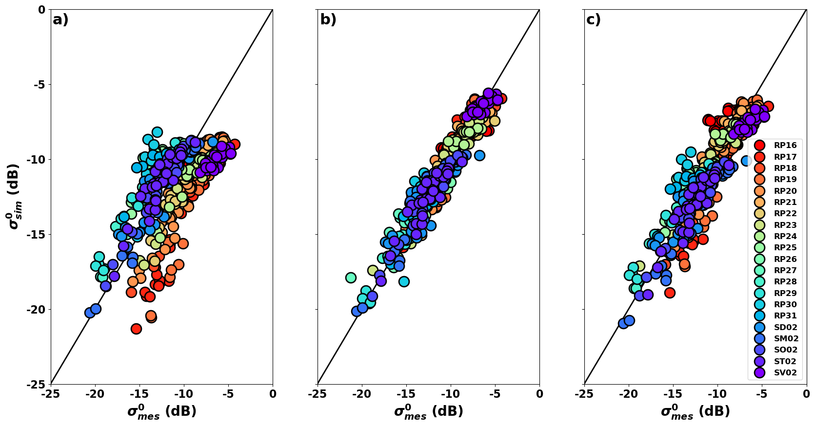
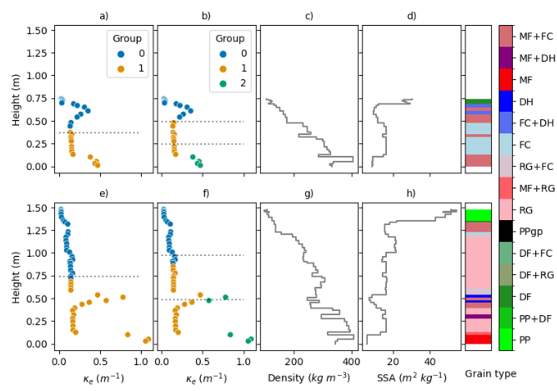
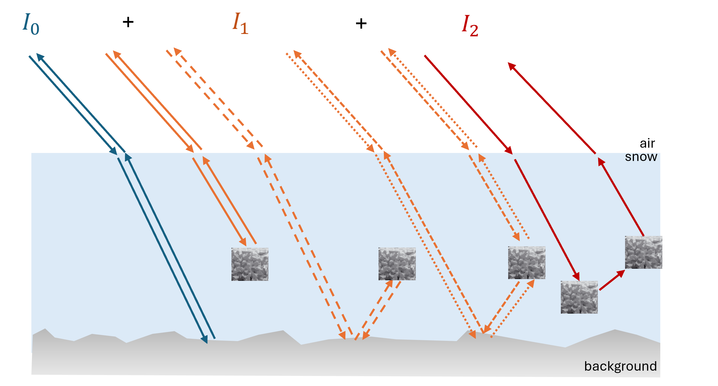
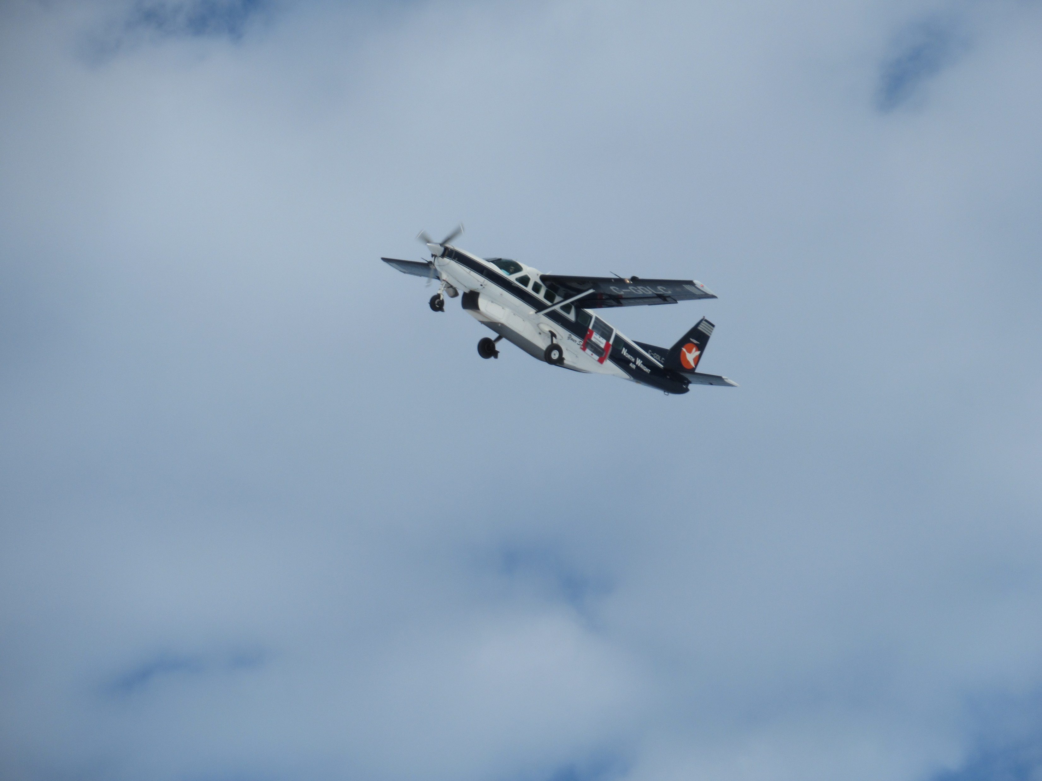
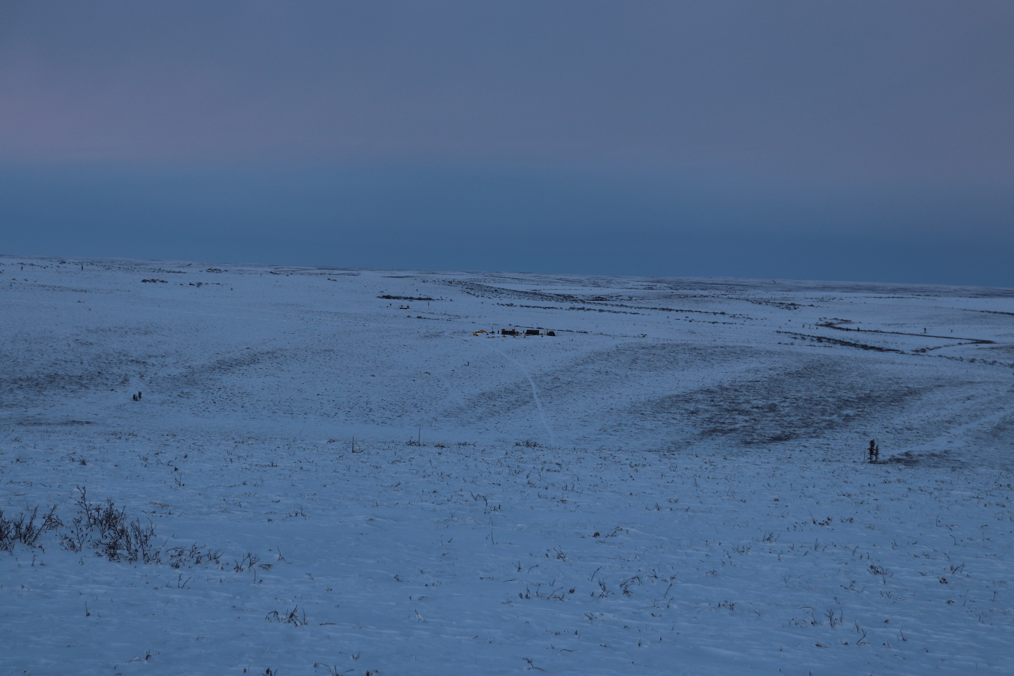


Forward Modeling of Ku-Band Signal
Optimize/Validate forward modeling approach used in SWE retrieval
RMSE = 2.6 dB
RMSE = 0.9 dB
RMSE = 1.3 dB
Validated forward modeling of Low Ku-Band signal in Arctic
See Julien’s Poster later!
Implementing new radiative transfer equation solver to improve computation and better discriminate scattering mechanisms
Montpetit et al (2024) TC Discussion
Meloche et al (In prep.) TC Discussion
Reduce land surface model layering to “Radar Equivalent Snow” layers improving computation without modifying snowpack geophysical properties
GitHub Snow Microwave Radiative Transfer Model (SMRT) Picard et al.

Slide 15
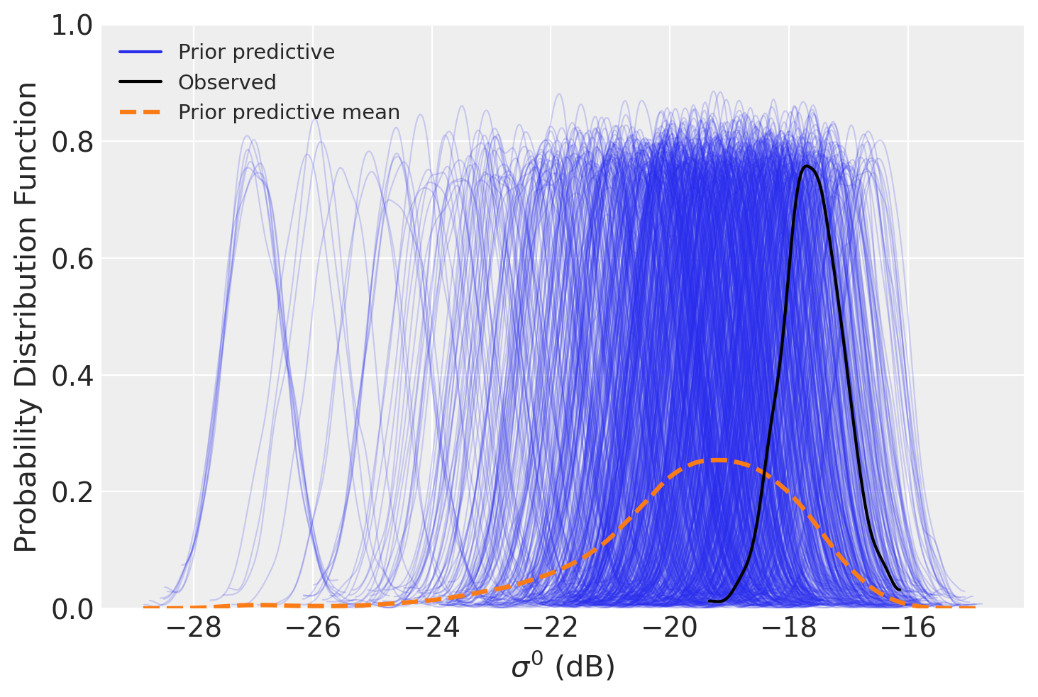
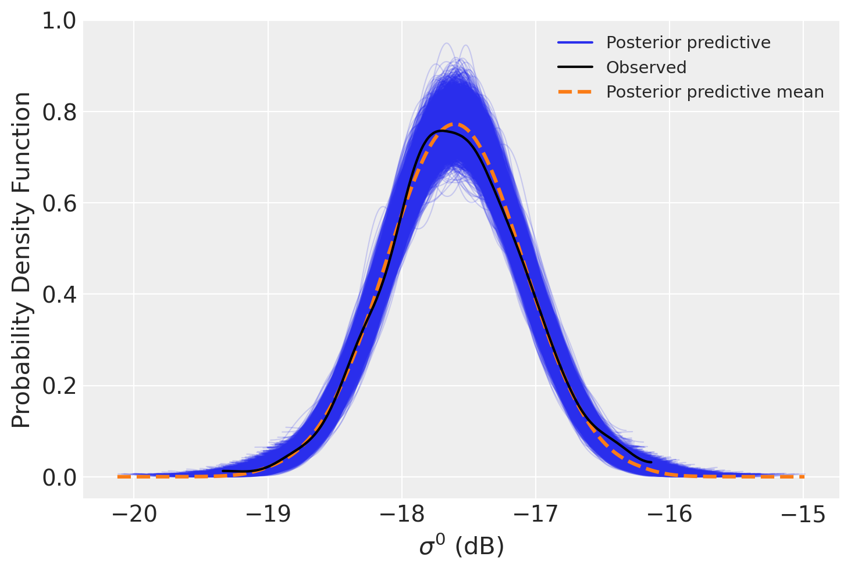
SWE Retrieval Algorithm
MCMC
Markov Chain Monte Carlo (MCMC):
Open-Source python library (PyMC)
Optimizes SSA, Density, Thickness for each layer (3 x N-layer parameters total)
Computation:
ECCC HPC Linux Server
Takes ~30 min to run algorithm for 2 snow layers (6 parameters total)
Could improve to ~30 sec when code is compiled (JAX)
Need to Jaxify SMRT (again see Julien’s poster!)

Slide 16
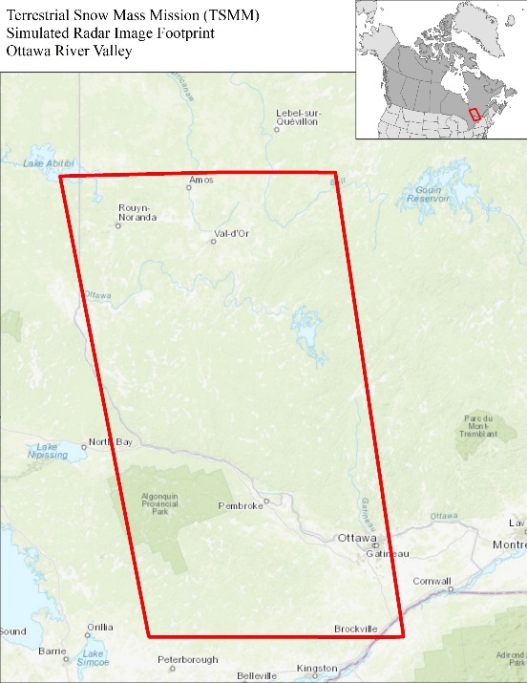
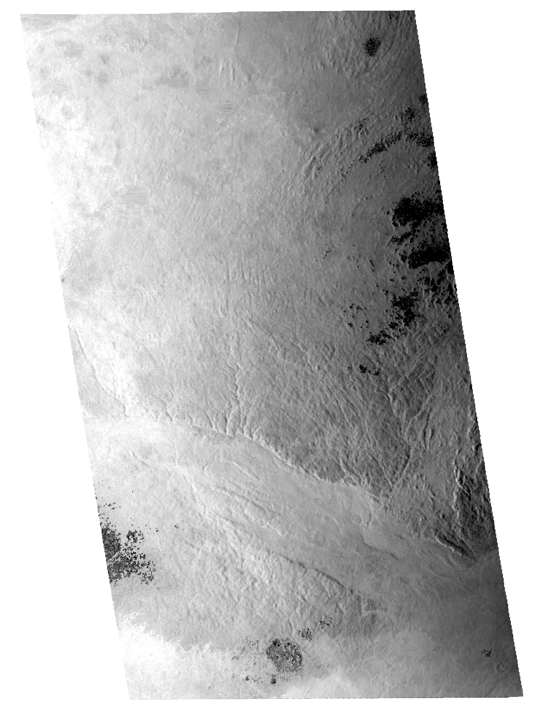
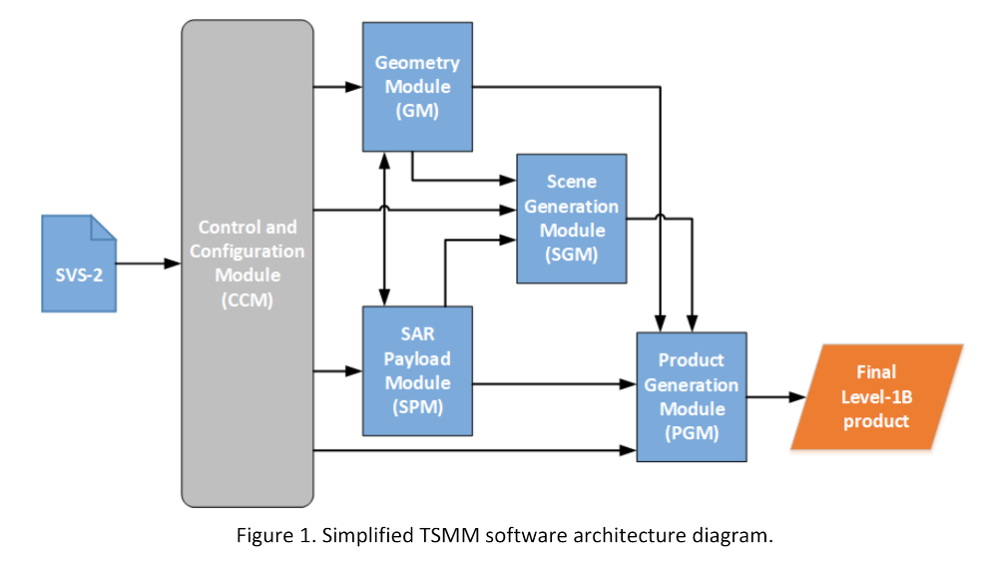
TSMM Data Simulator
Uses SVS-2 outputs as inputs
Generates scene using SMRT
Generates L1 product using Phase 0 orbital information
Simulated TSMM radar image (VV)
Ottawa River watershed
3 February 2023

Slide 17
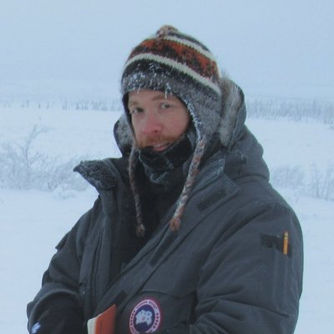
Mission Status
Pre-formulation phase:
All hands-on deck
Doubled human resources in last year
Data simulator delivered and working
Getting ready to produce synthetic experiments
Working on SMRT
Mid-Stream working group
Ongoing Stakeholder Engagement
Science and Applications Plan Drafted
TSMM team fully open to science and programmatic partnerships
Develop global SWE products
Benoit Montpetit, Ph.D. Research Scientist Climate Research Division benoit.montpetit@ec.gc.ca

Slide 18
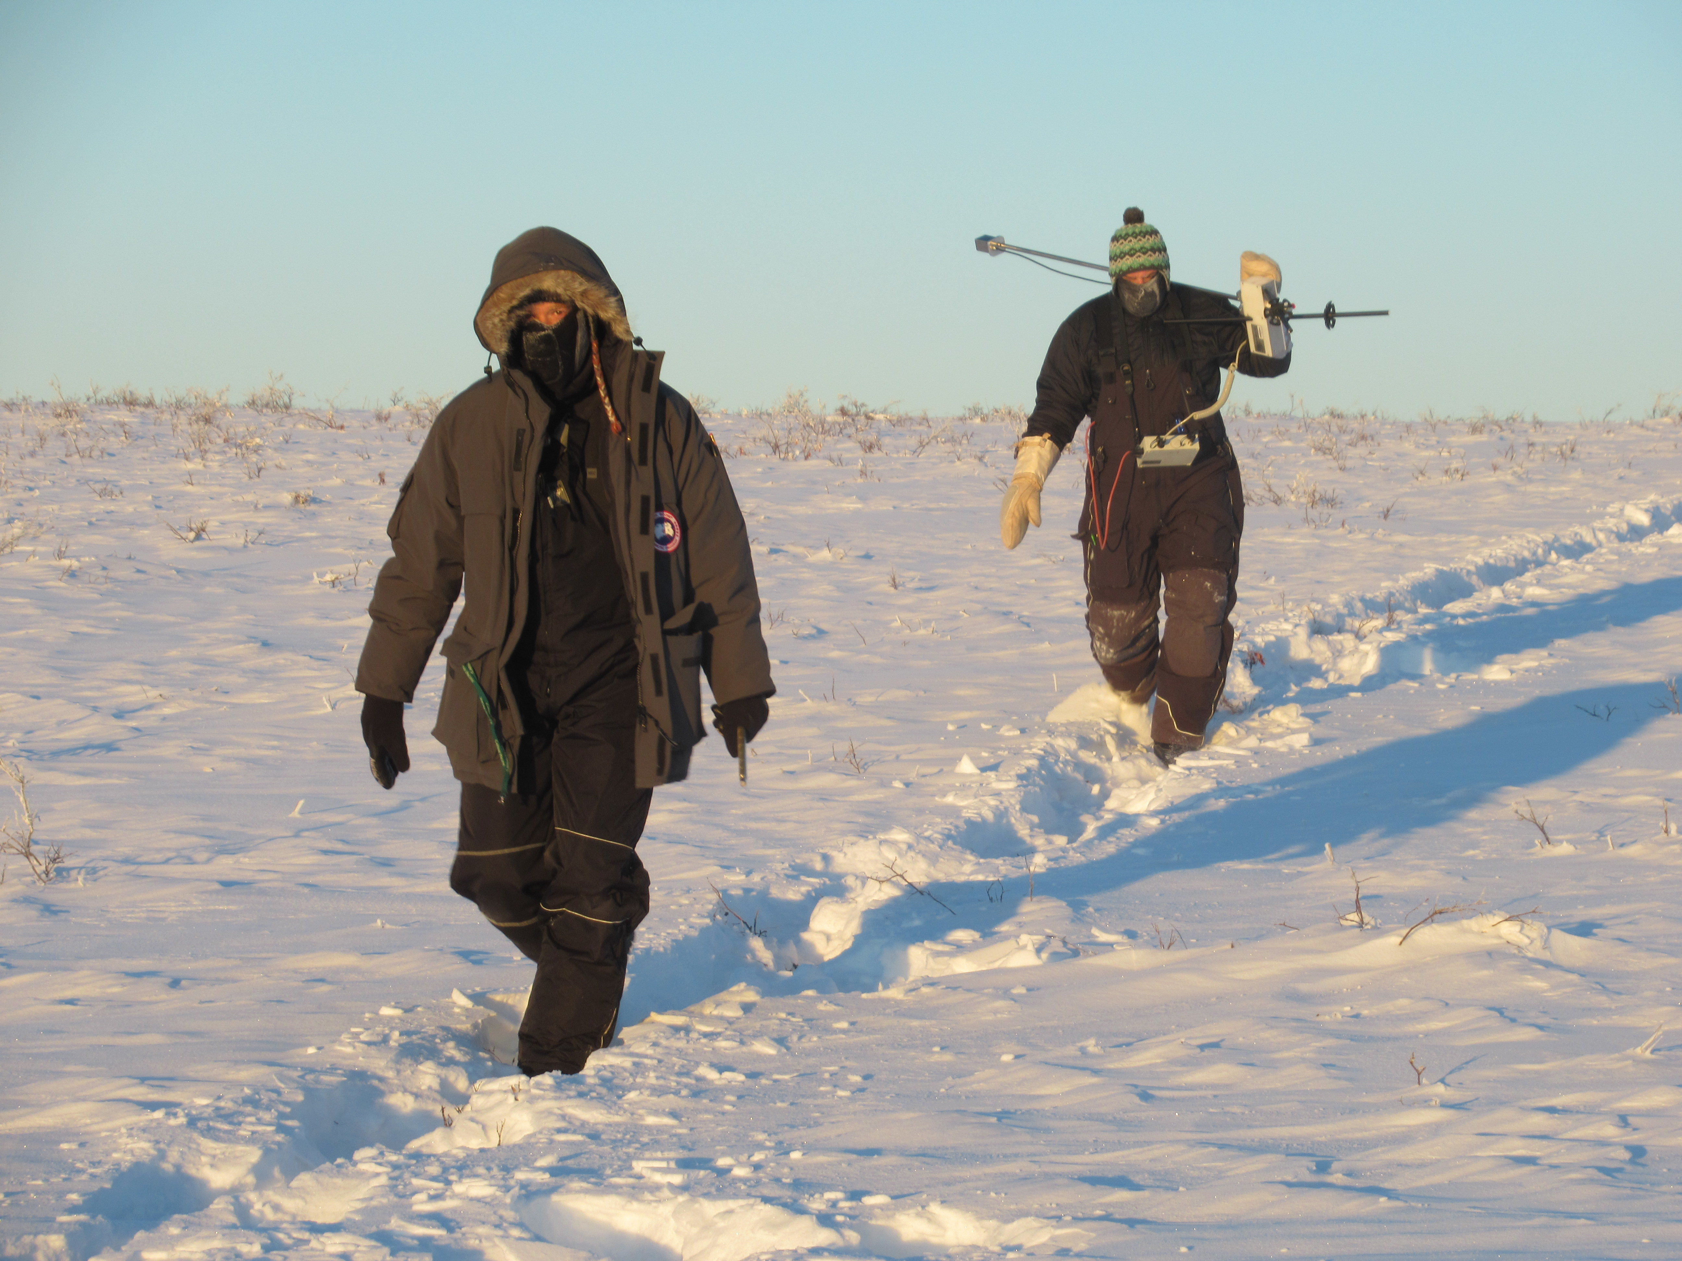
Merci!
Thank you

