Slide 1


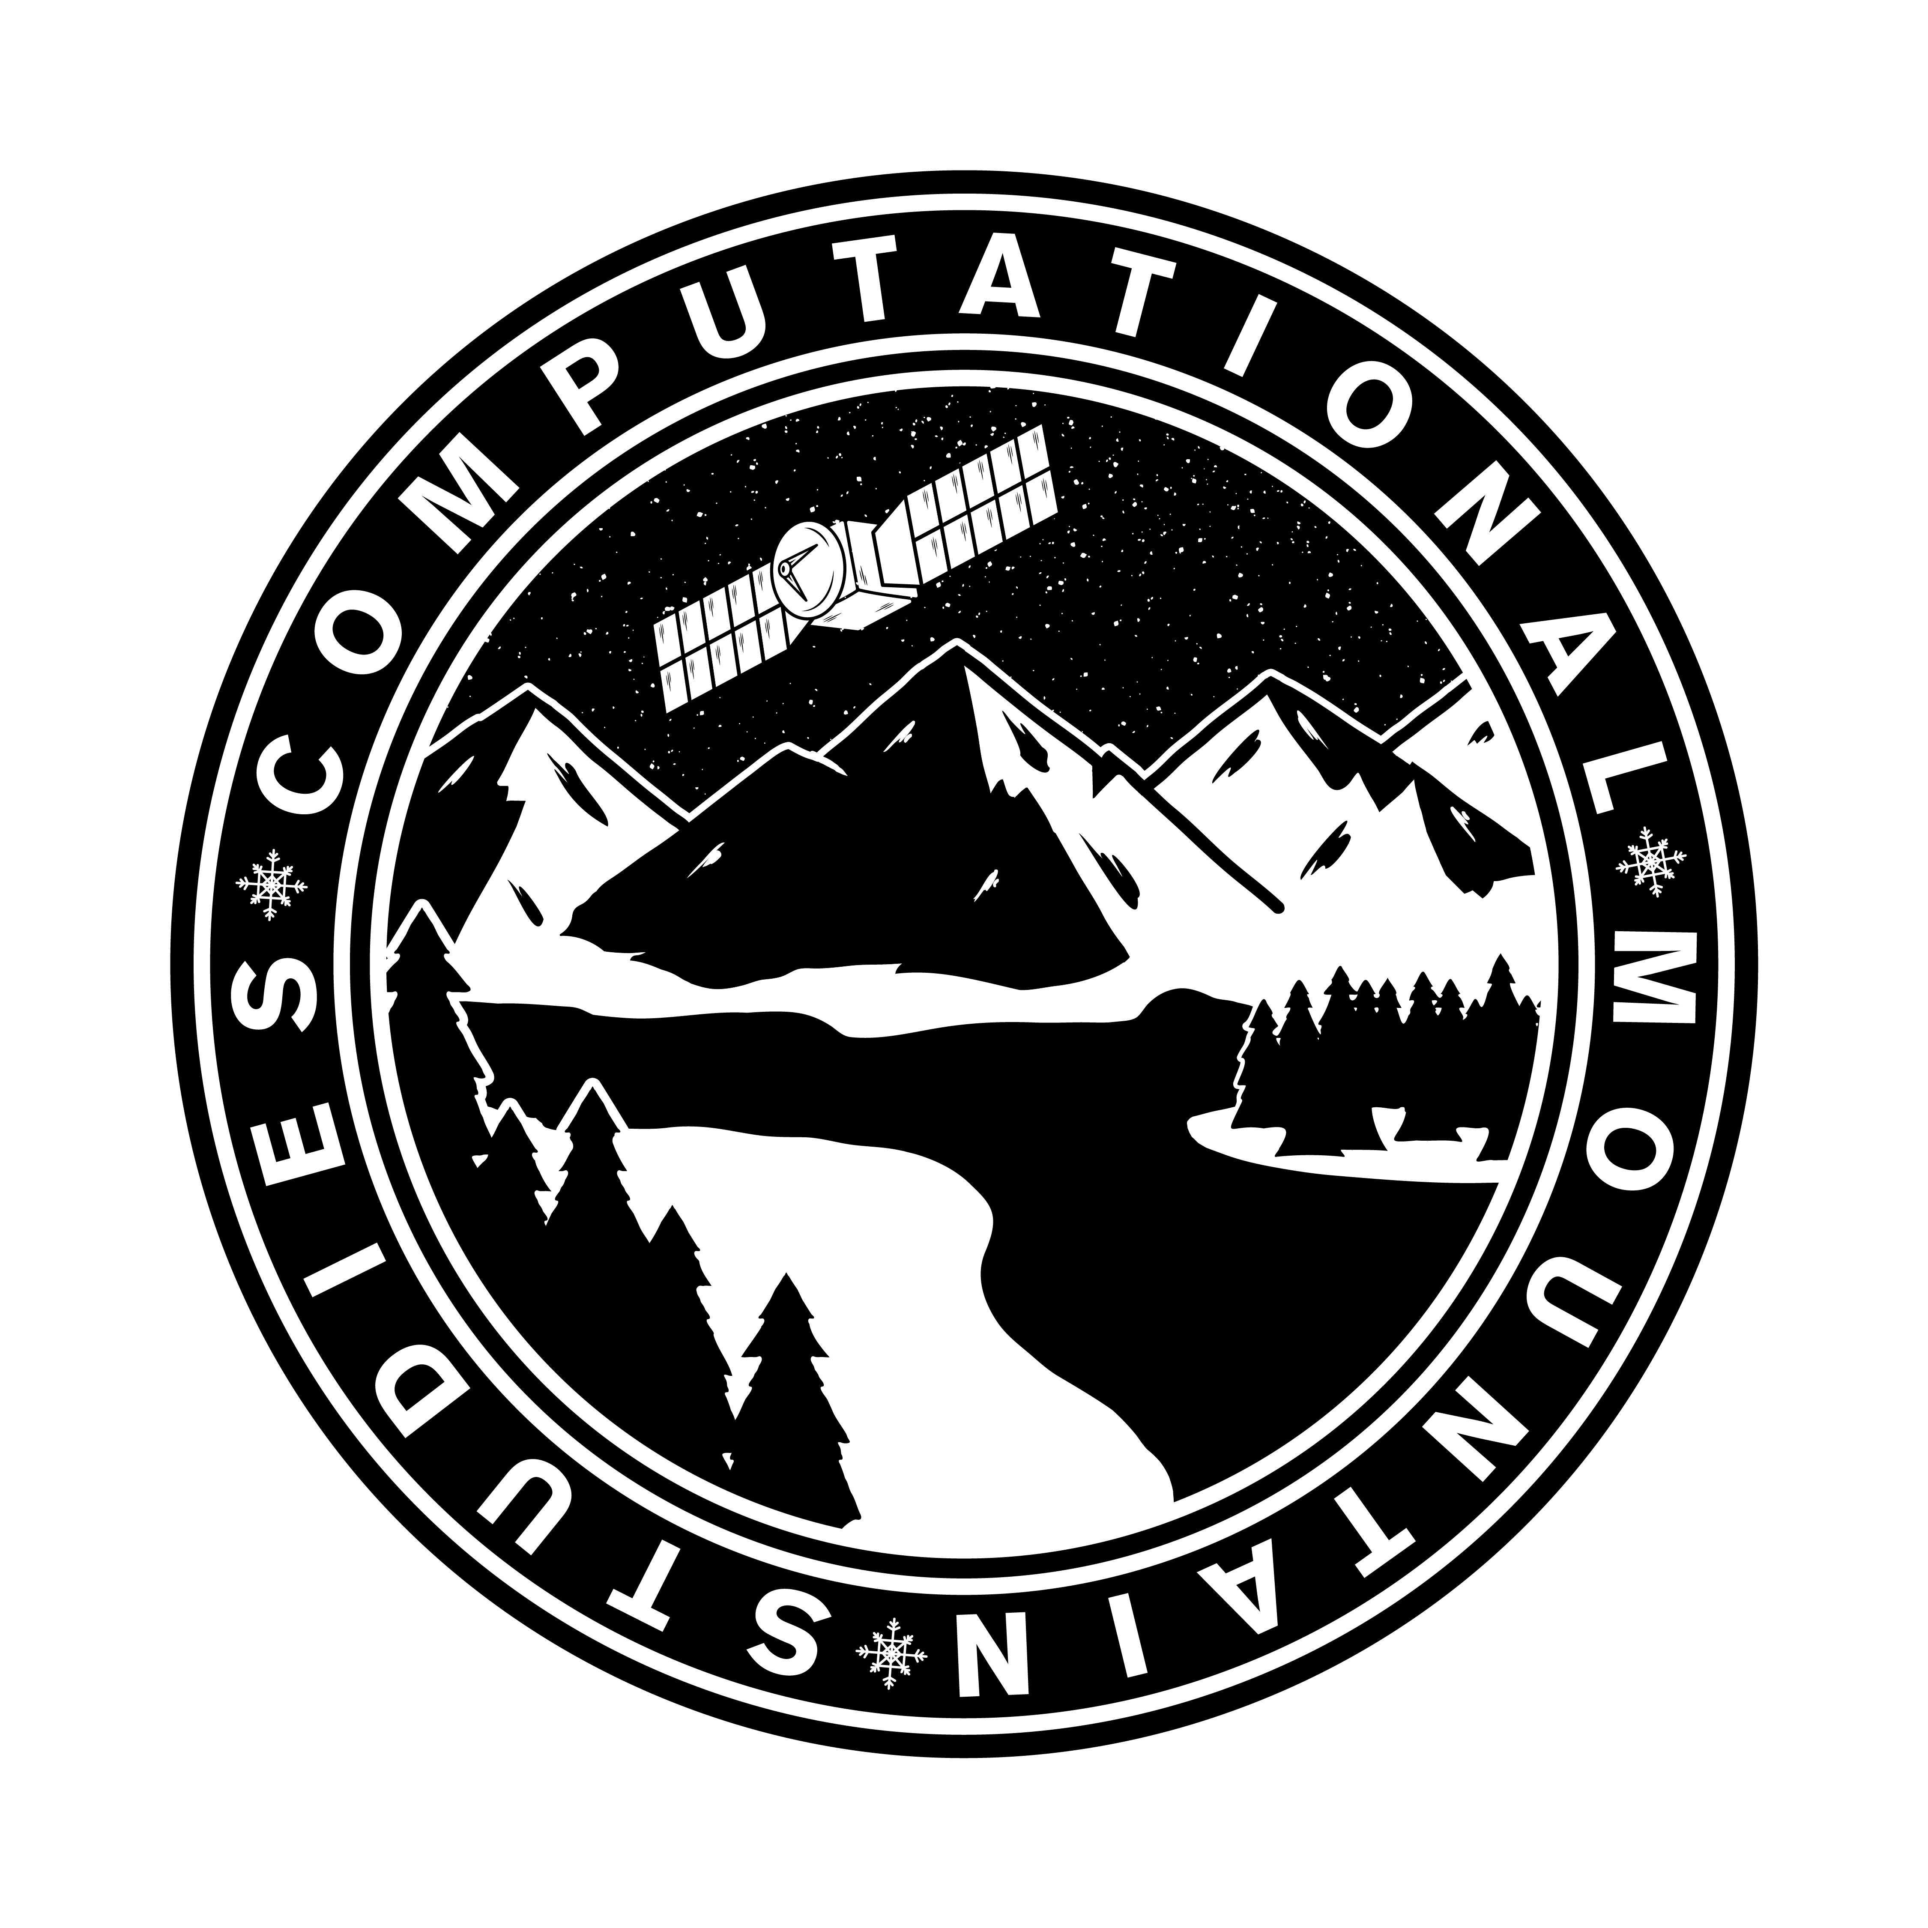
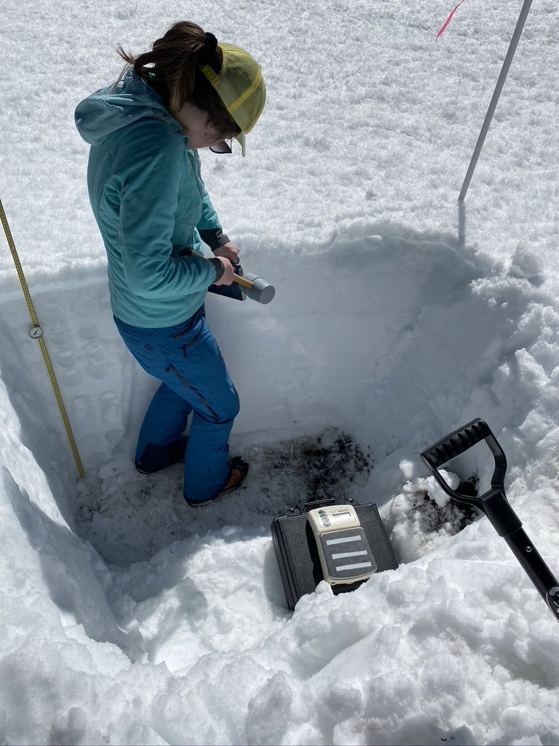
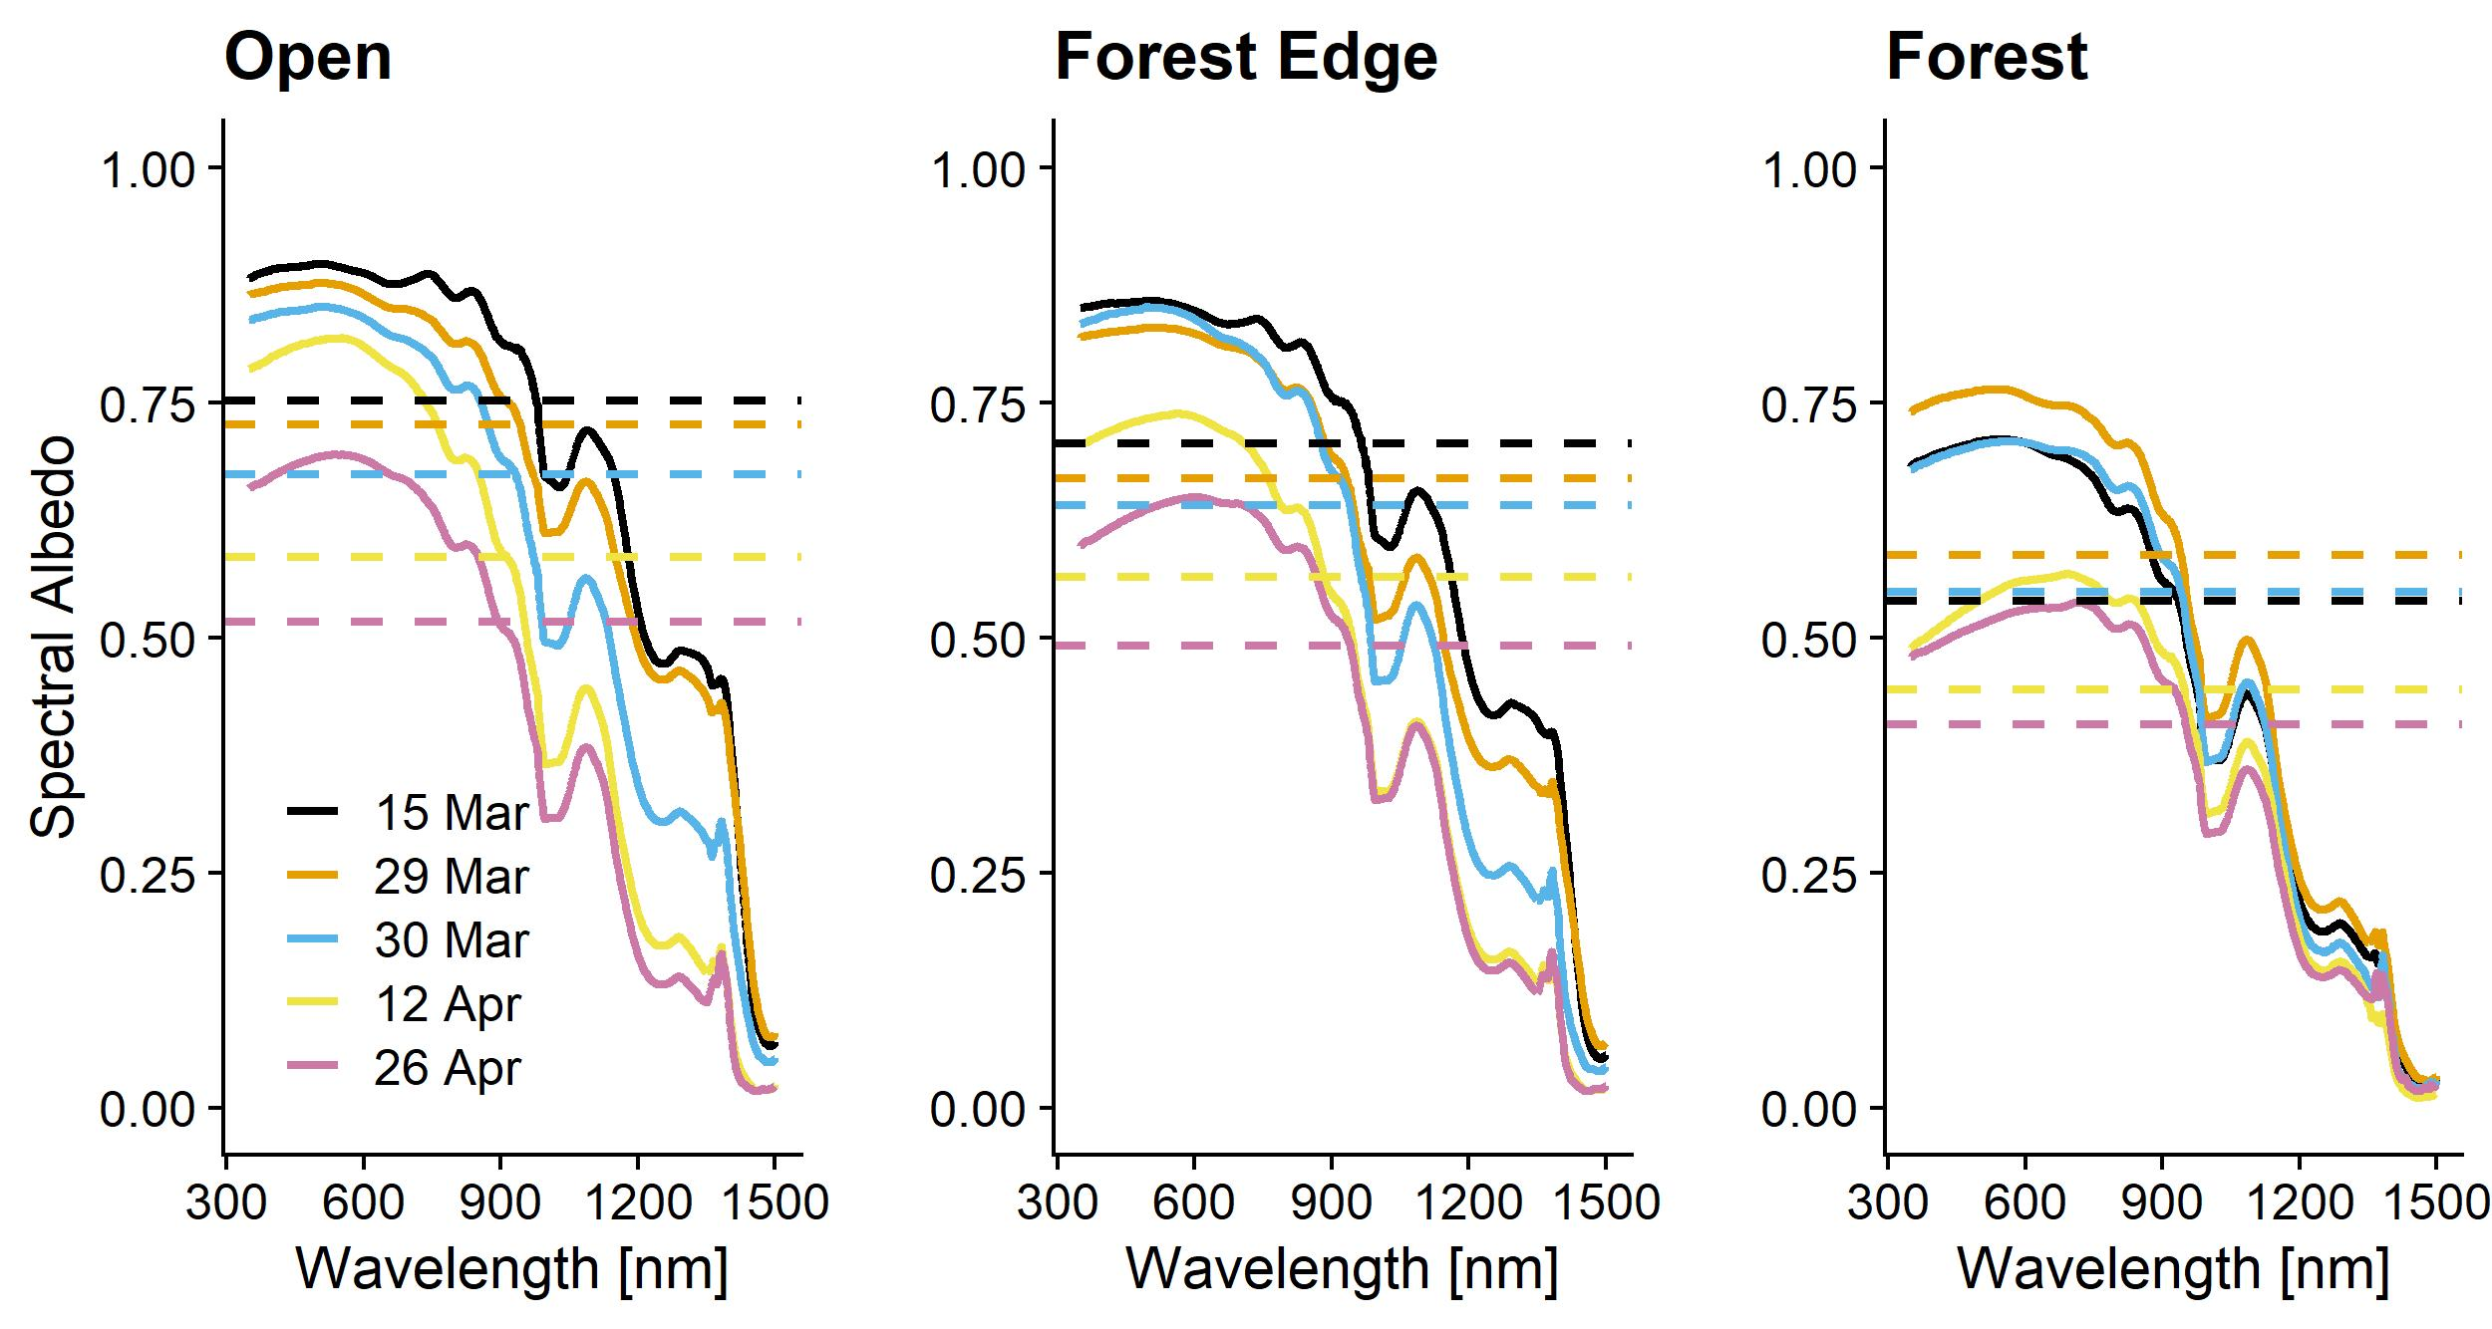
SnowEx 2020 Field Campaign at Sagehen Creek Field Station, CA
Jack Tarricone & Anne Nolin, University of Nevada, Reno
Research Goal:
Help validate the accuracy of the SWE measurement time series from the UAVSAR L-Band radar. In support of this goal we conducted a corresponding ground-based time series of intensive snowpack measurements.
Research Location:
Study Site:
Sagehen Creek is a 28 km² snowmelt dominated catchment located in the eastern Sierra Nevada, CA. It ranges in elevation from 1771 m to 2670 m and has maritime snow climate.
Methods:
The snow pit measurements were made at three sites, Forest (lower), Open (lower), and Tower 4 (upper). The depth, SWE, and albedo transects were made across a forest density gradient at the two lower sites. SWE was recorded every 20 m over a 320 m transect. Depth was recorded every 5 m.
Both the Open and Tower 4 pits showed decreasing SWE, while to Forest pit showed a small increase due to a slightly varied pit location
Data Collection Dates:
Date | Open | Forest | Tower 4 | SWE Transect | Depth Transect | Albedo
1/29/20 | x | x | x | x | x | x
2/5/20 |  |  |  | x | x | x
2/12/20 | x | x | x | x | x | x
2/19/20 | x | x | x | x | x | x
2/26/20 | x | x | x | x | x | x
3/4/20 | x | x | x | x | x | x
3/11/20 | x | x | x | x | x | x
3/19/20 |  |  |  |  | x
3/22/20 |  |  |  | x | x
Both the Open and Tower 4 pits decreased in depth and increased in density, while the Forest pit stayed relatively stable throughout.
Spectral Albedo Measurements from Greenwald & Nolin (forthcoming)

