Slide 1
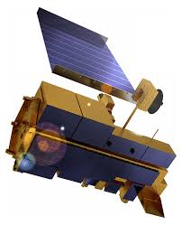
Statistical (fractal) Downscaling
idea
Spatial Statistics Amplitude (λ)
Ensemble of Realizations
Probabilistic UQ
Log power
10 dB
Specificity – localization of sub-grid scale (x,y) heterogeneity
β
3 dB
L_{u}
L_{m}
l_{d}
Log λ
Cao and Barros, 2020
Nogueira and Barros, 2017; Kim and Barros, 2002; Bindlish and Barros, 2002

Slide 2
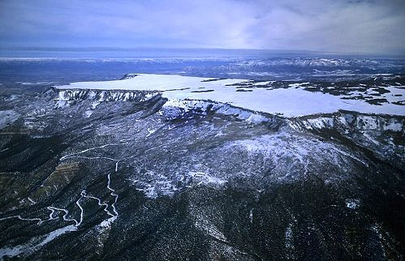
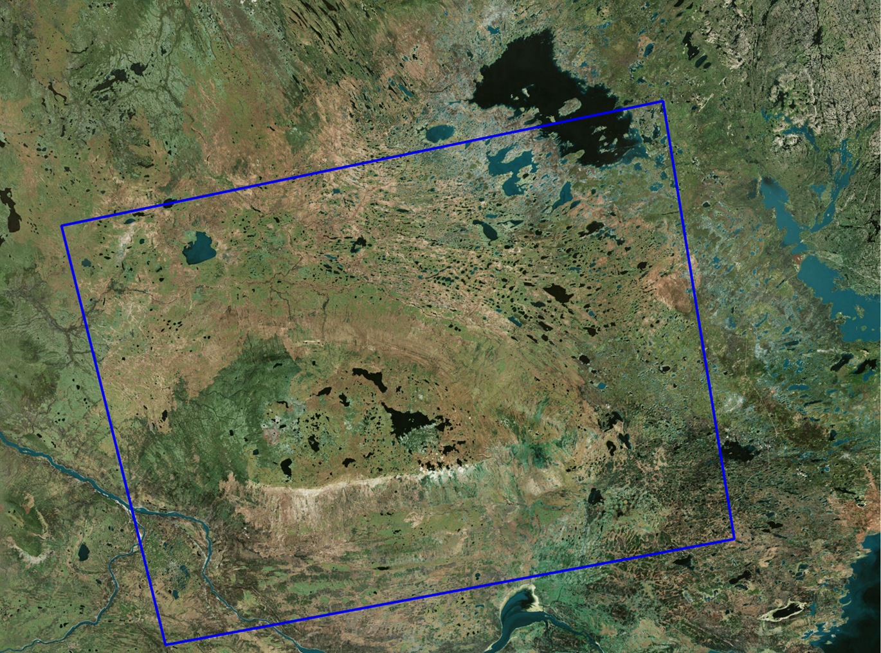
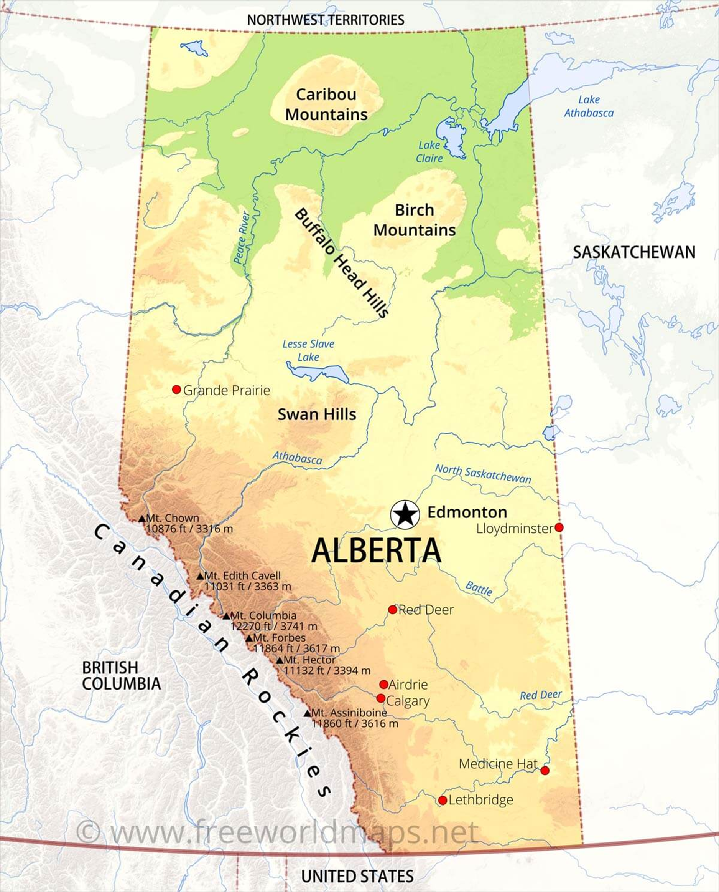
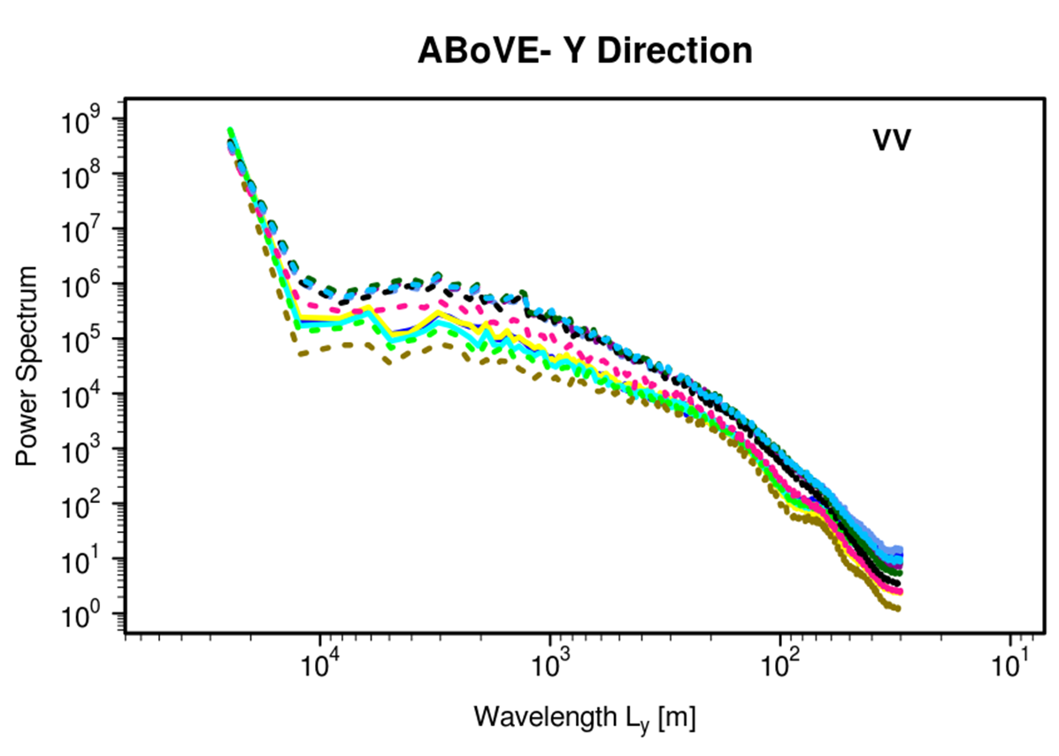
Dynamic Subgrid-Scale Microwave Fingerprints of Land-surface Heterogeneity – Contrasting Grand Mesa, CO, USA with Caribou Mountains, AL, CA
work
C-Band Sentinel-1
--SnowEx 2020--
Is preserving spatial statistics “adequate” to preserve key physical and biophysical connectivities?
Wetlands
transient
L [m]
Ana P. Barros
Siddardth Singh
Manickam and Barros, 2020

Slide 3
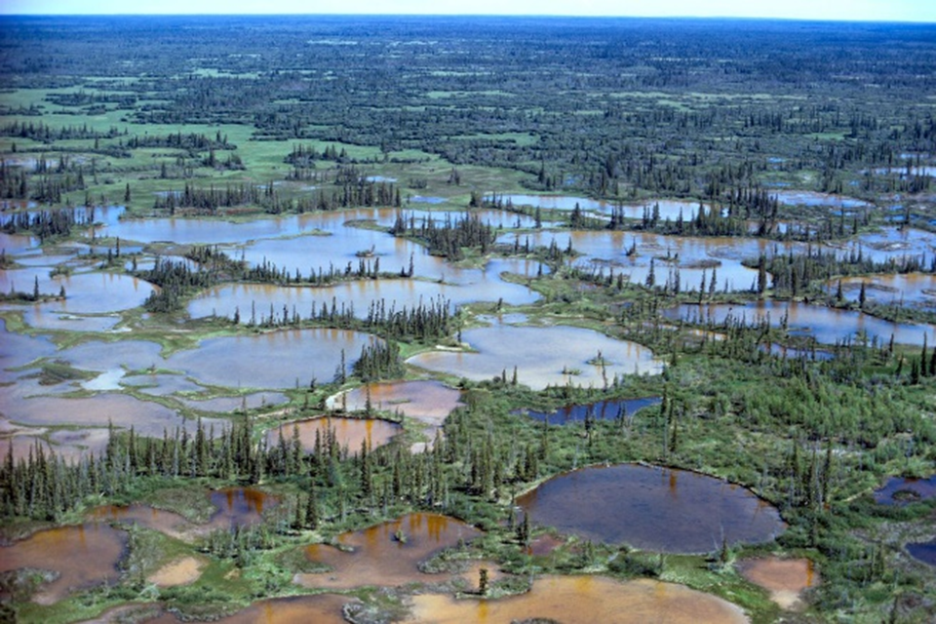
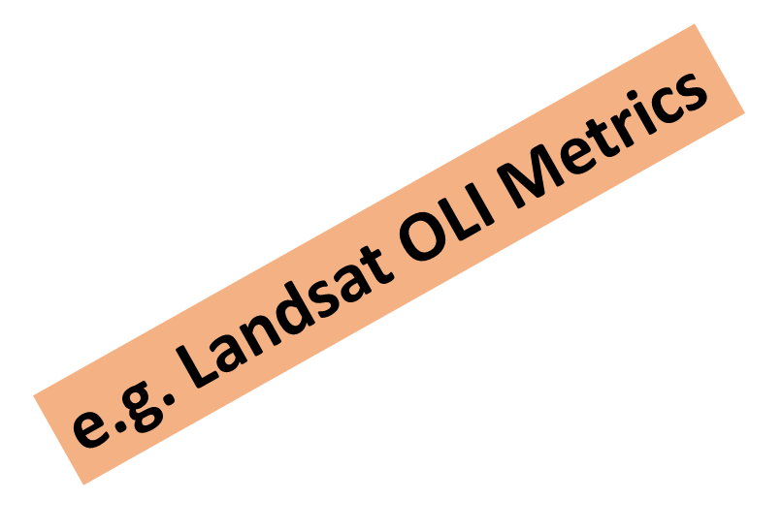
Physical-Statistical Downscaling
results
Wetlands ABOVE – “NDSI” 3/3/2019
Log power
Sub-grid redistribution
of downscaled backscattering kernel --- ψ (x,y,t)
--SnowEx 2020--
Multisatellite Multisensor Multifrequency Framework to learn ψ adaptively (ML,PCA) to detect ,interpret and map sub-grid scale variability in snow physics, and thus snowpack condition.
L_{m}
l
Log λ
Global scale
ψ (x,y,t) as System Monitoring (vs Variable Monitoring)

