Slide 1
The Snow Ensemble Uncertainty Project (SEUP) and recent modeling efforts in support of SnowEx
Melissa Wrzesien (GSFC/USRA)
with Rhae Sung Kim, Sujay Kumar, Carrie Vuyovich, and many others
SnowEx Virtual Meeting
11 September 2020

Slide 2
Motivation for SEUP
Estimating spatially distributed snow water equivalent (SWE) is one of the largest challenges of snow hydrology
Characterize SWE uncertainty across North America to identify regions and temporal periods with high variability
Use ensemble of land surface models (LSMs) to establish a baseline estimate of SWE and related uncertainty
NASA’s Land Information System (LIS) framework
Can use LSM ensemble and uncertainty in a data assimilation framework

Slide 3
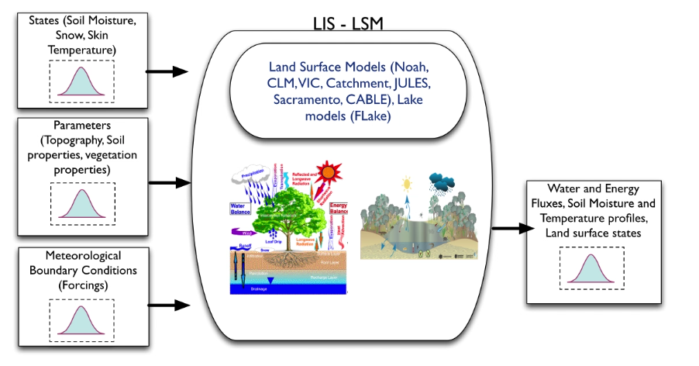
Snow Ensemble Uncertainty Project
2009-2017 Analysis period
5 km resolution
3 hourly time step
Output includes:
SWE
SCF
Evaporation
Surface Runoff
Soil Moisture
Rainfall
Snowfall
3 Forcing Datasets:
MERRA2
GDAS
ECMWF
Noah-MP (3-layer)
Noah 2.7.1 (1-layer)
Jules (1-layer)
CLSMF 2.5 (3-layer)
4 LSMs:
Slide adapted from Carrie Vuyovich

Slide 4
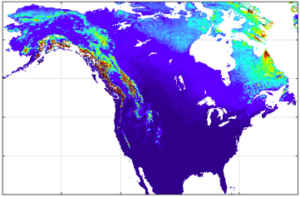
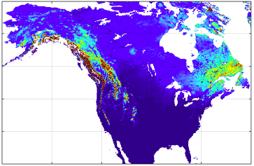
Largest SWE values in the mountains, but also large ranges between ensemble members
Ensemble mean SWE
Range of ensemble mean SWE
From Kim et al (in review) The Cryosphere

Slide 5
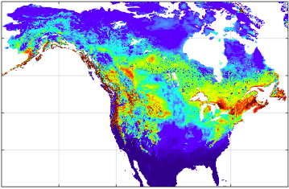
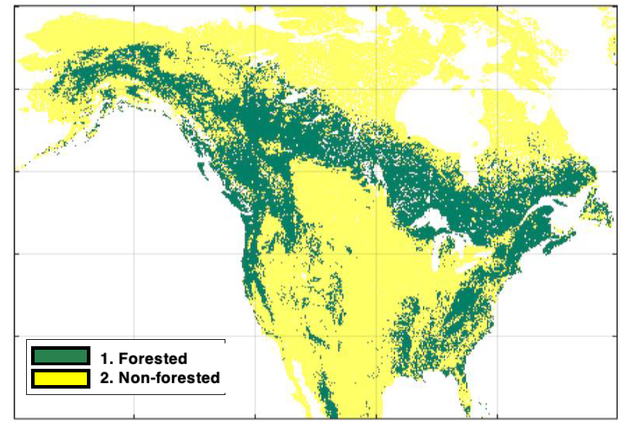
High variability in SWE between LSMs in boreal forest
Snow-vegetation interaction drives model spread, highlighting the need for improved model parameterizations in forested areas
Need additional observational constraints in forested regions to reduce uncertainty in models
High resolution observations (within forests)
Coefficient of
variation
From Kim et al (in review) The Cryosphere

Slide 6
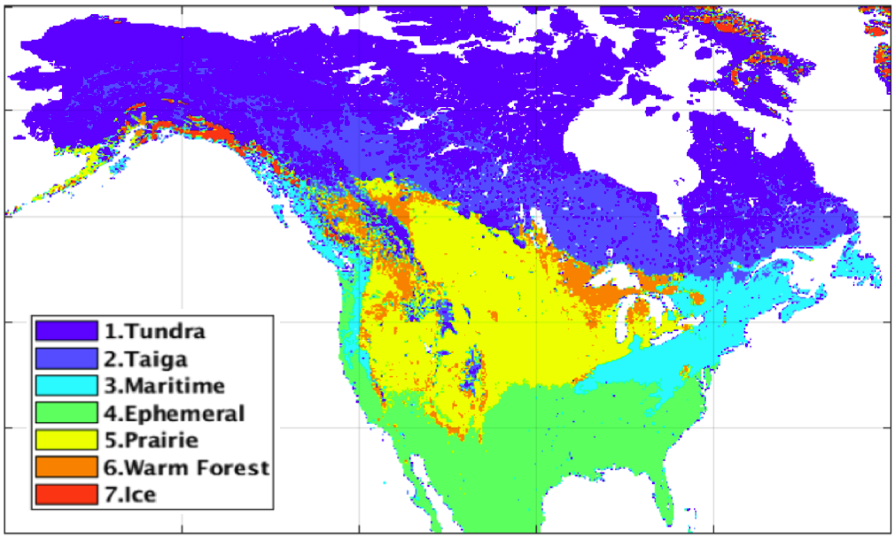
Tundra and taiga account for majority of North American snow storage, but both have high variability between ensemble members. Since tundra/taiga covers such a large area, accurate observations in shallow snow regions is essential for improved global-scale snow estimates
Snow Classes
Total Snow Water Storage
SWS Ensemble Spread
From Kim et al (in review) The Cryosphere

Slide 7
SEUP Phase 2 – Observing System Simulation Experiment (OSSE)
Snow-focused OSSE to evaluate the impact of data collected from proposed missions.
Assess potential mission designs
Quantify utility of observation beyond immediate variable of interest (in this case, beyond snow)
Assimilate combinations of variables to determine impact of single vs multiple observations
We have all the required components (LIS, LVT, TAT-C), making this OSSE a valuable experiment for planning a snow-focused mission

Slide 8
SEUP Phase 2 – Observing System Simulation Experiment (OSSE)
Figure from Bart Forman

Slide 9
OSSE Nature Run
Western Colorado domain that includes Grand Mesa (black box) and Senator Beck (circle)
Noah-MP with NLDAS2 meteorological forcing
~1 km spatial resolution
Run from September 2009 through July 2020
Calibrated against snow depth from the University of Arizona gridded data product

Slide 10
Calibrated nature run used as approximation of the “truth” Allows for more reliable model-based estimates of snow, a need highlighted within the community
TCC: 94%

Slide 11
SWE and snow depth averaged over full domain for the 11-year calibrated Nature Run, compared to default NoahMP and UA snow product
MAE_{c} = 0.98 km³
MAE_{u} = 0.99 km³
MAE_{c} = 8.78 mm
MAE_{u} = 10.35 mm
MAE_{c} = 0.029 m
MAE_{u} = 0.042 m

Slide 12
Evaluation of Noah-MP estimates against SnowEx 2017 snow pit observations
Grand Mesa
Simulation | MAE for SWE (mm) | MAE for depth (cm)
Calibrated | 169.2 | 39.6
Uncalibrated | 162.9 | 48.8
Senator Beck
Simulation | MAE for SWE (mm) | MAE for depth (cm)
Calibrated | 115.4 | 33.1
Uncalibrated | 142.5 | 43.1

Slide 13
SnowEx 2017 – Feb 22 at Grand Mesa
Calibrated NoahMP
Uncalibrated simulation has much lower estimates of snow depth on this day, compared with 22 snow pits.
For this day:
Bias_{cal} = 8.9 cm (6.5%)
Bias_{uncal} = -62.5 cm (-37.5%)
Uncalibrated NoahMP

Slide 14
Upcoming
SEUP Phase 2 – Snow OSSE
Synthetic observation generation
Snow cover (visible)
Snow depth (lidar)
SWE (passive microwave)
Albedo (visible)
Assimilate synthetic observations into Open Loop and compare with Nature Run
Real time simulations during next SnowEx campaign
Use simulations to help inform on-the-ground field observations

Slide 15
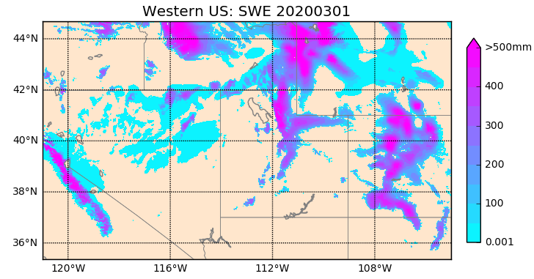
Near real time LIS simulations during SnowEx 2020 field work
Figure by Rhae Sung Kim

Slide 16
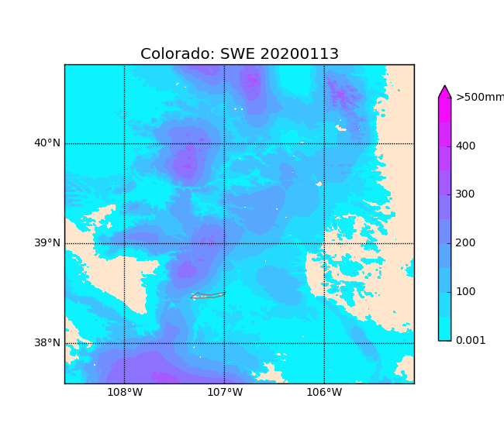
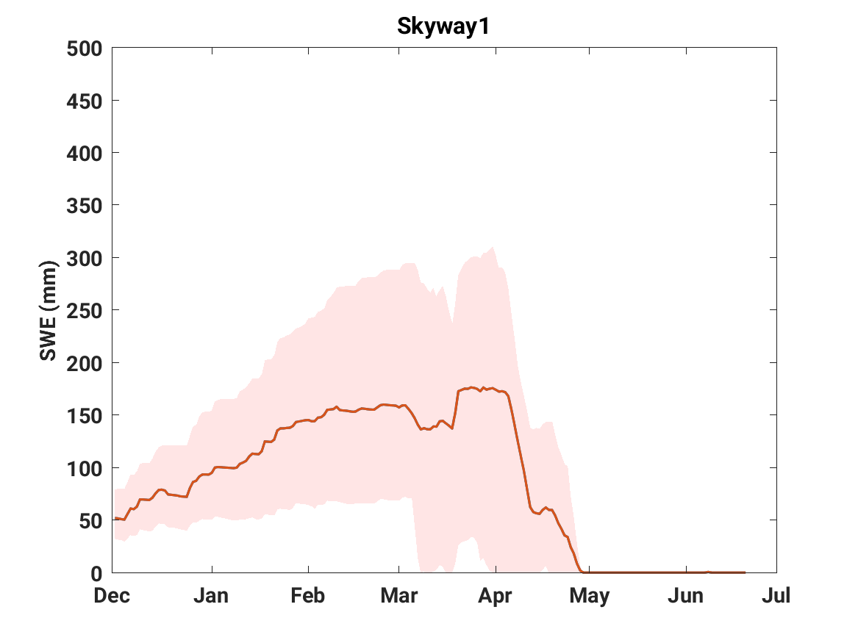
NRT could be used to inform field campaign
Figures by Rhae Sung Kim

Slide 17
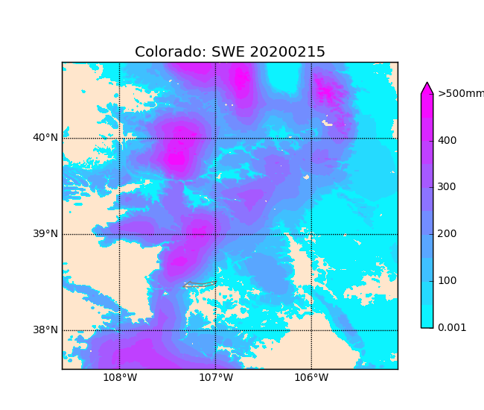
NRT could be used to inform field campaign
Figures by Rhae Sung Kim

Slide 18
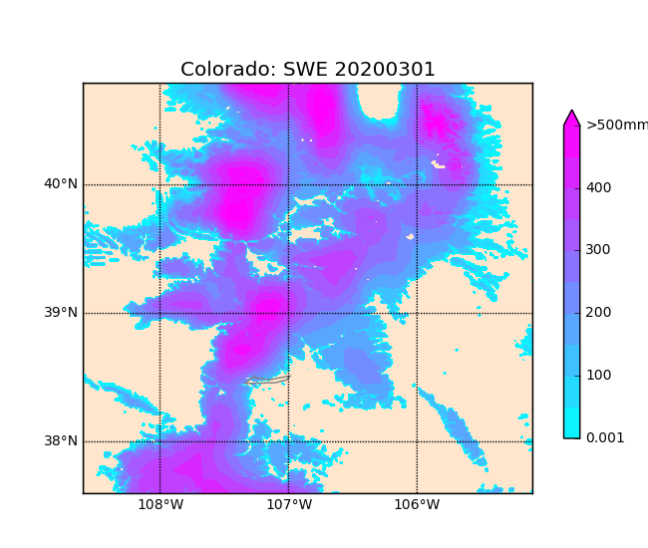
NRT could be used to inform field campaign
Figures by Rhae Sung Kim

Slide 19
Interested in being a part of SEUP?
Bi-weekly calls on Wednesdays at noon (eastern)
Contact Melissa if interested in joining, sharing research with the group, collaborating, using SEUP simulations, etc.
melissa.l.wrzesien@nasa.gov

