Slide 1
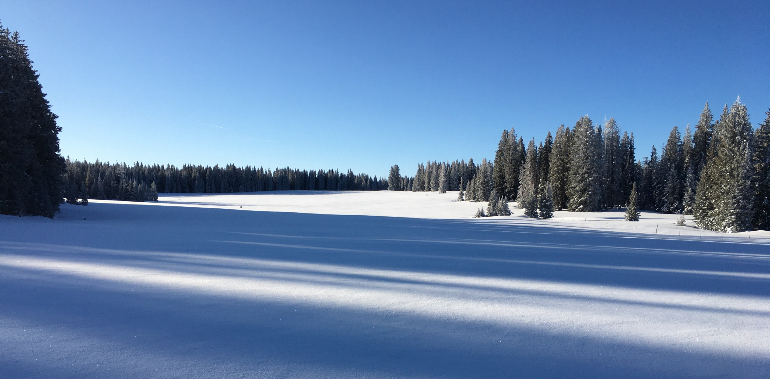
THP Snow Roadmap
Carrie Vuyovich
THP Snow Science Lead
NASA / Goddard Space Flight Center

Slide 2
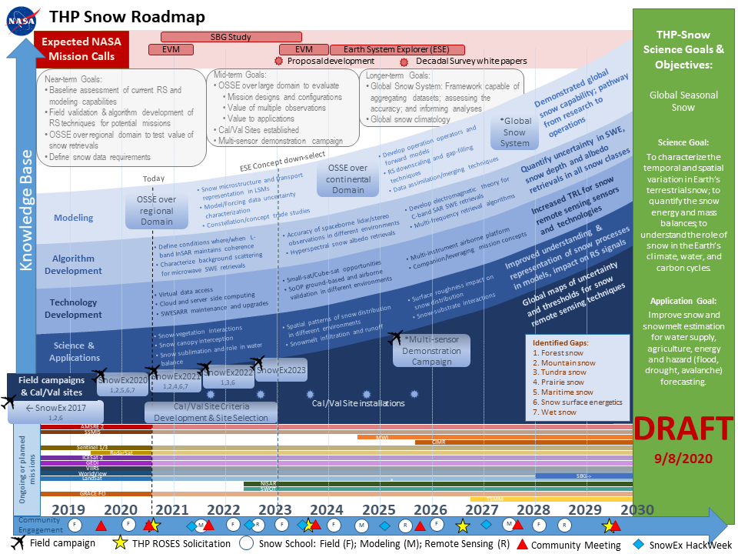
THP Snow Roadmap

Slide 3
THP Snow Program
Science Goal: To characterize the temporal and spatial variation in Earth’s terrestrial snow; to quantify the snow energy and mass balances; to understand the role of snow in the Earth’s climate, water, and carbon cycles.
Application Goal: Improve snow and snowmelt estimation capabilities for water supply, agriculture, energy and hazard (flood, drought, avalanche) forecasting.
THP Snow Roadmap: A near- to medium-term plan for future activities designed to prepare the snow community to be ready for upcoming opportunities, improve global snow characterization capabilities and meet identified snow data needs in order to achieve the overall Science and Application Goals.

Slide 4
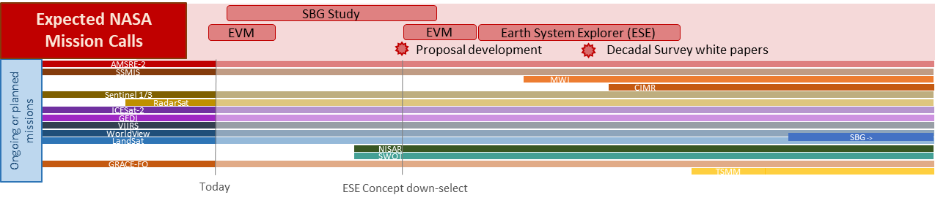
Timeline driven by upcoming satellite missions and opportunities
Potential opportunities for spaceborne snow observations:
Earth Venture Mission
NISAR – L-band InSAR
TSMM – Ku-band SAR
SBG – Hyperspectral
Earth System Explorer (ESE)
  Identify possible satellite technologies that meet mission criteria
  Define activities required to evaluate potential concepts
New techniques and advances are being demonstrated with existing satellites:
C-band SAR - Sentinel-1
Stereo-photogrammetry – Worldview, Planet, Pleiades
Spaceborne lidar – ICESat-2, GEDI

Slide 5
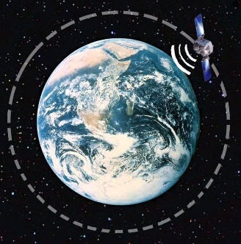
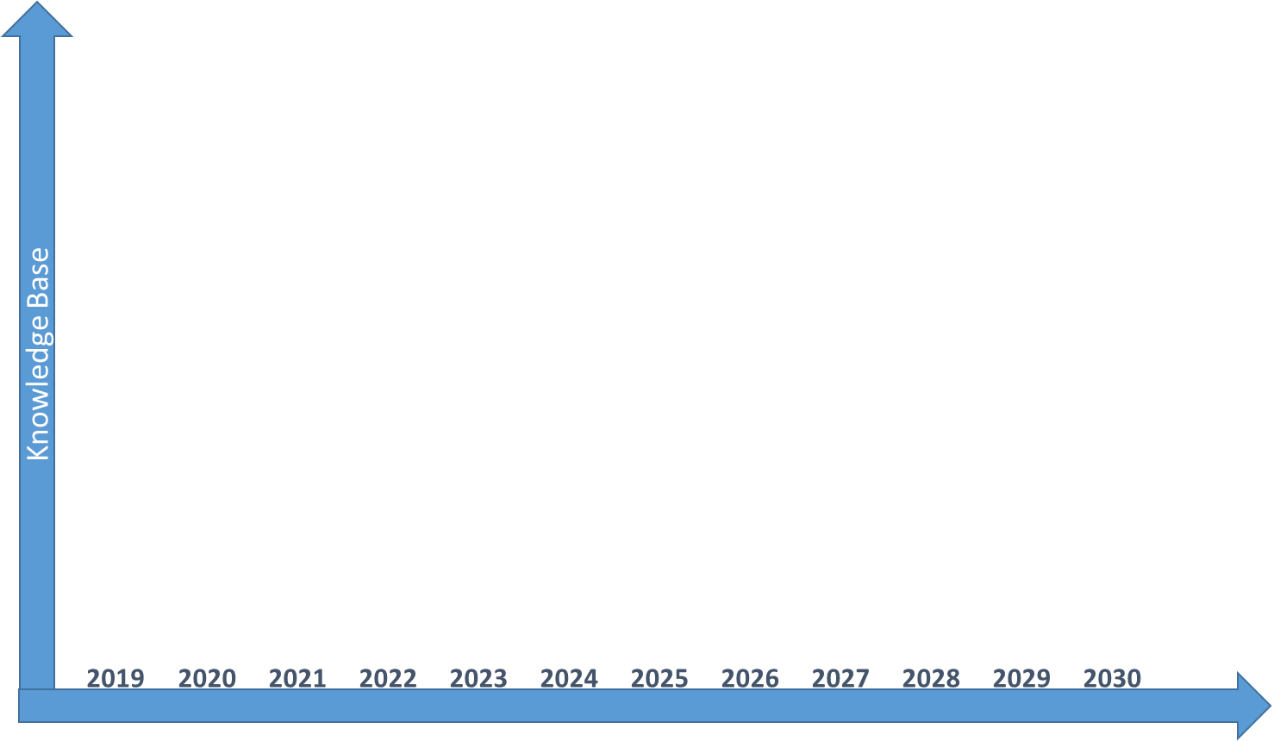
Roadmap Goals
Longer-term Goals:
Global Snow System: Framework capable of aggregating datasets; assessing the accuracy; and informing analyses
Global snow climatology & uncertainty characterization
Mid-term Goals:
Trade study analysis of mission designs and configurations
OSSE over large domain to evaluate
    Value of individual and multiple observations
    Value to applications
Cal/Val sites established
Multi-sensor demonstration campaign
Near-term Goals:
Baseline assessment of current RS and modeling capabilities
Field validation & algorithm development of RS techniques for potential missions
OSSE over regional domain to test value of snow retrievals
Define snow data requirements

Slide 6
Roadmap Objectives
Specific Activities and Needs:
Modeling: Demonstrated global snow capability with combined multi-sensor, model approach; pathway from research to operations
Model parameterizations and uncertainty
Data Integration: OSSEs/Trade Studies
Global snow system
Algorithm Development: Quantify uncertainty in SWE, snow depth and albedo retrievals in different snow classes and for different snow properties
L-Band InSAR
Microwave
Lidar/Stereo
Hyperspectral
C-Band SAR
SoOP
Technology Development: Increased TRL for snow remote sensing sensors and technologies
Data Access/Computing
Sensor Development
Innovations
Science & Applications: Improved understanding & representation of snow processes in models, impact on remote sensing signals
Snow/vegetation interactions
Snow/substrate interactions
Infiltration and runoff processes
Field Campaigns & ground validation: Global maps of uncertainty and thresholds for snow estimation techniques
SnowEx Campaigns
Calibration/Validation sites
Multi-sensor demonstration campaign
Community Engagement: Train and engage snow community to participate in field, modeling, technology development and data analysis activities
Snow Schools & Hackweeks
Community Meetings
Proposal Opportunities

Slide 7
Breakout Group: Modeling/SEUP
Recent work: characterization of uncertainty of SWE from LSMs over North America; implementation of new snow models into LIS (Crocus and SnowModel); calibration for OSSE Nature Run
Discussion points:
How can model estimates inform field campaigns (observation type, timing, location, etc)?
What type of field observations are needed for improving model representation/characterizing model uncertainty?
What type of real time modeling would be useful for upcoming campaigns?
Potential review papers on state of the science for snow modeling – redistribution, snow grain size, etc
Rhae Sung Kim, rhaesung.kim@nasa.gov
Melissa Wrzesien, melissa.l.wrzesien@nasa.gov

Slide 8
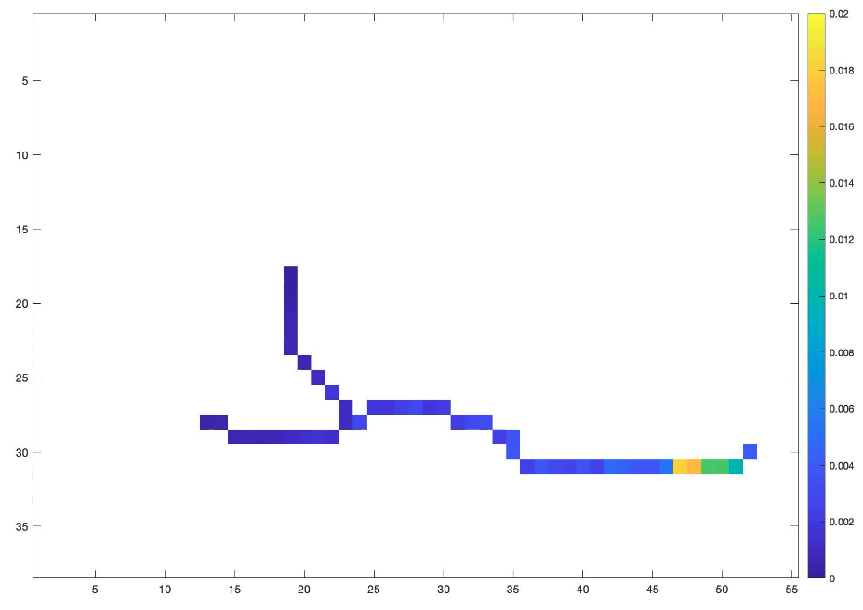
Breakout Group - Microwave Snow
A. X- and Ku- band volume scattering based approach for SWE retrieval – SnowSAR (9.6GHz, 17.2 GHz ), SWESARR (9.6GHz, 13.4GHz, 17.2GHz), UMass Ku Band (13.4GHz ), Airborne and Satellite SAR Processing
B. Canada TSMM ( Ku-, 13.4, 17.2 GHz) mission; Companion satellite of TSMM: Ku Band Interferometry
C. SnowEx Ground Measurements and Snow Physical Models
D. Using Sentinel 1 C-band (5.404 GHz) Radar Dataset for 1) snow/soil boundary roughness extraction and 2) Cross-polarization for deep snow retrieval
Leung Tsang, leutsang@umich.edu
DK Kang, dk.kang@nasa.gov

Slide 9
Breakout Group – L-Band InSAR
Eli Deeb, Elias.J.Deeb@erdc.dren.mil
Jewell Lund, lund.jewell@gmail.com

Slide 10
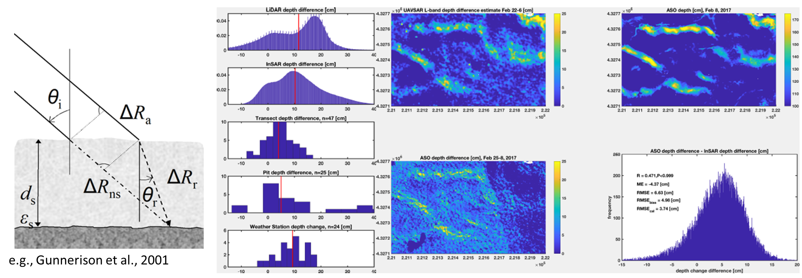
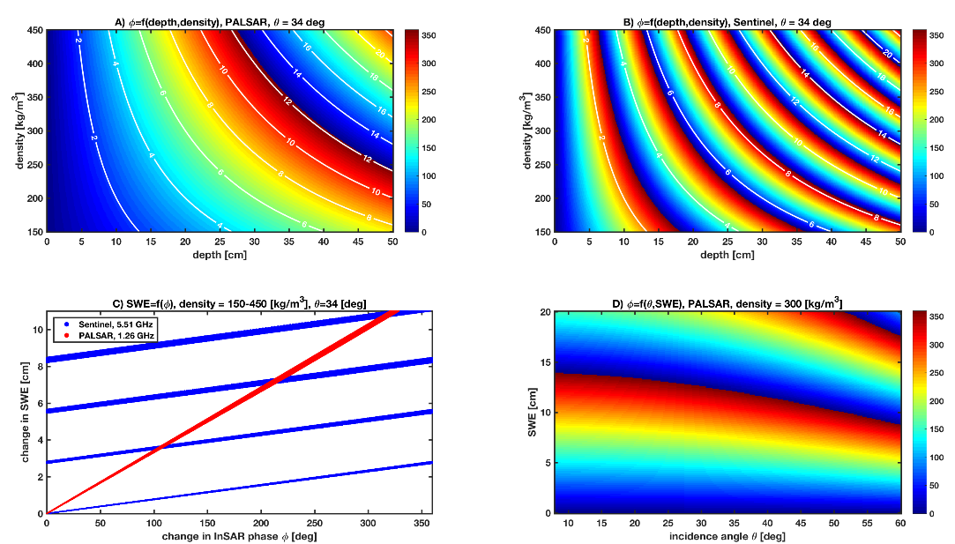
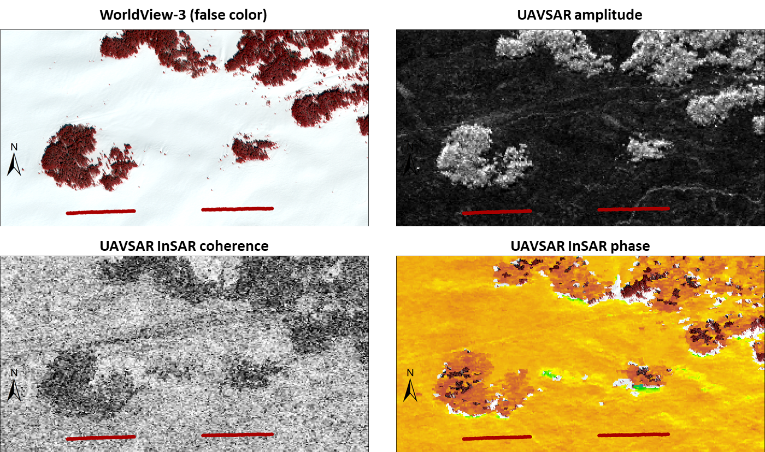
Breakout Group – L-Band InSAR
Physical properties that impact coherence
  Changes between acquisitions: soil conditions, snow wetness, accumulation greater than phase ambiguity, extreme snow microstructure contrast
Performance in steep terrain
Frequency dependent phase ambiguity
Vegetation interaction
Snow wetness
Results:
  SnowEx 2017
  SnowEx 2020
Eli Deeb, Elias.J.Deeb@erdc.dren.mil
Jewell Lund, lund.jewell@gmail.com

Slide 11
Breakout Group - Lidar/stereo WG
Purpose:
  Assess lidar, stereo and combined lidar+stereo technology for snow (airborne campaigns and future satellite missions)
Recent focus:
  Continued assessment of currently available on-orbit satellite resources for snow
    Lidar: ICESat-2, GEDI
    VHR Stereo: WorldView, SkySat, Pleiades
  Considering airborne options for 2021 and 2022 campaigns
Discussion topics:
  Value of combined lidar+stereo
  Surface Topography and Vegetation (STV) Mission workshop
  Airborne campaigns - experiment campaigns, balancing operational snow science vs. tests for future missions
  Uncertainty for different environments
Gaps in understanding:
  Stereo geometry, number of looks,
  Resolving power for individual trees, gaps between trees
David Shean, dshean@uw.edu
Nancy Glenn, nancyglenn@boisestate.edu

Slide 12
Breakout Group - Taiga/Tundra Snow Albedo
What do we need to know in order to enhance snow evolution models and representation of Taiga/Tundra snow albedo in land surface models?
  Change in albedo over time, space, scales – and uncertainties
  Albedo decay functions or other parameterizations
What do we need to measure?
  Spectral albedo – spectral range? precision? accuracy?
  Snow albedo across forest density and woody shrub-tundra gradients
  Light absorbing impurities – forest litter, charred woody debris, BC, dust
  Solar irradiance at snowpack surface – accumulation and ablation periods
  Forest and topographic characteristics from tree to forest scales (incl. shading), mtn. to flats
  Angular characteristics (BRDF) -- flat, mountainous, open, forested terrain
Where do we deploy to accomplish these objectives?
  Fairbanks region (Bonanza Creek, Caribou/Poker Flats, Shovel Creek fire)
  Toolik?
  Other?
Anne Nolin, anolin@unr.edu
Charles Gatebe, charles.k.gatebe@nasa.gov

Slide 13
Breakout Group - Science & Applications
Possible Topics for Discussion:
Who is currently using remote sensing of snow data?
Who would we like to target in the future?
  What are the current methods they use?
What is the spatial/temporal resolution “sweet spot”?
What are the major hurdles in this area?
What can other communities tell us?
How can field campaigns help improve our understanding of snow processes?
What is the impact of improved understanding and representation on our ability to inform applications (e.g. streamflow, flood/drought, etc.)?
Ryan Webb, rwebb@unm.edu
Kate Hale, Katherine.E.Hale@colorado.edu

Slide 14
BACKUP:
THP Roadmap
Specific Activities

Slide 15
Modeling
Objective: Demonstrated global snow capability with combined multi-sensor, model approach; pathway from research to operations
Specific research areas & needs:
Snow model parameterizations and uncertainty
  Advanced snow physics (e.g. microstructure, transport) in Land Surface Models (LSMs)
  Uncertainty in forcing data
  Subgrid spatial variability
Data Integration
  Snow Observation System Simulation Experiments (OSSEs) and Trade Studies to systematically evaluate the impact of different mission designs and choices
  Model-based remote sensing downscaling and gap-filling techniques
  Data assimilation/merging techniques
Global snow system

Slide 16
Algorithm Development
Objective: Quantify uncertainty in SWE, snow depth and albedo retrievals in different snow classes and for different snow properties
Specific research areas:
L-band InSAR
Microwave
Spaceborne lidar/stereo
Hyperspectral snow albedo
C-band SAR SWE retrievals
Signal of Opportunities (SoOP)
Multi-frequency retrieval algorithms

Slide 17
Technology Development
Objective: Increased TRL for snow remote sensing sensors and technologies
Specific research areas:
Data Access/Computing
  Virtual data access
  Cloud and server side computing
Sensor Development & Innovations
  SWESARR maintenance and upgrades
  SoOP ground-based and airborne validation in different environments
  Small-sat/Cube-sat concepts
  Multi-instrument airborne platform
  Companion/leveraging mission concepts

Slide 18
Science & Applications
Objective: Improved understanding & representation of snow processes in models, impact on remote sensing signals
Specific research areas:
Snow-vegetation interactions
Snow canopy interception
Snow sublimation and role in water balance
Spatial patterns of snow distribution in different environments
Snowmelt infiltration and runoff
Surface roughness impact on snow distribution
Snow-substrate interactions

Slide 19
Field Campaigns & ground validation
Objective: Global maps of uncertainty and thresholds for snow estimation techniques
Activities:
SnowEx Campaigns
  2017 – multi-aircraft, forest gradient focus
  2020 – multi-aircraft, various snow climates, time series approach
  2021 – small scale: time series, albedo and prairie focus
  2022 – tundra/taiga focus
  2023 – small scale; TBD
Multi-sensor demonstration campaign
Calibration/Validation long-term sites

Slide 20
Community Engagement
Objective: Train and engage snow community, in particular early-career snow scientists to participate in field, modeling, technology development and data analysis activities
Activities:
Community Meetings
Training
  Field schools
  Modeling schools
  Remote sensing schools
Hackweeks
Proposal opportunities

