Slide 1



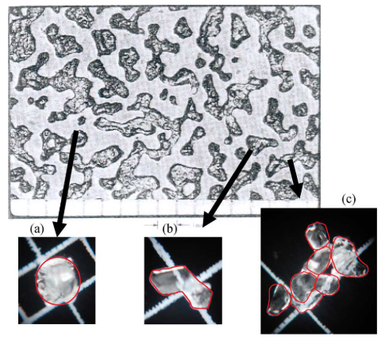
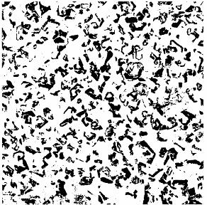
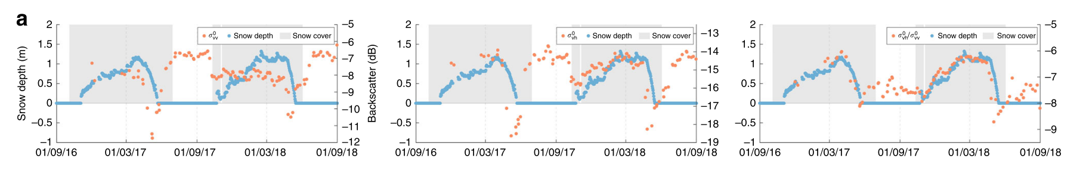
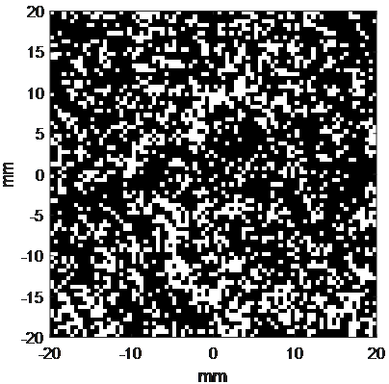
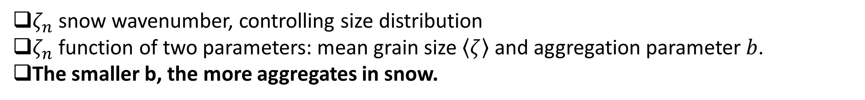
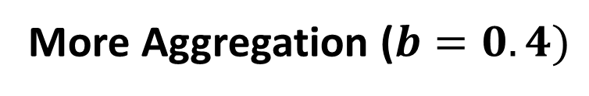

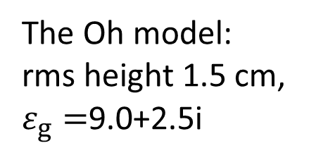
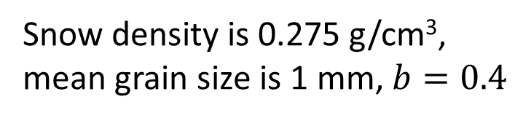
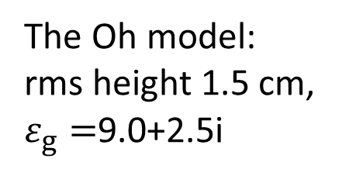

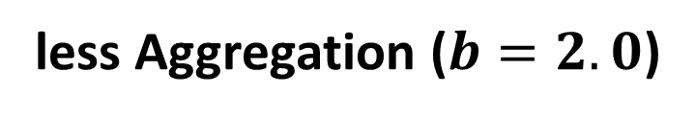
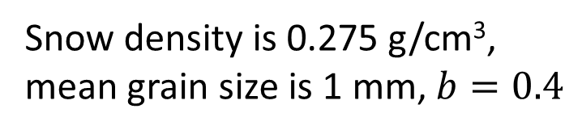
Modelling of snow volume scattering at cross-polarization of C and X band for mountain snow
Leung Tsang¹, Jiyue Zhu¹, and Xiaolan Xu²
Radiation Laboratory, Department of Electrical Engineering and Computer Science, The University of Michigan, Ann Arbor, 48109-2122 MI USA
Jet Propulsion Laboratory, California Institute of Technology, Pasadena, CA 91109 USA
Introduction
DMRT Model and Validation
In the past decades, techniques have been developed and shown acceptable accuracy for snow mass detection with satellite platforms such as the COSMO-SkyMed (X band) [1] and the Sentinel 1 (C band) [2]. Recently there was a published product based on the Sentinel-1 dual-polarization data (C band), mapping snow depth with 1 km² spatial resolution for the Northern Hemisphere mountain areas [2].
The previous belief in the community was that the volume scattering of snow is negligible at C band. The reason is that the snow grain size ranging from 0.1-3mm is much smaller than the wavelength, if the Rayleigh scattering is assumed. However, as indicated by the satellite data [2] and ground measurements [3], the cross-polarization of C band backscattering can gradually increase with snow accumulation.
As ice grains are densely packed in snow, ice grains can adhere to form irregular shape aggregates with larger diameter, accounting for stronger than expected co- and cross- polarization volume scattering at C and X band. In this paper, we study the effects of densely packed ice aggregates on snow volume scattering using bicontinuous dense media radiative transfer equation (DMRT-Bic). Results of DMRT-Bic gives stronger volume scattering than Rayleigh scattering and the frequency dependence of ~2.6 power. The backscattering calculated are consistent with radar measurements for both the co- and cross-polarization at C and X band [3].
Step 1: Calculate phase matrix $P\left(\hat{s},{\hat{s}}^{′}\right)$ with full wave simulation
Step 2: Apply the Dense Media Radiative Transfer (DMRT) to obtain backscatter with simulated $P\left(\hat{s},{\hat{s}}^{′}\right)$
$cosΘ\frac{dI_{inco}(\hat{s},z)}{dz}=−\left(κ_{s}+κ_{a}\right)I_{inco}\left(\hat{s},z\right)+∬dΩ^{′}P\left(\hat{s},{\hat{s}}^{′}\right)I_{inco}\left({\hat{s}}^{′},z\right)$, $cosΘ=\hat{s}∙\hat{s}′$
Snow density is 0.275 g/cm³, mean grain size is 1 mm
The Oh model:
rms height 1.5 cm, $ε_{g}=$9.0+2.5i
Aggregates in Snow and Bicontinuous Model
Ice aggregates formed by pressure and melt-refreeze events
Aggregates densely packed
Aggregates irregular shape and larger size, leading to stronger co- and cross-pol
Aggregation gives stronger scattering for both co- and cross-pol
Aggregation gives weaker frequency dependence
Validation with Data
The Oh model:
rms height 1.5 cm, $ε_{g}=$9.0+2.5i
Rounded
faceted
aggregates
Computer generated snow
real snow [4]
Snow density is 0.275 g/cm³,
mean grain size is 1 mm, $b=0.4$
Co-pol volume scattering smaller than co-pol surface scattering
Cross-pol volume scattering can be larger than cross-pol surface scattering
Cross-pol volume has larger dynamic range than co-pol
Snow density is 0.275 g/cm³,
mean grain size is 1 mm, $b=0.4$
$ζ_{n}$ snow wavenumber, controlling size distribution
$ζ_{n}$ function of two parameters: mean grain size $\left\langle ζ\right\rangle$ and aggregation parameter $b$.
The smaller b, the more aggregates in snow.
The Oh model:
rms height 1.5 cm, $ε_{g}=$9.0+2.5i
Correlation function
Spectral density
Co-pol backscatter almost no sensitivity to SWE
Cross-pol backscatter has sensitivity to SWE
VV
Simulations and Hans’ data are in good agreement for co- and cross-pol
Both simulations and data show that ratio of Cross/co-pol has about 2 dB dynamic range
Cross-pol backscatter of simulations is 2 dB lower than data because of underestimation of surface scattering from the Oh model
mean grain size is 1 mm
VH
Correlation function decays slower with more aggregation
Spectral density larger, decays faster
Aggregates gives stronger scattering and weaker frequency dependence
VH/VV
More Aggregation ($b=0.4)$
less Aggregation ($b=2.0$)
References
White: ice
Black: air
[1] S. Pettinato, E. Santi, M. Brogioni, S. Paloscia, E. Palchetti, and C. Xiong, “The potential of COSMO-SkyMed SAR images in monitoring snow cover characteristics,” IEEE Geosci. Remote Sens. Lett., vol. 10, no. 1, pp. 9–13, 2013.
[2] H. Lievens et al., “Snow depth variability in the Northern Hemisphere mountains observed from space,” Nat. Commun., vol. 10, no. 1, pp. 1–12, 2019.
[3] J. R. Kendra, K. Sarabandi, and F. T. Ulaby, “Radar measurements of snow: Experiment and analysis,” IEEE Trans. Geosci. Remote Sens., vol. 36, no. 3, pp. 864–879, 1998.
[4] A. Wiesmann, C. Mätzler, and T. Weise, "Radiometric and structural measurements of snow samples," Radio Sci., vol. 33, pp. 273-289, 1998.
[5] L. Tsang, J. A. Kong, and R. T. Shin, Theory of Microwave Remote Sensing, NJ, USA:Wiley-Interscience, 1985.
Snow density is 0.275 g/cm³, mean grain size is 1 mm
The ice particles more aggregated for smaller b

