Slide 1
Taiga/Tundra Snow Albedo Breakout Group
What do we need to know in order to enhance snow evolution models and representation of Taiga/Tundra snow albedo in land surface models?
Change in albedo over time, space, scales – and uncertainties
Albedo decay functions or other parameterizations
What do we need to measure?
Spectral albedo – spectral range? precision? accuracy?
Snow albedo across forest density and woody shrub-tundra gradients
Light absorbing impurities – forest litter, charred woody debris, BC, dust
Solar irradiance at snowpack surface – accumulation and ablation periods
Forest and topographic characteristics from tree to forest scales (incl. shading
Angular characteristics (BRDF) -- flat, mountainous, open, forested terrain

Slide 2
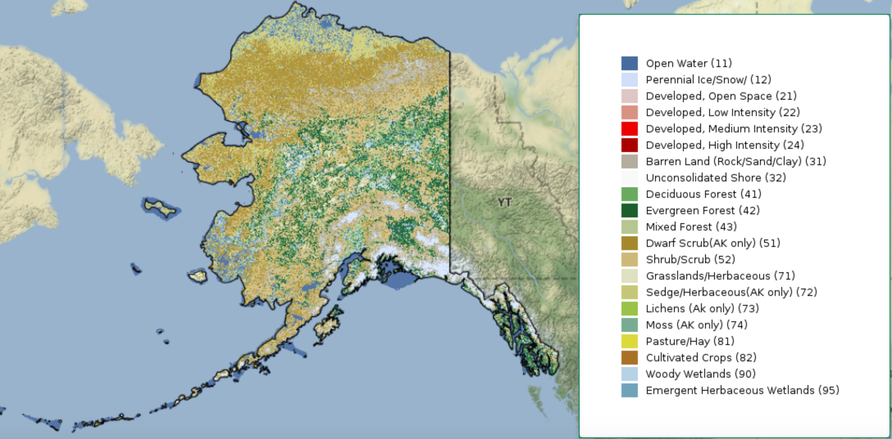
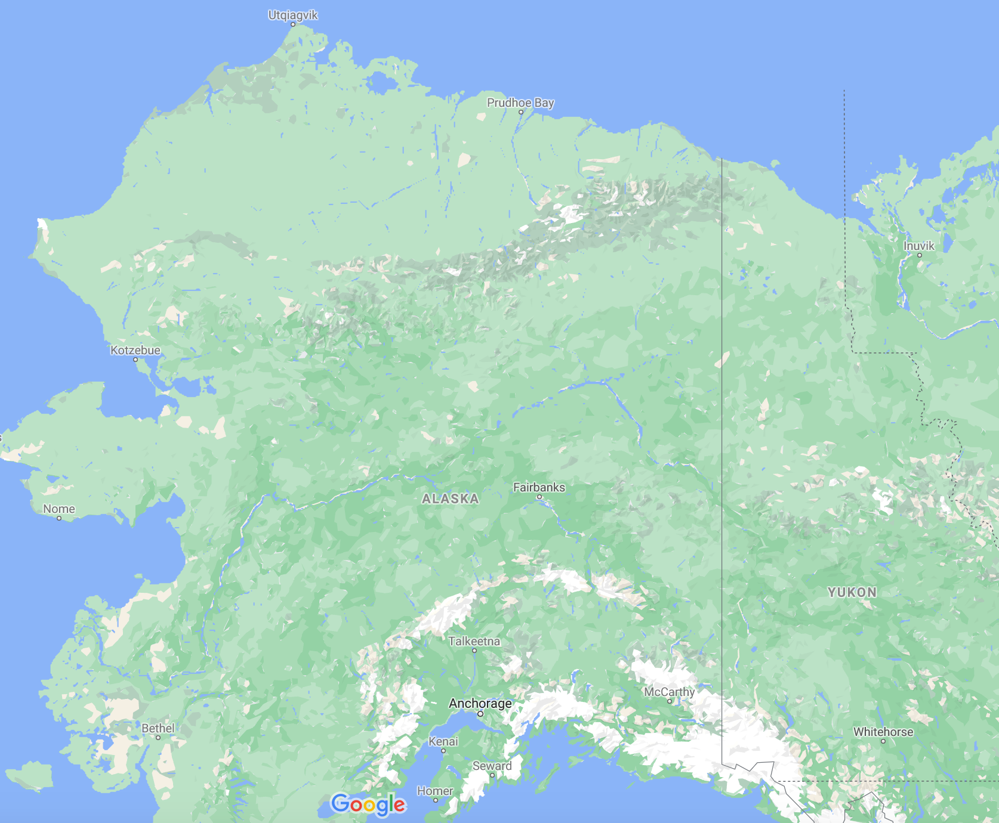
Aircraft to be based out of Fairbanks, AK, align with previous ABoVE flights
Fly rectangular boxes with long legs : 50-100 km long over (AVIRIS-NG) and circular tracks for CAR BRDF observations
Flight paths to collect data at different spatial resolution at the selected grounds sites, that means, flying A/C at different altitudes
Flight paths designed to collect data at desired spatial resolutions and swath widths during transit from the airport to selected sites
Ground-based observations at Taiga, Taiga-Tundra transition, Tundra sites
Bonanza Creek, Caribou/Poker Flat Long-term Ecological (LTER) sites, Shovel Creek Fire, CRREL sites (Taiga snow, wildfire)
Trail Valley Creek (TVC) near Inuvik (Taiga to Tundra Transition)
Elson Lagoon near Barrow (Tundra)
EL
TVC
FAI

