Slide 1
Jared Entin
Terrestrial Hydrology Program Manager
NASA Earth Science Division
September 11, 2020

Slide 2
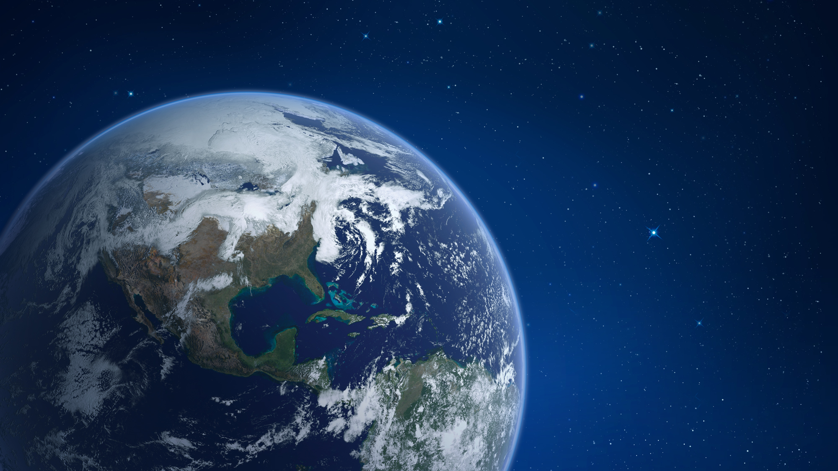
NASA EARTH FLEET
SWOT (CNES) 2021
TROPICS (6) 2020
LANDSAT-9 (USGS) 2021
SENTINEL-6 Michael Freilich/B (ESA) 2020, 2025
OPERATING & FUTURE THROUGH 2023
NISAR (ISRO) 2020
GEOCARB 2022
TSIS-2 2023
MAIA 2022
PREFIRE (2) 2022
TEMPO 2022
INVEST/CUBESATS
RainCube 2018
CSIM-FD 2018
HARP 2020
TEMPEST-D 2018
CIRiS 2020
CTIM*
HyTI*
SNoOPI*
NACHOS*
* Launch date TBD
GLIMR ~2026
PACE 2024 (NSO)
ICESAT-2 2021
GRACE-FO (2) (GFZ) 2023
CYGNSS (8) 2020
NISTAR, EPIC (DSCOVR/NOAA) 2020
ISS INSTRUMENTS
EMIT 2021
CLARREO-PF 2023
GEDI 2020
SAGE III 2020
OCO-3 2022
TSIS-1 2023
ECOSTRESS 2020
LIS 2020
CLOUDSAT (CSA) 2021
TERRA (JAXA, CSA) >2021
AQUA (JAXA, AEB) >2022
AURA (NSO, FMI, UKSA) >2022
CALIPSO (CNES) >2022
GPM (JAXA) >2022
LANDSAT 7 (USGS) ~2022
LANDSAT 8 (USGS) >2022
JPSS-2, 3 & 4 INSTRUMENTS
OMPS-Limb 2022
LIBERA 2027
OCO-2 >2022
SMAP >2022
(PRE) FORMULATION
IMPLEMENTATON
PRIMARY OPS
EXTENDED OPS
SUOMI NPP (NOAA) >2022
06.29.20

Slide 3
BIG THANK YOU!
This Meeting – Dorothy Hall, Peter Griffith, Ed Kim, Jessica Lundquist, HP Marshall, Carrie Vuyovich
Snow Program Planning – Carrie Vuyovich
SnowEx2020/2021 – HP Marshall, Carrie Vuyovich, Kelly Gleason, McKenzie Skiles, Eric Sproles
Sub-Group Meetings & Planning- Anne Nolin, Charles Gatebe, Paul Houser, Leung Tsang, Mike Durand², Chris Hiemstra
A Lot of Hard Work – Everyone Else!

Slide 4
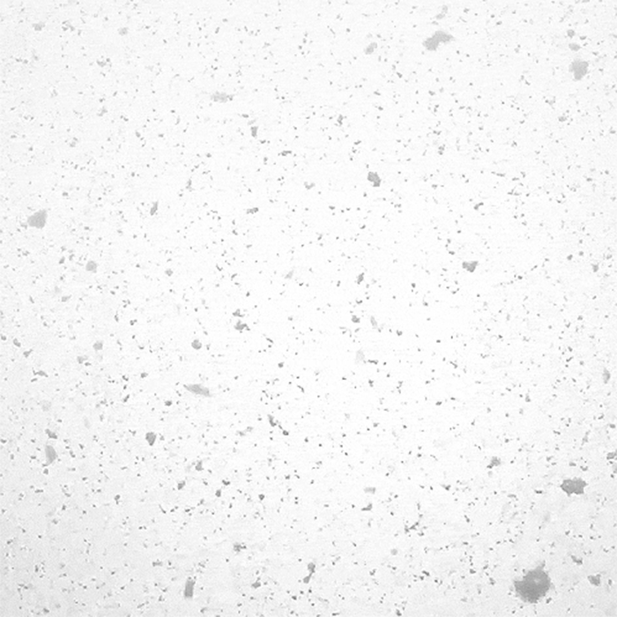
UPDATES
THP’20 Solicitation (Roses2020 A.24)
Focus on Satellite Snow Remote Sensing
Due date may be delayed to accommodate late running THP’19 solicitation and possibly an amendment to add a new topic which will not effect the current content.
Karen St. Germain – New Director of Earth Science Division
A Focus of ESD is on Designated Observables Studies
Surface Biology and Geology (incl. Snow Albedo, ET)
Aerosols & Clouds, Convections and Precipitation Study
Surface Deformation (extends L-band SAR)
Mass Change (extends GRACE)

Slide 5
Improve Diversity & Inclusion Be Bias-Free & Harassment-Free
NASA HQs – Upper Levels, SMD, ESD all developing strategies to be more inclusive.
We need to strive towards the same.
Bias and Harassment have no place at NASA nor our Activities.
Encouragement and Good Ideas are needed from the whole THP-Snow Community
Everyone is Empowered to speak-up to support these ideas and/or report bad or unprofessional behavior.

Slide 6
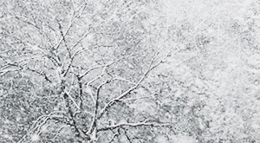
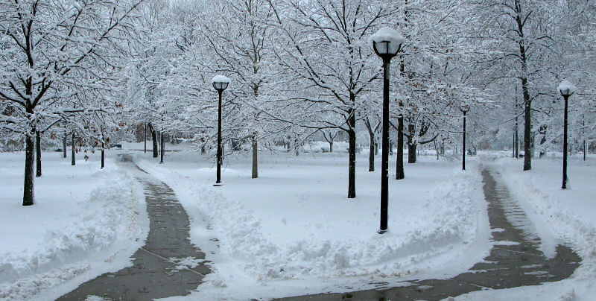
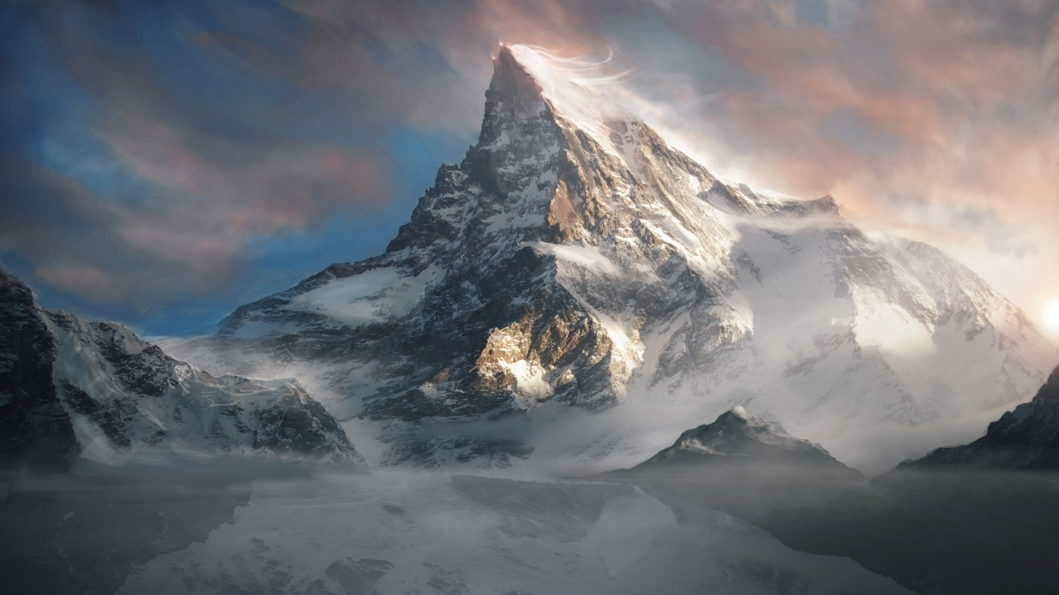
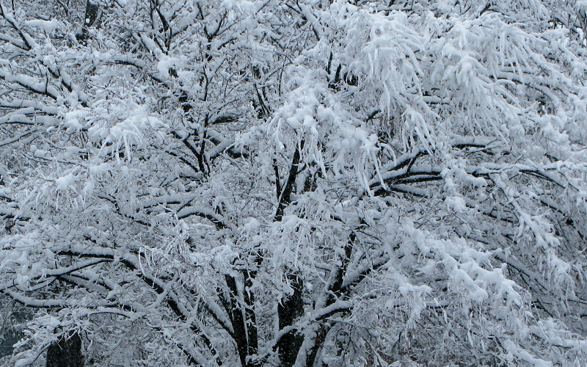
Questions?

