Slide 1
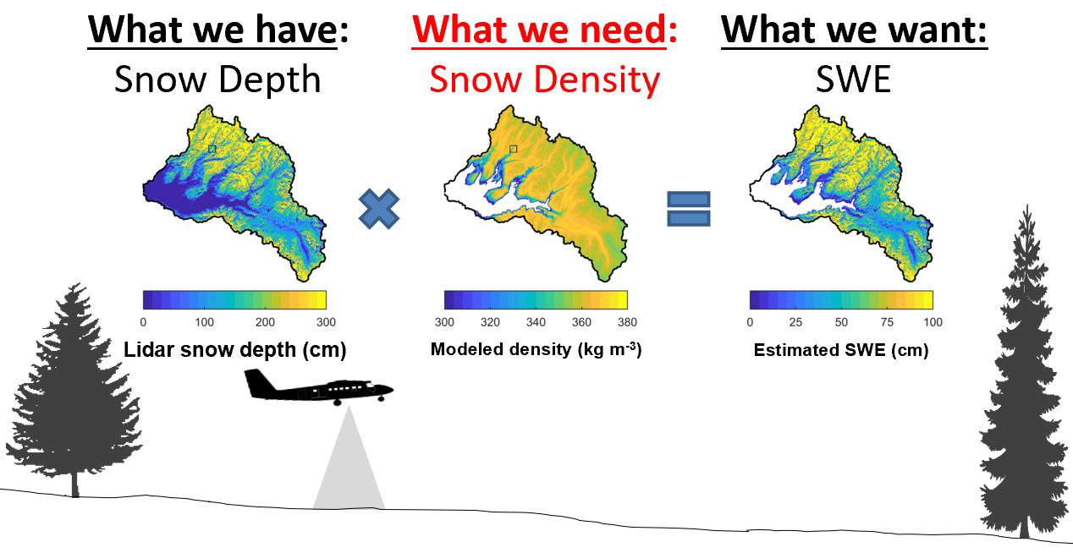
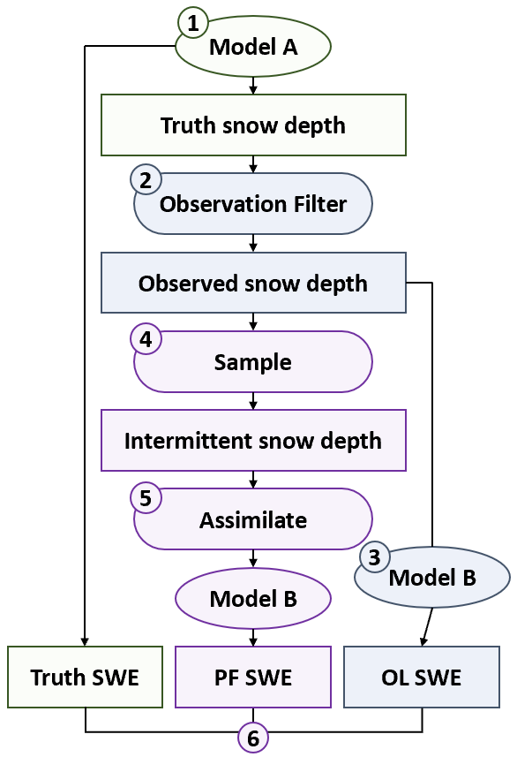
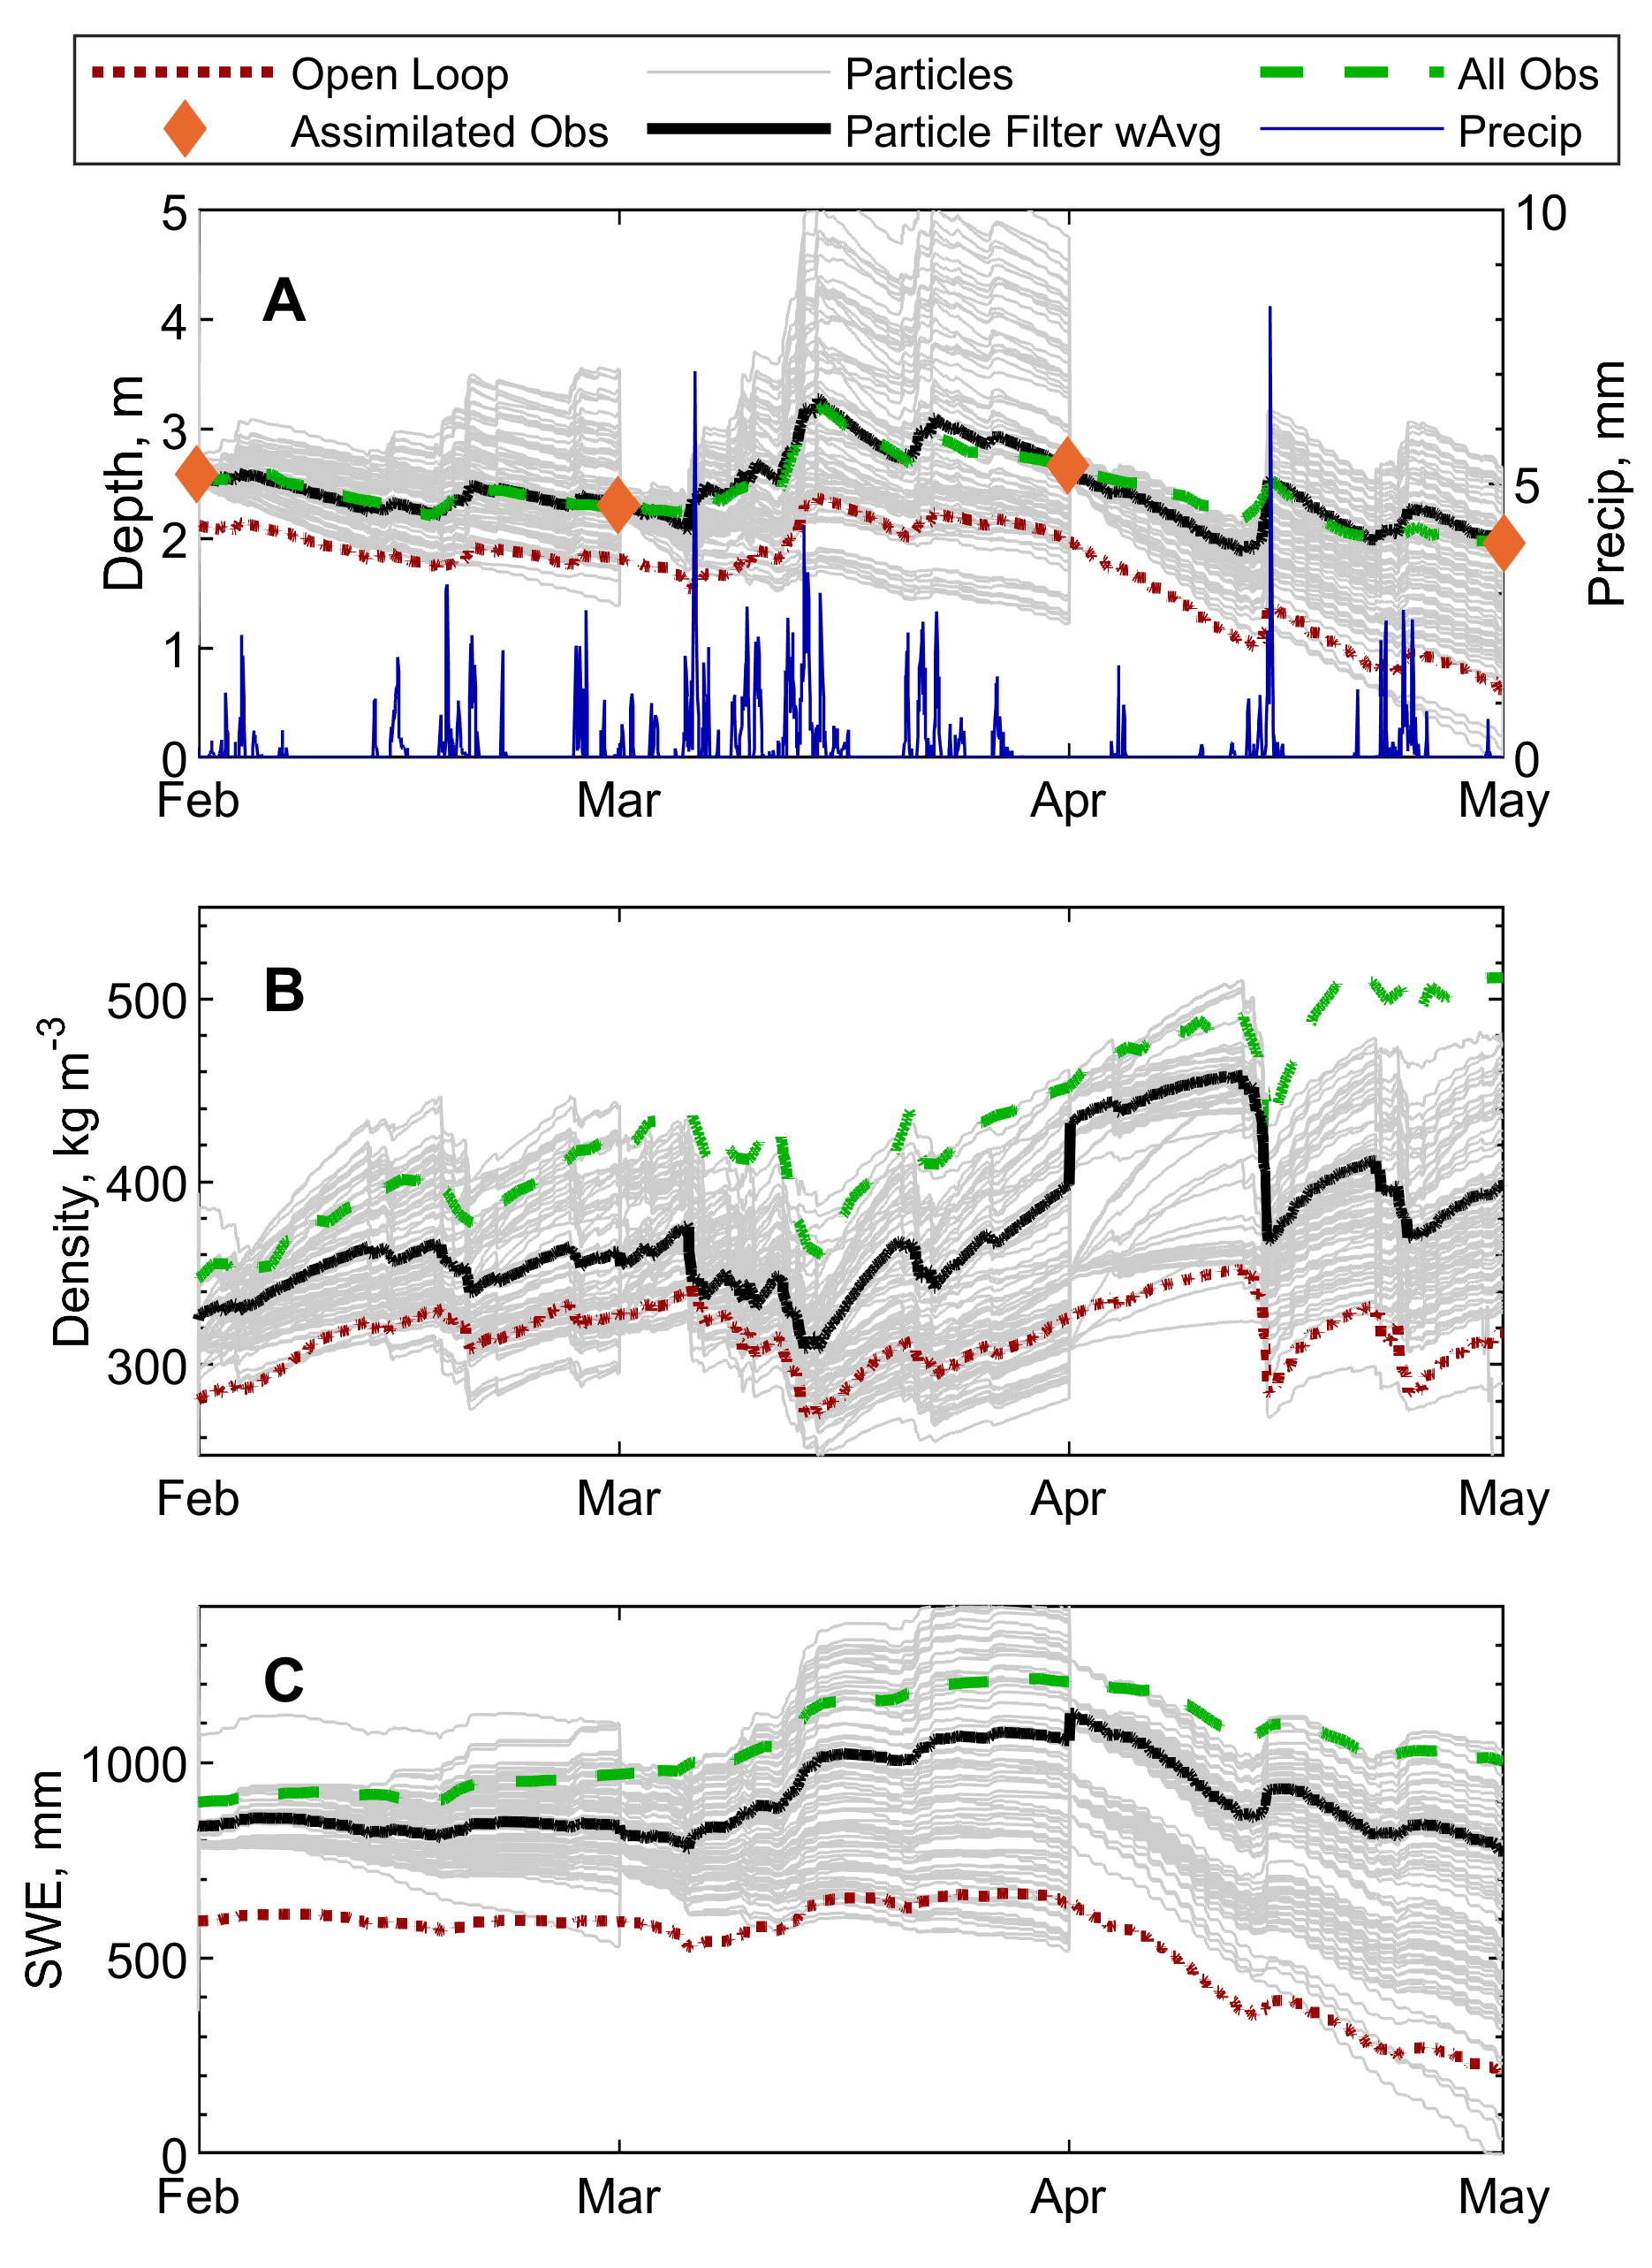
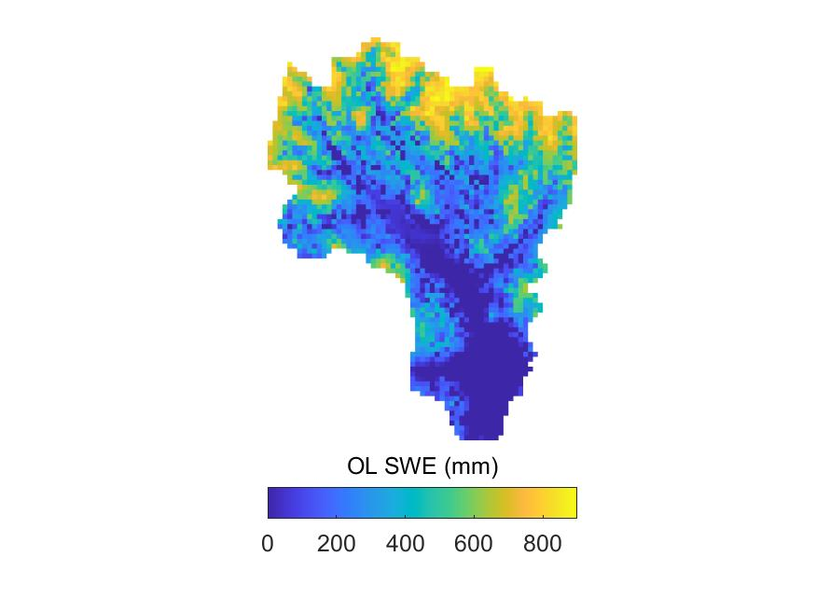
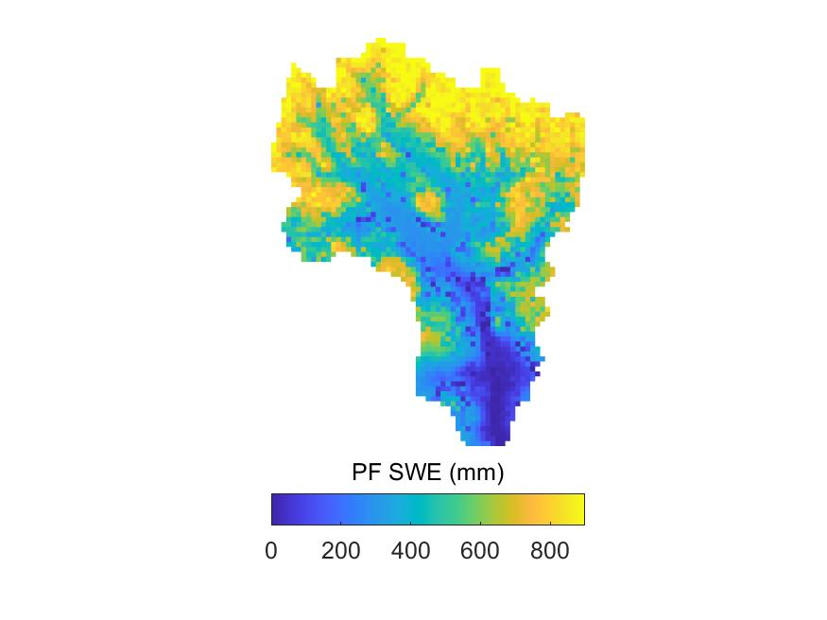
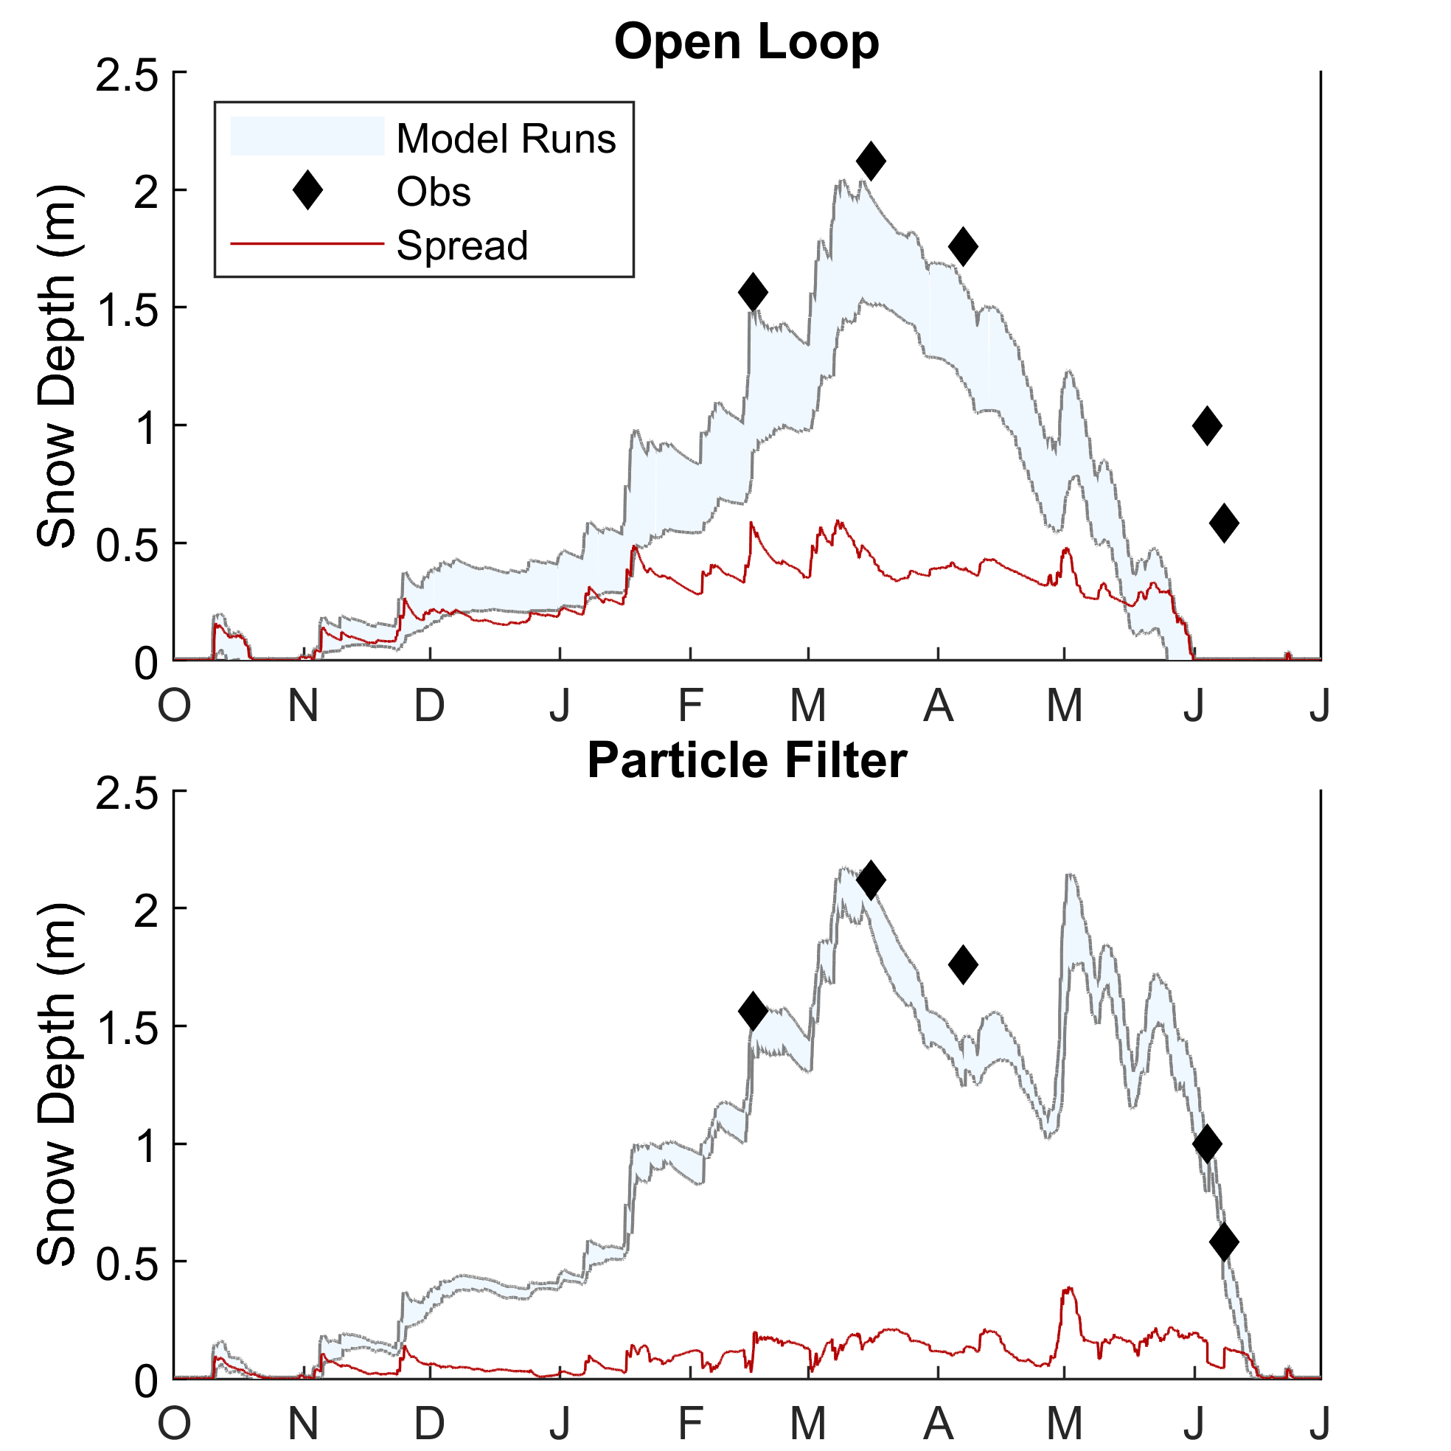
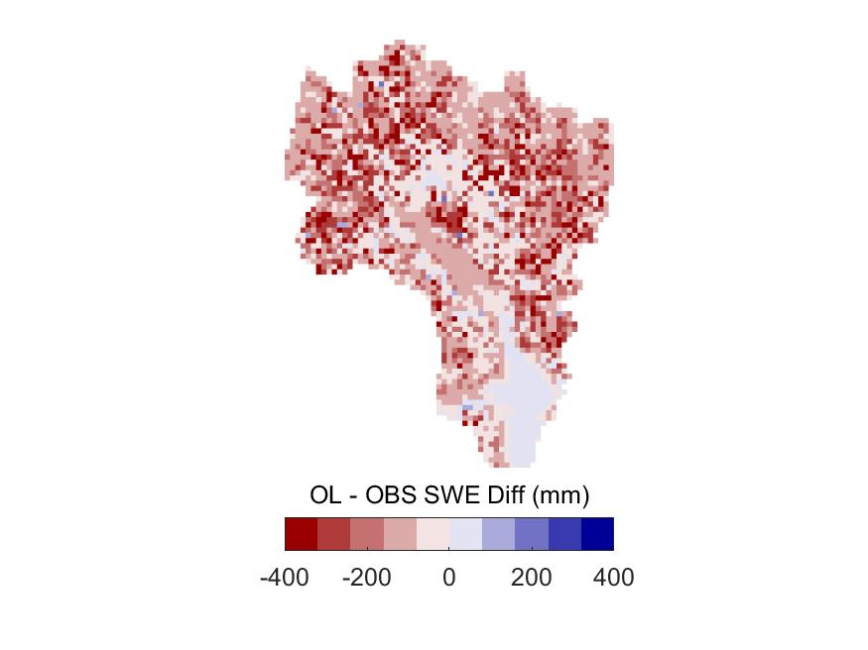
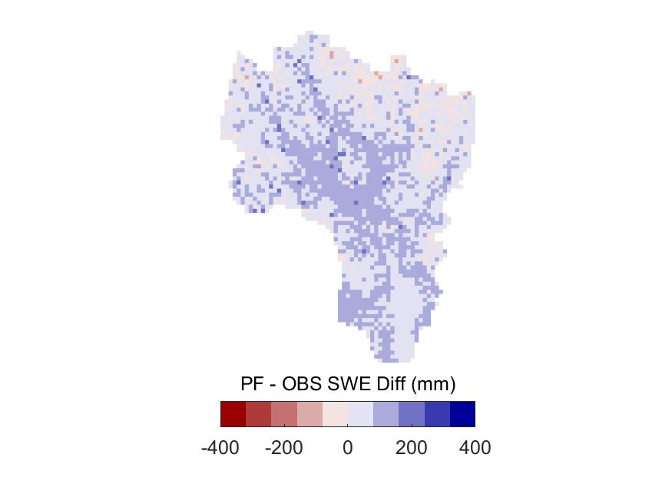
Real Results with Simulated Data: Synthetic Experiments with Data Assimilation of Snow Depth at Basin Scales to Inform Mission Design
Eric Smyth, Mark S. Raleigh, and Eric E. Small | eric.smyth@colorado.edu
Motivation / prior research
Goal: Improve modeled SWE at basin scales
The PF improves modeled depth, density, and SWE
1. Snow water equivalent (SWE) from remotely sensed snow depth (e.g. airborne lidar) relies on modeled snowpack density
Challenge #1: Lack of distributed snow data
East River Basin, CO
April 20, 2019
Solution: Observing System Simulation Experiment (OSSE)
Alpine3D
1
Generate synthetic “truth” snow depth using model A
2
Resample depth with an observation filter
250m grid spacing gives:
~21,500 total pixels
75 particles each pixel
Over 1.6 M simulations
3
Calculate open loop (OL) estimates of SWE
2. Assimilating snow depth (SD) with the Particle Filter¹ (PF) improves both density and SWE at the point scale²
4
Sample to create intermittent observations
FSM2
~32 km
5
Calculate particle filter estimates of SWE
6
Compare SWE estimates, relative to OL and an acceptable threshold
Challenge #2: Representation of forest canopy effects
~40 km
Solution: Assimilation of SD significantly reduces sensitivity
OL MAE:
140 mm
PF MAE:
65 mm
References
Acknowledgements
[1] van Leeuwen, P. J. (2009). Particle Filtering in Geophysical Systems. Monthly Weather Review, 137(12), 4089–4114. https://doi.org/10.1175/2009MWR2835.1
[2] Smyth, E. J., Raleigh, M. S., & Small, E. E. (2019). Particle Filter Data Assimilation of Monthly Snow Depth Observations Improves Estimation of Snow Density and SWE. Water Resources Research, (4), 1296–1311. https://doi.org/10.1029/2018WR023400
This work was supported by the National Aeronautics and Space Administration (NASA) Terrestrial Hydrology Program under Grant No. NNX17AL41G and NASA FINESST Grant No. 80NSSC19K1374. We thank Richard Essery for making FSM2 code available. (https://github.com/RichardEssery/FSM2). NLDAS-2 forcing data were acquired through NASA GES DISC (https://ldas.gsfc.nasa.gov/nldas/NLDAS2forcing.php).

