Slide 1
Surface Biology and Geology (SBG): On the path to global snow albedo
S. McKenzie Skiles, University of Utah
ASO
NASA Earth Observatory

Slide 2
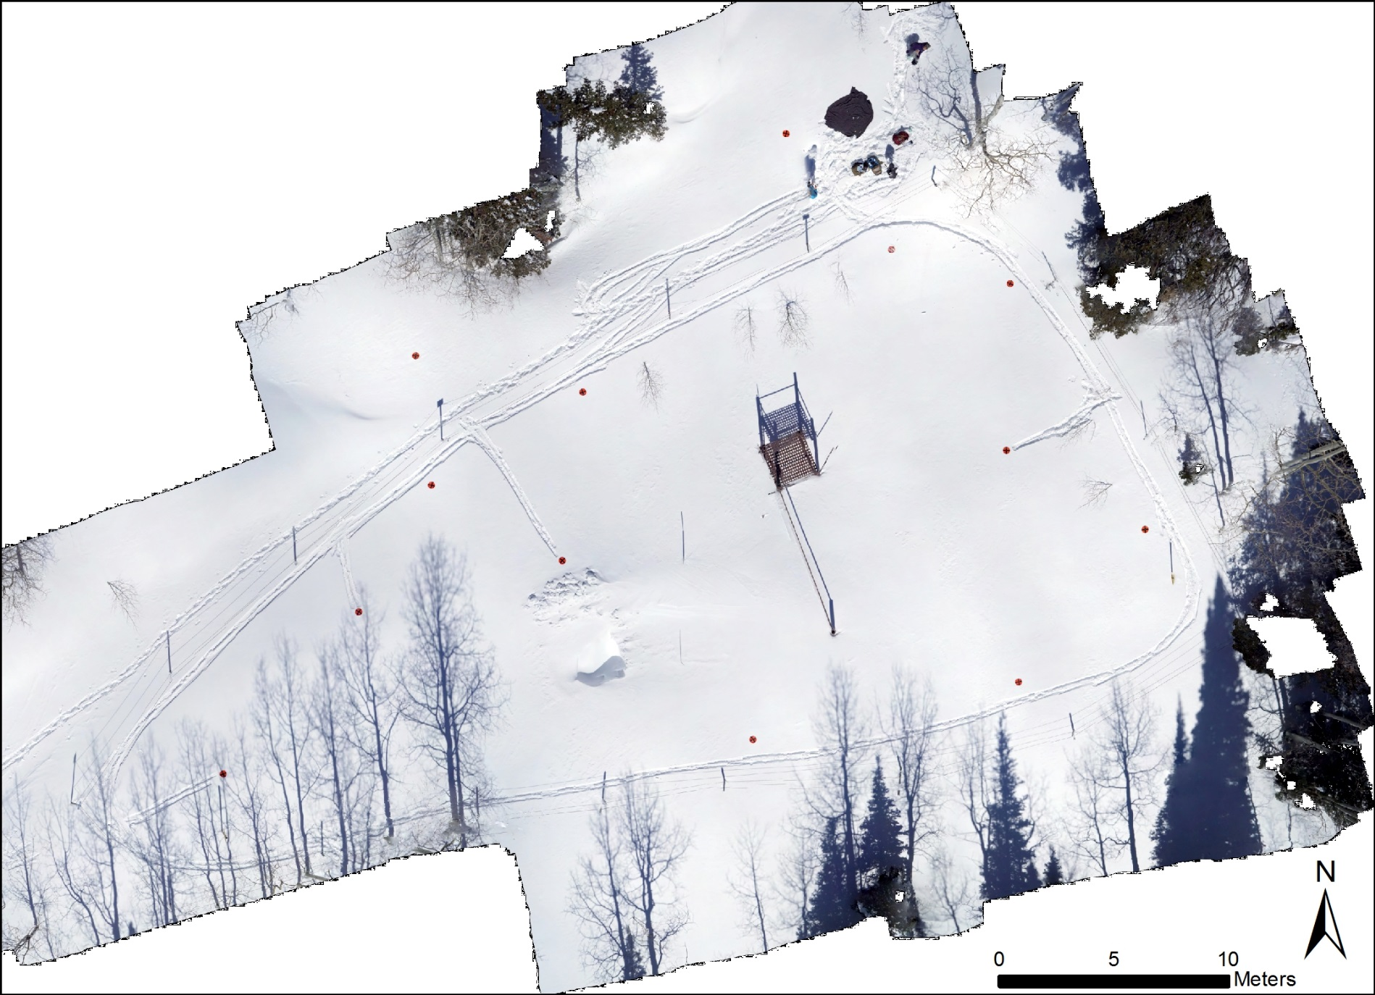
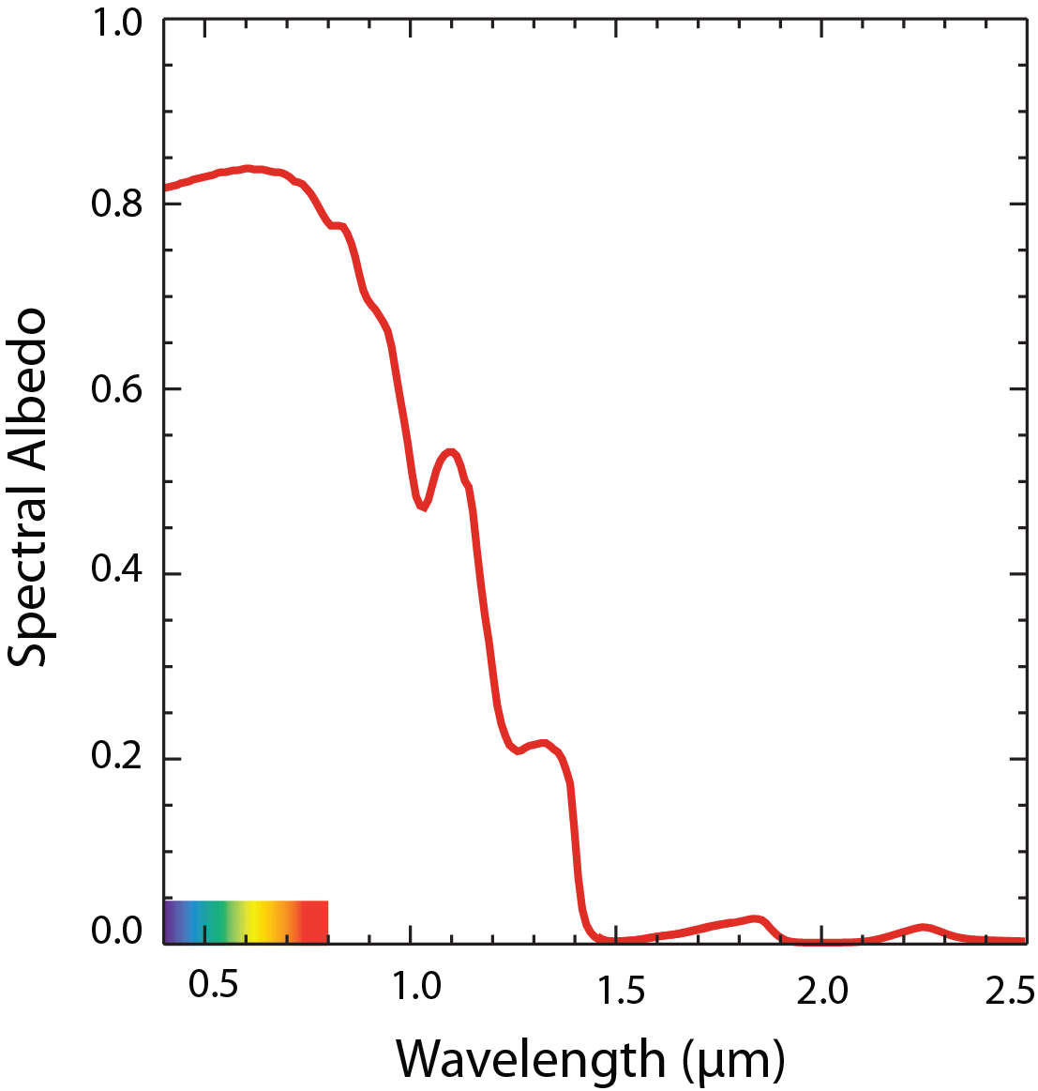
Snow Albedo
Background
Camera Location/
Overlap
Broadband Albedo Time Series
Spectral
Albedo
DEM
Spectral Albedo
Time Series
Snow albedo, a primary control on snowmelt rates via its modulation on net solar radiation,
has high spatial, temporal, and spectral variation

Slide 3
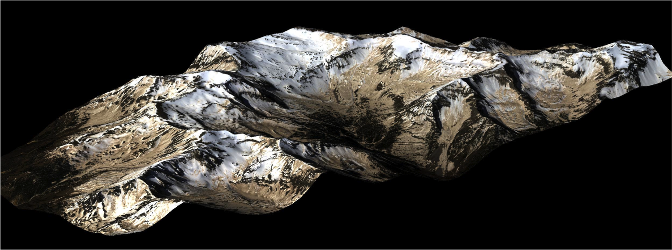
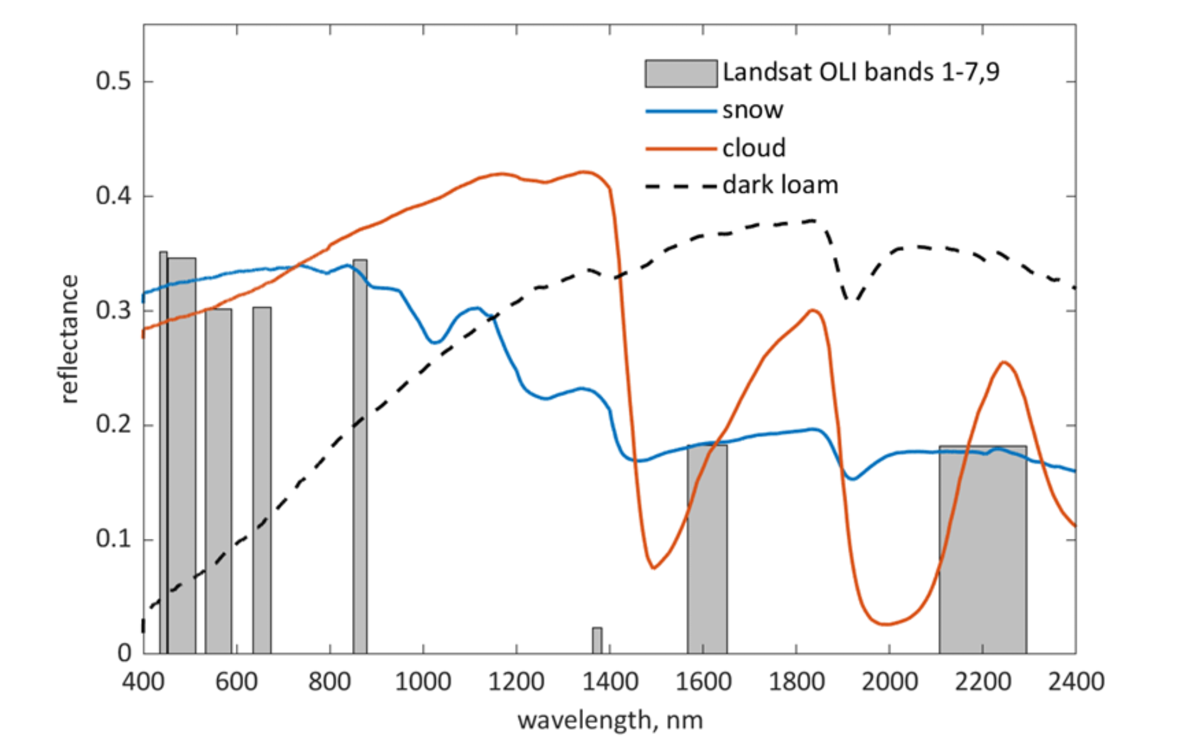
Snow and multispectral sensors
Background
Camera Location/
Overlap
DEM
Source: Jeff Dozier
Current multispectral satellites lack the spatial, spectral, and temporal resolution for us to measure snow albedo (namely in mountainous terrain), or controls on snow albedo, with quantitative certainty
There is no publicly available snow albedo dataset from satellite remote sensing
Differentiating clouds from snow is also a relevant challenge with multispectral platforms

Slide 4
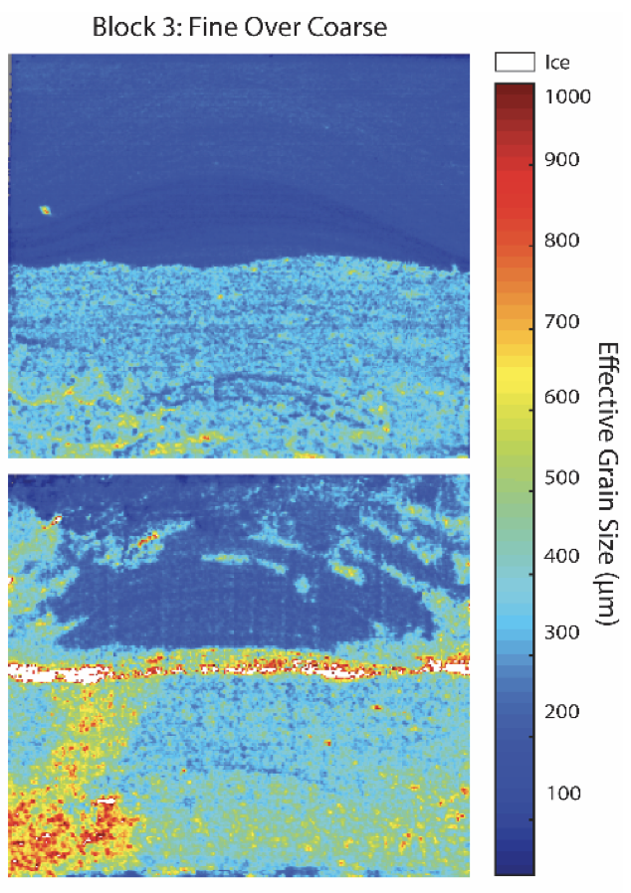
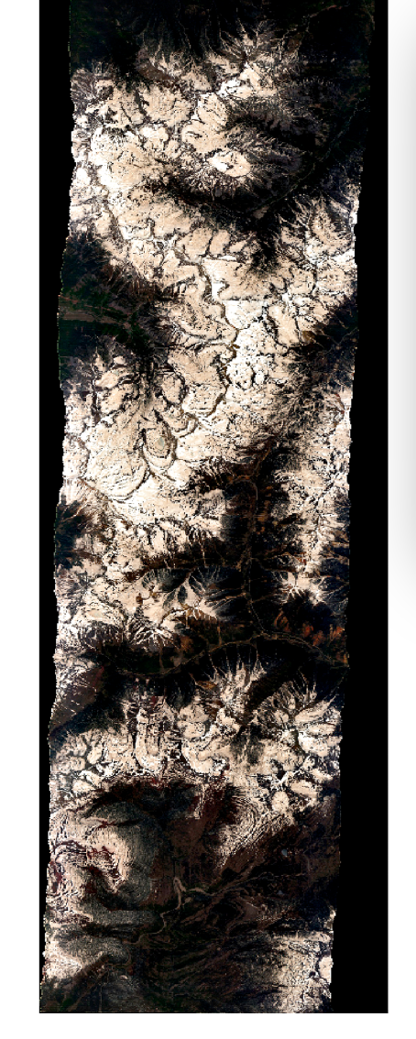
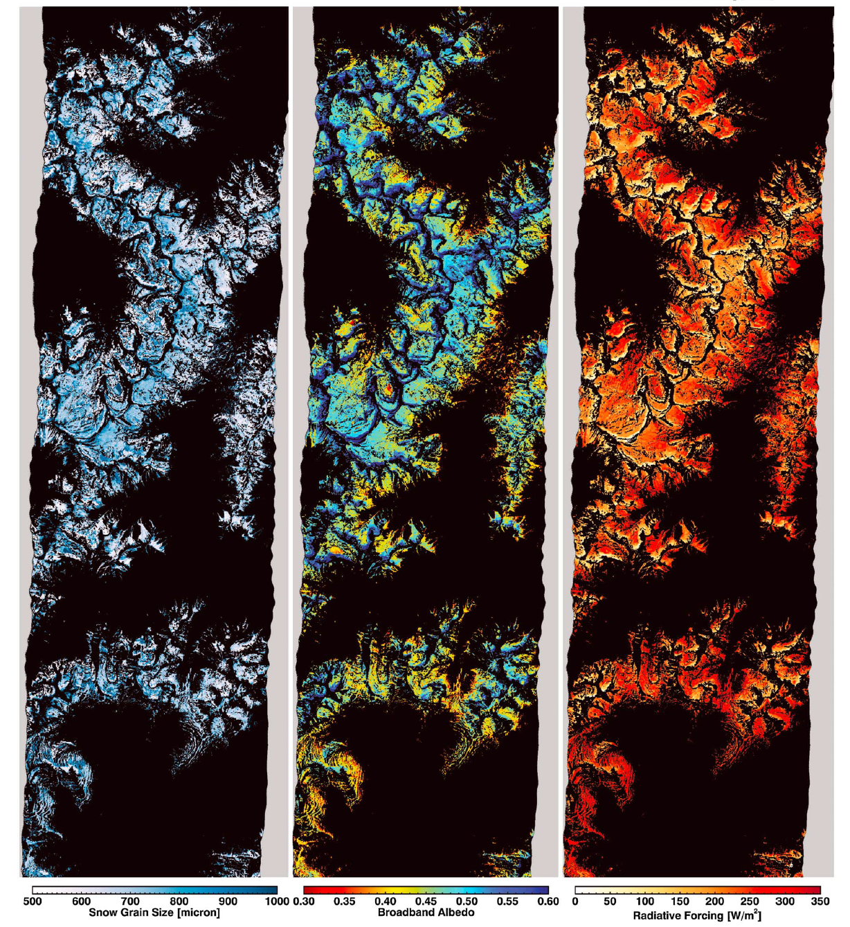
Snow Imaging Spectroscopy
Lab scale grain size retrieval
(Resonon Pika NIR-320;
Donahue, Skiles, & Hammonds 2020)
Background
High quality snow property retrievals have been demonstrated from field and airborne spectroscopy systems
Base algorithms for grain size, LAP radiative forcing, and broadband snow albedo are considered mature

Slide 5
Decadal Survey
Background
An imaging spectrometer is among the five observations in the “designated” (high priority) class recommended in the Decadal Survey for future space missions, with the intent to better remotely sense surface biology and geology, including
snow albedo. National Academies, 2018

Slide 6
Surface Biology and Geology (SBG)
https://sbg.jpl.nasa.gov/

Slide 7
Surface Biology and Geology (SBG) study
The SBG Study has three objectives:
Identify and characterize a diverse set of high value SBG observing architectures
Assess the performance/cost effectiveness of architectures against research/applications objectives
Perform sufficient in-depth design of one+ candidate architectures to enable near-term science return
The study integrates inputs from Research & Applications working groups:
Applications, Algorithms, Modeling, and Calibration / Validation
The study ended its first phase with more than sixty potential architecture configurations ranging from very large multi-sensor platforms to constellations of smallsats, each intended to meet the science and applications objectives in the SBG Science and Applications Traceability Matrix (SATM)
Now in Phase 2, each of these options is being evaluated; instrument characteristics (optical performance, mass, volume, power, data rate) are being refined, cost estimates are being developed, and potential partnerships with commercial and international organization are being explored
Expected to launch no earlier than 2027
https://sbg.jpl.nasa.gov/

Slide 8
SBG Value Framework Assessment
A gray diagonal line depicts a cost performance profile
Blue dots depict individual architectures
Architectures below the Threshold mission or above the cost target will not be considered
https://sbg.jpl.nasa.gov/framework

Slide 9
Snow in the SBG Science Traceability Matrix
Topic
Hydrology
-> Decadal Survey (DS) Science Question
How is the water cycle changing?
--->DS Science/Application Objective
H1-c Quantify rates of snow accumulation, snowmelt, ice melt, and sublimation from snow and ice worldwide at scales driven by topographic variability
----->Parameters
Snow and glacier albedo and surface temperature. Spectral albedo of subpixel snow and glaciers at weekly intervals to an accuracy to estimate absorption of solar radiation to 10%. Ice/snow temperature to ± 1K. At spatial resolution of 30 to 100 m.
https://sbg.jpl.nasa.gov/

Slide 10
Snow in the SBG Science Traceability Matrix
https://sbg.jpl.nasa.gov/

Slide 11
SBG Pathfinder Study
SISTER: SBG Space-based Imaging Spectroscopy and Thermal pathfinder
Year 0:
Complete a rapid design study for a flexible architecture that allows for augmentations as technology advances, and complementary paradigms
Year 1:
Build prototype workflow(s) for processing pseudo SBG datasets
Years 2-3:
Process pseudo SBG datasets through existing workflows, rapidly prototype and improve processing throughputs
Years 4-5:
Adapt workflows based on improved algorithms from external partners or project-provided Algorithm Theoretical Basis Documents (ATBDs)
SnowEx contribution
Atmospheric Correction and Algorithm Maturation
Charles Gatebe, Nancy Glen, McKenzie Skiles

Slide 12
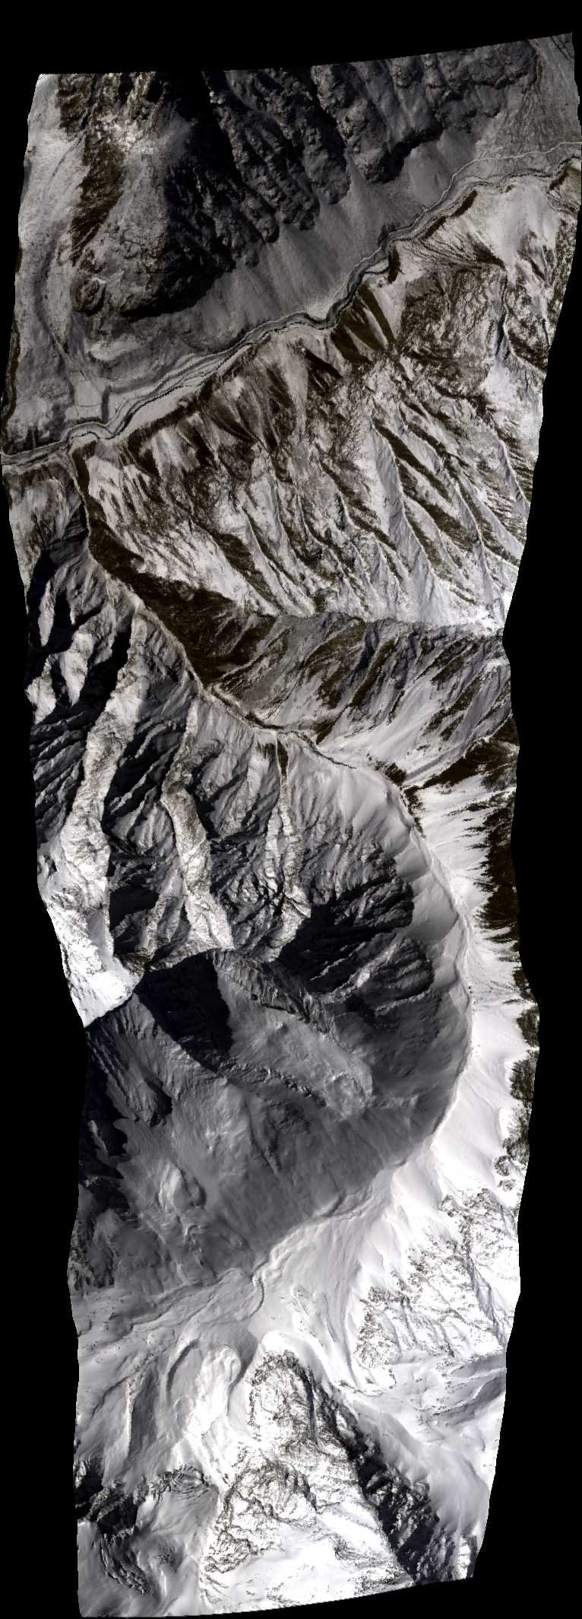
AVIRIS Next Generation
Camera Location/
Overlap
Pushbroom imaging spectrometer
Spectral resolution: 380 nm to 2510 nm with 5 nm sampling (425 bands)
Radiometric resolution: 14 bit
Focal plane array: 480 (spectral) x 640 (cross track)
High signal-to-noise ratio
Currently flies on King Air B200
Average ground speed is 100 kts @ 13,000 ft AGL (4 m pixel resolution)
Range is 700 nautical miles (5 hours)
AVIRIS-NG
Orthorectified
True Color
Himachal
Pradesh (India)
DEM

Slide 13
SBG Study Website
https://sbg.jpl.nasa.gov/
McKenzie Skiles
m.skiles@geog.utah.edu

