Slide 1
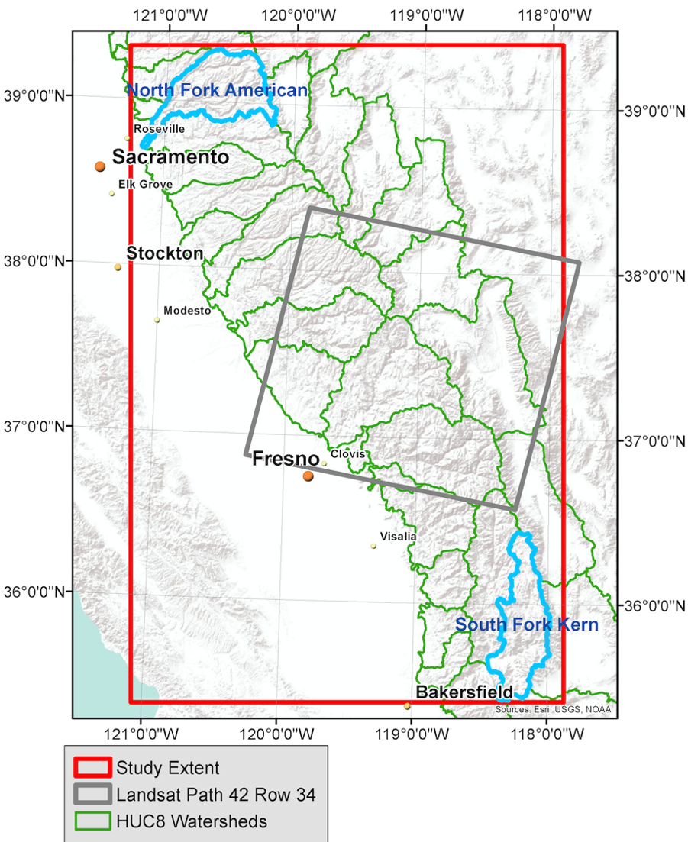
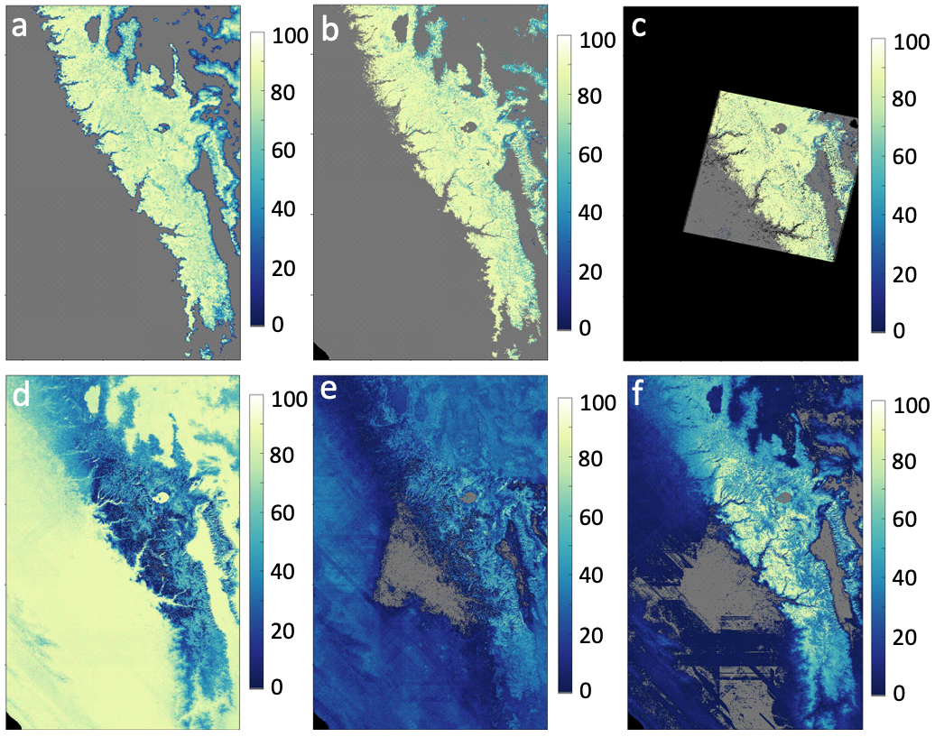
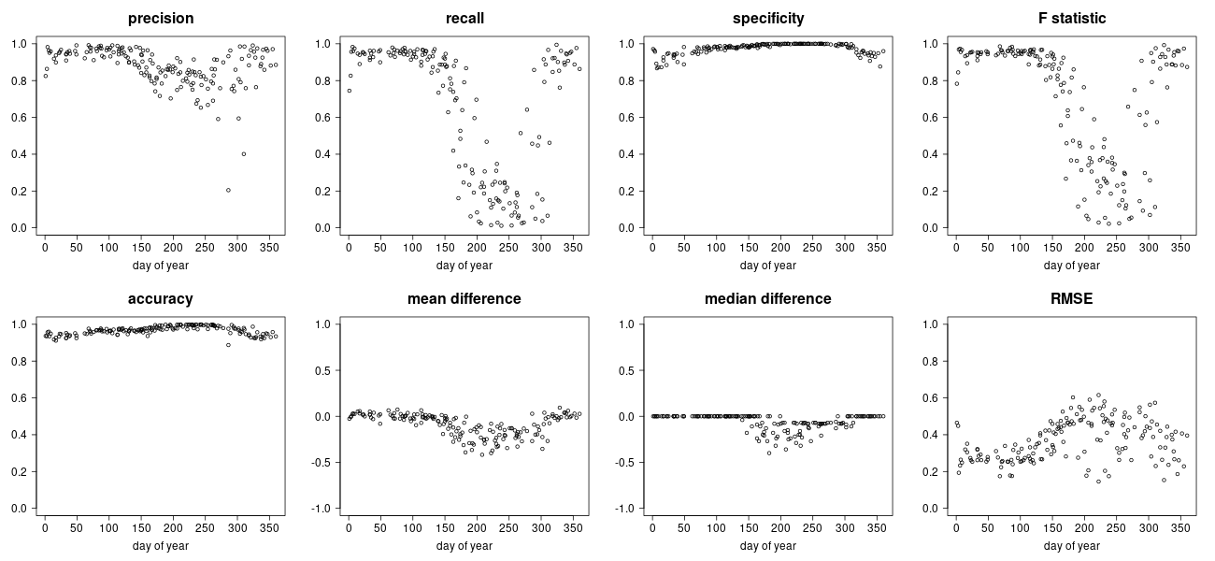
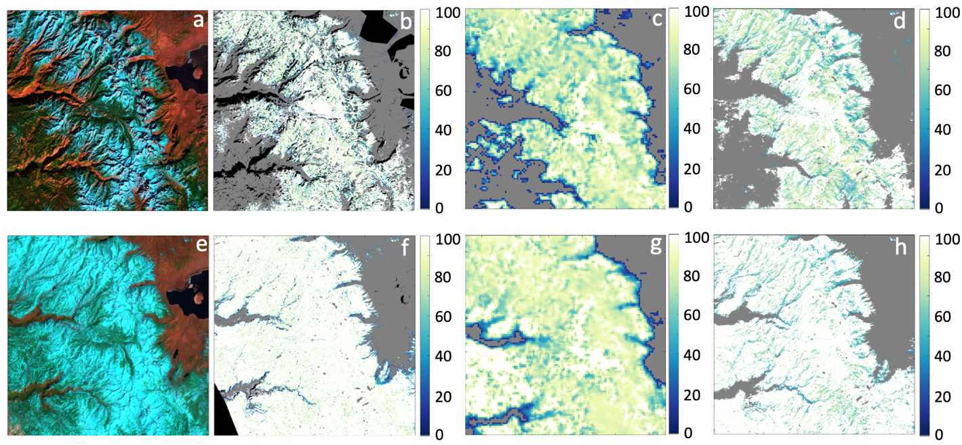
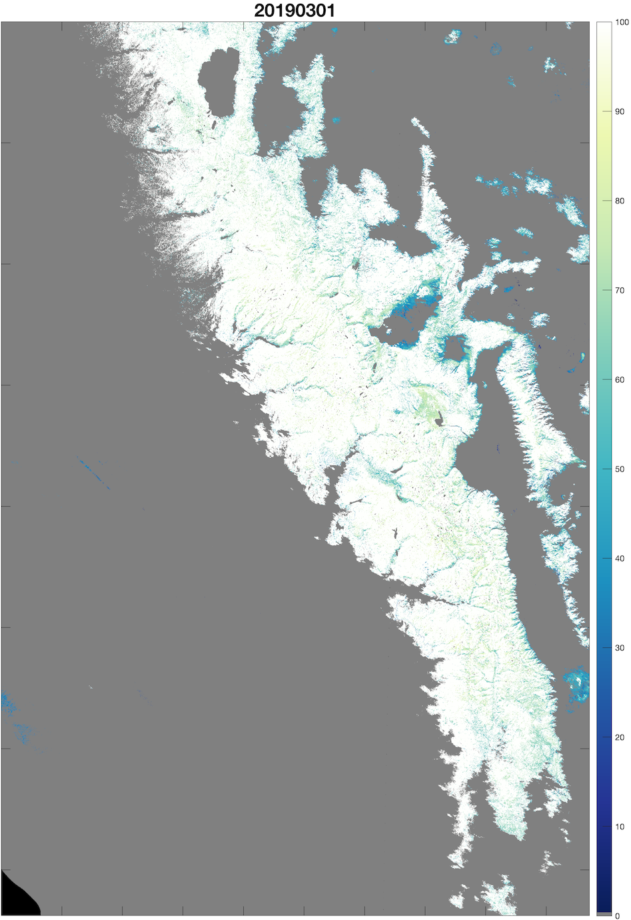
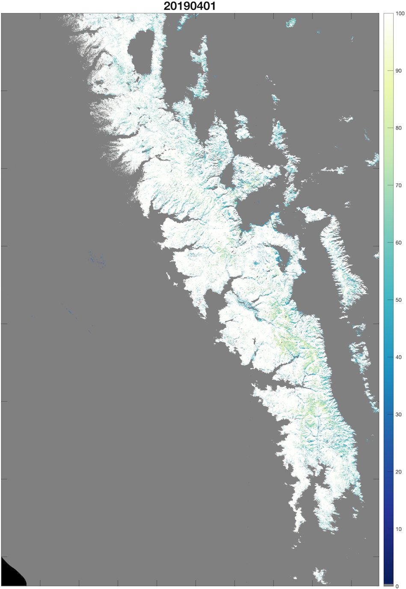
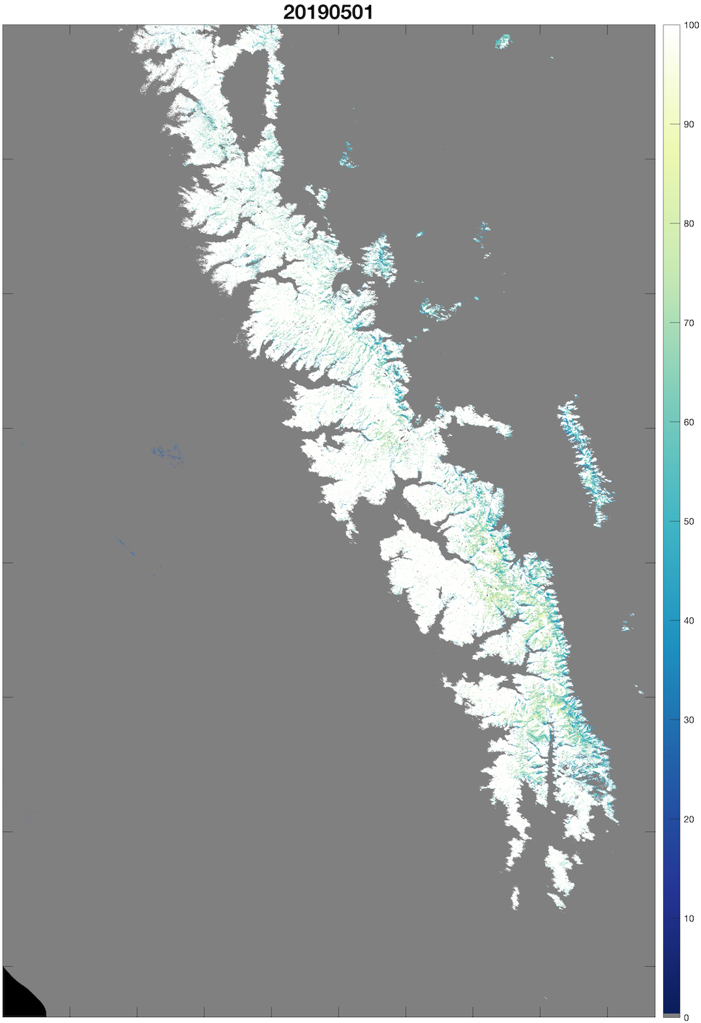
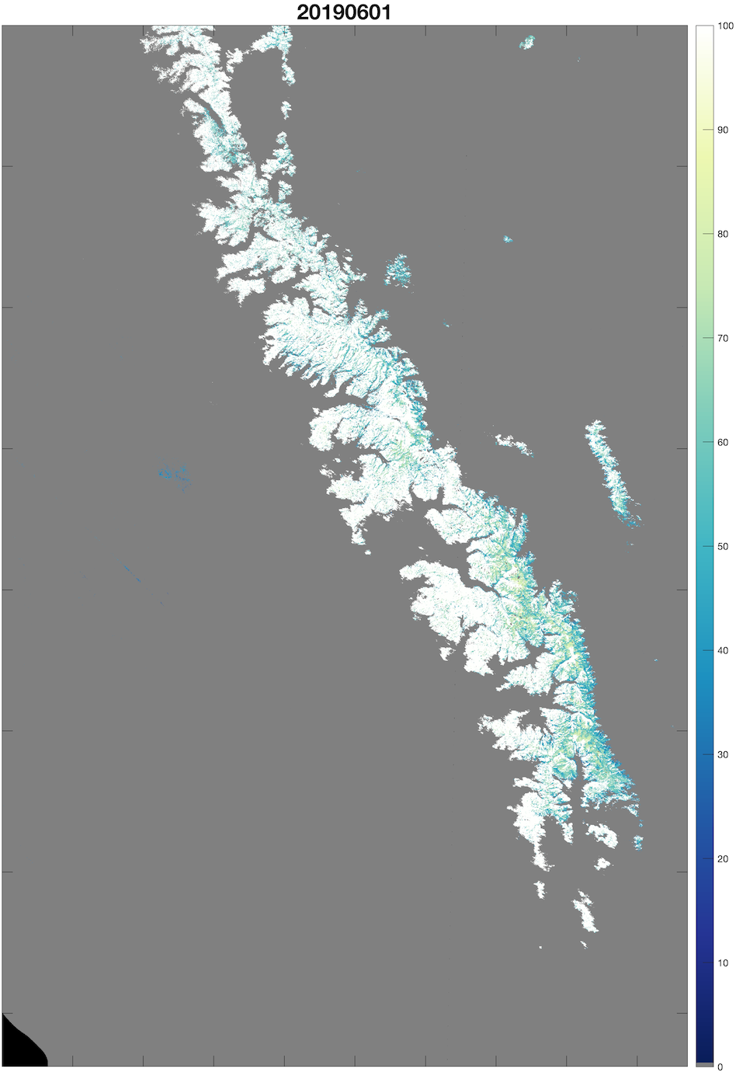
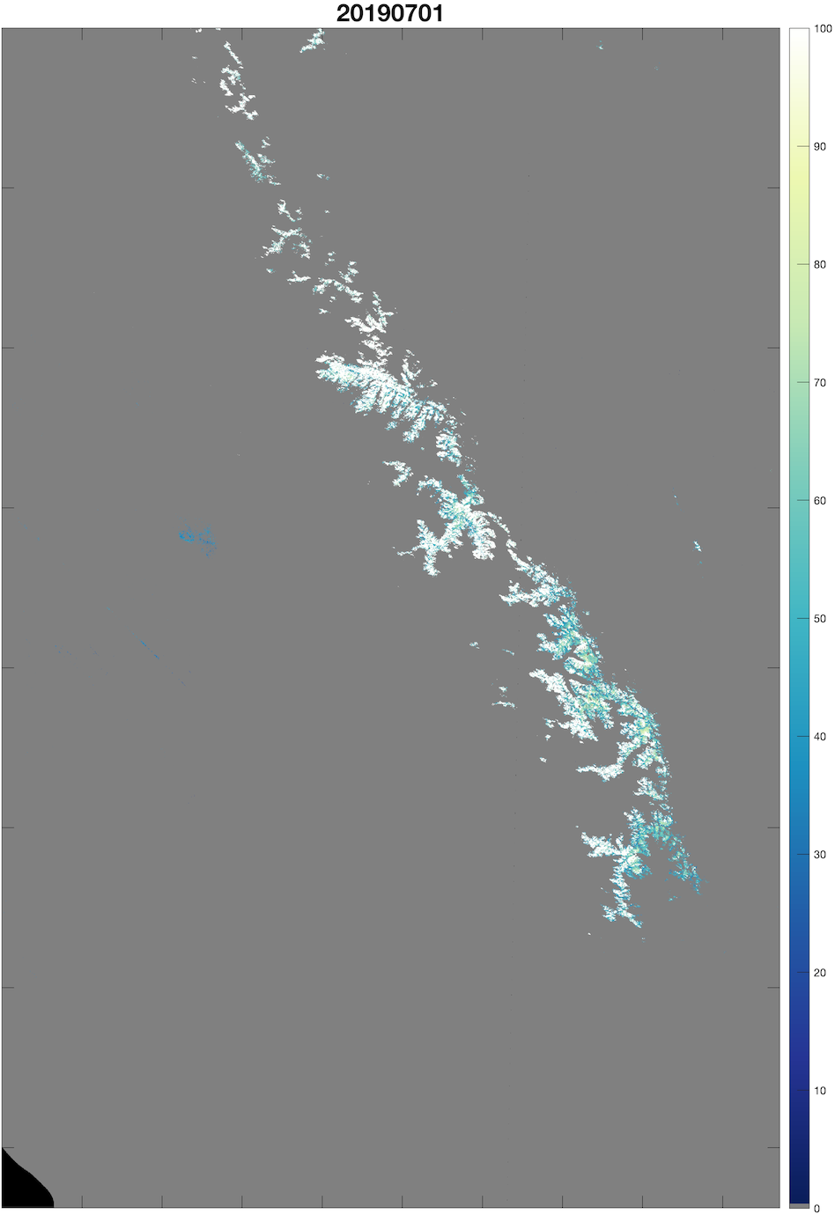
Fusion of Landsat and MODIS for daily 30 m snow surface properties
Karl Rittger¹, Mitchell Krock¹, William Kleiber¹, Edward Bair², Mary J. Brodzik¹, Tom Stephenson³, Balaji Rajagopalan¹, Kat J. Bormann⁴, Thomas H. Painter⁵
¹University of Colorado, Boulder, ²University of California, Santa Barbara ³California Department of Fish and Wildlife, 4Airborne Snow Observatory Inc., ⁵University of California, Los Angeles
1. Study area and methods
3. Results
4. Accuracy relative to Landsat 30 m
Two stage random forest
Separately fits a classification and regression random forest on training data and combines them during the prediction step
First stage represents a classification step that predicts: 0%, 1% to 99%, 100%
For 1% to 99%, we use a second random forest
Completely randomized design for selecting training data points
Validation with > 95% of existing observations from Landsat
Random forests with 100 trees, and allow for splits over three variables at each node
Using more trees (e.g. the default value 500) produced slightly better prediction scores at the cost of substantially increased computation time and memory
Figure 3: Downscaling uncertainty for February 16, 2008. The top row contains (a) MODIS fSCA at 500 m, (b) the spatially downscaled MODIS fSCA at 30 m and (c) Landsat fSCA for this day. The bottom row contains probabilities of (d) 0% fSCA, (e) a value between (0,100)% fSCA and (f) 100% fSCA, respectively.
MODIS fSCA
Downscaled
prediction
Landsat fSCA
Figure 6: Validation metrics for the downscaled predictor versus validating Landsat image, plotted by the corresponding day of year. Note that between DOY ~150 and 300 there is very little snow in California (Figure 1)
Probability of
0% fSCA
Probability of
1 to 99% fSCA
Probability of
100% fSCA
Table 1: Validation metrics for random forest predictions as functions of training sample size (columns)
Samples | 5e4 | 1e5 | 2e5 | 3e5
Precision | 0.932 | 0.935 | 0.939 | 0.941
Recall | 0.887 | 0.893 | 0.898 | 0.901
Specificity | 0.980 | 0.985 | 0.985 | 0.986
F score | 0.909 | 0.913 | 0.918 | 0.921
Accuracy | 0.965 | 0.966 | 0.968 | 0.969
Mean difference | 0.003 | 0.003 | 0.004 | 0.004
RMSE | 0.340 | 0.330 | 0.320 | 0.314
Compute time | 1.2 hr | 6 hr | 22.8 hr | 40.5 hr
Table 2: Validation metrics for random forest predictions as split by season
 | DJF | MAM | JJA | SON
Precision | 0.94 | 0.93 | 0.94 | 0.95
Recall | 0.90 | 0.88 | 0.91 | 0.91
Specificity | 0.99 | 0.99 | 0.98 | 0.99
F score | 0.92 | 0.91 | 0.92 | 0.93
Accuracy | 0.97 | 0.97 | 0.96 | 0.98
Mean difference | 0.01 | 0.00 | 0.01 | 0.00
RMSE | 0.32 | 0.33 | 0.32 | 0.29
Figure 1: Study extent in the California Sierra Nevada. HUC8 basins from the North Fork of the American River basin to the South Fork of the Kern River basin are shown in green.
false color RGB
Landsat fSCA
MODIS fSCA
Downscaled prediction
2. Variable importance
For the classification forest 1st stage
(based on the Gini index)
Figure 2: Variable importance for the classification forest based on the Gini index (top) and for the regression forest based on variance reduction (bottom). Values on the left plot are scaled by 1e6 and values on the right plot are scaled by 1e8
Note: statistics in these tables are calculated using the pixel weighted values in contrast to Figure 6 which shows statistics by image
Figure 4: For December 8, 2002 (top) and April 23, 2003 (bottom), false color RGB which shows snow as cyan, rock and soil as red, forest as green and water as black (a & e), fractional snow cover from Landsat (b & f), fractional snow cover from MODIS (c and g), and fused snow cover at 30m (d and h).
5. Conclusion and way forward
We used scale invariant two stage random forest model along with fractional snow cover estimates from spectral mixture analyses to create daily snow cover maps at 30 m. Validation metrics show that with adequate sampling over time and space we can combine infrequent snow mapping from 30 m data with daily data at 500 m to produce accurate daily maps of snow at 30 m resolution. Alternative validation data such as airborne data or high-resolution commercial observations will be useful for continuing validation in a range of topography including shadowed and forested areas. Snow cover under tree canopy continues to be a challenging area to both estimate and validate snow on the ground, but LIDAR and buried temperature sensor networks could continue to improve our understanding of snow in the forests. Moving forward, observations from the VIIRS instruments on Suomi NPP and Joint Polar Satellite System (JPSS-1 and JPSS-2) will be instrumental in extending the current record of fractional snow cover from the MODIS instrument and Landsat 8 can provide a more complete set of training data with no saturation. Spectral mixture analyses and spectral differencing methods provide other snow surface properties such as snow grain size, snow albedo, and the impact of light absorbing impurities to which these fusion methods may be applied further extending our understanding of the temporal spatial distribution of snow. These satellite observations can be used to improve our SWE and streamflow forecasting efforts.
For the regression forest
2nd stage
(based on variance reduction)
Figure 5: 30 m fractional snow cover on the first of March, April, May, June, and July in 2019

