Slide 1
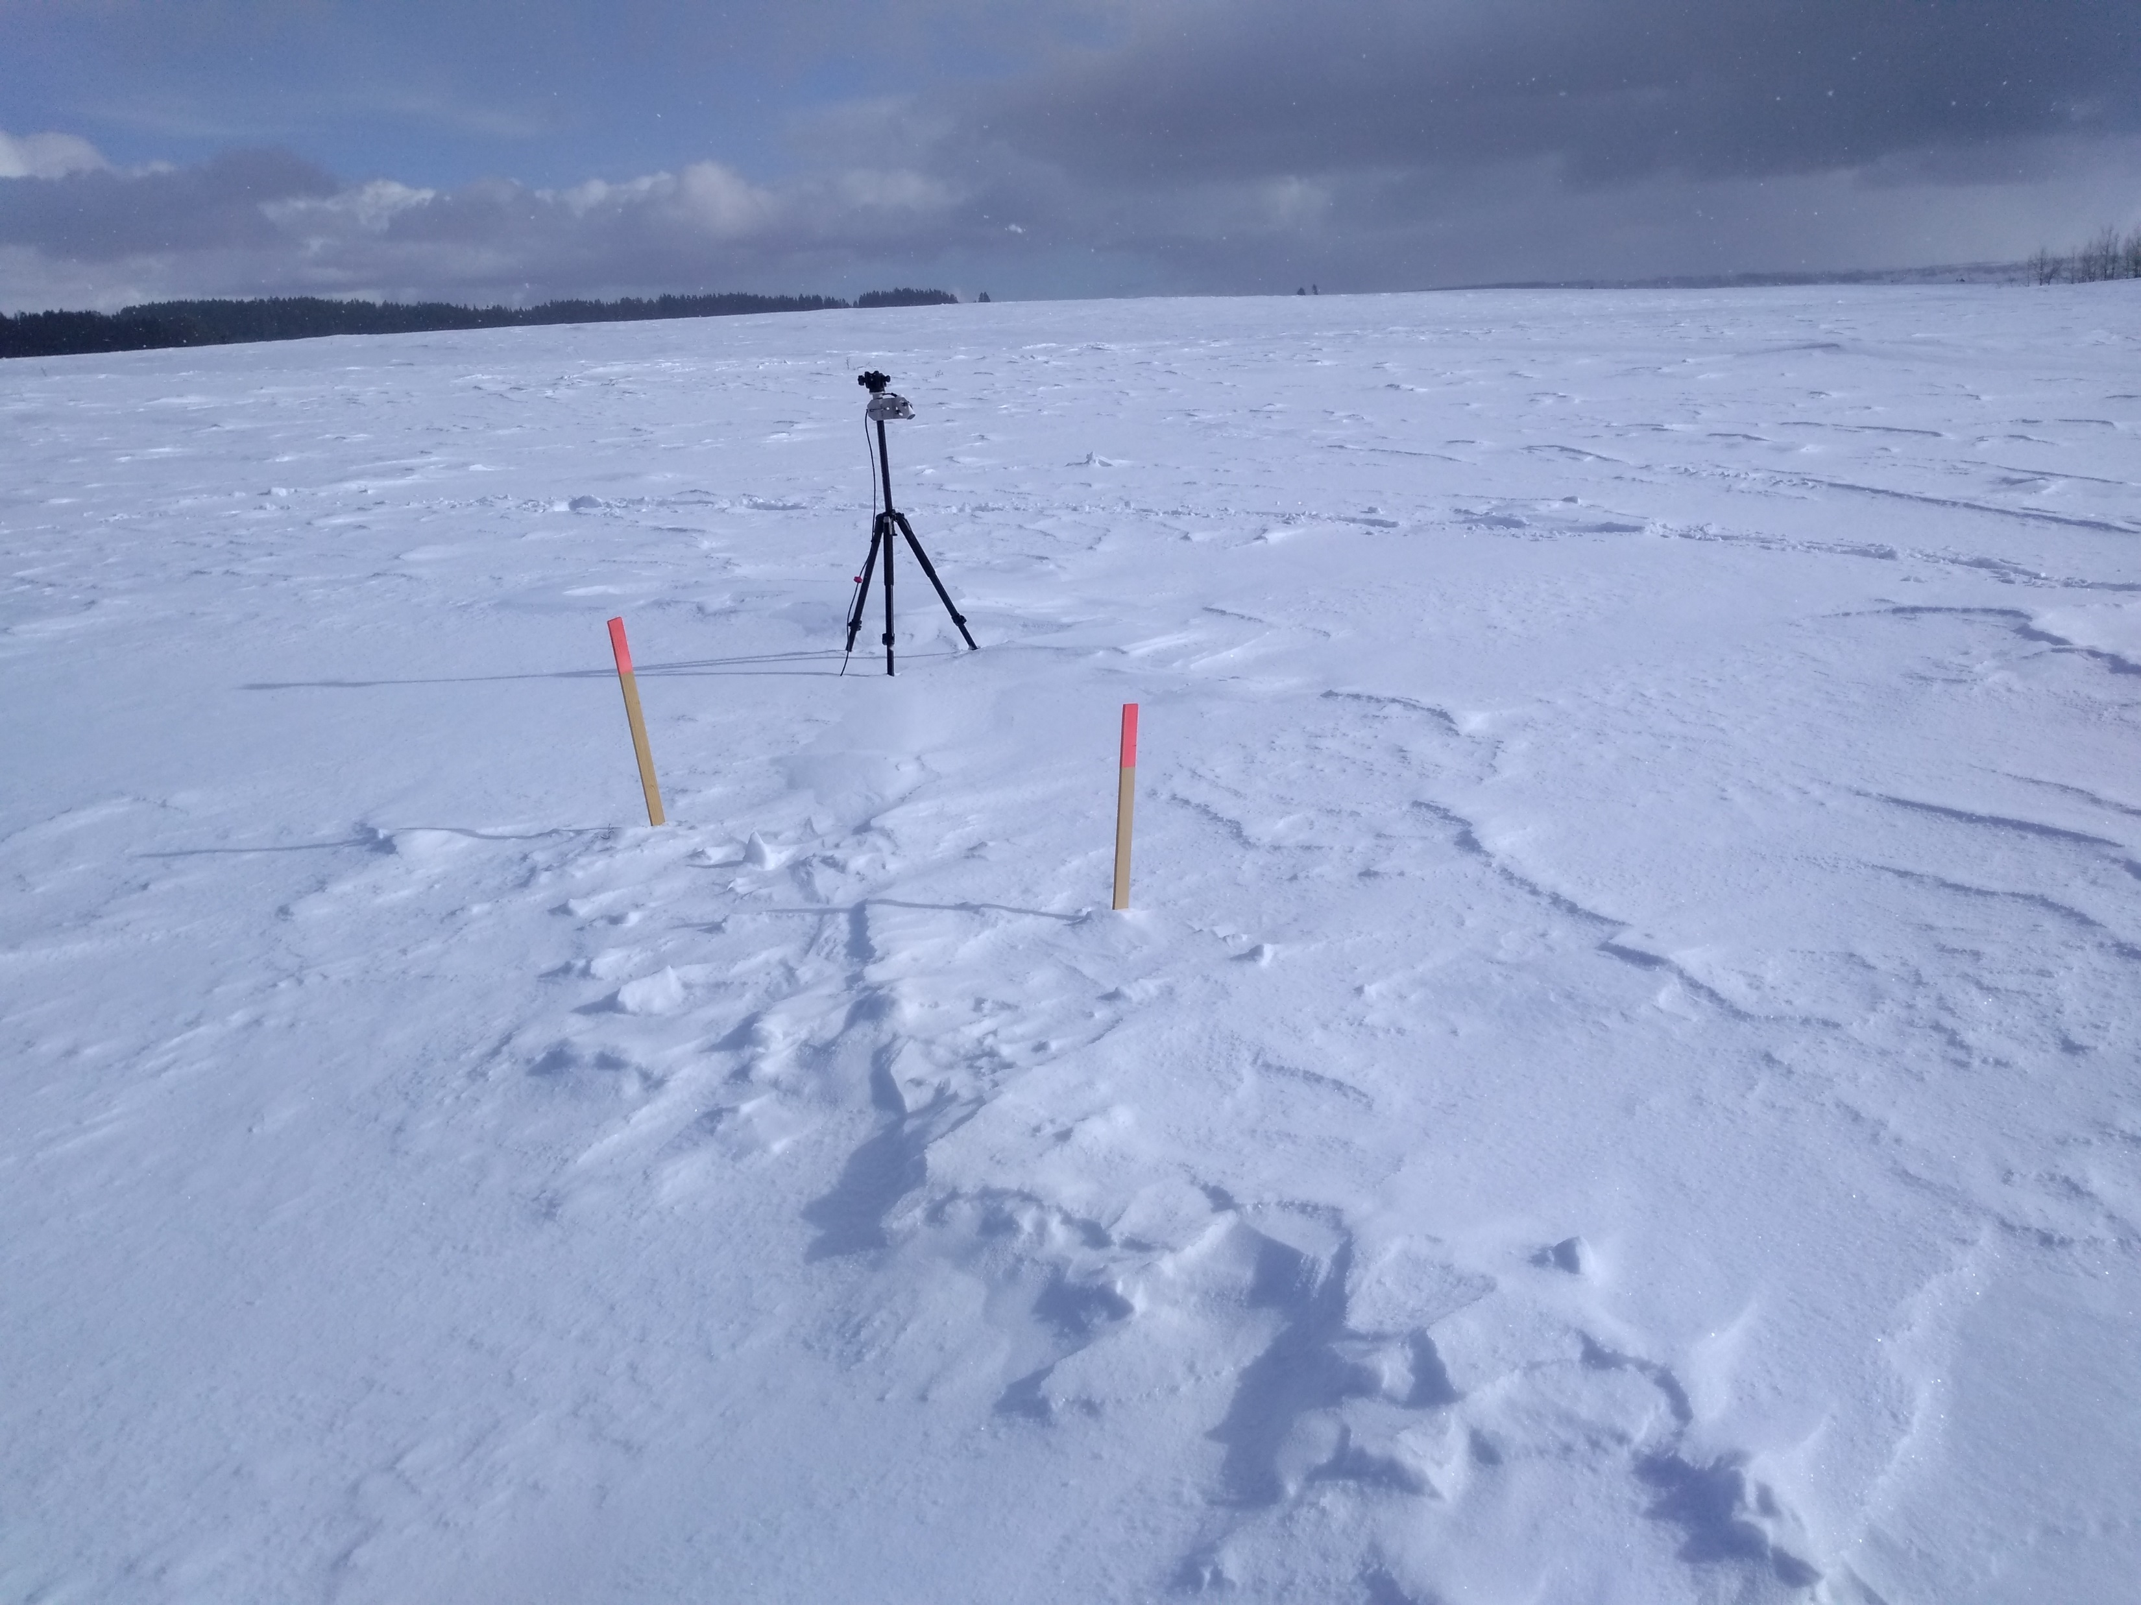
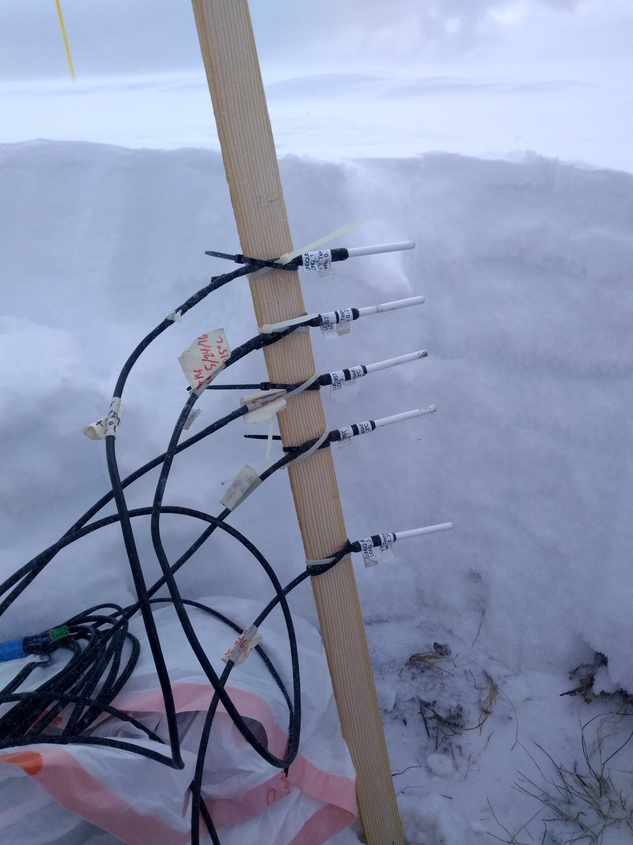
Snow Temperature Measurements
During the SnowEx2020 Grand Mesa IOP
(Left) ASTER 90 m spatial resolution, and (right) ECOSTRESS 70 m thermal infrared observations coincided with airborne IR collections on cloud-free days. Evaluating GOES ABI against these imagers could allow this analysis to be transferred to other study areas.
ECOSTRESS Feb 11
ECOSTRESS Feb 11
ASTER Feb 8
Steven Pestana¹, Jessica Lundquist¹, Chris Chickadel^{1,2}
To evaluate snow surface temperature observations of Grand Mesa from the GOES-16 and -17 Advanced Baseline Imagers (ABI), ground-based snow temperature measurements were recorded during the SnowEx 2020 Grand Mesa IOP. Coincident higher resolution satellite and airborne infrared imagery was collected to provide context for the spatial variations of surface temperatures across the study area.
Temperature [°C]
Feb 8
Feb 10
Feb 11
Feb 12
Radiometer
5 cm
10 cm
15 cm
Temperature [°C]
20 cm
Datalogger
Location
Snow Temp. Sensors (buried)
30 cm
Filled-in snow pit
(Left) At snow pit 2S10, an infrared radiometer and buried temperature sensors were installed to measure snow temperatures at and beneath the surface. (Above) Airborne IR mosaics from the four days of flights provide high spatial resolution (~5m) surface temperature maps of Grand Mesa.
^{1.} Civil and Environmental Engineering, UW; ^{2.} Applied Physics Lab, UW

