Slide 1
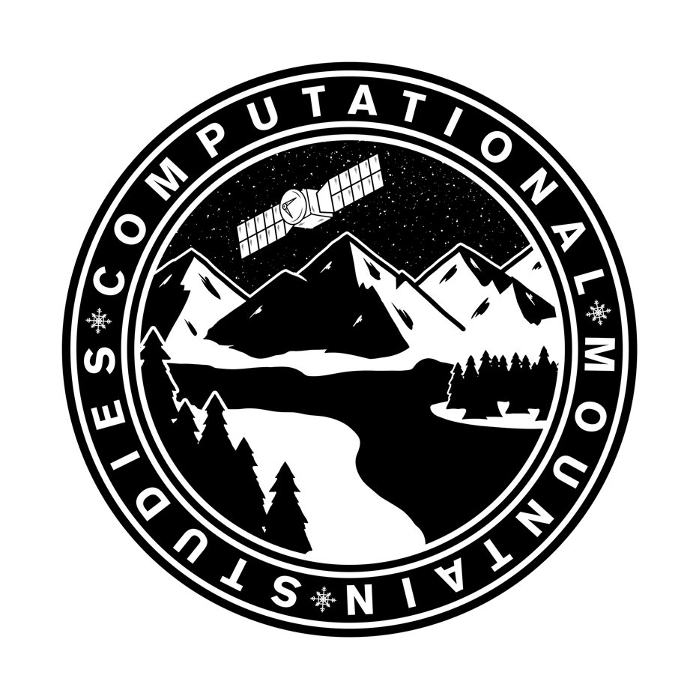
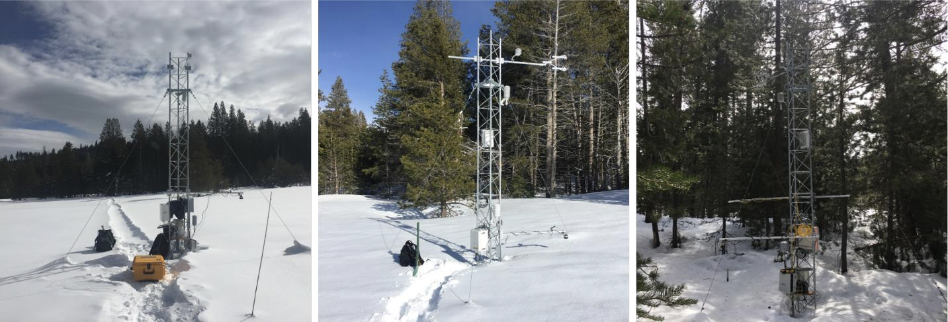
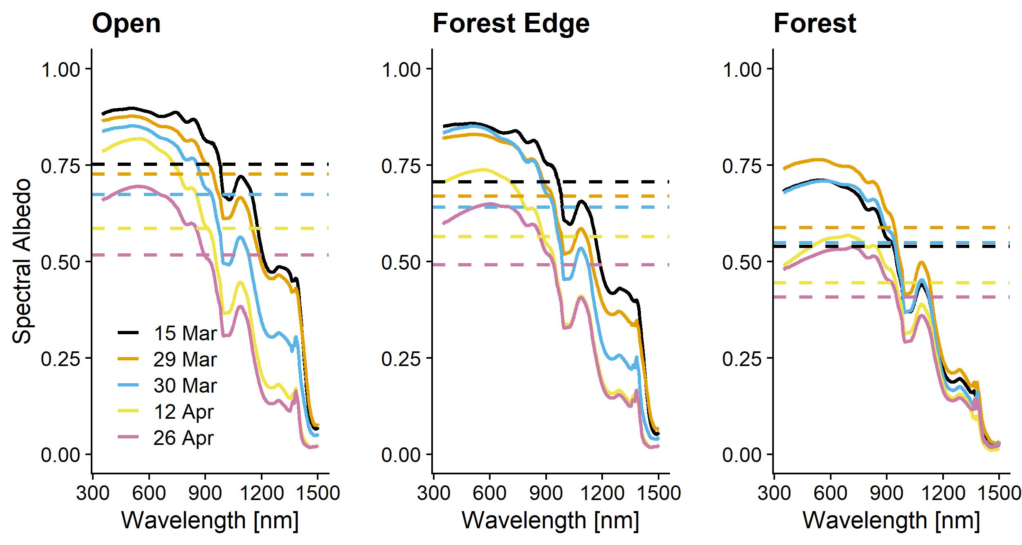
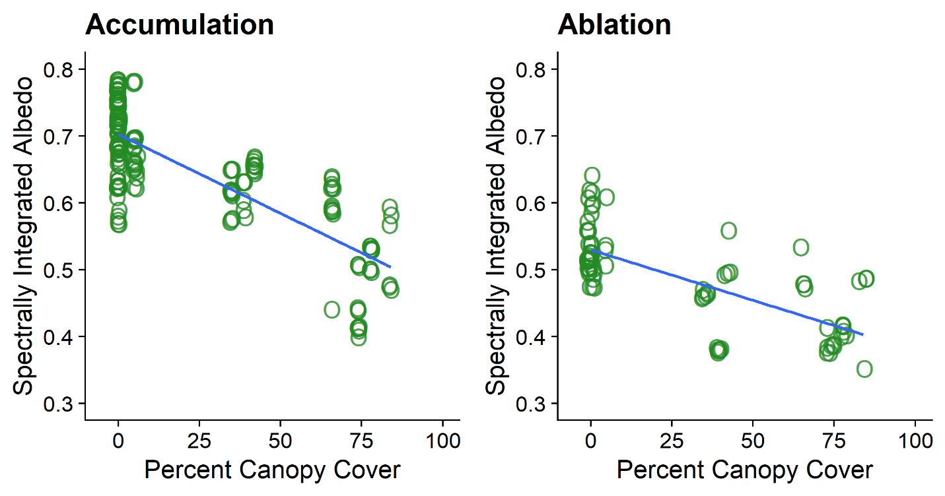
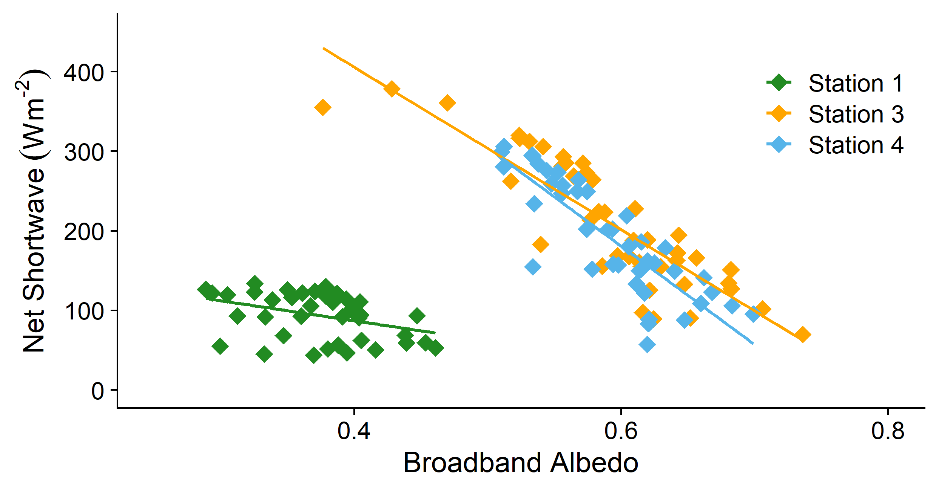
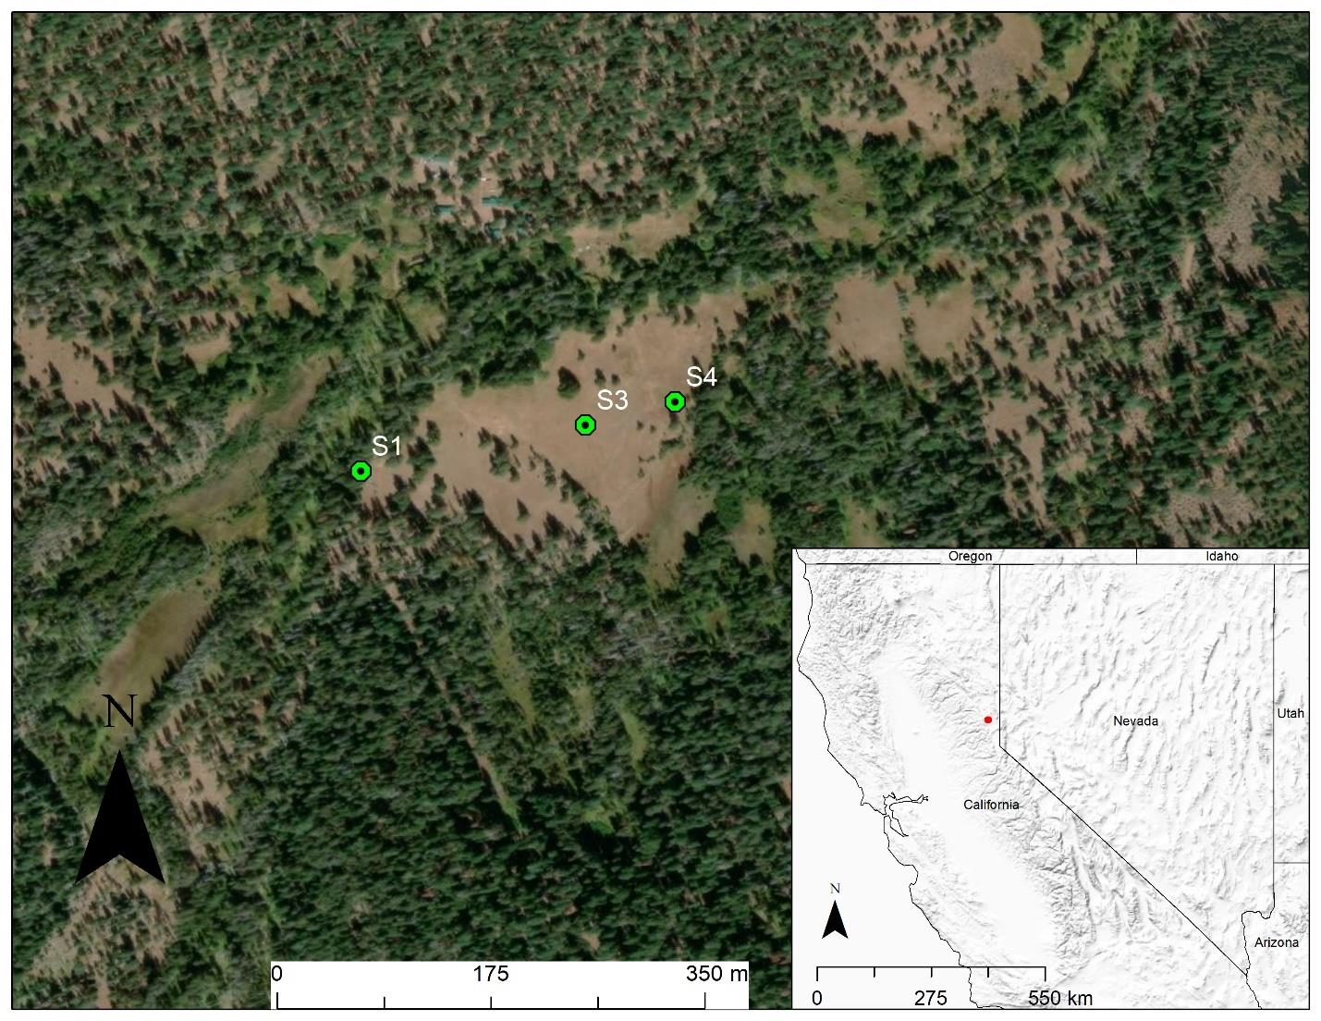
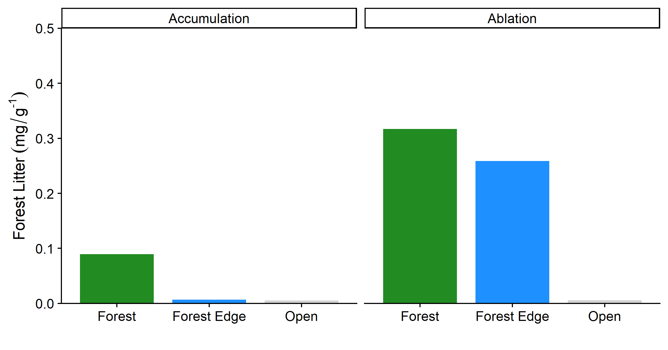
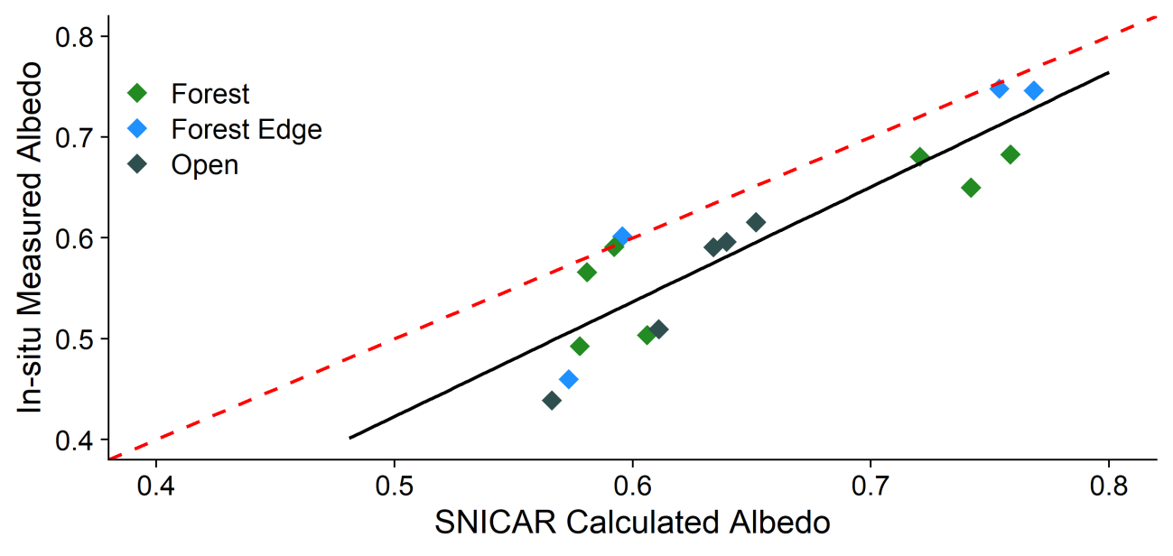
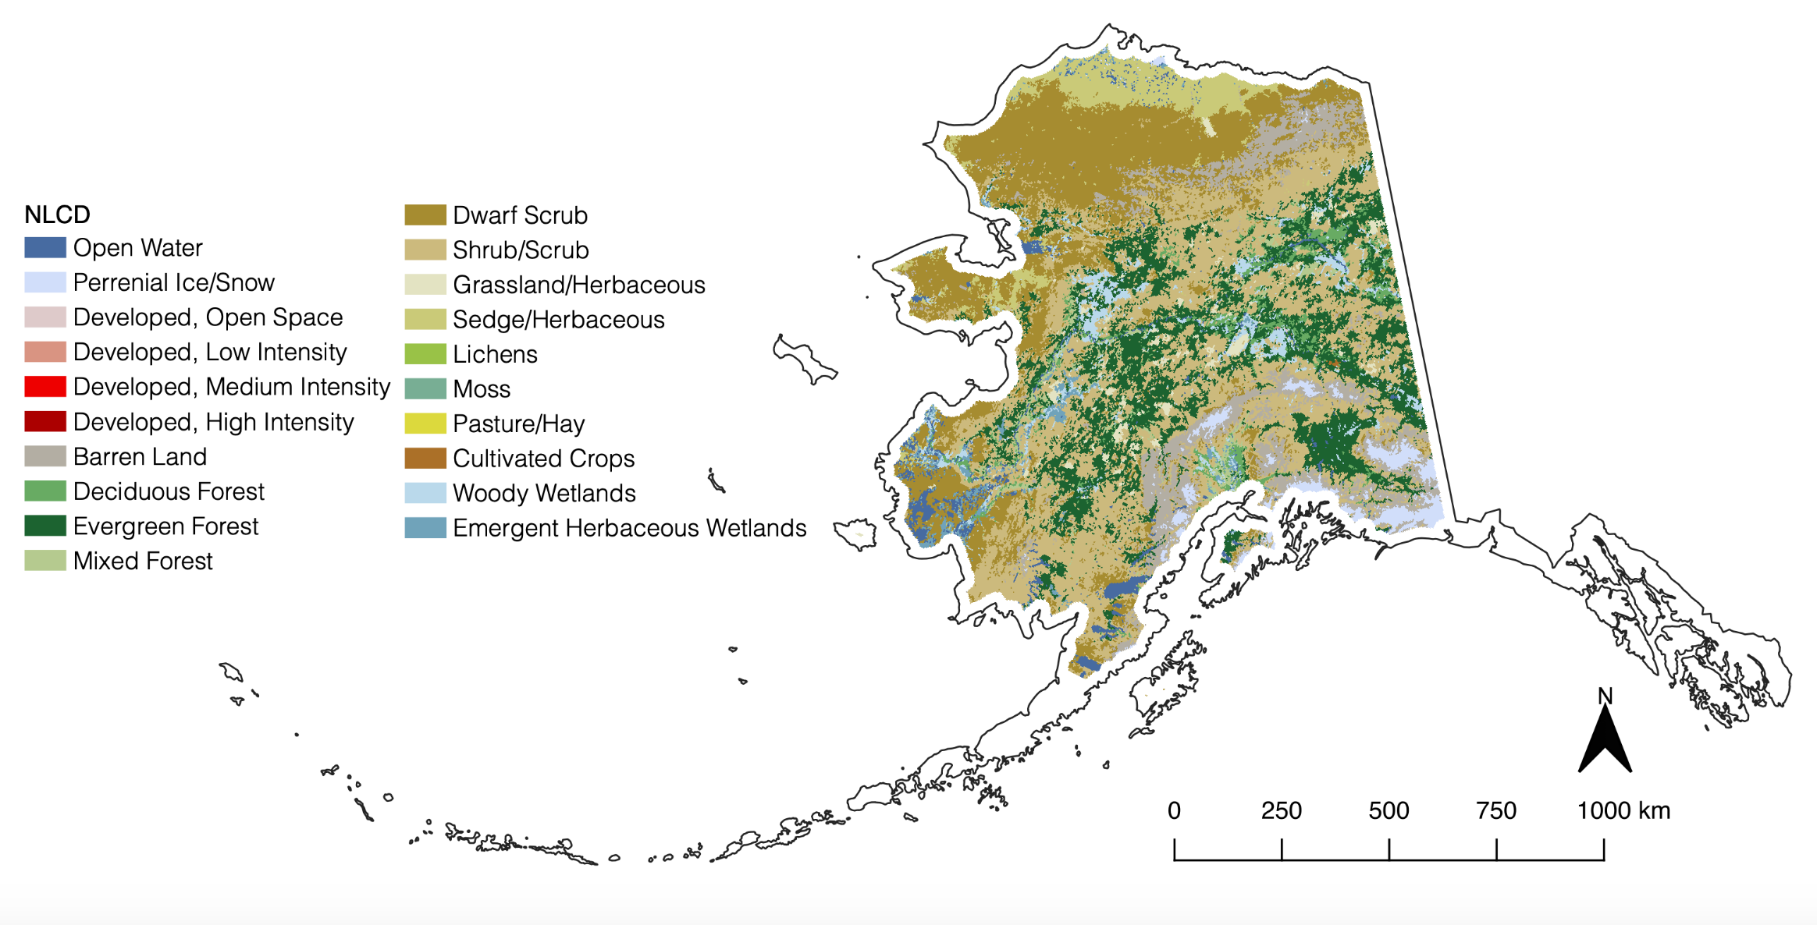
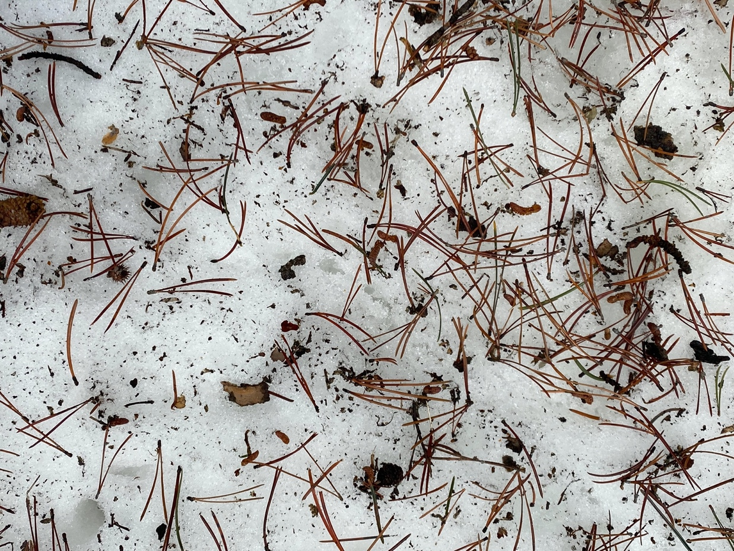
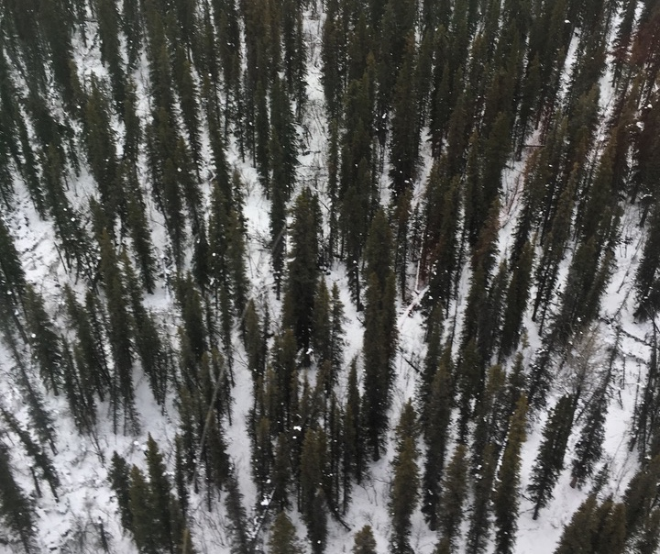
Introduction: Snow albedo thought to be a primary control on timing and rate of snowmelt in mountain watersheds. But is this the case in snow forests?? In snowy forests, there are few measurements of snow albedo and we lack an understanding of how albedo changes across forest density gradients and over the snow season. Satellite-based albedo measurements have high uncertainties even under the best of conditions. We present recent results of a field experiment and consider future needs for snow albedo research in forested regions.
Objectives:
Quantify the spatial and temporal variability of snow albedo across a forest density gradient and as a function of forest litter;
Quantify the contribution of snow albedo and net shortwave radiation to the snowpack energy balance for forest, edge, and open;
Consider uncertainties, future directions for boreal forest snow albedo.
Study Site:
Sagehen Creek Field Station and USFS Experimental Watershed:
Located in the California Sierra Nevada at an elevation of 1940’ Vegetation is temperate coniferous forest and grassy meadows. Annual precipitation is about 85-100 cm, ~80% is snowfall. We installed three meteorological/eddy flux stations span a forest density gradient
Methods:
Transect measurements of spectral snow albedo using a Spectral Evolution RS-3500 spectroradiometer on six dates in winter 2019
Snow samples analyzed for forest litter (vacuum filtration); BC and dust also measured
Concurrent snow depth and SWE transects
Continuous energy balance, eddy flux measurements at stations
1-m airborne lidar data to estimate percent canopy cover
Snow grain size using Nolin & Dozier (2000) inversion method
SNICAR used to model albedo
Forest Litter Reduces Snow Albedo in Forests but Solar Irradiance is Also Important
Anne Nolin¹, Alexander Greenwald¹, Keith Jennings²
¹University of Nevada, Reno; ²Lynker Technologies, Inc.
Key Findings:
Forest litter reduces snow albedo about 22% compared with open areas. Litter becomes concentrated during that ablation period.
Snow albedo in forests has high variability and uncertainties; but because subcanopy solar irradiance is low snow energy balance is less sensitive to albedo.
For snowy forests, we still don’t know the accuracy requirements, the spatial and temporal uncertainties, and measurement scales needed for satellite-based albedo measurements.
Spectrally snow albedo decreases with from open to forest sites and over time. Horizontal lines are spectrally-integrated albedo values.
Spectrally-integrated snow albedo decreases with increased forest density. The effect is strongest in the accumulation period though still strong during ablation.
Net SW radiation is strongly a function of snow albedo in the open (S3) and forest edge (S4) sites but is only weakly related to albedo in the forest (S1).
Measured forest litter from snow samples during accumulation and ablation periods. Open sites have very low litter concentrations while the dense forest has high concentrations especially in the ablation period when it concentrates on the snowpack surface.
The SNICAR radiative transfer model is not able to accurately model snow albedo for the case forest litter.
What is needed is a modified version of the model that accounts for larger size and spectral characteristics of forest litter.
The boreal forest (above) is the largest terrestrial ecosystem on the planet. It has high spatial variability, dramatic wildfire disturbance, and rapidly declining snowpacks. We plan to characterize albedo variability and uncertainties in SnowEx 2022.

