Slide 1
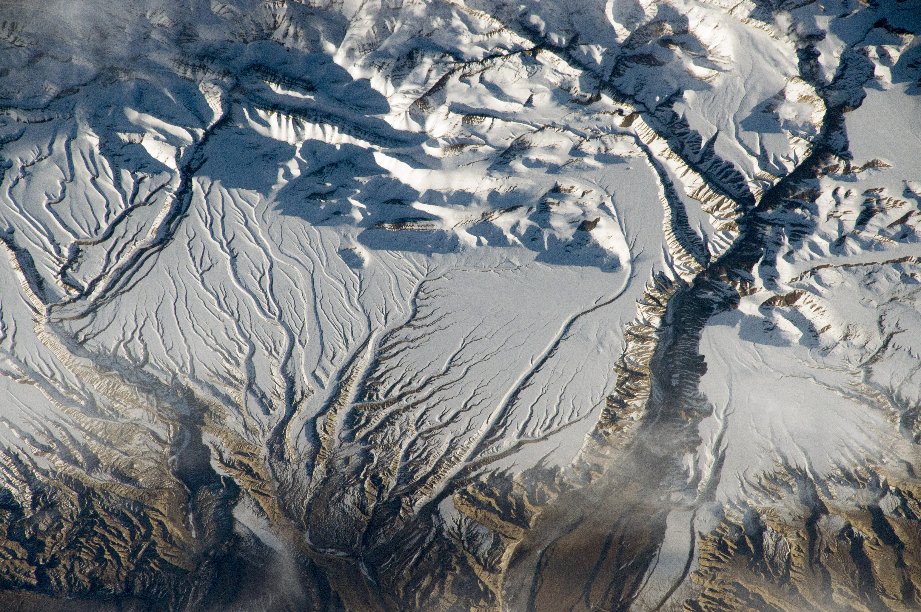
Data Delivery update
Megan Mason
meganmason491@boisestate.edu
SnowEx Fall Planning Meeting – September 11 & 14, 2020
Notes:
Hello, I am Megan Mason. I am working as the Data Management Liaison between the dataset PI’s and the National Snow and Ice Data Center (NSIDC).
Before our scheduled break, I will present you a data delivery update.

Slide 2
Outline
Data Access Tools
SnowEx 2017 Datasets
SnowEx 2020 Datasets
Data Submission Information
Megan Mason
meganmason491@boisestate.edu
Notes:
The presentation includes: Data access tools, SnowEx 2017 datasets – recently published and outstanding datasets, the progress on 2020 datasets both for Grand Mesa and the Time Series, and Data set submission instructions.

Slide 3
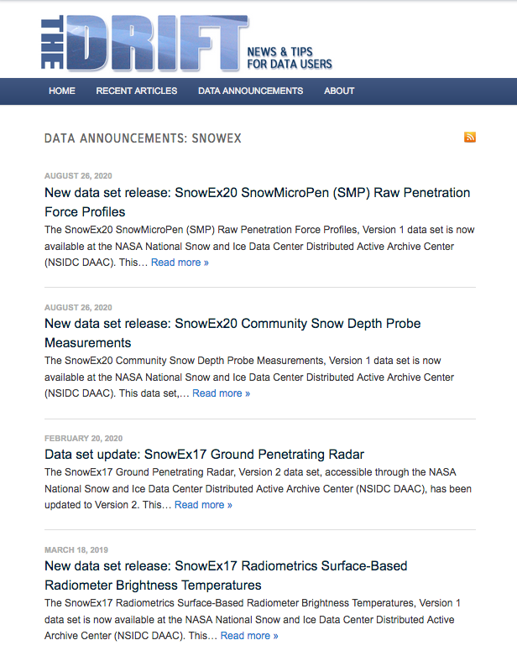
NSIDC SnowEx Data Announcements Page
https://nsidc.org/the-drift/data-set/snowex/
Release date
Google: NSIDC SnowEx Drift
Data set title
Reverse chronological
Data set DOI
Notes:
If you want to stay up today date with publications you can find them in reverse chronological order if you read The Drift.
(click)
Here you can see the data set release date, data set title, and get the DOI. The link is above, but also a keywork search of: NSIDC SnowEx Drift will get you there.

Slide 4
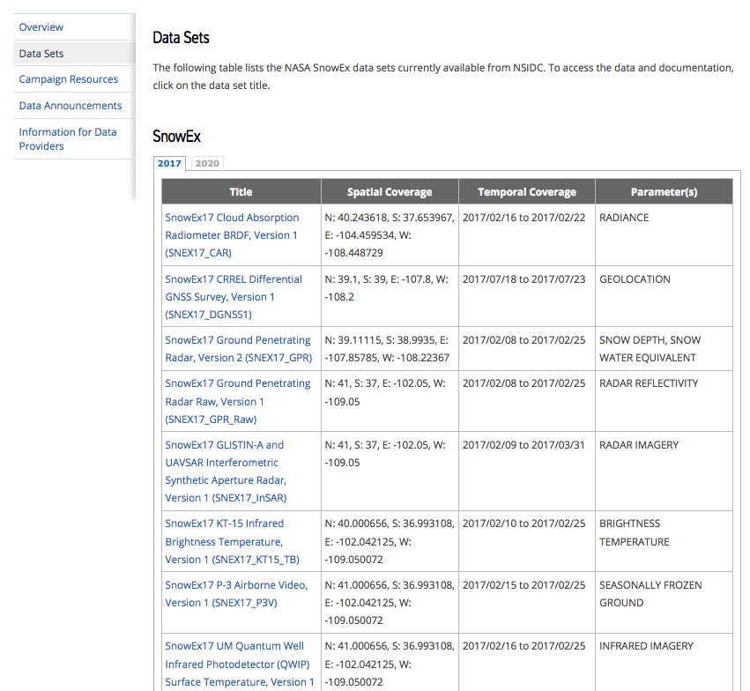
NSIDC SnowEx Data sets Page
https://nsidc.org/data/snowex/data_summaries
Tab by year
Google: NSIDC SnowEx data sets
Notes:
The second data access tool is to visit the NSIDC Data Sets page.
All published data sets are listed here.
(click)
You can tab by the year (2017, 2020). Again, the keyword search here is: NSIDC SnowEx data sets
Currently there are 21 data sets published for 2017, and 2 for 2020. That wraps up data access.

Slide 5
2017 Data Updates
New releases since 2019 Fall Meeting
SnowEx17 Radiometrics Surface-Based Radiometer Brightness Temperatures
SnowEx17 CRREL Terrestrial Laser Scanner (TLS) Point Cloud
SnowEx17 Boise State University Raw Terrestrial Laser Scanner (TLS) Point Cloud
SnowEx17 Boise State University Terrestrial Laser Scanner (TLS) Point Cloud
Data set updates
SnowEx17 Ground Penetrating Radar
Data set products published with NSIDC
14
7
Notes:
Draw your attention to the newest data releases since our fall meeting time last year:
1 – Brightness Temperatures from four surface-based radiometers @ 89, 37, 19, and 11 GHz
And three TLS datasets:
2 – TLS point cloud from CRREL
3 – TLS point cloud from Boise State, raw
4 – TLS point cloud Boise state
One data set was updated since then: GPR that followed the manual snow depth transects.
PLOT

Slide 6
SnowEx’17 Airborne Data Status
Instrument name (Airborne) | Primary data product(s) | Product Name
Cloud Absorption Radiometer (CAR) | Spectral BRDF, albedo, imagery | SNEX17_CAR
CASI-1500 Hyperspectral VNIR Imager (ASO hyperspectral imager) | irradiance, radiative forcing, snow albedo, snow grain size, snow-covered area (SCA), land surface classification | Data set outstanding/status unknown
Riegl LMS-Q1560 (ASO lidar) | surface elevation, snow depth, change in snow depth, snow water equivalent (SWE), snow density | ASO_3M_SD, ASO_50M_SD, ASO_50M_SWE
Riegl LMS-Q1560 (ASO lidar) | Lidar waveforms | Processing in progress by BSU/GSFC
PhaseOne iXU 180-R50 (ASO camera) | visible imagery | Data set outstanding/status unknown
QWIP camera | P3 thermal IR imagery | SNEX17_QWIP_ST
KT-15 | P3 thermal IR brightness temperature | SNEX17_KT15_TB
P-3 video camera | P3 video imagery | SNEX17_P3V
UAVSAR (L-band SAR) | Quad Pol Backscatter, Single Look Complex Stacks | SNEX17_InSAR Available at JPL UAVSAR site
GLISTIN-A (Ka band SAR) | Backscatter, Topographic Height | SNEX17_InSAR Available at JPL UAVSAR site
SnowSAR | X/Ku backscatter, SAR imagery | SNEX17_SnowSAR, SNEX17_SnowSAR_Raw
WISM radiometer (passive microwave) | brightness temperature | SNEX17_WRP
Please send updates/corrections to ed.kim@nasa.gov

Slide 7
SnowEx’17 Field Data Status
Instrument name (Field) | Primary data product(s) | Product Name
IceCube, IRIS | relectance, grain size, Specific Surface Area | SNEX17_SSA
DGNSS | precision locations of pits/transects/TLS | SNEX17_DGNSS1
Snow MicroPenetrometer (SMP) | force profiles | SNEX17_SMP
Snow MicroPenetrometer (SMP) | force profiles, Senator Beck basin | SNEX17_SMP2
Manual snow depth probe (transects) | Community Snow depth Measurements | SNEX17_SD
Community Snow Pit Measurements | Profiles of density, temperature, grain size, stratigraphy; photos | SNEX17_SnowPits
Meteorological stations (4x SnowEx) | met & surface energy balance | Data set outstanding/status unknown
Meteorological stations (1x GMSP) | met & surface energy balance | available from J. Deems
Manual soil moisture | Gravimetric soil moisture, soil density, surface roughness, veg biomass | Processing in progress at GSFC
Please send updates/corrections to ed.kim@nasa.gov

Slide 8
SnowEx’17 GBRS Data Status
Instrument name (GBRS) | Primary data product(s) | Product Name
UW-Scat (X/Ku radar) | quad-pol backscatter, Mueller Matrices. | SNEX17_UWScat
6-18GHz & 25 GHz FMCW | FMCW radar profiles | SNEX17_GBB_FMCW
Ground Penetrating Radar | Ground Penetrating Radar | SNEX17_GPR, SNEX17_GPR_Raw
Radiometrics (passive microwave) | Brightness temperatures | SNEX17_SBR
Riegl VZ-4000; Riegl VZ-6000; Riegl VZ-400 (TLS) | surface elevation, vegetation elevation, vegetation structure, snow depth | Data set outstanding/ status unknown
Riegl VZ-1000 (TLS) | surface elevation, vegetation elevation, vegetation structure, snow depth | SNEX17_TLS_PC_BSU
Leica ScanStation C10 (TLS) | surface elevation, vegetation elevation, vegetation structure, snow depth | SNEX_TLS_PC_CRREL
Judd snow depth sensor | 15 min sonic snow depth | SNEX17_SSD
Wingscapes TimelapseCam | RGB images | NSIDC submission, PI needs to transfer data
Additional datasets anticipated
Please send updates/corrections to ed.kim@nasa.gov

Slide 9
2020 Grand Mesa Data Sets
Data processing
Submitted
In review
Published
6
5
Ground-based
Airborne
GIS
4
# of Expected Data Sets
3
2
1
0
Core
Radar*
Lidar
Met
Lidar
Radiometer
UAVSAR
SWESARR
Thermal IR
Micro-structure
Spectrometer
Spectrometer
FMCW Radar
NOHRSC Gamma
Data package
2020 Grand Mesa Data Sets
* Multiple data level products per data set.

Slide 10
2020 Grand Mesa Data Set Status
Published
SnowEx20 Community Snow Depth Probe Measurements, Chris Hiemstra
SnowEx20 SnowMicroPen (SMP) Raw Penetration Force Profiles, Megan Mason
In Review
(UPDATE to) SnowEx17 CRREL Terrestrial Laser Scanner (TLS) Point Cloud (SNEX17_TLS_PC_CRREL), Arthur Gelvin
SnowEx20 Grand Mesa IOP BSU 1 GHz Multi-polarization GPR Raw (SNEX20_BSU_GPR_Raw), Tate Meehan
NSIDC Queue
SnowEx20 Grand Mesa Intensive Observation Period Snow Pit Measurements (SNEX20_GM_SP), Carrie Vuyovich
SnowEx20 Laser Snow Microstructure Specific Surface Area Data (SNEX20_SSA), Michael Durand
SnowEx20 Temporary Soil Moisture Stations, Michael Cosh
SnowEx20 COSMOS Stationary Soil Moisture (SNEX20_CSSM), Michael G Lewis
SnowEx20 COSMOS Rover Soil Moisture (SNEX20_CRSM), Michael G Lewis
SnowEx20 Boise State University Terrestrial Laser Scanner (TLS) Point Cloud (SNEX20_TLS_PC_BSU), Ahmad Hojatimalekshad
SnowEx20 Grand Mesa IOP BSU 1 GHz Multi-polarization GPR (SNEX20_BSU_GPR), Tate Meehan
SnowEx20 Grand Mesa IOP BSU Multi-polarization 1 GHz GPR CMP Raw (SNEX20_BSU_CMP_Raw), Tate Meehan
SnowEx20 Grand Mesa IOP BSU 1 GHz Multi-polarization GPR CMP Snow Water Equivalent (SNEX20_BSU_CMP_SWE), Tate Meehan
SnowEx20 Grand Mesa IOP BSU Multi-polarization 1 GHz GPR CMP Travel-Times (SNEX20_BSU_CMP_TT), Tate Meehan
SnowEx20 Snow Temperature Vertical Profile Time Series Raw (SNEX20_VPTS_Raw), Steven Pestana
SnowEx20 Grand Mesa CRREL Leica C-10 TLS Snow-Off and Snow-On Data (SNEX20_TLS_CRREL), Arthur Gelvin
Notes:
the first two published datasets for 2020 are Community Snow Depth Probe Measurements and the Snow Micro Penetrometer data set.
there are currently two data sets in active review at NSIDC:

Slide 11
2020 Grand Mesa Data Set Status Continued…
Submitted to NSIDC
SnowEx 2020 Grand Mesa Fall Gravimetric Soil Moisture, Ludo Brucker
SnowEx 2020 Grand Mesa Fall Snow Water Equivalent, Ludo Brucker
SnowEx 2020 Grand Mesa Fall Snow Pits, Ludo Brucker
SnowEx 2020 Grand Mesa Fall Snow Depth, PI: Ludo Brucker
SnowEx 2020 Grand Mesa SWESARR Brightness Temperature, Ludo Brucker
SnowEx 2020 Grand Mesa GIS Data Package, Chris Hiemstra

Slide 12
Time Series Dataset Types
Core Datasets
snow pits, interval boards, depth transects, federal sampler
Site Infrastructure Datasets
weather/met
tower-based
fixed, long-term instrumentation
high temporal
low spatial
Remote Sensing Datasets
GBRS
airborne
satellite
low-mid temporal
high spatial
Coincident Datasets
ground-based GPR
non-stationary TLS
SLAM
SMP
ASD
others…
low temporal
low-high spatial

Slide 13
2020 Time Series Data Set Submissions
NSIDC Queue
SnowEx20 Senator Beck Basin Transect Ground Surface Temperature (SNEX20_SB_GST), Jeff Derry
SnowEx20_COCP_GPR, Dan McGrath
SnowEx20_COCP_GPR_Raw, Dan McGrath
Time Series Snow Pits
5 states
12 major sites
32 different snow pits (with 5+ repeat snow pits)
250+ time series snow pits

Slide 14
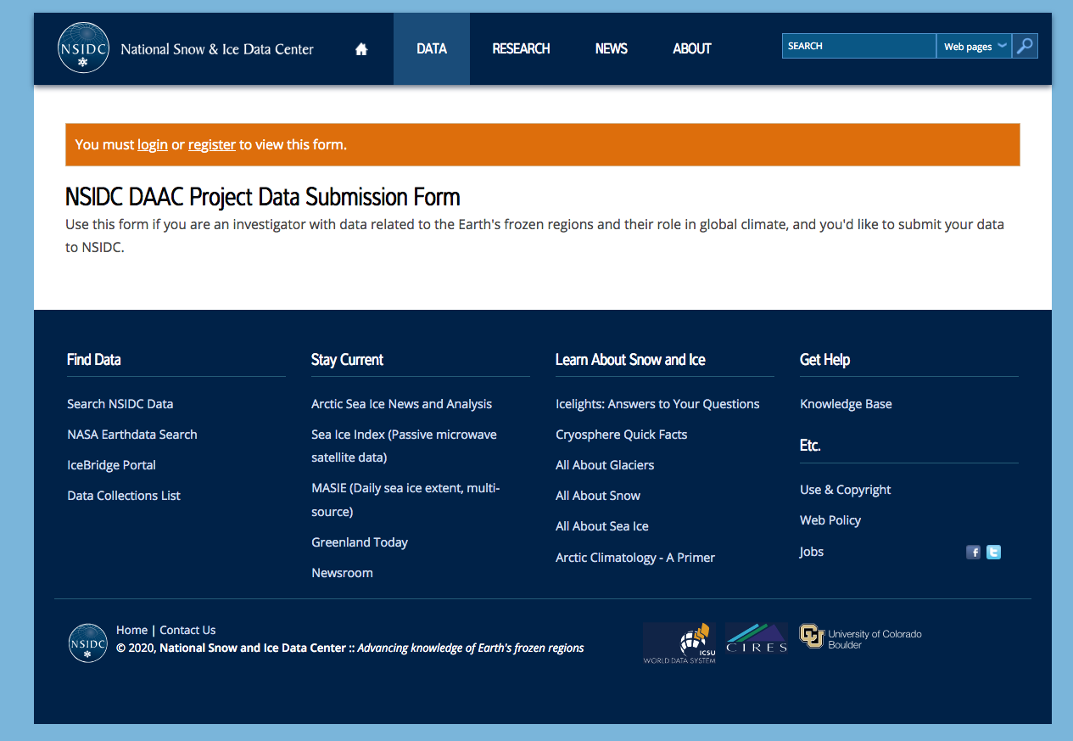
How to Submit Data
https://nsidc.org/data/daac-project/submit
Login/register

Slide 15
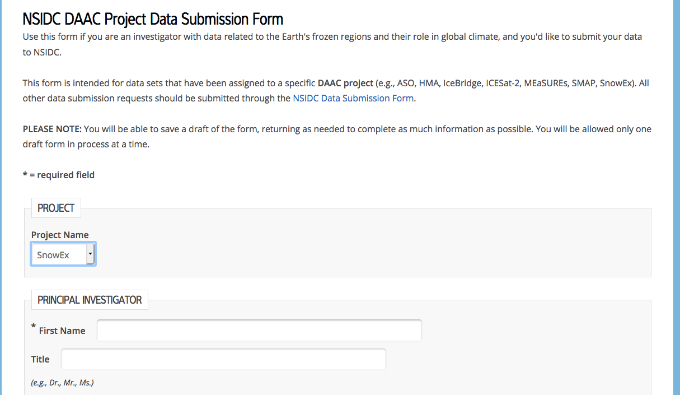
How to Submit Data
https://nsidc.org/data/daac-project/submit
Select Project

Slide 16
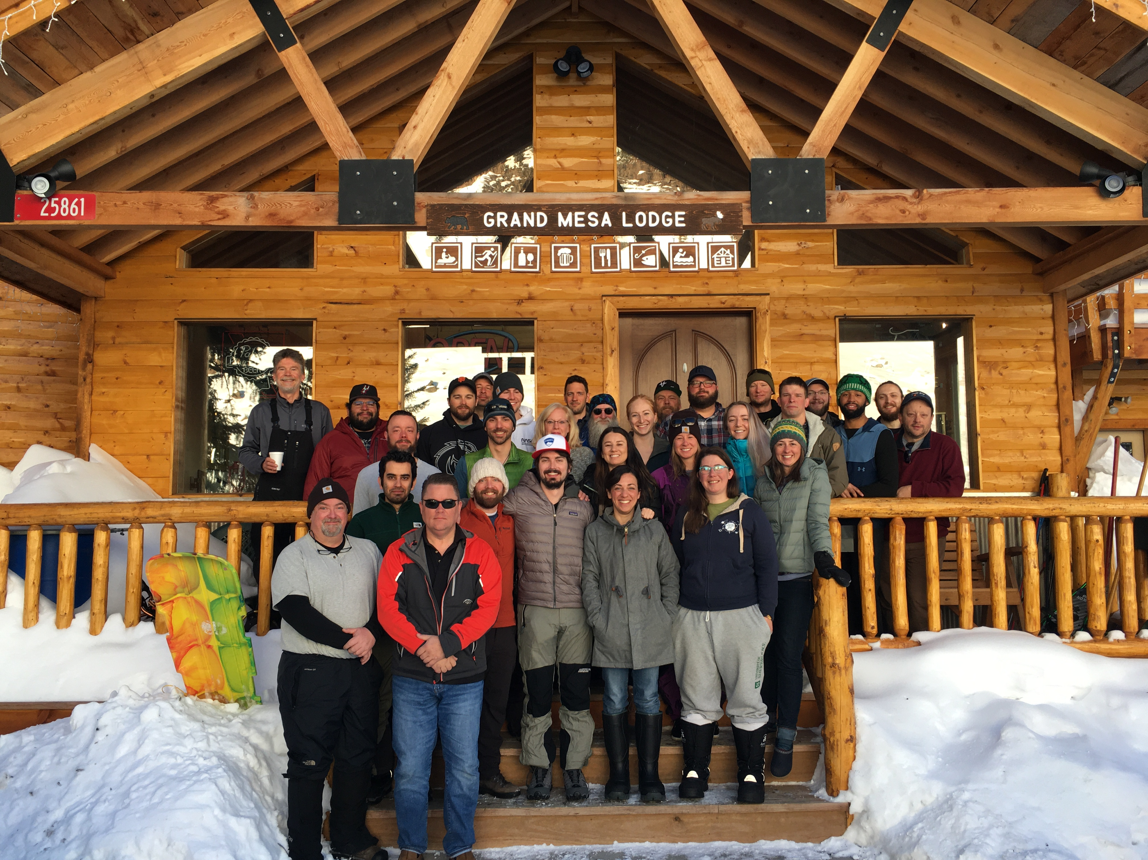
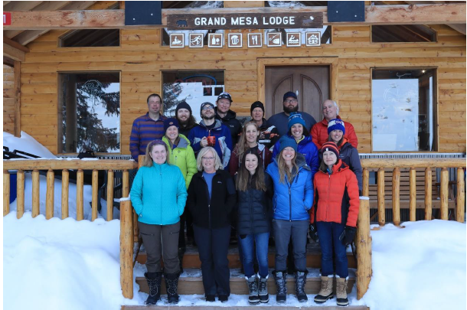
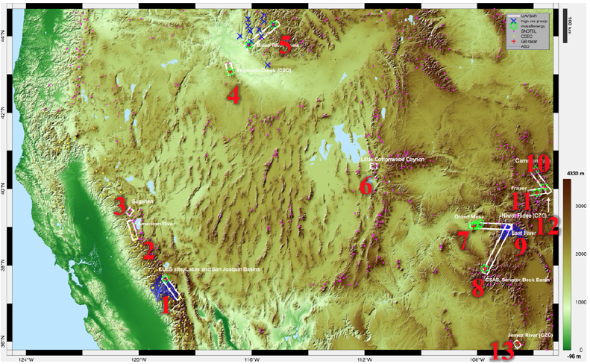
Thank you SnowEx Community
ALL Grand Mesa Participants (in person, and data processing folks too! )
ATA Aerospace for ALL logistics and solutions
Time Series Leads and ALL observers and data contributors!
SnowEx Leadership Team – your dedication is outstanding!
Megan Mason
meganmason491@boisestate.edu

