Slide 1
Future Planning for Global Snow

Slide 2
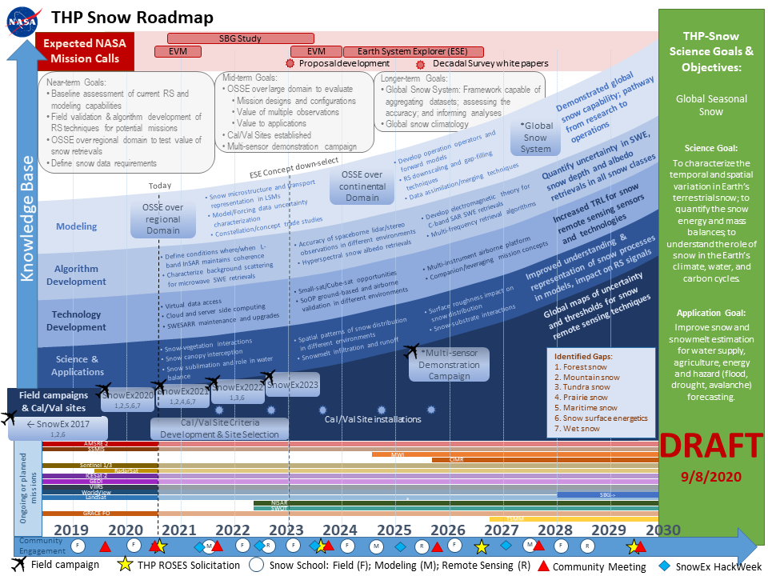
THP Snow Roadmap

Slide 3
Timeline driven by upcoming satellite missions and opportunities
Potential opportunities for spaceborne snow observations:
Earth Venture Mission
NISAR – L-band InSAR
TSMM – Ku-band SAR
SBG – Hyperspectral
Earth System Explorer (ESE)
Identify possible satellite technologies that meet mission criteria
Define activities required to evaluate potential concepts
New techniques and advances are being demonstrated with existing satellites:
C-band SAR - Sentinel-1
Stereo-photogrammetry – Worldview, Planet, Pleiades
Spaceborne lidar – ICESat-2, GEDI

Slide 4
Future Planning
Breakout group charge:
What activities are missing/essential?
How does the timeline match with upcoming deadlines?
What partnerships or other opportunities should we be aware of?

Slide 5
Breakout Group: Strategic Planning
Science-Application-Mission Vision & Goals
Mission Considerations
Observation Gaps
Time/Space Resolution
Timeline
Discussion:
What are the research, reviews, and answers that must be ready by proposal time?
Paper/Proposal list: https://drive.google.com/drive/folders/1d-k155K5RXCSu3lHPGEWqjxZzVyvdeNj
Snow mission science vision: https://docs.google.com/document/d/1BtxGKMOB3eOACJVPCMYUaZOeLUjAplO-tABnWgB3IGg/edit?usp=sharing
How do we prioritize research, roadmap tasks, etc (with a limited time and budget)?
How to we focus and motivate the snow community towards a mission?
How do we strategically position our community for success?
Paul Houser (phouser@gmu.edu)
Ana Barros (barros@duke.edu)

Slide 6
Mike Durand (durand.8@osu.edu)
Chris Hiemstra (Christopher.A.Hiemstra@erdc.dren.mil)

Slide 7
Breakout Group: Maritime snow
Discussion points:
What are the most critical uncertainties about snow in the maritime zone?
What are the biggest challenges to remote sensing of snow in the maritime zone? Where/when?
How can ground-based networks and models be used to overcome these snow remote sensing challenges? What measurement and model advances are needed?
What strategies/technologies are needed to improve within and below canopy process understanding and characterization of snow in maritime forests?
What knowledge about snow processes and sensing might be transferable to the maritime zone from SnowEx campaigns in other snow zones (tundra, taiga, continental, prairie, etc.)? What is less likely to transfer due to the uniqueness of maritime snow?
Leads: Liz Burakowski (elizabeth.burakowski@unh.edu)
Mark Raleigh (raleigma@oregonstate.edu)

Slide 8
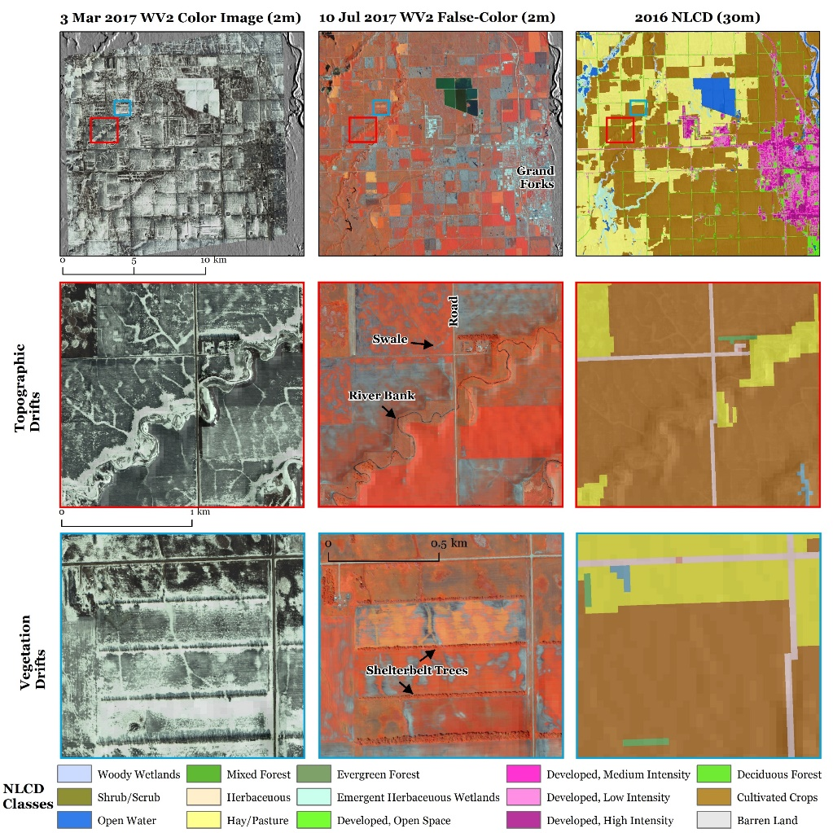
Breakout Group: Prairie Snow
Why Prairie snow?
Prairies cover almost 1/3 of the Earth’s land surface globally
important for agriculture, water management, flooding concerns, energy & carbon cycle interactions, ecological issues, etc.
Low stature vegetation, wind redistribution, subtle topography, rapidly changing conditions, and shallow snow create unique snow heterogeneity
Winter 2021 planned activities: local-scale campaign at CARC, MT
UAV Lidar & albedo, hyperspectral, UAVSAR flights, ground meteorology, snow, & soil
Key questions to discuss (not limited)
1. What are the current gaps in remote sensing of prairie snow?
Impact of substrate characteristics (vegetation, soil composition & moisture, and freeze-thaw state) on remote sensing techniques
Characterizing spatial heterogeneity of snow (especially wind-driven redistribution, sublimation)
Rapidly changing conditions (metamorphism, wet snow, etc.)
2. What sensors might be beneficial (shallow, transitional snow) – esp. path to space?
L-band InSAR, Lidar, multi-band SAR/radiometer, hyperspectral, Gamma radiation, SfM, others?
3. Which opportunities/collaborations should we be aware of?
Agricultural & ecological communities, Canadian agencies & universities, flood forecasters, others?
Prairie snow group – Sam Tuttle (setuttle@syr.edu) , Eunsang Cho (ec1072@wildcats.unh.edu)
4. What do we want to achieve, and when?

Slide 9
Breakout Group: Observing System Simulation Experiment (OSSE)
What is the OSSE community currently doing?
Components of current OSSE:
Sensor types to explore?
Orbital simulator (a.k.a., space-time subsampler)?
Observation operators?
Radiative transfer model; machine learning; others?
Error characteristics?
Land surface models used?
Fraternal versus synthetic twin?
End-user applications?
Water availability?
Drought and/or flood prediction?
Economic impacts?
Other ideas / comments / questions / concerns?
Bart Forman, baforman@umd.edu
Sujay Kumar, sujay.v.kumar@nasa.gov

