Slide 1
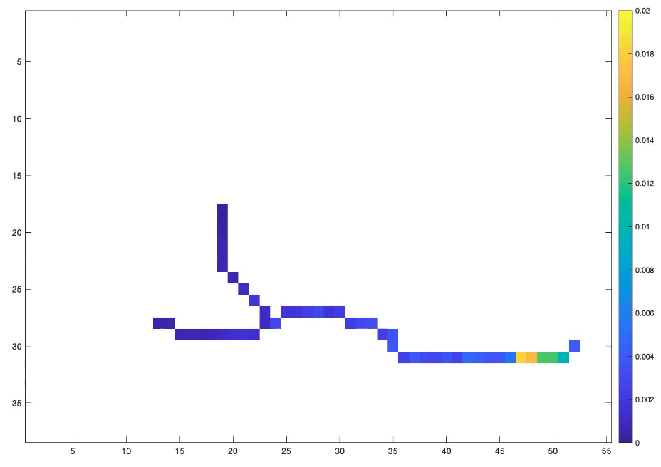
Breakout Group Highlights- Microwave Snow
A. X- and Ku- band volume scattering based approach for SWE retrieval – SnowSAR (9.6GHz, 17.2 GHz ), SWESARR (9.6GHz, 13.4GHz, 17.2GHz), UMass Ku Band (13.4GHz ), Airborne and Satellite SAR Processing
B. Canada TSMM ( Ku-, 13.4, 17.2 GHz) mission; Companion satellite of TSMM: Ku Band Interferometry
C. SnowEx Ground Measurements and Snow Physical Models
D. Using Sentinel 1 C-band (5.404 GHz) Radar Dataset for 1) snow/soil boundary roughness extraction and 2) Cross-polarization for deep snow retrieval
Leung Tsang, leutsang@umich.edu
DK Kang, dk.kang@nasa.gov

Slide 2
Breakout Group: To Address
Baseline assessment – what is the current state of the science?
What are the remaining gaps that need to be addressed? Identify targets of opportunity to address these gaps (e.g. proposal calls) and low hanging fruit.
What ongoing research contributes to the Roadmap?

Slide 3
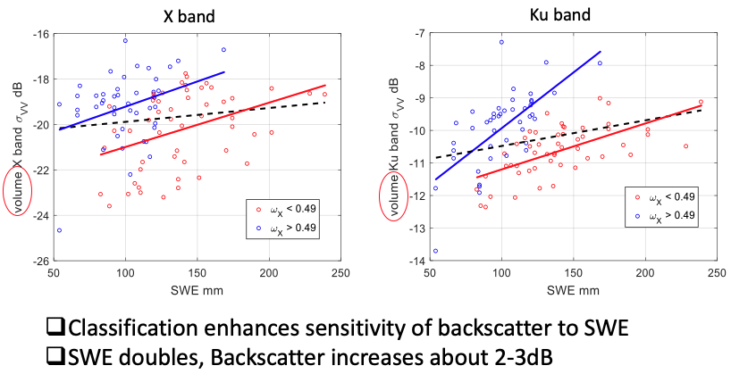
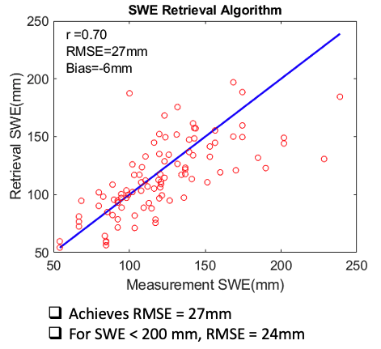
what is the current state of the science?
Canada SnowSAR 2013
2013 Performance

Slide 4
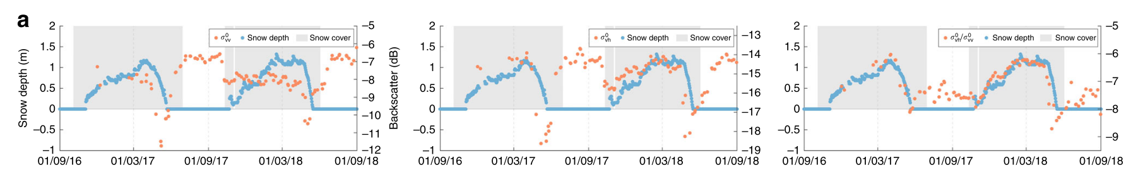
Volume Scattering C band (5.4 GHz)
Data from Lievens paper
Radiative Transfer Model
VH
VH/VV
Co-pol has no sensitivity to SWE
Cross-pol backscatter increase with SWE
Ratio of Cross/co-pol has 2 dB increase with SWE
H. Lievens et al., “Snow depth variability in the Northern Hemisphere mountains observed from space,” Nat. Commun., vol. 10, no. 1, pp. 1–12, 2019.

Slide 5
Remaining Gaps to Be Addressed
Substrate: How to deal with the effect of the substrate (soil freeze thaw state, roughness, and submerged vegetation) on retrievals?
Microstructure: How to best include prior information in the retrieval algorithms? To understand how snow grain size properties scale spatially in tundra environments? How to inter-calibrate between physical snow models , radiative transfer models and SAR data
Forest Cover : To what extent do these measurements penetrate various types of canopies?

Slide 6
What & When are the Mission Opportunities?
Today
2020
2021
2022
2023
2024
2025
2026
2027
2028
2029
2030
2033
2035
2040
Sentinel-1 (C-band SAR)
S-1 NG
MODIS/VIIRS (vis/ir)
Existing/planned commercial stereo photogrammetry
Existing passive mw
AMSR-3 (passive mw)
Future pmw
MetOp-SG MWI (passive mw)
IceSat2, GEDI (existing lidar)
SBG (albedo)
NISAR (L&S-band InSAR)
TSMM (Ku-SAR)
SWOT (Ka-band InSAR)
CIMR (passive mw)
THP snow focus
SNoOPI (SoOp)
Snow EVM (SoOp)
Snow Explorer-class
Color code:
Operational missions
(guaranteed)
approved missions
(in-orbit or will launch)
Mission proposals
(launch if selected)

Slide 7
Leveraging/Partner Opportunities vs. Proposal Risk—Evaluation Metrics
Timing: how much will the sensor/mission overlap in time w/snow mission?
How certain is the mission? E.g. operational, proposal, end-of-life, etc.
Spatial: coverage wrt global & specific snow types, swath width, resolution,
Temporal: coverage wrt global & specific snow types, revisit interval
Accuracy: wrt different snow types & vs. confounding factors; where would it improve global SWE & how much?
Other Limitations—e.g., saturation, thin snow/deep snow, wet snow, channels…
Bottom line: How much would the leveraging opportunity increase our proposal’s selectability?
For high-value options, what do we need to do to close key proposal risks?

Slide 8
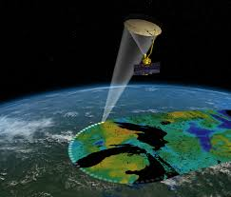
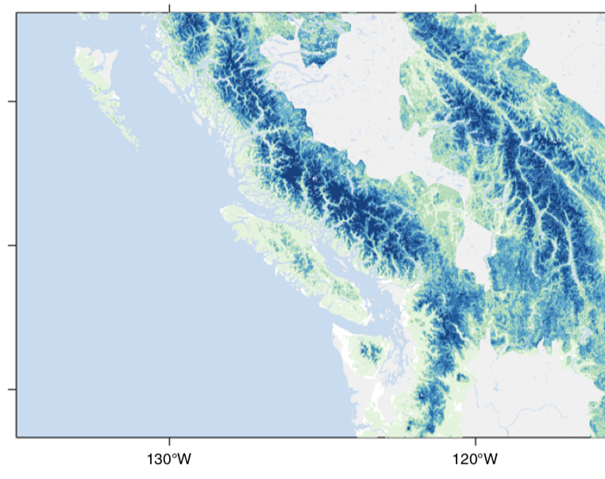
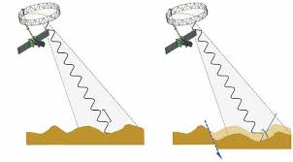
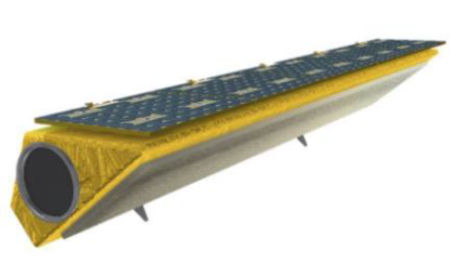

Identify targets of opportunity to address these gaps
L S-band NISAR (UVASAR): Interferometry and background scattering
L-band SMAP: Freeze/Thaw
C-band SENTINEL 1: Deep snow
SnowEx campaign 2021-2023
CSA-FAST funded airborne measurements and analysis, 2021-2023

Slide 9
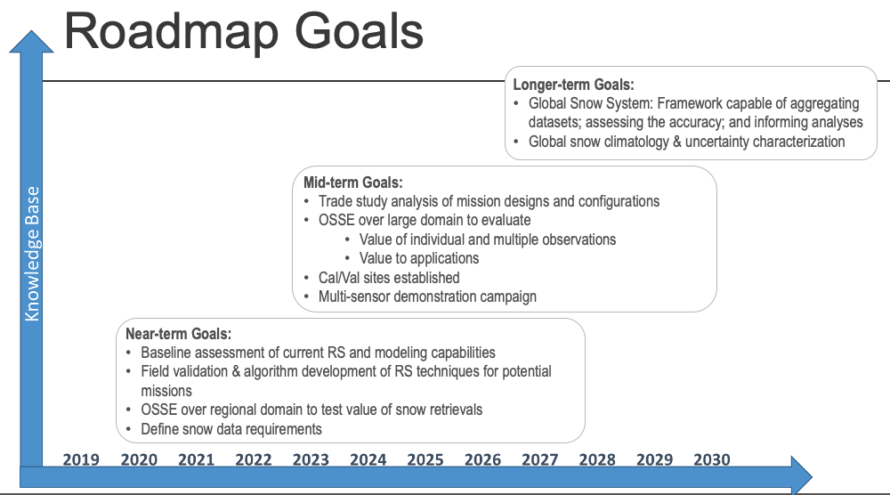
What ongoing research contributes to the Roadmap?
DMRT, SMRT, Unified
Ku-Ka passive, C-active
Apply snow model
Strong theoretical basis by using DMRT/SMRT
Active only method + P+A method
SSA➔ direct use, Weather data ➔ snow model

