Slide 1
Decadal Survey and Snow Mission Opportunities
Edward Kim
NASA/GSFC
THP Snow Virtual Meeting
9/11/2020

Slide 2
The Decadal Survey and Seasonal Snow
Earth Science Decadal Survey 2—”DS2” (2017)
Snow mentioned in multiple panels—particularly the Water & Climate panels
DS2 focus was on observables not missions: SWE/depth is one, albedo is another
Observable categories (not a complete list)
Designated = guaranteed missions; albedo (including snow) is in this category
Explorer = 7 measurements vying for 3 mission slots; SWE is in this category
Our competition = the other 6 potential Explorer missions
Caveat: observation requirements were not entirely consistent—use with caution
Suggested sensing techniques also require careful parsing—e.g., ‘Ku/Ka radar’ actually refers to a GPM-style altimeter, not a SAR
Water panel’s overarching goal: integrated observing system of whole Global Water Cycle
THP is NASA HQ’s program primarily responsible for SWE
Other NASA HQ programs are primarily responsible for supporting the albedo observable

Slide 3
Decadal Survey Take-Aways
The 2017 Decadal Survey identifies SWE/depth as an Explorer category observable, one of 7 competing for 3 mission slots
Explorer AO date & launch date are uncertain, but typical timeline suggests launch ~end of decade and proposals due mid-decade (earliest scenario)
Leveraging/partnering is required to provide multi-sensor concept, but also carries risk
Explorer mission concept needs to be defined in <2 years; 2 candidate sensors have been identified, but there may be others
SnowEx & other THP Snow activities need to be identified and prioritized to support Explorer concept definition and proposal development
Be involved in Working groups and Breakout groups to contribute your input
Big payoff comes after selection → proposal selectability is top priority

Slide 4
Snow mission proposal strategy thoughts
Explorer competition will be at a high level
The competition will propose global obs → we need to propose Global SWE
Includes all seasonal snow types, but uncertainty varies w/type → avoids trap of requiring unrealistic accuracy in all cases
Global snow products (cover, depth, SWE) already exist (IMS, GlobSnow, NWP, AMSRx), so a snow mission would be an improvement rather than a totally new product
Which snow types/conditions do existing products exclude?
1st time *global* SWE product = extra selling point; ties well into DS
Snow addresses the missing reservoir in NASA’S water cycle observations
Combine multiple RS techniques + models; both a plus & a risk
Tiered validation strategy similar to SMAP
Big payoff comes after selection → proposal selectability is top priority

Slide 5
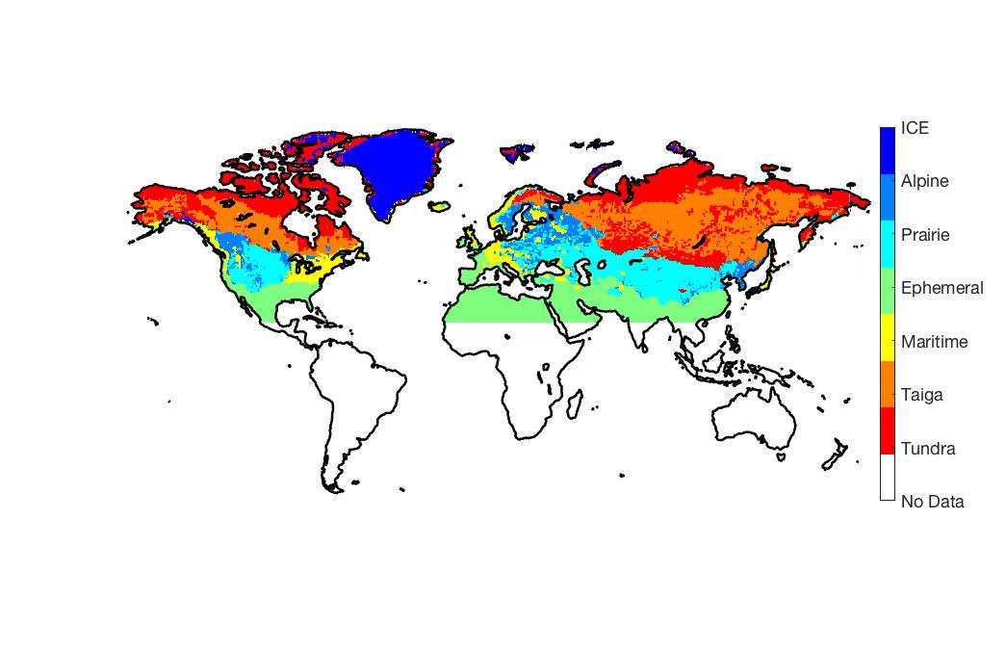
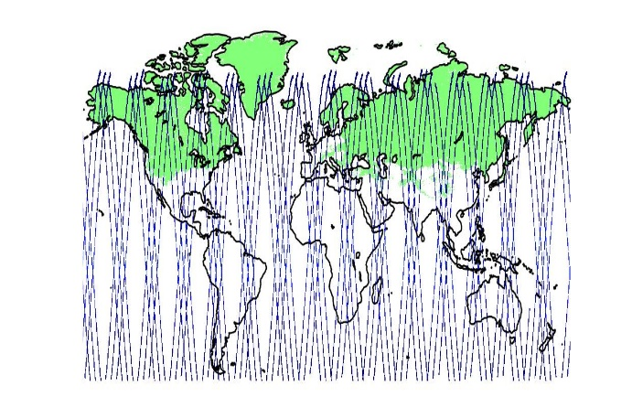
Mission Concept Considerations (+/-)
No single SWE sensing technique works everywhere → combination
Many sensors already in orbit or planned → leveraging
No single space agency can afford the entire system → partnering
Natural questions: what would we get from different mission configurations? → tradeoffs
Example: snow maps + orbit simulators
 | 1 day | 3 day | 30 day
AMSR-2 | 98.3% | 99.8% | 99.8%
Sentinel-1 | 24.7% | 59.9% | 92.2%
ICESat2* | 0% / 1.1% | 0% / 3.2% | 1.4% / 20.4%
Wide swath LIDAR | 5.7% | 15.8% | 49.2%
+
Average percentage of sensor-observed snow coverage

Slide 6
A Note on Proposal Scope
A Global SWE mission concept will require a combination of sensors
The majority of the constellation will consist of leveraged sensors that are already going to be in orbit in the same timeframe (think GPM paradigm)
The Explorer budget ($350M) is only enough to launch ~one key ‘missing’ sensor
But if the Explorer proposal promises to deliver Global SWE, then the proposal must outline ALL elements required to deliver that product, for example
Any algorithms required to take the data from each sensor, combine them, and generate the Global SWE product
Using existing algorithms or SWE products from the leveraged sensors is acceptable—i.e., the Explorer proposal does not need to invent new algorithms for each sensor…unless that is required in order to meet SWE uncertainty targets
In other words, the proposal’s primary deliverable is the data product (Global SWE), and the sensor that gets launched is a tool to enable that product to be generated. The same is true for the other tools: algorithms, cal/val, etc. ALL the tools required to deliver the product must be laid out in the proposal, but NASA wouldn’t need to pay for the leveraged ones.

Slide 7
Snow Explorer-class Mission Timeline (notional)
2019
Today
2020
2023
1
2024
2026
2031
2
9
3
4
5
7
Not to scale
6
8
Field campaigns
SnowExs: 3 more years
Canadian campaigns?
Finnish campaigns: next 3 years
Analyze data/develop robust algorithms (coincident w/campaigns) 5-6 yrs
Design the mission concept (e.g., constellation components, models) ~6 yrs
Write the proposal 1 yr
Review panel/selection process 1 yr (note: timing of call not yet known)
Congratulations! Your mission proposal has been selected
Design, build, test your satellite ~5 yrs
Launch!
Groundbreaking science
It is possible to
accelerate this
timeline
CAVEATS: notional dates, various assumptions

Slide 8
What & When are the Mission Opportunities?
Today
2020
2021
2022
2023
2024
2025
2026
2027
2028
2029
2030
2033
2035
2040
Sentinel-1 (C-band SAR)
S-1 NG
MODIS/VIIRS (vis/ir)
Existing/planned commercial stereo photogrammetry
Existing passive mw
AMSR-3 (passive mw)
Future pmw
MetOp-SG MWI (passive mw)
IceSat2, GEDI (existing lidar)
SBG (albedo)
NISAR (L&S-band InSAR)
TSMM (Ku-SAR)
SWOT (Ka-band InSAR)
CIMR (passive mw)
THP snow focus
SNoOPI (SoOp)
Snow EVM (SoOp)
Snow Explorer-class
Color code:
Operational missions
(guaranteed)
approved missions
(in-orbit or will launch)
Mission proposals
(launch if selected)

Slide 9
Leveraging/Partner Opportunities vs. Proposal Risk—Evaluation Metrics
Timing: how much will the sensor/mission overlap in time w/snow mission?
How certain is the mission? E.g. operational, proposal, end-of-life, etc.
Spatial: coverage wrt global & specific snow types, swath width, resolution,
Temporal: coverage wrt global & specific snow types, revisit interval
Accuracy: wrt different snow types & vs. confounding factors; where would it improve global SWE & how much?
Other Limitations—e.g., saturation, thin snow/deep snow, wet snow, channels…
Bottom line: How much would the leveraging opportunity increase our proposal’s selectability?
For high-value options, what do we need to do to close key proposal risks?

Slide 10
Global Snow Mission Considerations
Near-global SWE products already exist, so to be successful, a Global Snow Mission proposal must do (significantly) better in some manner
Candidate ‘most valuable improvements’:
Lower SWE uncertainty (accuracy & precision) in places where SWE products already exist
Retrieve SWE in places where we don’t really have SWE products today → the confounding factor (CF) areas = forests & complex terrain
Note: forests occur in complex terrain areas, so if we can make a big improvement with respect to forest SWE, we likely also get improvement for complex terrain, but the converse is not necessarily true

Slide 11
Candidate Explorer Mission Sensors
Two techniques potentially meet the criteria for an ESE snow mission: global, fits cost cap, community-supported, addresses science questions and fills gaps, but each has strengths and issues when faced with the challenges of snow sensing
Assumed Criteria | Potential Concept 1: Ku-band volume scattering approach for SWE retrieval | Potential Concept 2: Lidar/ Stereophotogrammetry snow depth retrieval
Pros | Global coverage Sub-weekly repeats 1km resolution, with targeted higher-resolution looks possible Not impacted by clouds | Forests (50% of global snow) → lidar still works even in thick forests Wet snow: indirect sensing via depth still works High-resolution Deep snow: does not saturate
Cons | Direct SWE sensing fails for wet snow Signal impacted by forests Snowpack internal structure affects direct SWE sensing & the structure changes over time | Swath very narrow Medium to long repeat Vertical resolution may not be good enough for shallow snow Impacted by clouds: global avg 55%, may be higher for snow place/times of interest

Slide 12
But what do we need to do?
SnowEx Science Plan
New knowledge
Proposed future SnowExs
Potential modeling activities
Mission proposal needs
Updated Science Plan
Prioritized SnowEx activities
Future SnowEx Implementation Plans
Prioritized modeling activities
Schedules
Work assignments
Identify prioritization criteria
Apply prioritization criteria
List of high-value activities
Working group & Breakout group discussions
(have you joined a working group yet?)

Slide 13
SnowEx Science Plan + New Knowledge → updated Prioritization Criteria
Science Plan Prioritization captured thinking at time of writing, but timeframe & cost criteria were not applied
New knowledge (timeframe, cost, technical) → new prioritization
Example: C-band SAR (Sentinel): ‘new’, should be added to Science Plan as mission critical, or at least evaluation should be very high priority
Timeframe criterion: missions that overlap (yes/no/maybe)
Cost criterion: standalone mission above or below Explorer cost cap
Technical criteria: limits vs. snow type or confounding factor, or other limit
Selectability criteria: globalness (coverage, swath, revisit), synergy w/other measurements in same timeframe, overall proposal risk

Slide 14
Example: Apply Prioritization Criteria
ILLUSTRATION ONLY—YOUR ACTUAL IDEAS WILL VARY
# suggests a high-value activity
RS method | timeframe | Cost < $350M | Technical (limitations) | Gives us | selectability | priority
C-band SAR | Yes (Sentinel) | Yes (free) | Need theory #, wet snow | Mts, deep snow | good | crucial
L-band InSAR | No (NISAR) | no | dense forest, wet snow?, long repeat | Mts? Deep? | risky | Low
Ku volume scat | No/maybe (TSMM) | no | Algorithm, saturation, forest?, wet snow # | Medium depth dry snow, 5d repeat | Neutral/risky | medium
Passive mw | Yes (multiple) | Yes (free) | Validation #, saturation, forest, wet snow, thin snow, resolution | Prairie, tundra, 2-3d repeat | Good | high
albedo | Yes (VIIRS,SBG) | Yes (free) | ok | Melt season | Good | neutral
photogrammetry | Yes (multiple) | Yes (maybe free) # | possible forest solution | Forests, mts, deep snow? Wet snow? # | Good | High
lidar | No/maybe # | Yes/maybe # | Narrow swath, but forest solution | Forests, deep snow, wet snow | Neutral /good | medium
Ka-InSAR | No (SWOT) | no | Penetration, trees, long repeat | Melt season | risky | low
modeling | yes | yes | Complexity # | Fills gaps | neutral | high

Slide 15
Priorities Suggest High-Value Activities (SnowEx activities in red; non-field activities in green)
ILLUSTRATION ONLY—YOUR ACTUAL IDEAS WILL VARY
C-band SAR: develop + validate theory; validation using Sentinel
Radar volume scattering method: further algorithm work, test under wider conditions
Passive microwave: better wide area validation (prairie & tundra), evaluate forest correction
Photogrammetry: validate for range of snow types & confounding factors (already done??), assess coverage/repeat vs. snow type, cost, etc
Lidar: cost estimates, leveraging options, wider swath technology
Mission simulator (not an OSSE, but overlaps with SEUP/OSSE effort)
Evaluate mission concepts: Orbit/coverage tradespace evaluation tool
Evaluate existing global SWE prodcuts: Quantify error bars, draw map: Globsnow, AMSR2, etc
Modeling: focus on ‘must-haves’ = tall poles for proposal

Slide 16
Proposal Risk Thoughts on SWE change vs. absolute SWE
If you have a time series of absolute SWE, you also have SWE change (relative SWE), but the converse is not true
To construct absolute SWE from relative SWE, several additional requirements must be met, and errors are cumulative
If the requirements are not met, you might re-set your absolute SWE for the season to zero (or have to increase the error bar size dramatically)
When constructing SWE change from absolute SWE, the error accumulation is significantly reduced
Many of the sensing techniques needed to achieve ‘global SWE’ are absolute SWE techniques

Slide 17
Takeaways from Explorer AO timeline
AO date typically known <1yr in advance & takes 1yr to write proposal → need to already be working on proposal
<2 years until we need to lock down the mission concept--actually earlier to pass internal review gates at NASA Centers
Only 1-2 more SnowExs before lockdown → prioritze strategy vs. convenience
Finite resources → need to prioritize our activities to be ready in time
Lower priority activities are not eliminated; there will be future opportunities
Need (convincing) algorithm papers to cite in proposal
Need review papers to cite in the proposal
Need Science & Applications Traceability Matrix (SATM)

