Slide 1

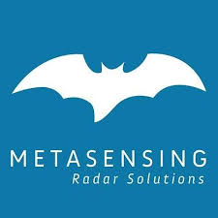


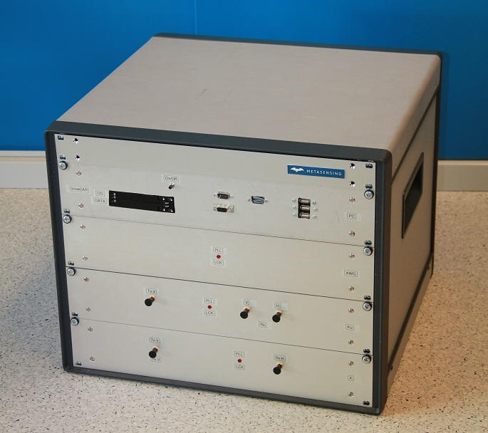
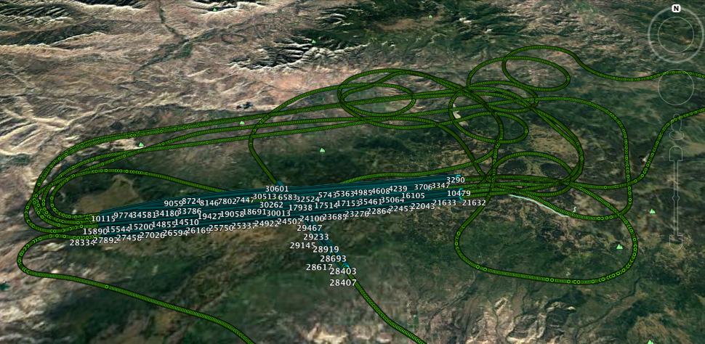
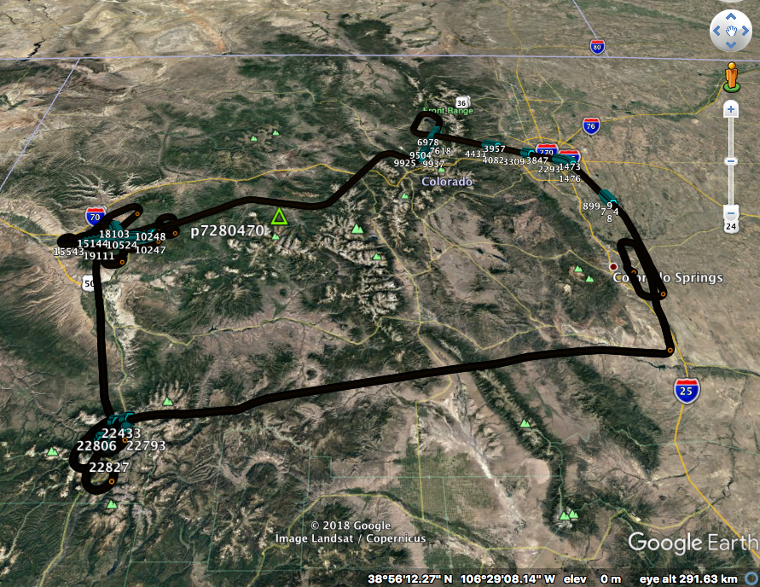
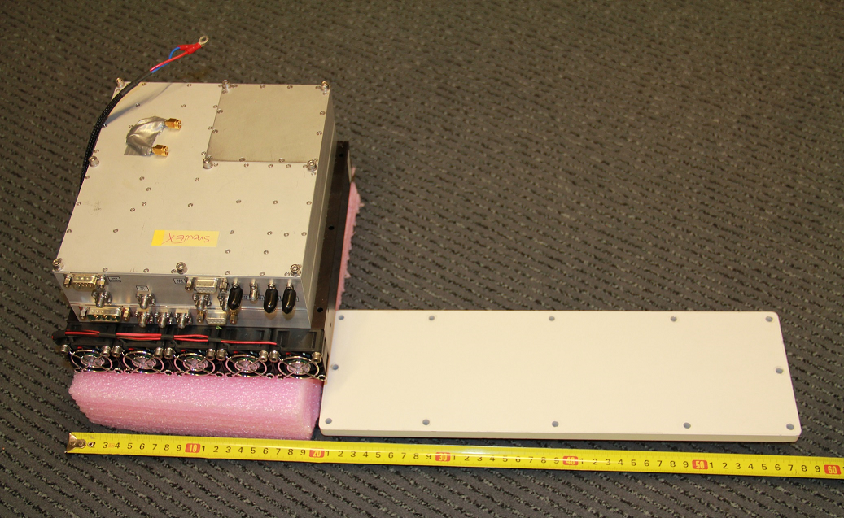
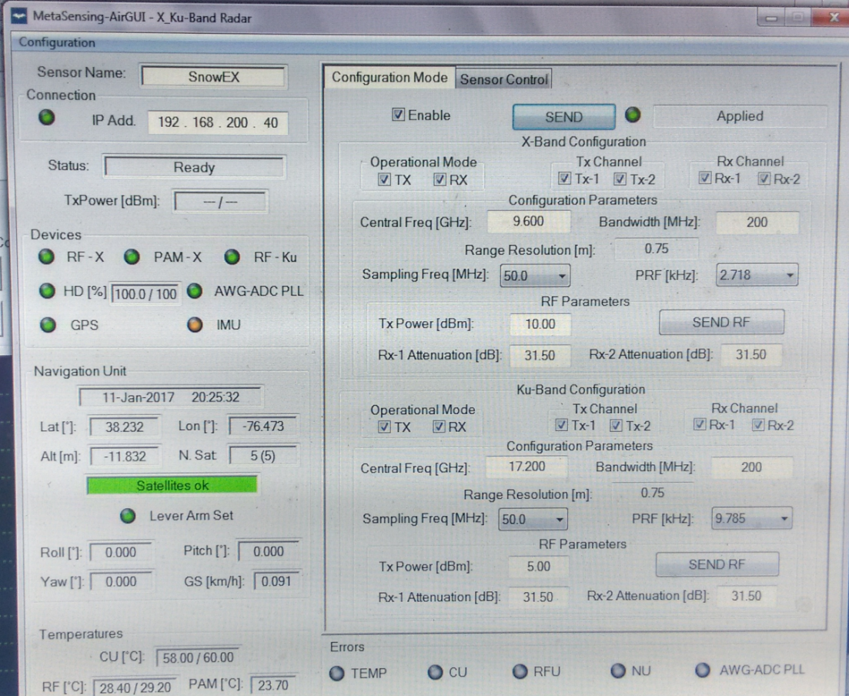
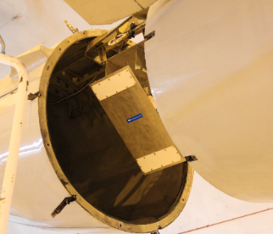
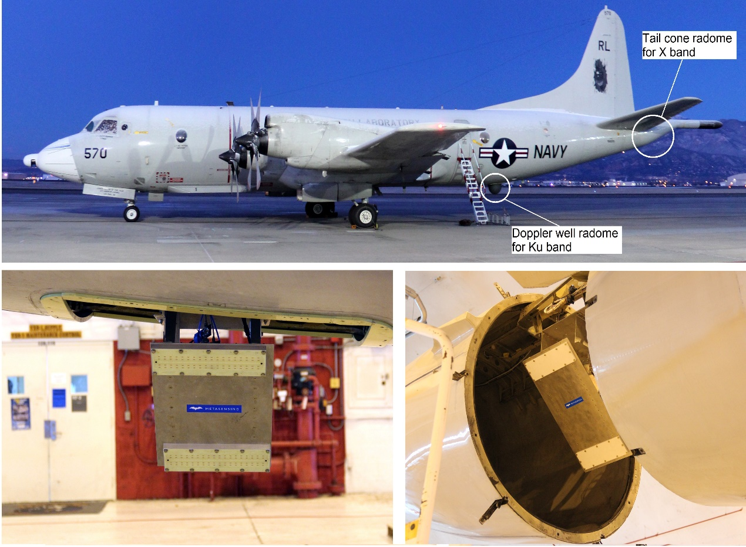
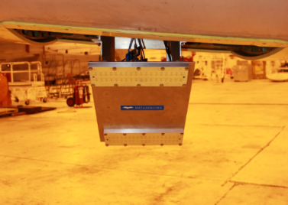
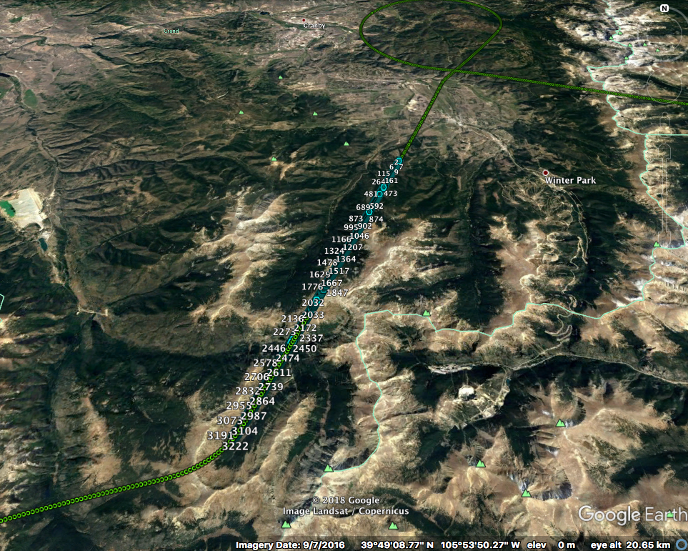
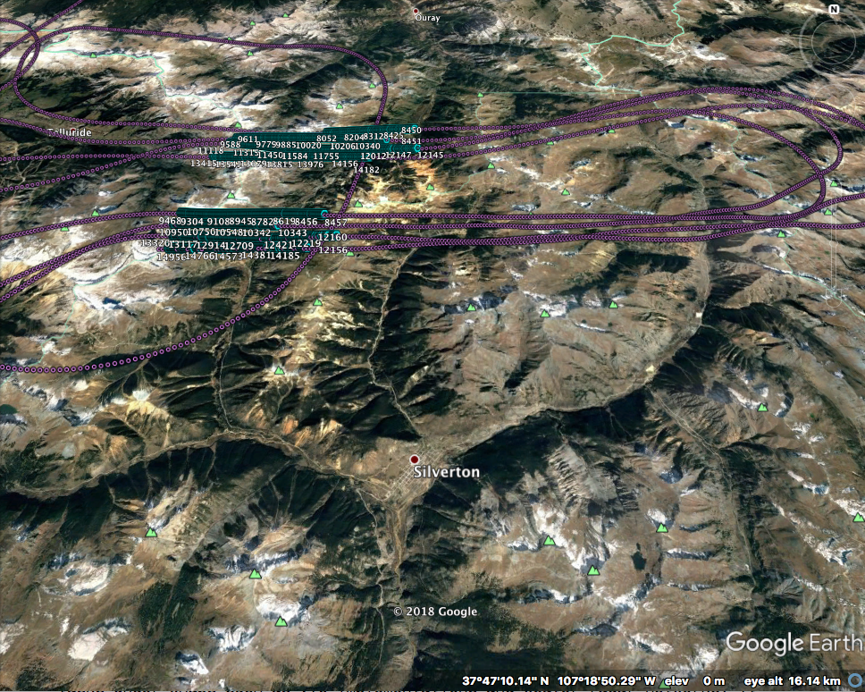
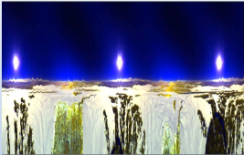
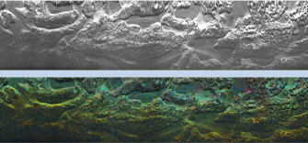

UPDATED WITH LATEST RESULTS
Preliminary SnowSAR Results from SnowEx 2017
Edward Kim¹, Jiyue Zhu², Leung Tsang², Do-Hyuk “DK” Kang^{1,3}, Alex Coccia⁴, Karlus Macedo⁴, and Adriano Meta⁴
¹NASA Goddard Space Flight Center, Greenbelt, USA
² Radiation Laboratory, Department of Electrical Engineering and Computer Science, The University of Michigan, Ann Arbor, USA
³ESSIC, University of Maryland, College Park, USA
⁴MetaSensing BV, Noordwijk, Netherlands
Abstract
SnowSAR details
Flight Track Examples
SnowEx 2017 was the first in a multi-year series of airborne remote sensing campaigns, designed to address gaps in snow retrieval techniques in preparation for a future snow satellite mission. A variety of sensor types were flown to collect multi-sensor airborne data. In combination with detailed ground truth, this multi-sensor dataset enables critical trade studies to determine optimum sensor-plus-model combinations for different snow conditions and confounding factors. Up to half of terrestrial snow-covered areas are forested, and forests are a major confounding factor for global snow retrievals. Therefore, the main focus of SnowEx 2017 was evaluating the performance of the various sensing techniques to retrieve snow water equivalent (SWE) under steadily increasing amounts of forest cover. The primary site of Grand Mesa, Colorado, USA was selected for its natural gradients of forest density and SWE with a minimum of other factors.
Radar retrievals of SWE relying on volume scattering have been studied for three decades, using a variety of frequencies, with varying degrees of success. The most recent volume scattering algorithms have focused on using 2 to 3 frequencies and both co- and cross-polarizations in the 9—18 GHz range (X through Ku bands). As such, one of the primary SnowEx 2017 airborne sensors was a dual-band (X & Ku) radar, the SnowSAR. Earlier versions of SnowSAR were used in 2011 and 2012 campaigns in Finland as well as a 2013 campaign in Canada. For SnowEx 2017, SnowSAR was installed on a P-3 aircraft from the US Naval Research Laboratory. Challenges associated with the aircraft, the installation, schedule, and flying weather all contrived to limit the amount of data collected. However, months of painstaking processing has yielded data that should be of value to the original objectives of SnowEx 2017. This paper will describe in detail the SnowSAR data that were collected, and provide quality assessments of the backscatter coefficient in terms of date, time, location, frequency, polarization, snow conditions, overlap with ground truth sites, forest density, etc. The challenges as well as potential remedies/caveats will be described in order to help guide users and maximize exploitation of this valuable data.
Dual frequency SAR developed by MetaSensing in 2011 for ESA’s CoReH20 effort
X Band (9.6 GHz) & Ku Band (17.2 GHz)
Full polarization: VV, VH, HV, HH
Radiometrically calibrated SAR images (1 dB accuracy)
Multiple upgrades from 1st version
High degree of customization
Many successful campaigns worldwide
Grand Mesa flight track zoom
SnowEx 2017 SnowSAR flight & data notes
 |  | bands | altitude | flight lines | notes
date | sites | working | feet (AGL) | flown
16-Feb | GM,SB,FF | X,Ku |  | 3 | discovered need to fly lower altitude than planned
18-Feb | GM, FF | X,Ku | 6500 | 8 | strong winds, turbulence, higher altitude, speed & angle limits
20-Feb | GM, FF | see note | 2500 | 2 | abort to fix sensor & conserve duty hours for later flights
21-Feb | GM, FF | X,Ku | 3500 & 14500 | 20 | strong winds, turbulence, higher altitude, speed & angle limits
22-Feb | SB, FF | X,Ku | 17500 | 11 | strong winds, turbulence, higher altitude, speed & angle limits
SnowSAR underwent major upgrades before SnowEx 2017
New polarimetric antennas with better radiation performance (both X and Ku)
Integrated RF modules with increased transmitted power (10W X, 5W Ku)
Control GUI featuring parameters tuning
SnowEx 2017 Sites
Example Feb 16, 2017 P-3 flight track
Integrated RF module
Primary SnowEx site:
Grand Mesa (GM)
Primary SnowEx site:
Grand Mesa (GM)
Tertiary SnowEx site:
Fraser Forest (FF)
Grand Junction
Tertiary SnowEx site:
Fraser Forest (FF)
New antenna
P-3 base:
Peterson AFB
P-3 base:
Peterson AFB
SnowEx 2017 details
Ku band
Control GUI
X band
NRL P-3: 4 sensors
SnowEx Year 1 (2017) was a major community-wide campaign to collect aircraft and ground-based multi-sensor observations along with extensive ground truth measurements, to enable algorithm development and to guide trade studies needed to determine an optimum combination of measurements, sensors and models for a future snow satellite mission. Forest cover—affecting about half of global snow-covered areas—was used to challenge all the sensing techniques.
Secondary SnowEx site: Senator Beck Basin (SB)
CAR
(BRDF)
SnowSAR
Fraser flight track zoom
Keep in mind: due to weather (e.g., wind & turbulence, clouds), flight safety protocols, and sensor or aircraft issues, not every flight visited all 3 sites, and not all flight lines were flown during each flight. All sensors & aircraft in SnowEx 2017 experienced such situations.
SnowEx 2017 Aircraft Science Sorties
2 thermal IR sensors, HD video
Aircraft | Instruments | # Sorties | FEBRUARY
 |  |  | 1 | 2 | 3 | 4 | 5 | 6 | 7 | 8 | 9 | 10 | 11 | 12 | 13 | 14 | 15 | 16 | 17 | 18 | 19 | 20 | 21 | 22 | 23 | 24 | 25 | 26 | 27 | 28
P-3 | SnowSAR, CAR, IR Suite (AESMIR) | 5 |  |  |  |  |  |  |  |  |  |  |  |  |  |  |  | 1 |  | 1 |  | 1 | 1 | 1
TOI | WISM | 3 |  |  |  |  |  |  |  | 1 | 1 | 1
King Air | ASO | 6 |  |  |  |  |  |  |  | 1 |  |  |  |  |  |  |  | 1 |  |  |  | 2 | 1 |  |  |  | 1
G III (AFRC) | GLISTIN-A | 4 |  |  |  |  |  |  |  |  | 1 |  |  |  |  |  |  |  |  |  |  | 1 | 1 |  |  |  | 1
G III (JSC & AFRC) | UAVSAR | 3 |  |  |  |  |  | 1 |  |  |  |  |  |  |  |  |  |  |  |  |  |  |  | 1 |  |  | 1
CAR
SnowSAR
Senator Beck Basin
flight track zoom
SnowSAR Data & Analysis Examples
Summary/Conclusions
Radar data
X band simulations
Ku band simulations
Backscatter difference: forest and open areas
SnowSAR (MetaSensing/ESA) was flown during SnowEx 2017 on the P-3 aircraft
Bands and polarizations applicable to volume scattering SWE retrieval approach
X Band (9.6 GHz) & Ku Band (17.2 GHz); Full polarization: VV, VH, HV, HH
Challenges: schedule/certification bureaucracy/weather/aircraft
First time installation on NRL P3; short testing time; NAVAIR certification delayed P-3 arrival until Feb 15
SnowSAR data collected on 4 days: Feb 16, 18, 21, 22
Strong winds→ strong turbulence→ higher altitude → weaker signal
Strong winds→ strong turbulence→ platform stability reduced→ amplitude uncertainty/reduced dynamic range & spatial resolution degraded
Strong winds→ exceeded SAR processing limits on downwind & crosswind lines (also for UAVSAR, GLISTIN-A)
Broken windshield grounded P-3 aircraft/no flight on Feb 25
Best SnowSAR data acquired on Feb 21
  X band: 4 channels with good SNR (despite high noise in 2 channels)
  Ku band: 2 channels (1 Co, 1 X pol) with acceptable SNR (low returns)
Other days/sites with apparently good data identified so far
  Feb 16: Fraser, both frequencies
  Feb 18: certain tracks at X band
  Feb 22: certain tracks, both frequencies
Further examination may identify additional good data. While the full SWE algorithm requires co-pol & x-pol from both bands (4 channels), even a single channel can be used to check & improve forward electromagnetic models, the effect of trees, low vegetation, soil substrate, wet snow, etc.
Check out the SnowSAR dataset at NSIDC: SNEX17_SnowSAR
Sigma0 from SNEX17_SnowSAR_20170221174335
rms height= 0.5 cm,
OH for surface scattering,
snow depth 1.4m
$ε_{snow}=1.43$
$ε_{g}=4+1i$
Electromagnetic simulation predicts:
for grain size of 0.4 mm,
Ku band: total -10 dB, surface -14 dB, vol -12 dB
X band: total -14 dB, surface -14.5 dB, vol -22 dB
Actual data values
Most Ku band data located between -16 dB to -10 dB
Most of X band data -22 dB to -10 dB
Mean grain size:0.4 mm
pixel index
Sigma0 in dB
Preliminary findings:
Simulated & actual total backscatter values are comparable !
Differences likely due to heterogeneity and forest effects
Next steps:
Forward electromagnetic modeling utilizing additional ground truth
Compare retrieved SWE with ground truth SWE
Consider effect of forest on SWE retrieval performance
Backscatter of forest area larger than that of open land
Backscatter at open land close to the Gaussian distribution, while more complex at forest areas
pixel index

