Slide 1


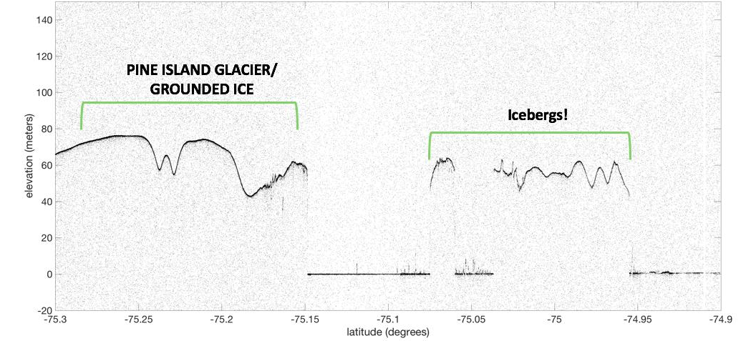
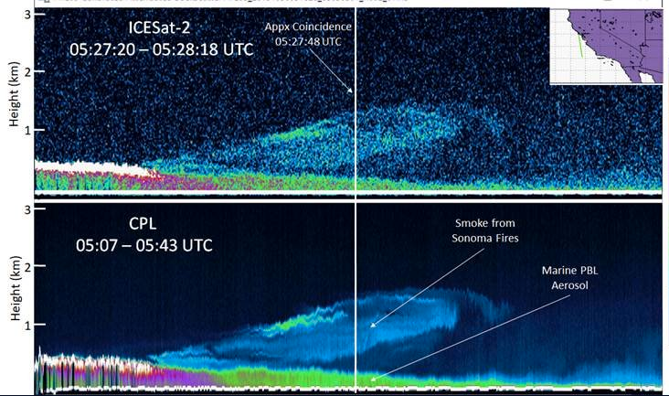
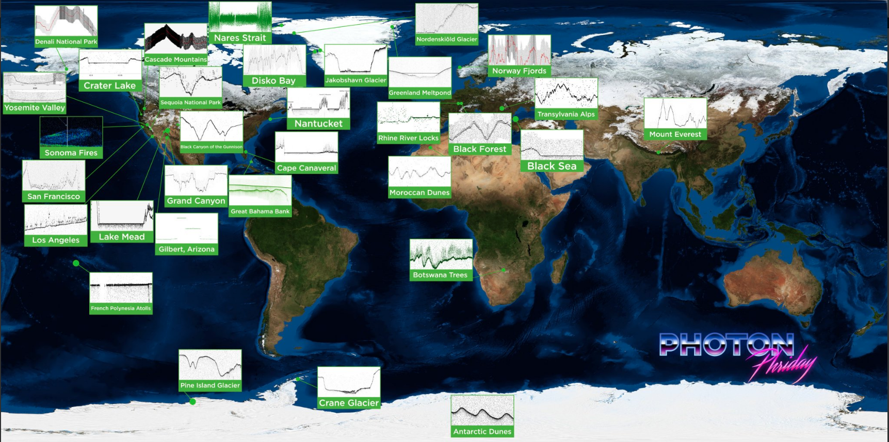
ICESat-2 Update and Application to SnowEx
Tom Neumann, Project Scientist
Nathan Kurtz, Deputy Proj. Sci.
Kaitlin Harbeck, Data Product Mgmt.

Slide 2
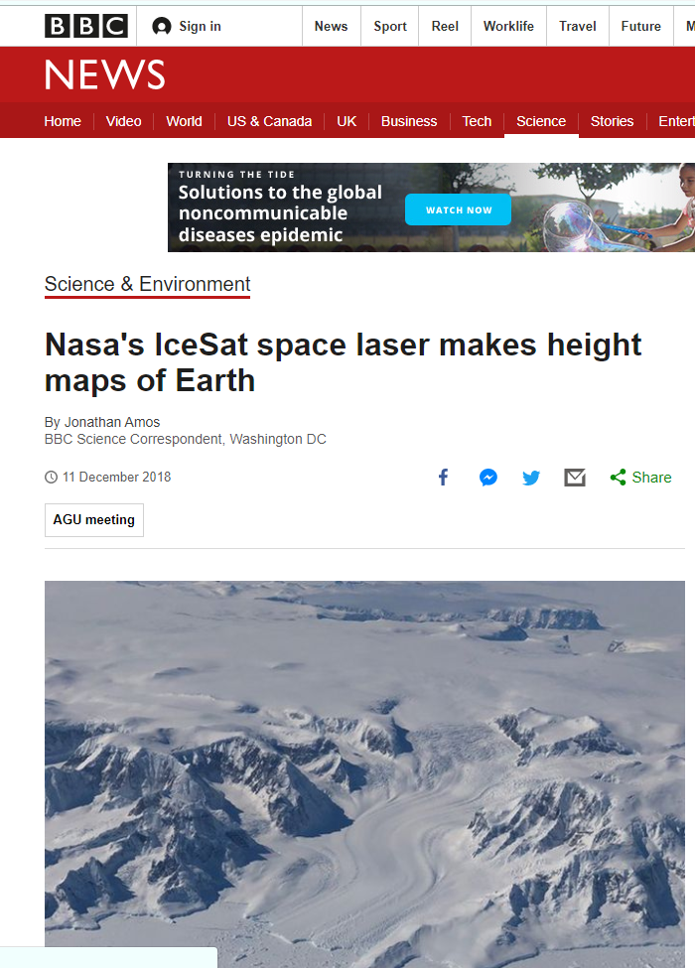
Mission Status
ICESat-2 Mission
NASA’s Earth observing altimetry mission
Successor to ICESat (2003-2009)
Designated as a top priority in Earth Science Decadal Survey
Launched successfully September 2018
More than a trillion measurements to date
All data available at National Snow and Ice Data Center
(nsidc.org)
Notes:
I mentioned previously that ICESat-2 is a flagship cyrospheric mission the was borne out of the 2007 decadal survey recommendation to continue high quality elevation measurements over our polar regions using laser altimetry. That is, can we observe changes in the ice sheets to provide mass balance estimation and measure sea ice freeboard to derive sea ice thickness and seasonal extent characteristics. These were similar objectives for the successor mission ICESat.

Slide 3
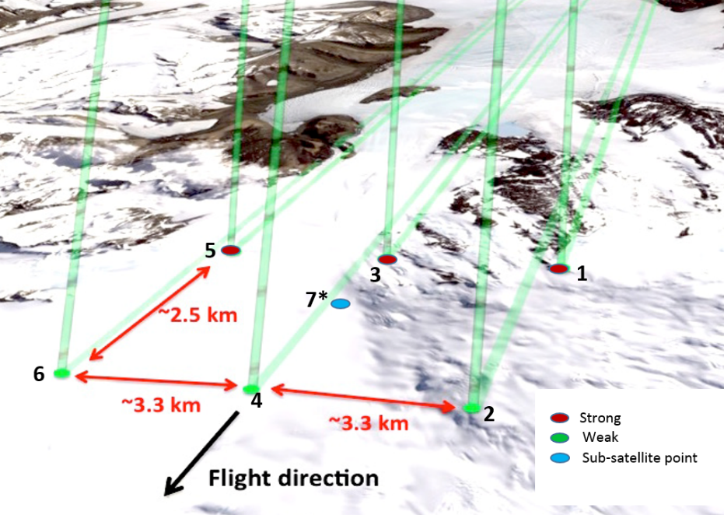
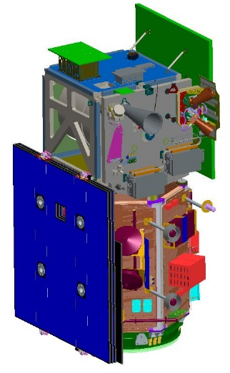
ICESat-2 Mission Overview
Payload
ATLAS – Advanced Topographic Laser Altimeter System developed at Goddard Space Flight Center, Greenbelt, MD.
Measures time of flight of laser pulses
Measures pointing direction
Single-photon sensitive detection
6 beams, arranged in 3 pairs
10 kHz pulse-rep. rate
11 m footprint
spaced 0.7m along-track
532nm wavelength
~3 km spacing between pairs provides spatial coverage
~90 m pair spacing for slope determination (2° yaw)
high-energy beams (4x) for better performance over low-reflectivity targets.
Implementation
Lifetime: 3 years, with consumables for 5+
Orbit: 496 km, non-sun-synch, 92° inclination
Repeat: 91 day exact repeat, ~30 day sub-cycle
Science Data: 1 TB/day
System Pointing: Control = 45 m (14.3 m, CBE)
Geolocation Knowledge = 6.5 m (4.0 m, CBE)
Magruder, L.A., Neumann, T. A., Brunt, K., Farrell, S., Fricker, H., Gardner, A., Neuenschwander, A., et. al., (2019) New Earth orbiter provides a sharper look at a changing planet. EOS, 100, https://doi.org/10.1029/2019EO133233
Notes:
Points to focus on:
Photon counting technology comes in different flavors. For awhile the only systems operational were the DoD’s quick response capability that utilized Geiger mode dection configuration which meant that the receiver- the photo multiplier tube was operated beyond the breakdown voltage and an incident photon would result in an exponential gain. ATLAS technology is what is called linear mode, which has a more sensitive receiver and more complex timing system to accommodate high laser repetition rates.
With photon level sensitivities the laser onboard ATLAS is lower power than the original ICESat which also accommodates higher laser repetition rates. This is important because the high repetition rates means more measurements in the along track direction. As such, ICESat-2 at a 10 kHz rate and an average altitude of nearly 500 km is able to provide measurements every 70 cm. Another novelity of this mission is that it is a multibeam system where a diffractive optical element produces 6 beams from one laser. These six beams are configured in 3 beam pairs with the spacing shown on the right. Each pair component is 90 m across track separation and each pair is 3.3 km apart. This helps to disentangle surface slope from elevation changes in repeat measurements. Additionally, each pair consists of a high and low energy beam to allow from some level of dynamic radiometry depending on the surface reflectivity.
Other aspects of the mission are that it has a 12 m footprint diameter and operates in the green regions of the electromagnet spectrum- a visible beam at 532 nm

Slide 4
Current Status
726 days on orbit since launch
ATLAS: transmitting laser light since 1 October 2018
605 billion laser pulses (compared with 2 billion from ICESat)
6 beams, arranged in pairs
11 m footprint diameter
0.7 m along-track spacing
Performance metrics remain nominal, and within requirements

Slide 5
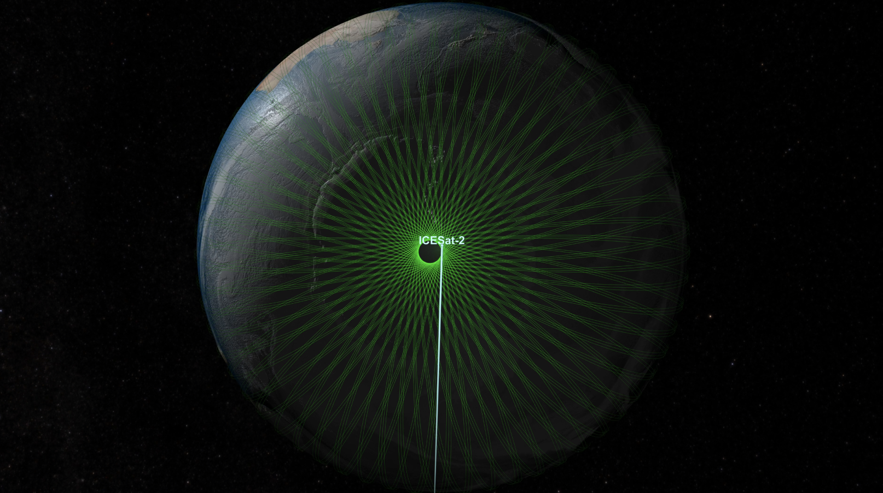
Orbit and Coverage
500 km altitude
88S to 88N
15 revs/day
1387 tracks
91-day revisit
Ground tracks at icesat-2.gsfc.nasa.gov

Slide 6
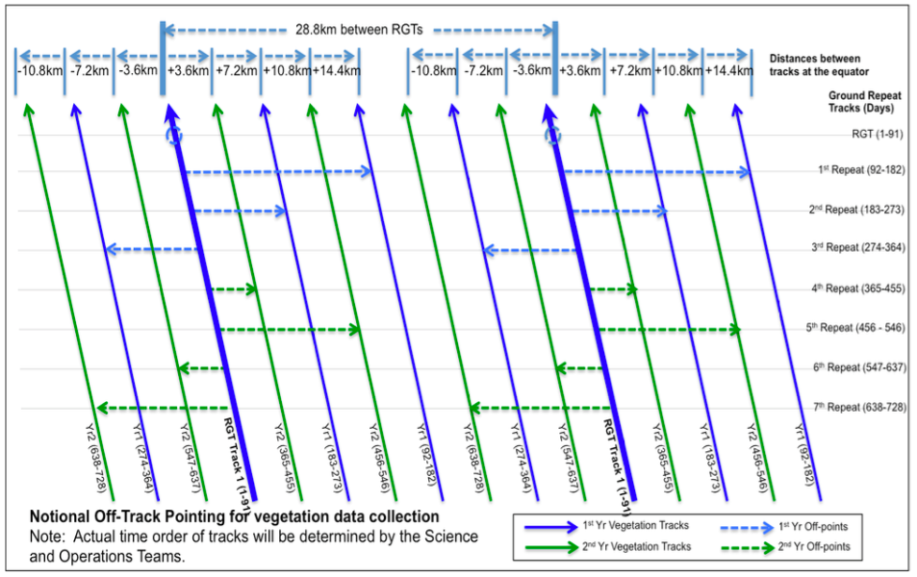
Off Pointing in Mid-Latitudes

Slide 7
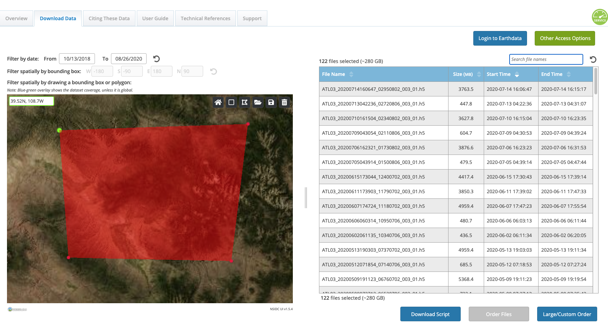
Grand Mesa, CO
via NSIDC spatial search tool

Slide 8
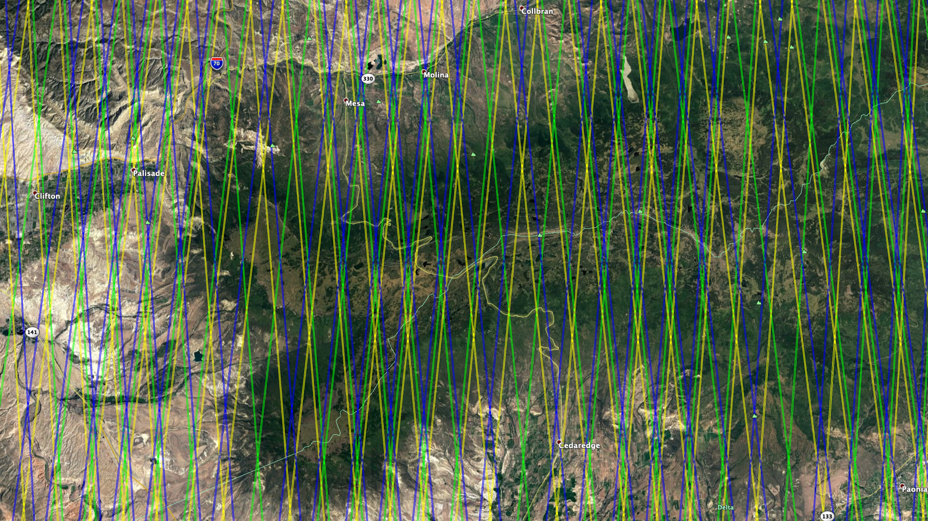
Grand Mesa, CO
Reference Ground Tracks
repeat every 91 days
Cycle 9 begins late September 2020
5 RGTs intersect Grand Mesa every 91 days:
211
714
737
1156
1179
Some are ascending passes, some descending
Yellow is right pair
Green is center pair
Blue is left pair
Tracks from Cycle 1 through Cycle 6 are shown

Slide 9
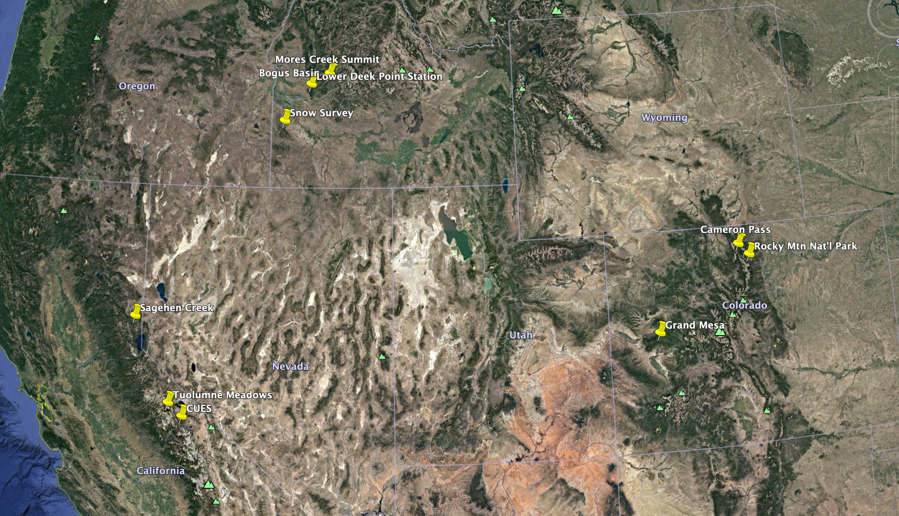
Current Snow-Off IS2 Data Collection a/o 8/20/2020

Slide 10
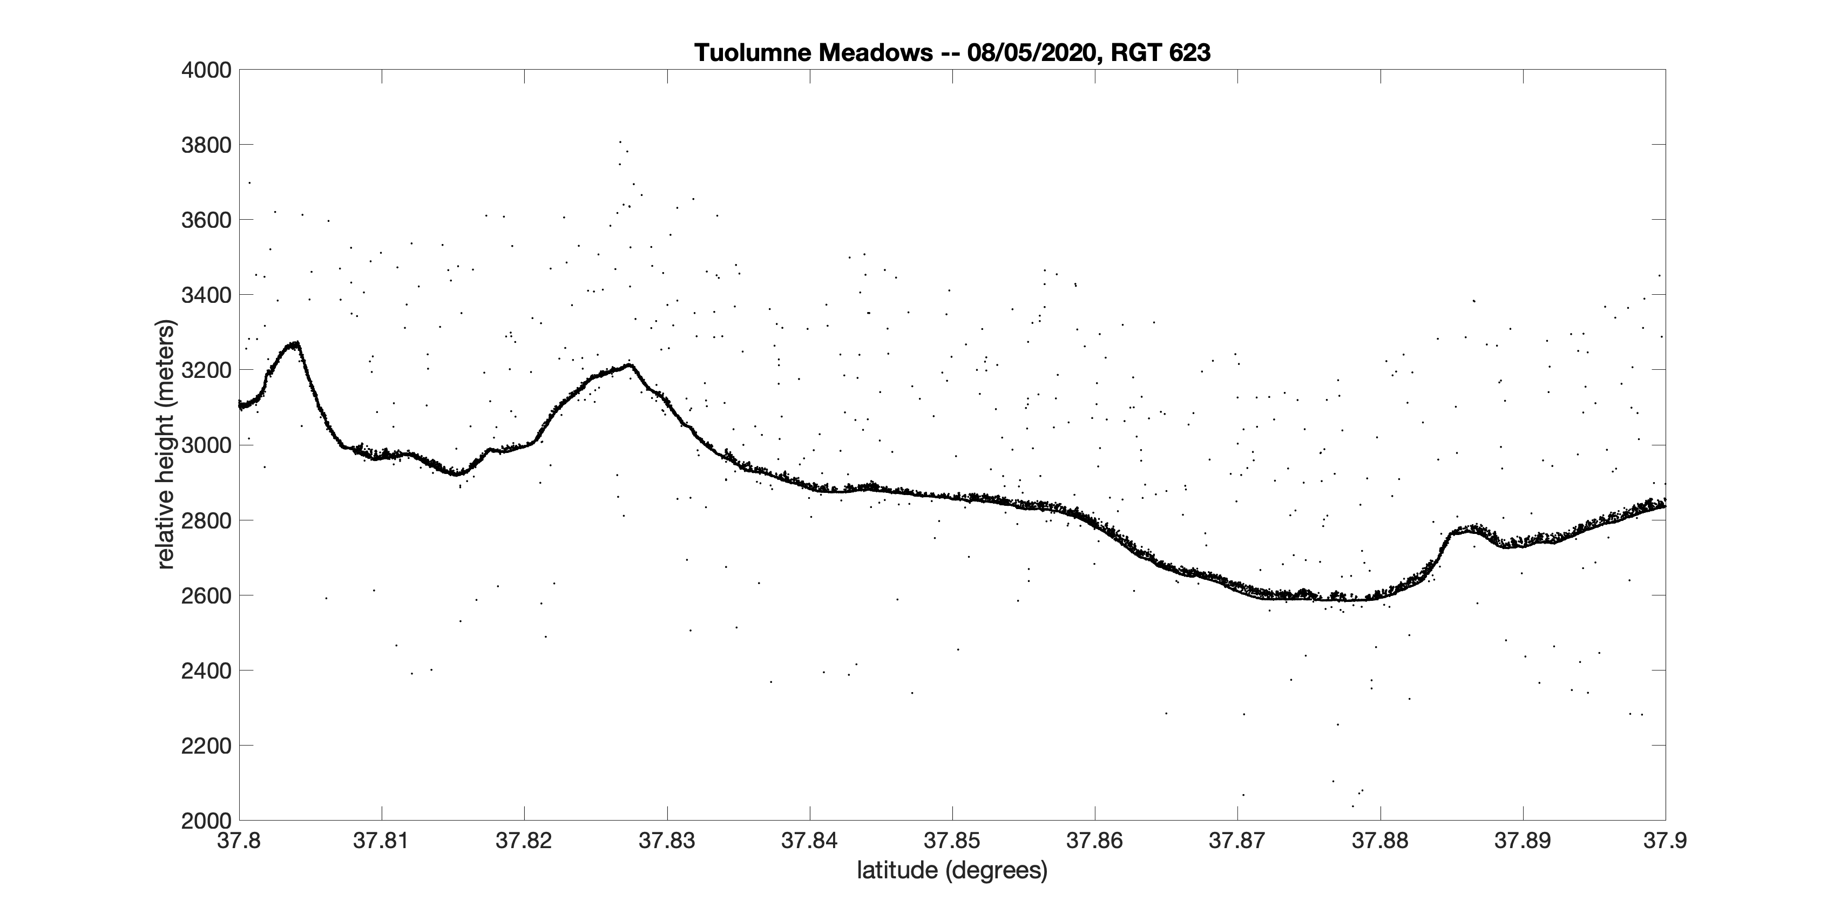

Slide 11
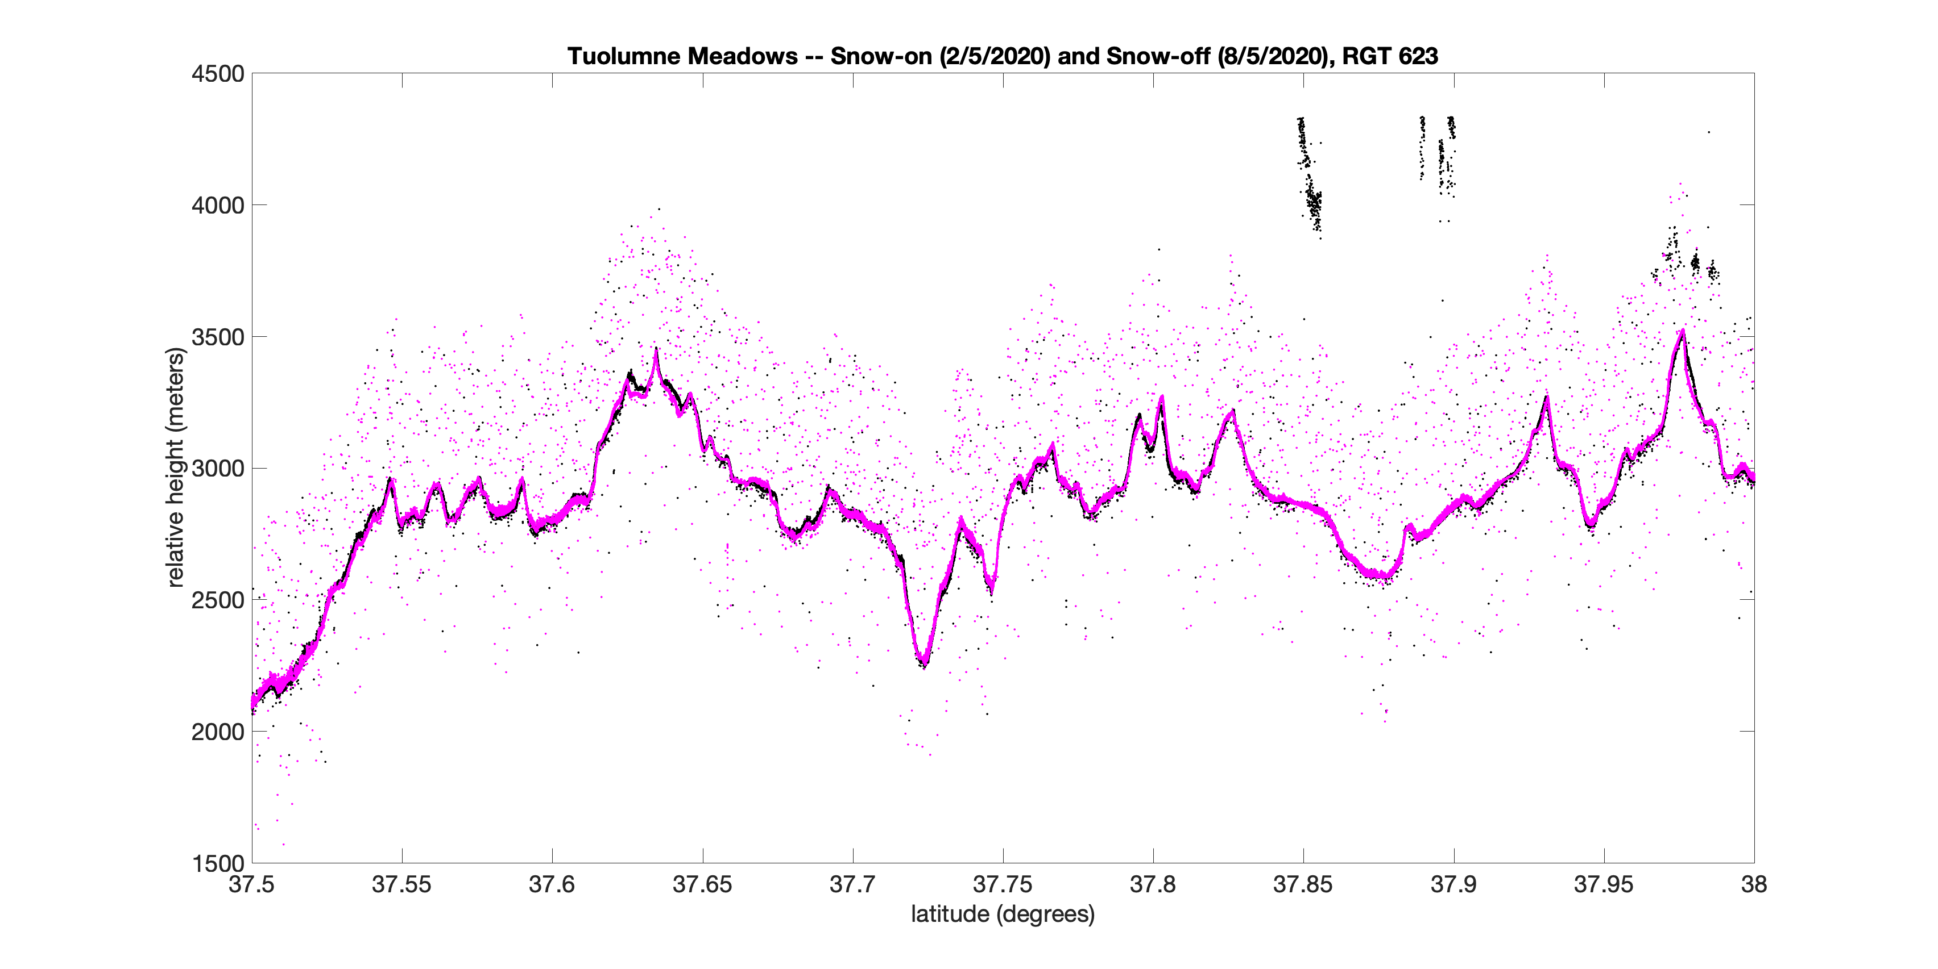
2/5/2020
8/5/2020

Slide 12
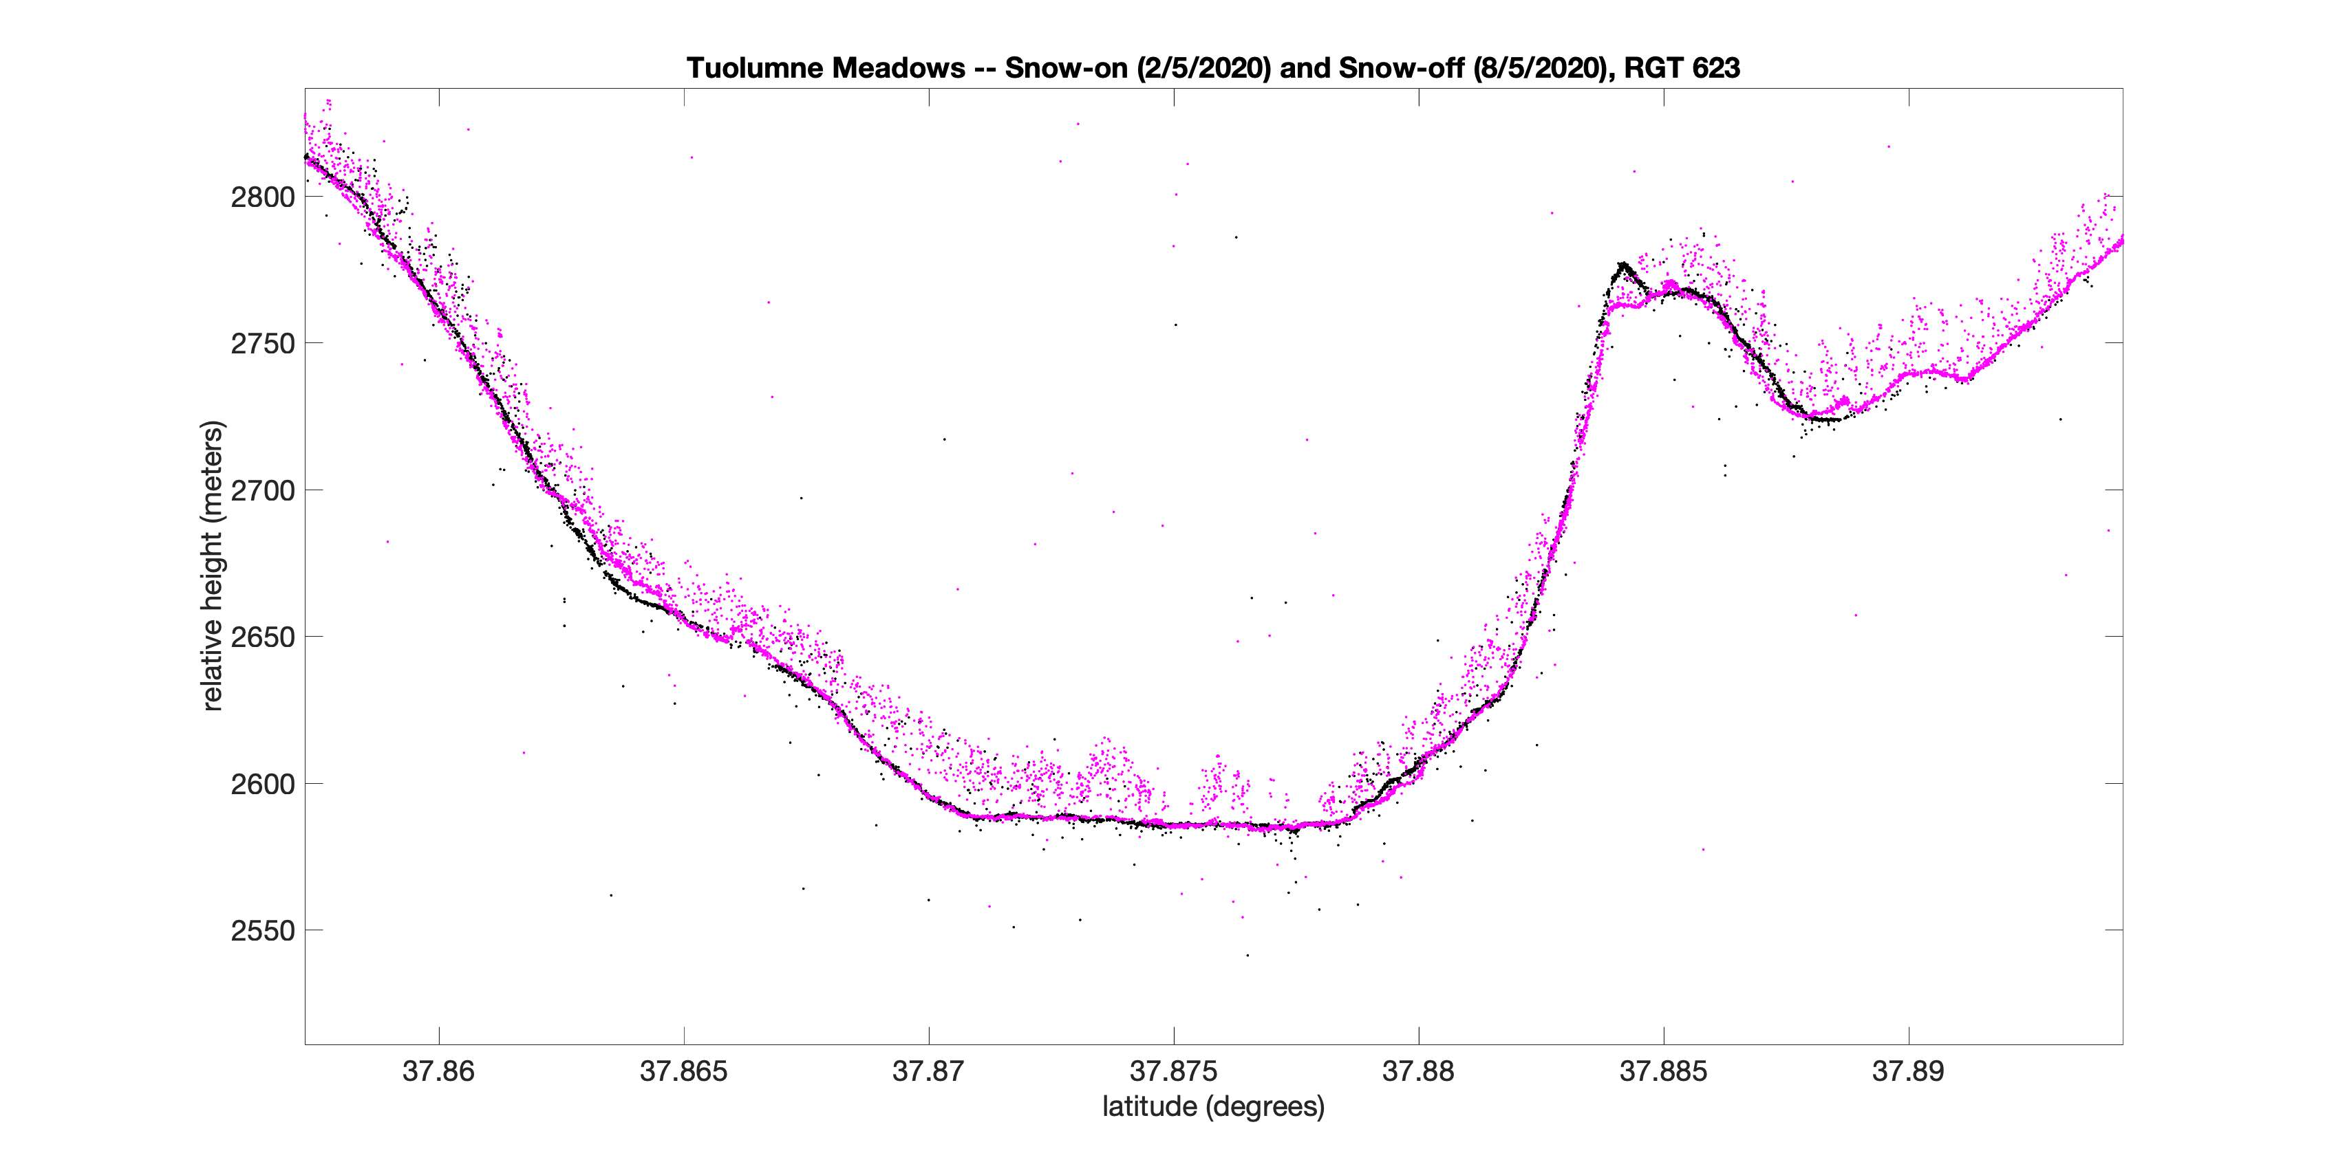
2/5/2020
8/5/2020

Slide 13
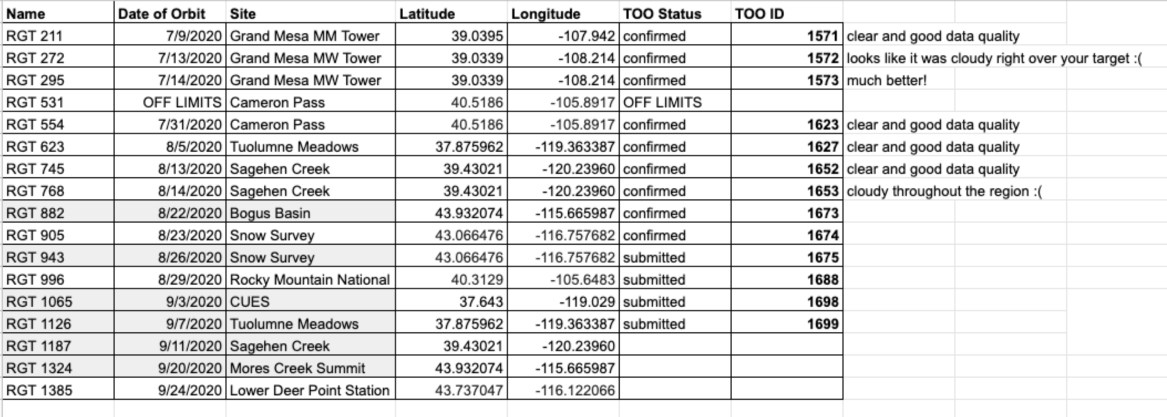
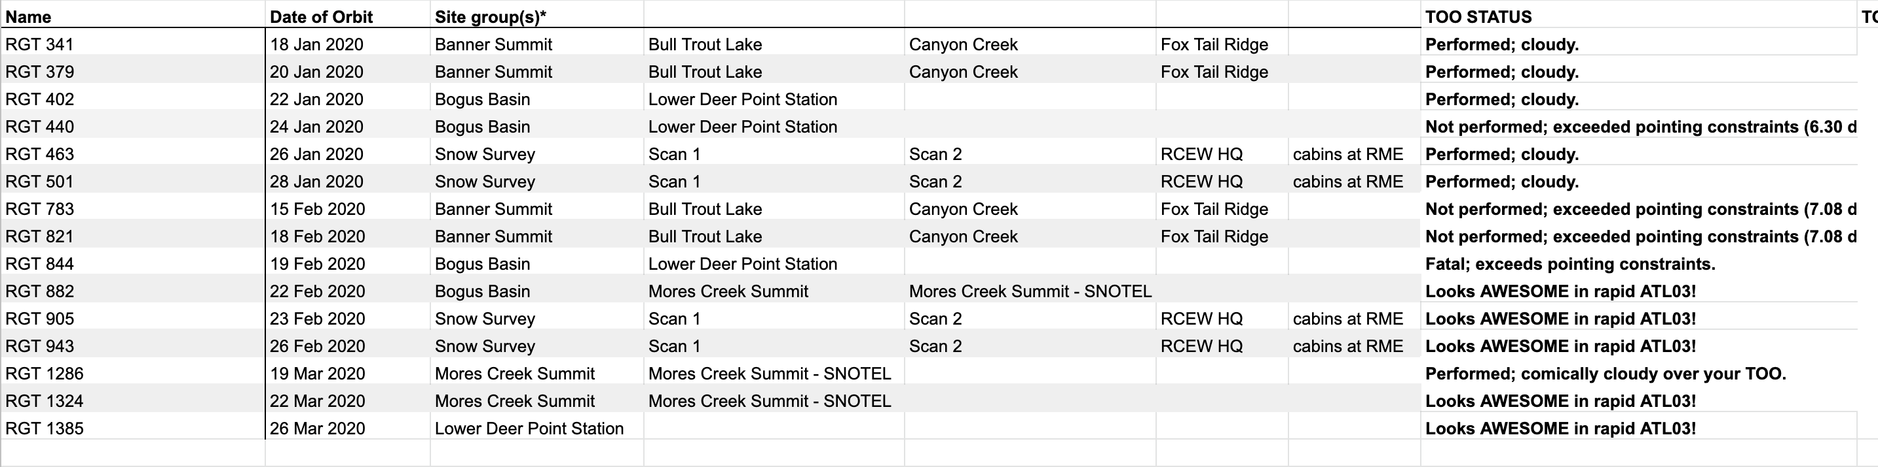
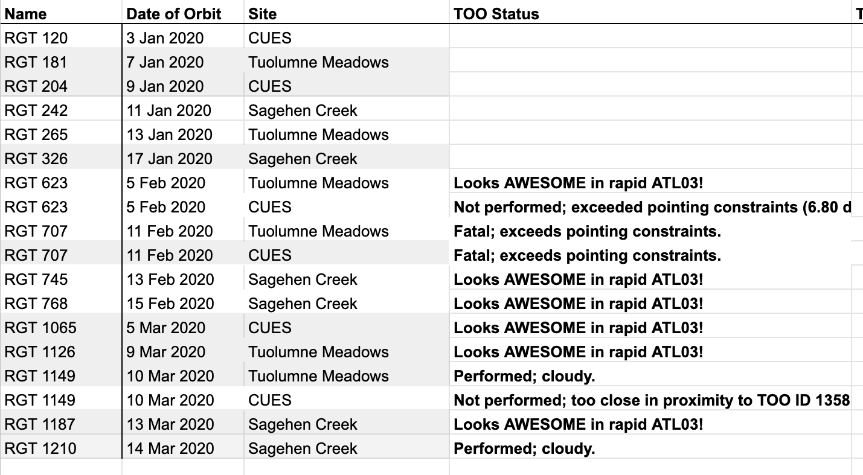
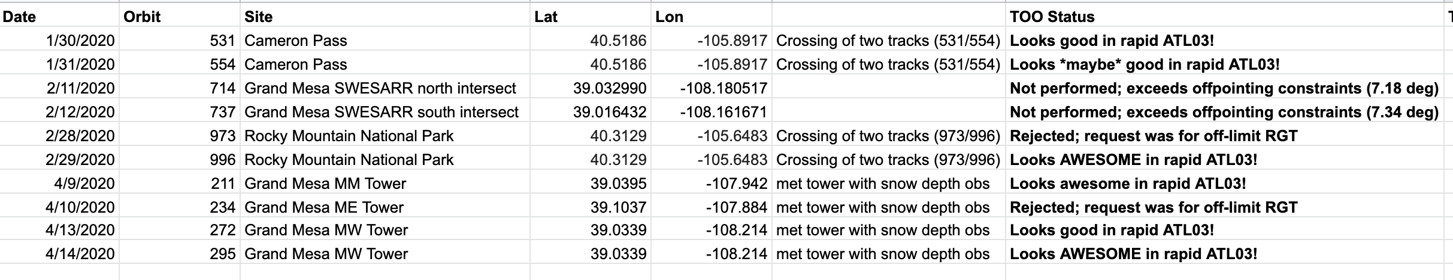
Pointing at SnowEx Sites
Summer Snow Off Status
Idaho Snow On Status
California Snow On Status
Colorado Snow On Status

Slide 14
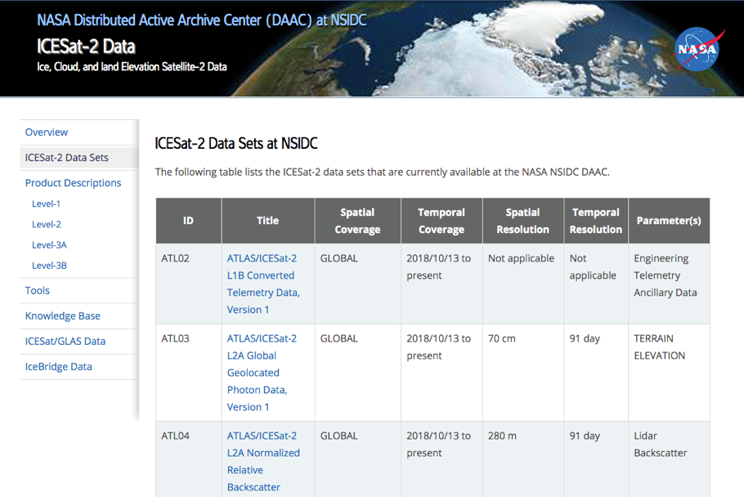
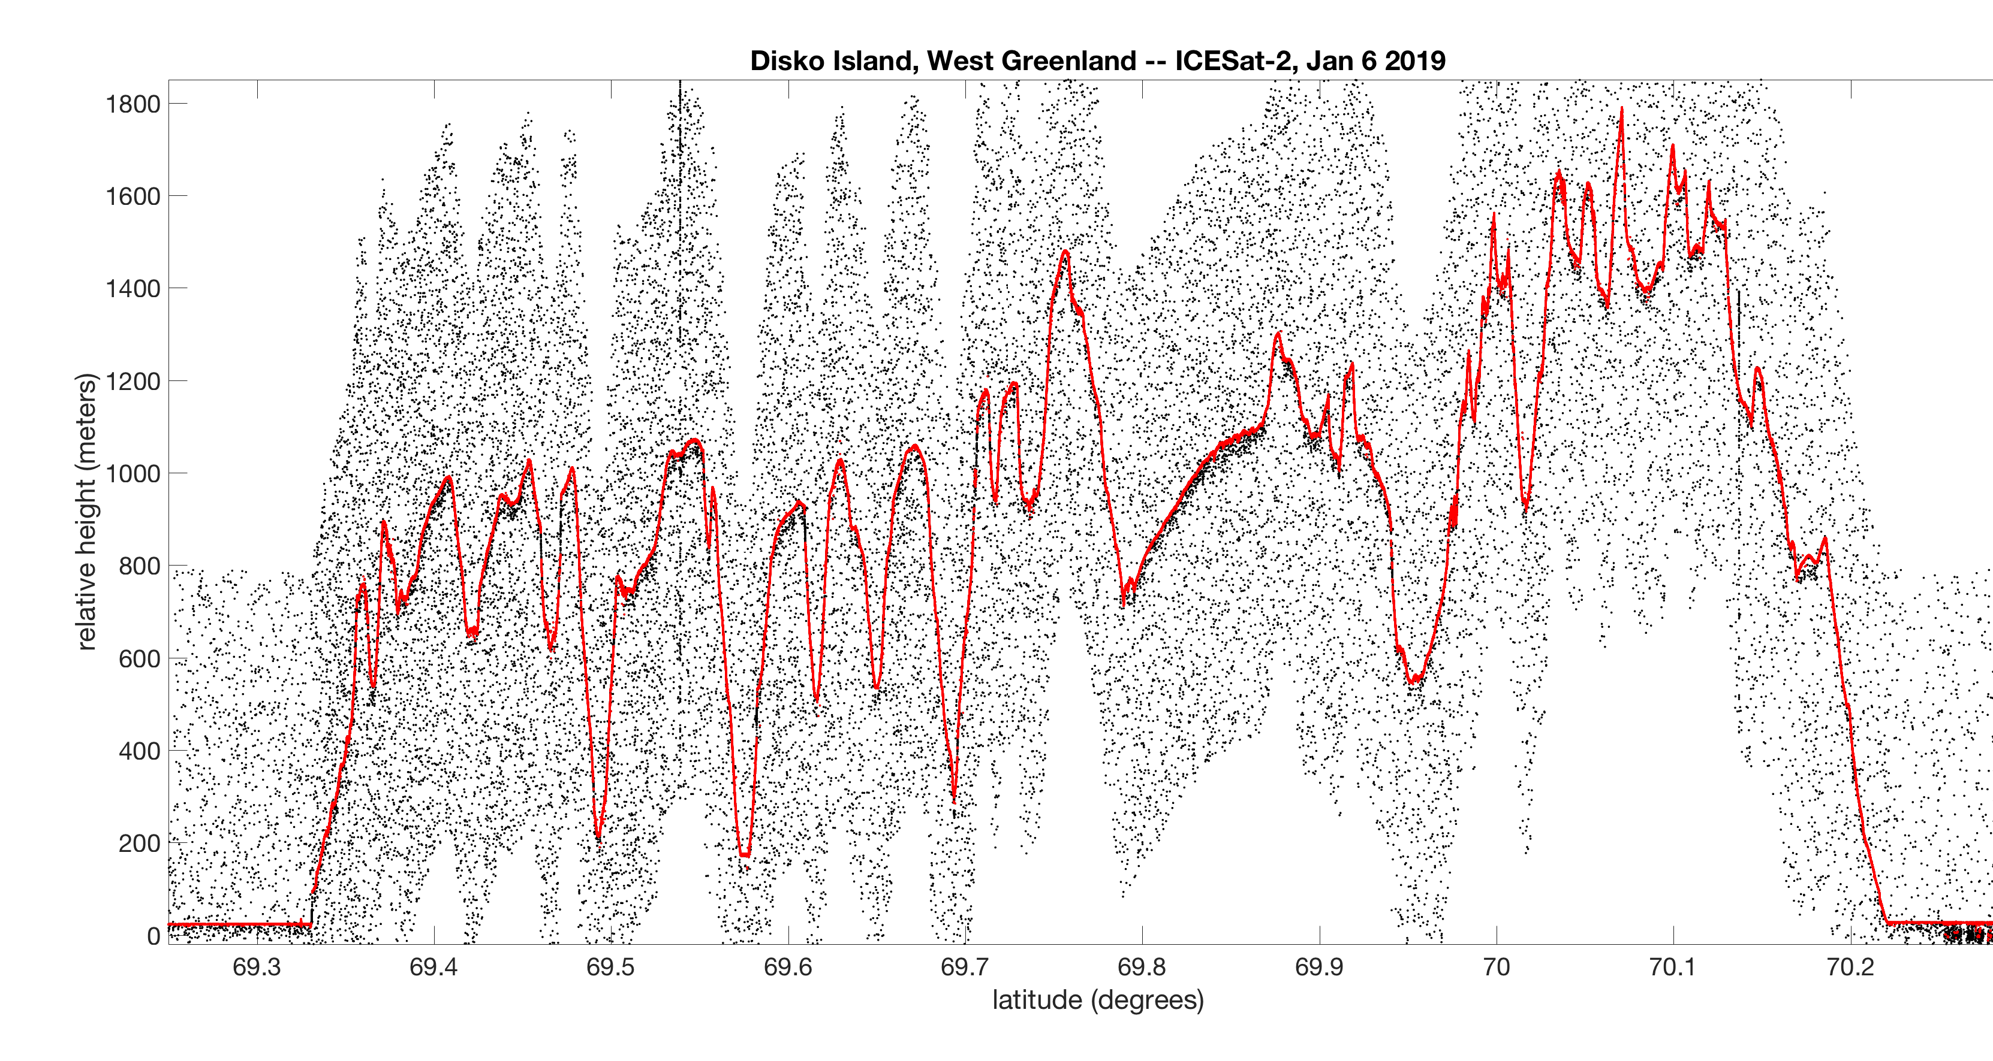
ICESat-2 Data are Publicly Available
National Snow and Ice Data Center (NSIDC DAAC)
Data Products:
Geolocated Photons (ATL03)
Land Ice Elevation
Sea Ice Elevation and Freeboard
Land Elevation (ATL08)
Atmospheric Backscatter
Ocean Surface Height
Inland Water Elevation
Rel003 data out 5 May 2020
Data through 15 July 2020
2297 unique data users to date
7,712,619 files served from since May 2019
Rugged topography in Greenland

Slide 15
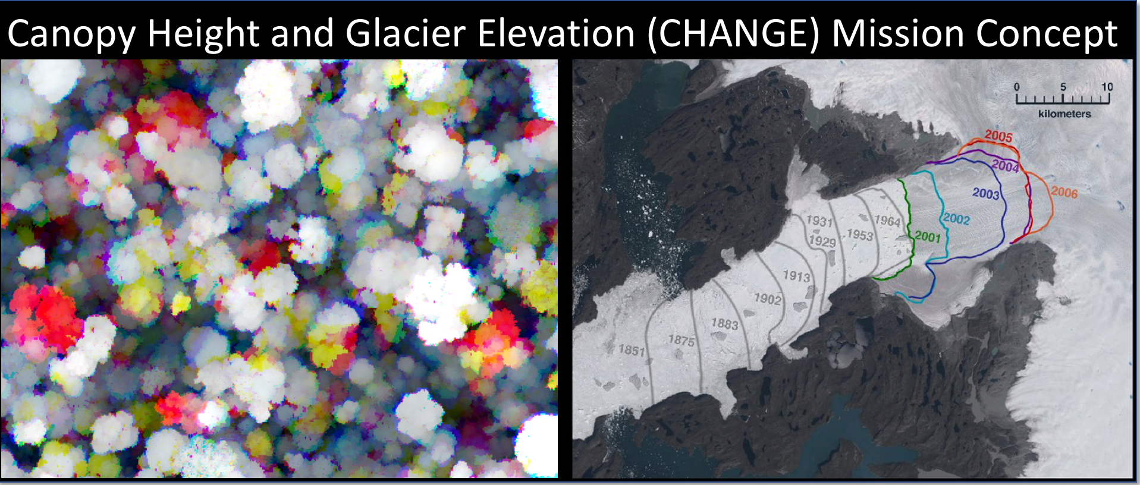
PIs: Cook, Morton, Neumann
Collaborators: Scott, Neigh, Yin, Martino, Vuyovich (GSFC)
Shean (Univ. of Washington), Morin (Univ. of Minnesota), Howat (Ohio St.), Gardner (JPL), Smith (Univ. of Washington)

Slide 16
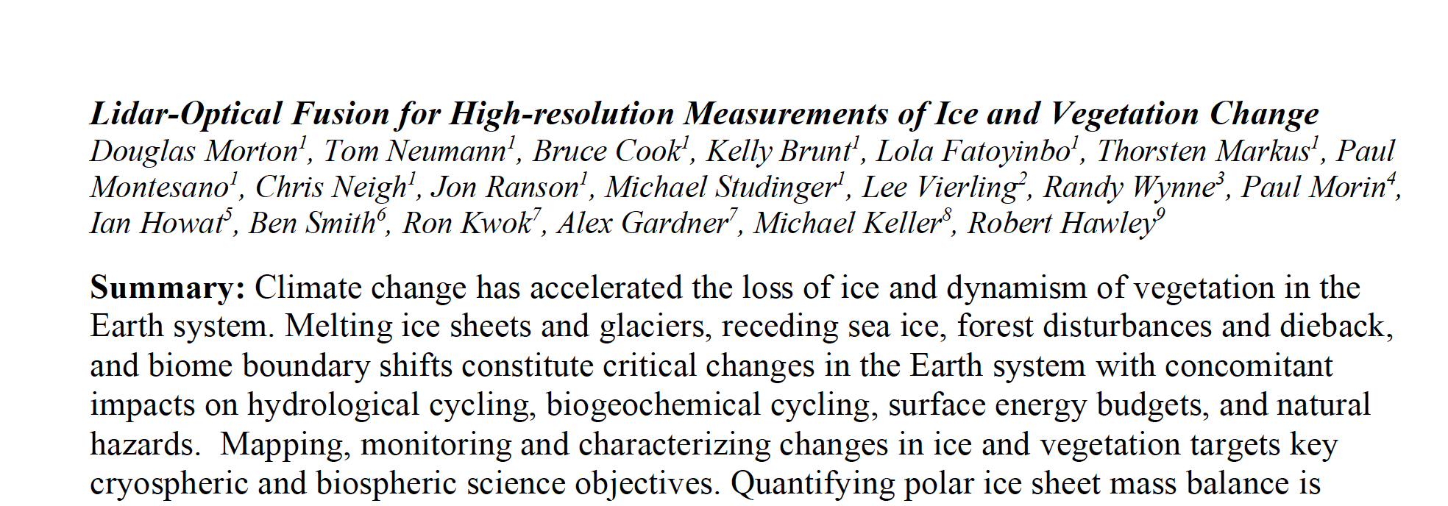
CHANGE: Concept paper for Decadal Survey
One of ~125 such White Papers
One of ~handful of laser altimetry white papers

Slide 17
CHANGE Science
Full time stereo & lidar operation
Seasonal (90 day) repeat ground tracks to assess fine-scale changes in ice topography and vegetation structure
1064 nm laser for vegetation profiles, ice sheet elevation
Fusion: lidar-derived control points in image swath; knowledge of features in lidar footprint.
Noh & Howat, 2015

Slide 18
CHANGE Measurement Concept
Concept in development for Earth System Explorers Announcement of Opportunity
COMPASS Lab at GRC, Aug 2018

Slide 19
ICESat-2 Measures the Earth
ICESat-2 well on it’s way to meeting science requirements:
ice sheet elevation, sea ice freeboard, vegetation canopy height
30+ science papers already in print; many more in review
Initial data quality: < 10 cm vertical, < 10 m horizontal
Spacecraft and instrument remain nominal

