Slide 1
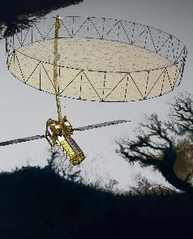
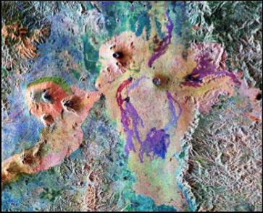


The NISAR Mission and Applications to Snow Hydrology
1
Rick Forster¹, Jewell Lund¹, Eli Deeb², HP Marshall³
NISAR slides provided by Paul A Rosen, NISAR Project Scientist
Jet Propulsion Laboratory,
SnowEx Workshop: September 11, 2020
2
3

Slide 2


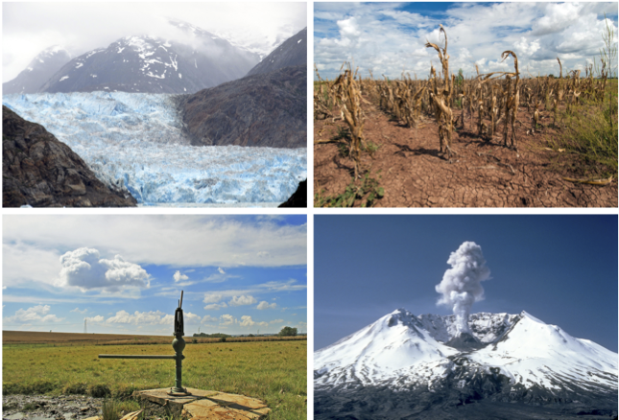
NISAR (NASA-ISRO SAR)
ISRO (Indian Space Research Organization
NASA Science Focus: Capturing the Earth in Motion
NISAR will image Earth’s dynamic surface over time, providing information
on changes in ice sheets and glaciers, the evolution of natural and
managed ecosystems, earthquake and volcano deformation,
subsidence from groundwater and oil pumping, and the human impact of
these and many other phenomena.

Slide 3


NISAR Science Overview and Program Context
NRC 2007 Decadal Survey recommended a DESDynI Mission for near-term launch to address important scientific questions of high societal impact.
NASA’s Climate Architecture identified the radar’s important role in climate (cryosphere and carbon) and water cycle science.
Dynamics of Ice: Ice sheets, Glaciers, and Sea Level
  Will there be catastrophic collapse of the major ice sheets, including Greenland and West Antarctic and, if so, how rapidly will this occur?
  What will be the resulting time patterns of sea-level rise?
  How are alpine glaciers changing in relation to climate?
Ecosystems and Biomass Change
  How do changing climate and land use in forests, wetlands, and agricultural regions affect the carbon cycle and species habitats?
  What are the effects of disturbance on ecosystem functions and services?
Solid Earth Deformation: Hazard Response
  Which major fault systems are nearing release of stress via strong earthquakes?
  Can we predict future eruptions of volcanoes?
  What are optimal remote sensing strategies to mitigate disasters and monitor/manage water and hydrocarbon extraction and use
The NASA NISAR Science Definition Team has developed a set of integrated requirements to respond to the Climate Architecture and other important questions, with ISRO Science participation
Coastal Processes: India
  What is the state of important mangroves?
  How are Indian coastlines changing?
  What is the shallow bathymetry around India?
  What is the variation of winds in India’s coastal waters?

Slide 4
Interferometric Synthetic Aperture Radar (InSAR) concept
InSAR measures surface deformation by measuring the difference in the phase of the radar wave between the two passes if a point on the ground moves and the spacecraft is in the same position for both passes (zero spatial baseline).

Slide 5
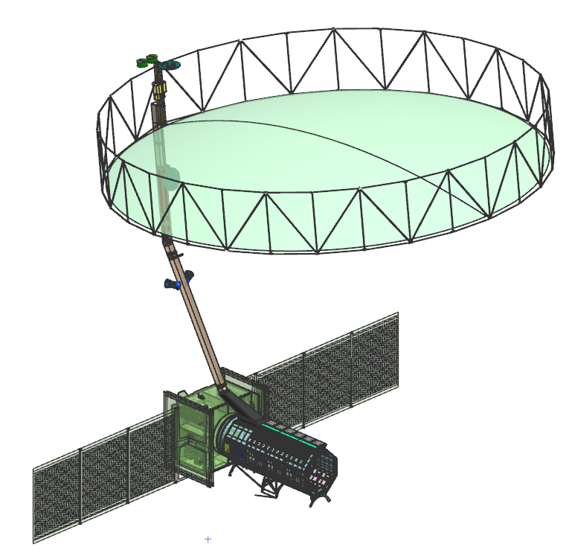
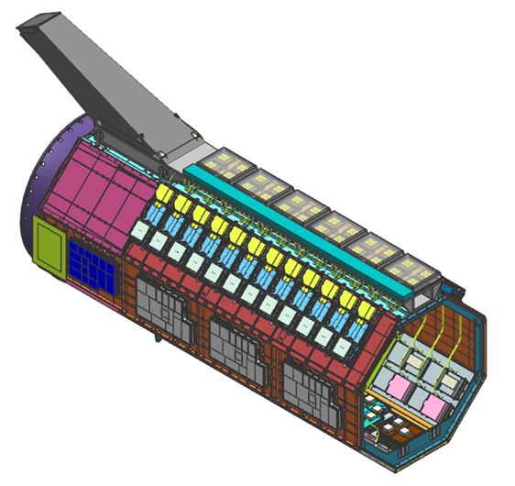
Instrument Physical Layout
Radar Antenna
Reflector (RAR)
S-SAR Feed RF
Aperture
(S-FRAP)
Radar Antenna
Structure (RAS)
L-SAR Feed RF
Aperture
(L-FRAP)
Boom Attach
Point
Radar Antenna
Boom (RAB)
L-SAR Radar
Instrument
Controller (RIC)
(Inside RIS)
I3K Spacecraft Bus
Solar Arrays
L-SAR Digital
Electronics
S-SAR Electronics
(Inside RIS)
L-SAR Transmit
Receive Modules (TRM)
Radar Instrument
Structure (RIS)

Slide 6
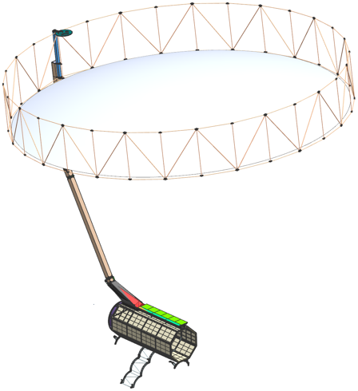
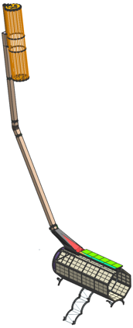
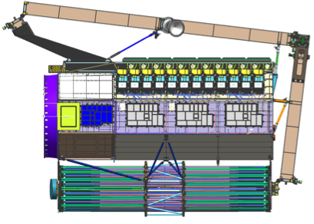
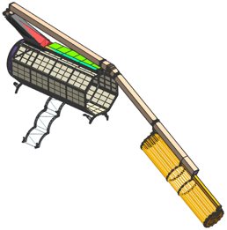
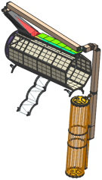


Reflector / Boom
Reflector (RAR)
  Selected NGAS-Astro Aerospace to provide AstroMesh (AM-1) Perimeter Truss mesh reflector
  Stiff, light-weight design meets pointing and stability requirements
  Completed 20G quasi-static load assessment of the Reflector with the GPS Antenna; no modifications are required to the reflector; launch restraint requires minor modifications
Boom (RAB)
  JPL in-house development joint with the SWOT project
  Completed boom hinge study; selected actuated 4-hinge design
  Currently developing deployment architecture
Reflector
Deployed
Boom Deployed
Reflector/Boom Stowed

Slide 7
L-SAR Instrument Features
Side looking L-band Synthetic Aperture Radar
Fully polarimetric for classification and Biomass
Repeat pass interferometer for deformation
  Tight Orbit and Pointing Control
  Tight phase stability over imaging time
Split Spectrum for ionosphere mitigation
Multi-beam Array fed Reflector to achieve a 240 km swath
  SweepSAR timing and Digital Beam Forming to reduce ambiguities and preserve resolution / looks
PRF Dithering to fill transmit interference gaps
Seamless mode transitions to minimize data loss
On-board filtering and compression to reduce downlink

Slide 8

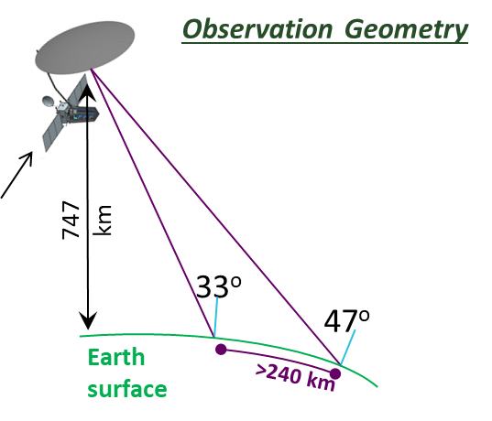
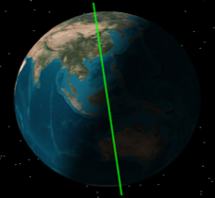


Solid Earth, Ecosystems, Cryosphere Science and Applications Mission
NISAR Characteristic: | Enables:
L-band (24 cm wavelength) | Low temporal decorrelation and foliage penetration
S-band (9 cm wavelength) | Sensitivity to lighter vegetation
SweepSAR technique with Imaging Swath > 240 km | Global data collection
Polarimetry (Single/Dual/Quad) | Surface characterization and biomass estimation
12-day exact repeat | Rapid Sampling
3 – 10 meters mode-dependent SAR resolution | Small-scale observations
Pointing control < 273 arcseconds | Deformation interferometry
Orbit control < 500 meters | Deformation interferometry
L/S-band > 50/10% observation duty cycle | Complete land/ice coverage
Left-only pointing (Left/Right capability) | Uninterrupted time-series Rely on Sentinel-1 for Arctic
NISAR Uniquely Captures the Earth in Motion
6 AM / 6 PM
Planned Launch: Late 2022

Slide 9
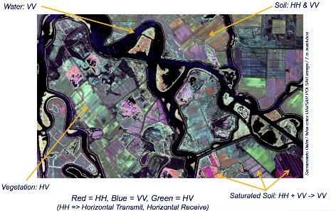
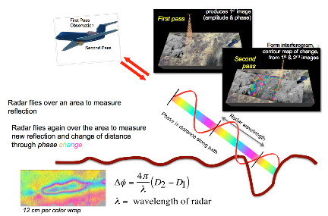
Versatility of SAR for Studying Earth Change
Polarimetric SAR
Use of polarization to determine surface properties
Applications:
  Flood extent (w/ & w/o vegetation)
  Land loss/gain
  Coastal bathymetry
  Biomass
  Vegetation type, status
  Pollution & pollution impact (water, coastal land)
  Water flow in some deltaic islands
Interferometric SAR
Use of phase change to determine surface displacement
Applications:
  Geophysical modeling
  Subsidence due to fluid withdrawal
  Inundation (w/vegetation)
  Change in flood extent
  Water flow through wetlands
9

Slide 10
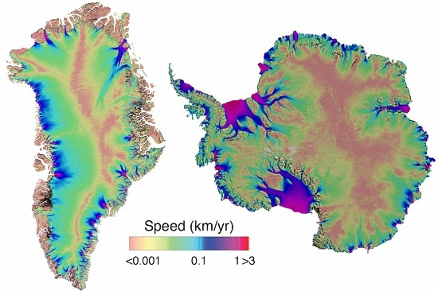
Routine Ice Sheet wide velocity mapping
Click to return to main

Slide 11
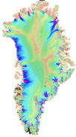
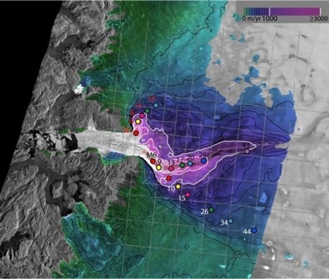
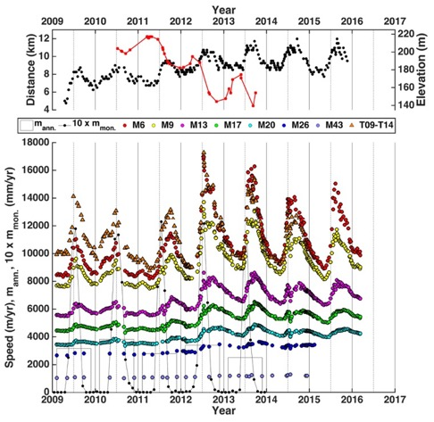
Cryosphere – Dynamic Ice Sheets
Jakobshavn Isbrae
Update to Joughin et al., 2014
Requires time-varying horizontal velocities at near-weekly sampling intervals in areas of potential rapid or seasonal change to an accuracy better than 3% plus 10 m/yr (1-sigma) at 500-m resolution (> 80% coverage)
Click to return to main

Slide 12
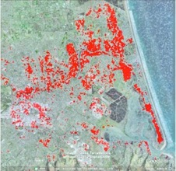
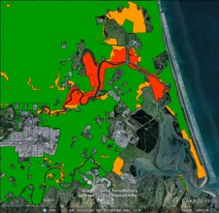
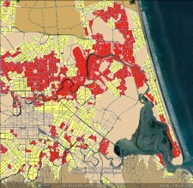
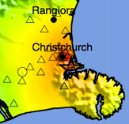

Disaster Response
Damage Proxy Map from radar data
Shakemap released
by USGS NEIC
Radar data acquired
by ALOS satellite
Official damage map released
based on ground observations
Official damage map updated
based on ground observations
2011
Feb
Mar
Apr
May
Jun
Jul
Aug
Sep
Oct
M6.3 Christchurch Earthquake
185 people killed
> 1000 buildings destroyed
Over US $30 billion damage
Original ALOS Data © JAXA, METI 2011
Official damage map provided by the New Zealand Government (http://data.govt.nz)

Slide 13
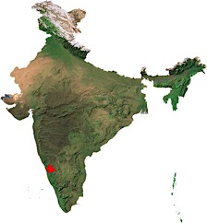
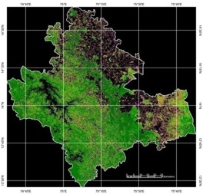
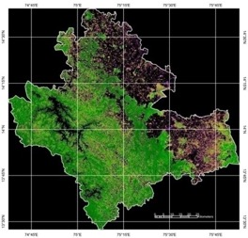
Above-ground Dynamics of Forest Biomass
ALOS PALSAR-1 HH+HV pol Data
Shimoga
(Karnataka)
BIOMASS
Shimoga (KAR.)
2008
BIOMASS
Shimoga (KAR.)
2010
Y_{BIOMASS (t/Ha)} = A + (B * σ⁰_{HV}) + (C * σ⁰ _{HH-HV})
σσ⁰ is backscattering coefficient in dB and A, B and C are the model coefficients
(RMS Error < 25 t/ha for biomass range within 120 t/ha)
N
N
model coefficients (A,B & C) have been calculated for different types of forests at several bio-climatic regions
Biomass (ton/ha)
(Deciduous forest dominated by teak (Tectona grandis) vegetation)
No forest < 20 20 – 50 50 – 80 80 – 120 120 – 160 > 160

Slide 14
NISAR Systematic Observations
Hi-res
3-pol
Repeated every 12 day cycle for the life of the mission
Med-res
2-pol
No target conflicts: overlapping targets uses union of all modes specified
Colors indicate different radar modes
Persistent updated measurements of Earth
41 Tbits / day total L+S band science data downlink
120 Tbytes / day total L+S band L0-L2 data products
J. Doubleday
P. Sharma, JPL
14
Notes:
Hi-res 3-pol = 40 MHz BW Quasi-quad pol (40 MHz HH/HV + 5 MHz VV/VH
Med-pol 2-pol = 20 MHz BW Dual Pol – 20 MHz HH/HV + 5 MHz HH/HV

Slide 15
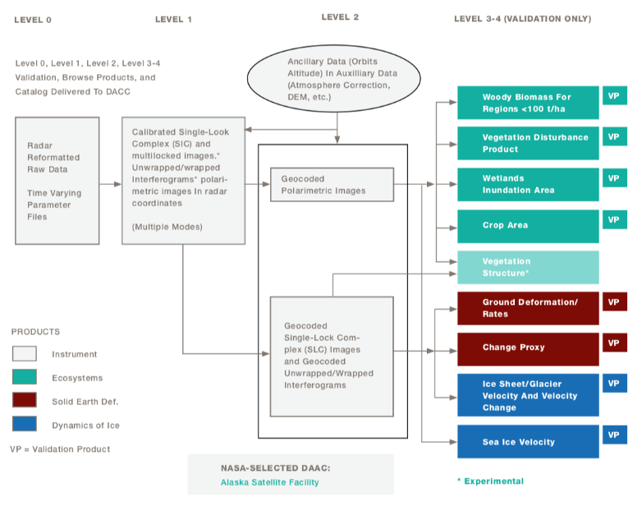
NISAR – Mission Data Products
15

Slide 16

SWE from InSAR: Theory
t₁
ΔR_{ns} = Path length without snow
θ_{i} = Incidence angle
d_{s} = Snow depth
ε_{s} = Permittivity
ΔR_{a} = Path length through atmosphere
ΔR_{r} = Path length refracted through snow
θ_{r} = Refracted radar angle
t₀
θ_{i}
ΔR_{a}
Phase shift due to snow:
ΔR_{r}
d_{s} ε_{s}
ΔR_{ns}
θ_{r}
For NISAR parameters
and snow density up to 0.5 g/cm³
(modified from Guneriussen et al., 2001)
ΔSWE (cm) = 2.03 φ_{snow} (radians)

Slide 17
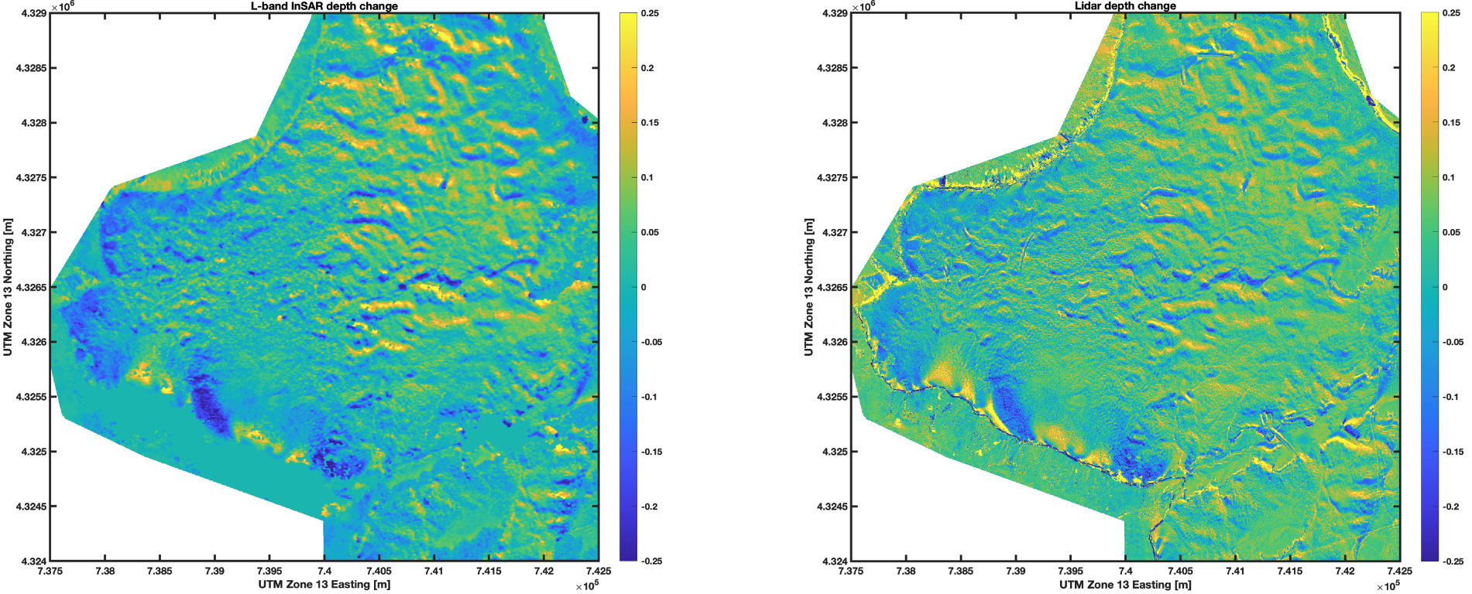

Recent L-band InSAR results from SnowEx 2020
UAVSAR pair from Grand Mesa, Feb 13 - Feb 1, 2020
Quantum Spatial Inc (QSI) lidar flights for depth change, Feb 12-Feb 1, 2020
Lidar accuracy ~3-5cm per flight, expected ~6-10cm accuracy for depth/depth change products
UAVSAR depth inversion uses phase change and incidence angle, with measured surface density (200 kg/m^3). No tunable parameters!

Slide 18
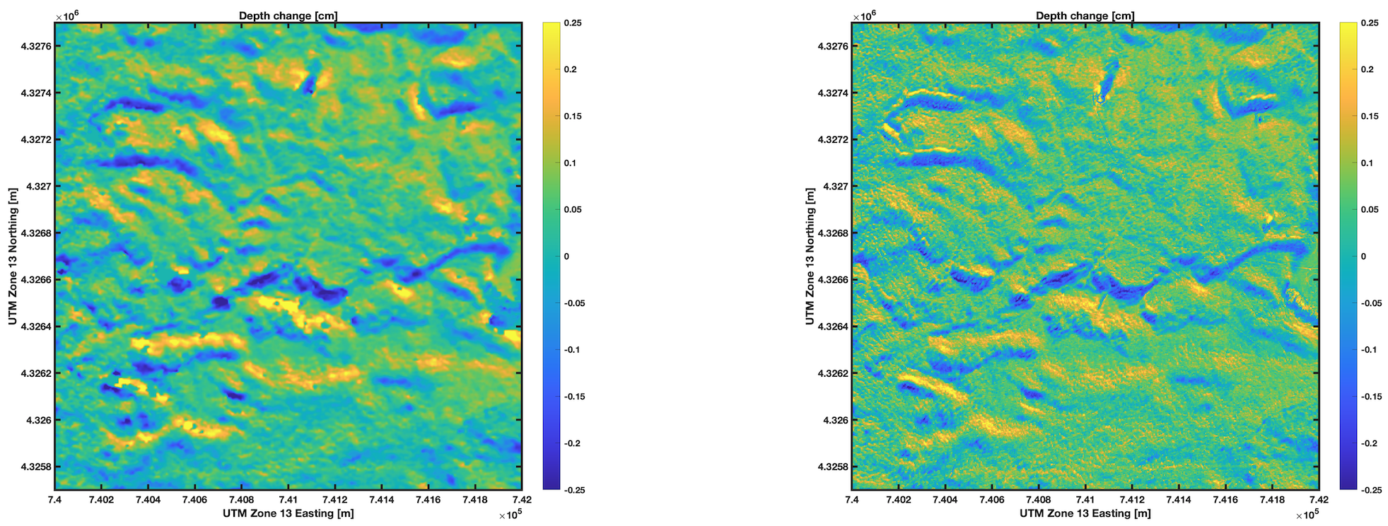
Recent L-band InSAR results from SnowEx 2020
Zoom in on 2km x 2km region with dynamic range in depth
R-value = 0.76, RMSD=4.7cm depth, 0.9cm SWE
Independent high-resolution spatial snow information is critical for evaluation of radar approaches

Slide 19
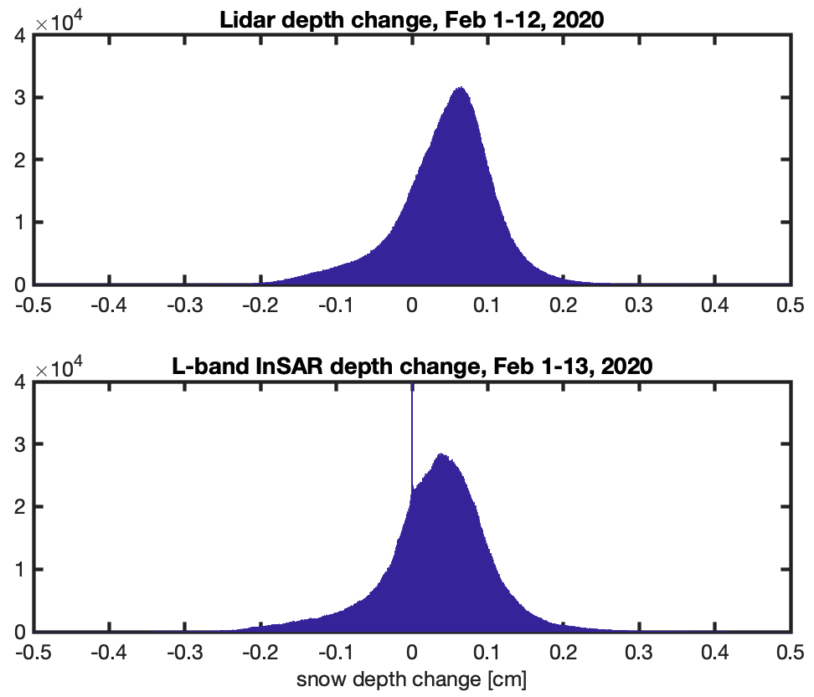
Recent L-band InSAR results from SnowEx 2020
Independent field observations of depth change show a mean depth change of 9cm over this period
In these conditions (surface density ~200 kg/m^3), 360 deg phase change can capture 46cm depth change. Reference location and surface density estimate required.
Correlation loss after 3-12 weeks depending on conditions, much shorter in vegetation
SnowEx2021 focused on capturing larger SWE/depth changes, and exploring transition between dry and wet snow
Technique shows promise for defining snow accumulation patterns
More work needed to define limitations in vegetation and steep topography

Slide 20
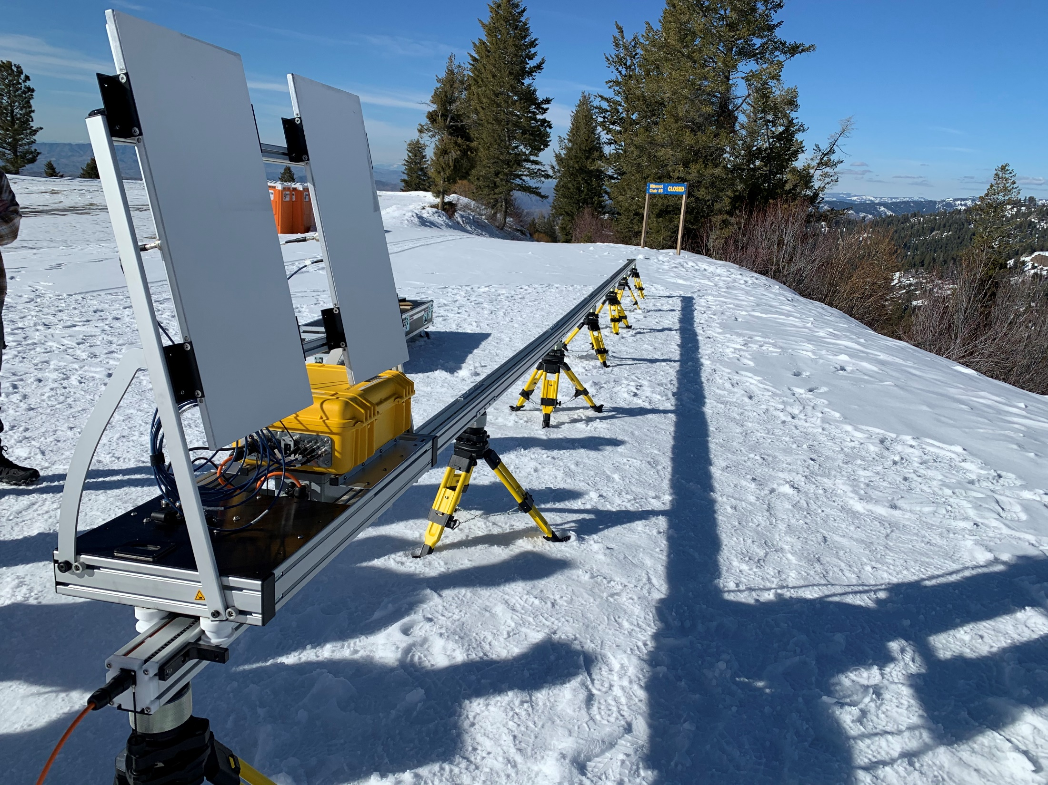
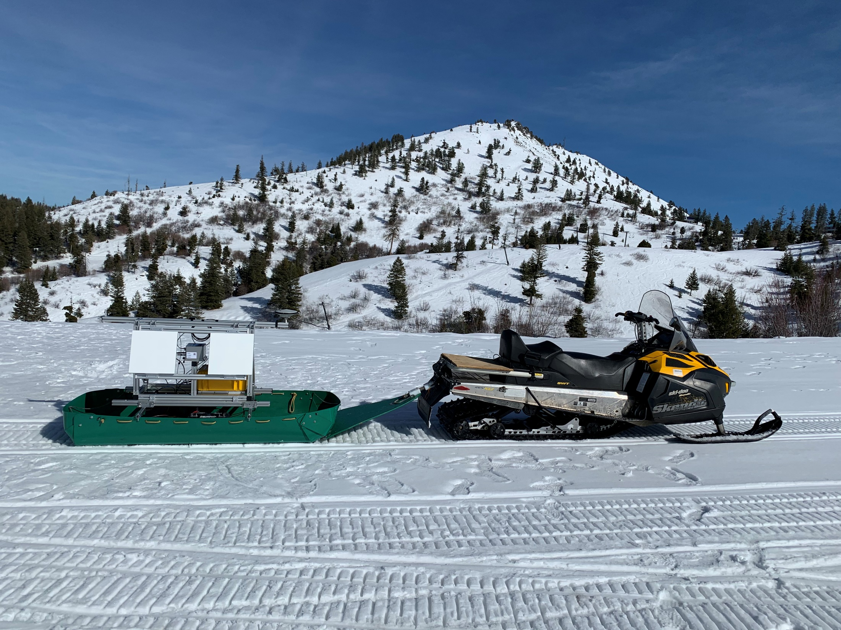
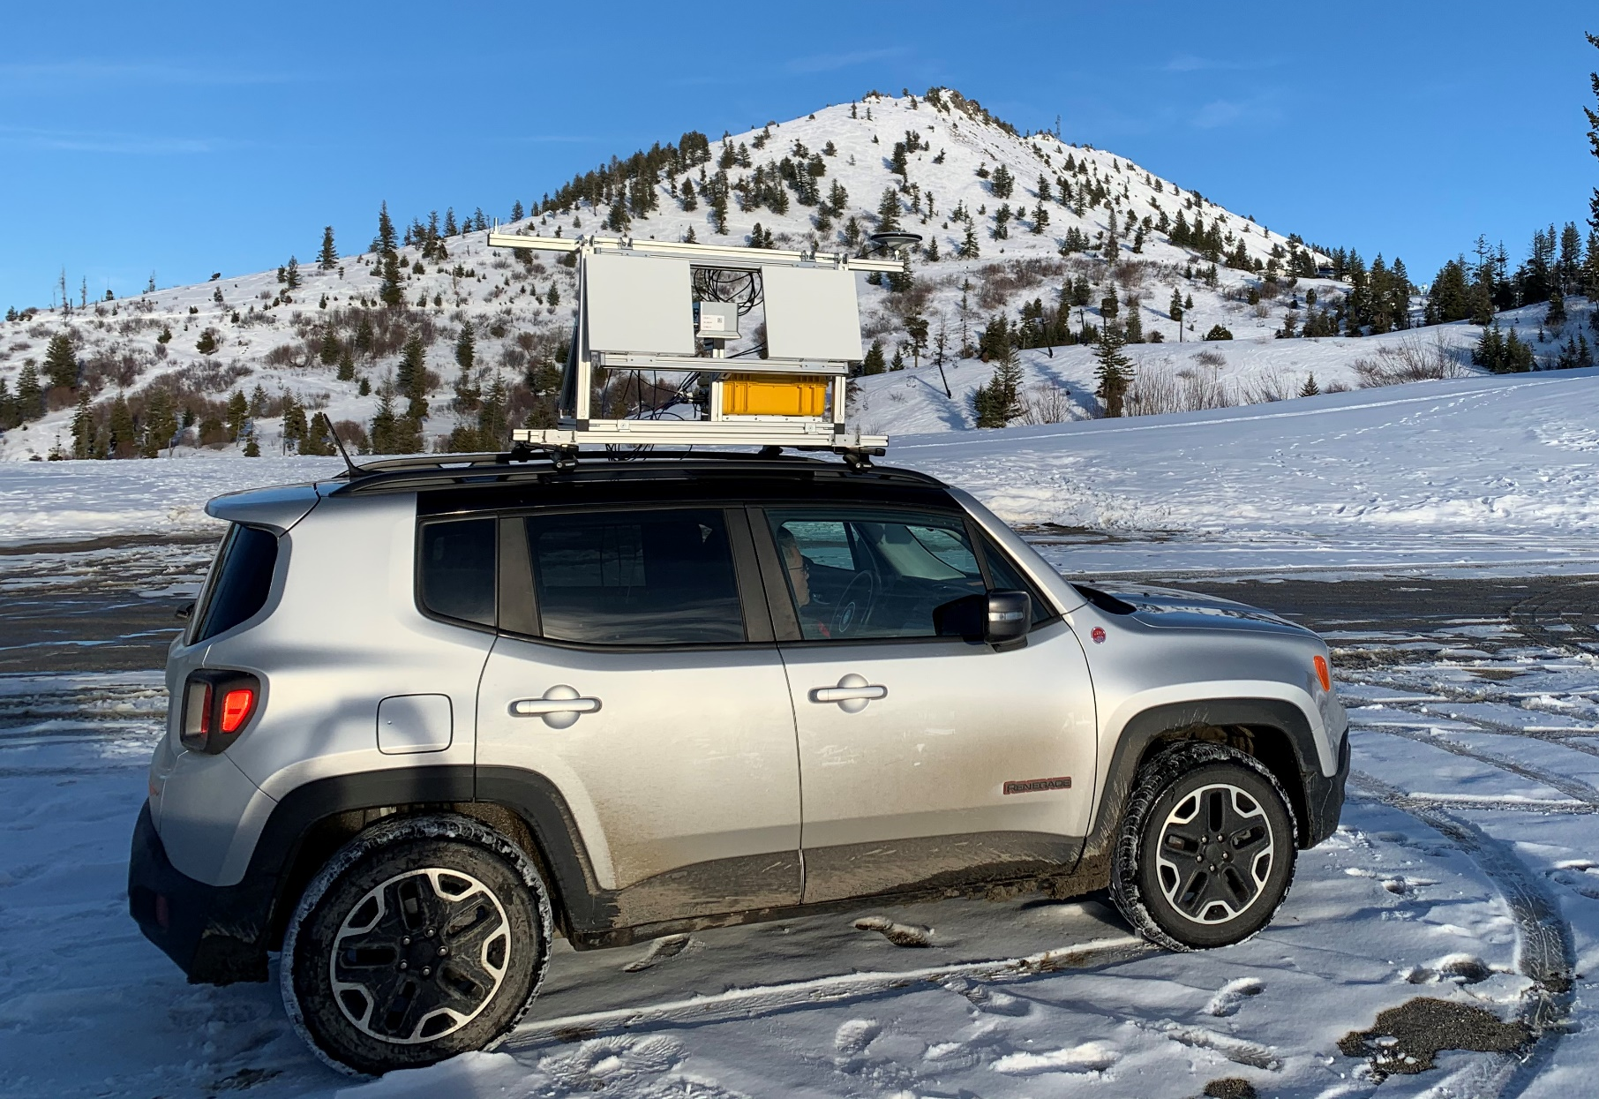
CRREL Ground-based L-Band InSAR experiment at Bogus Basin, ID

Slide 21
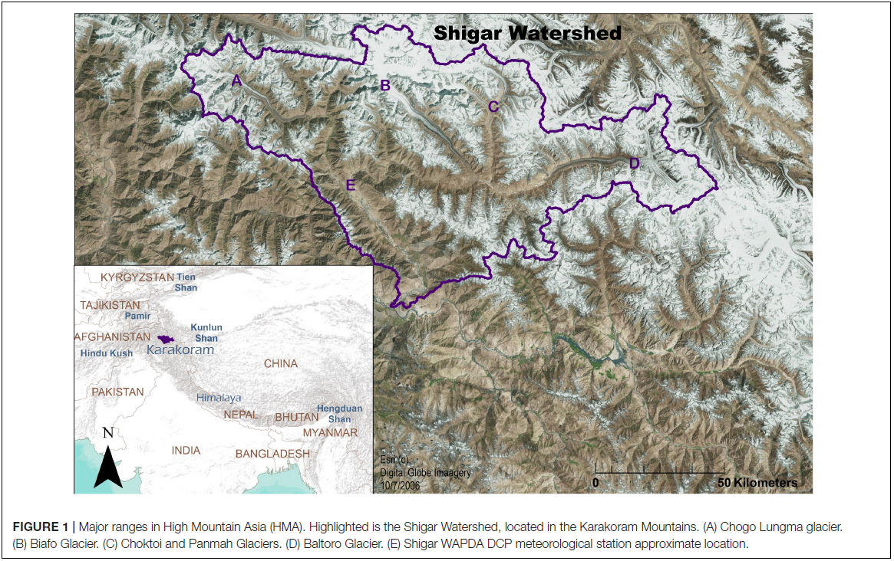
Snow melt mapping with SAR
Lund et al., 2020

Slide 22
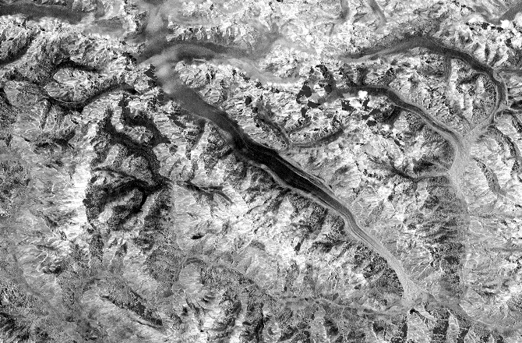
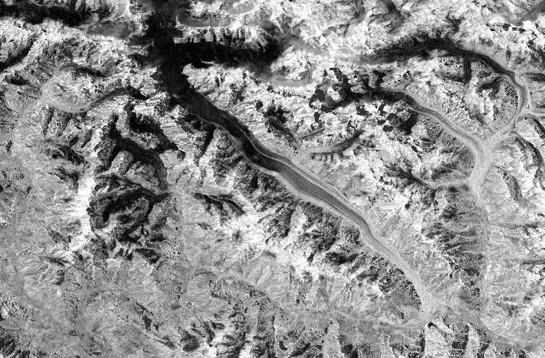
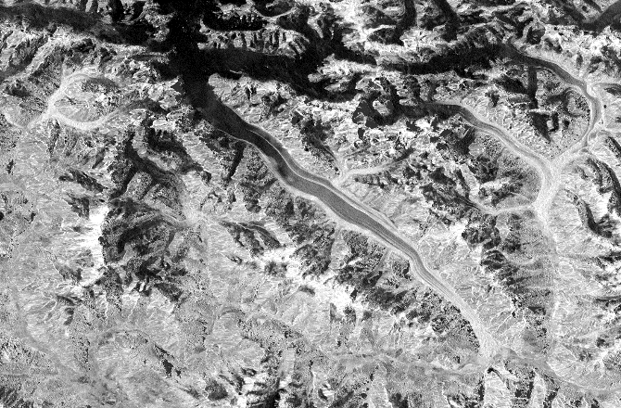
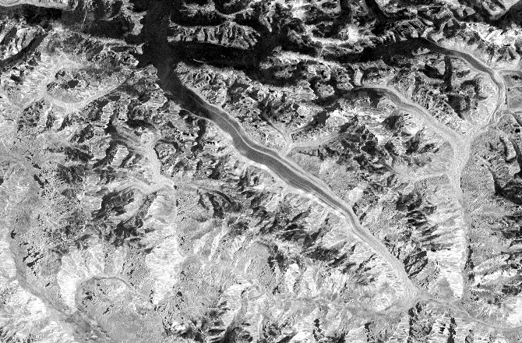
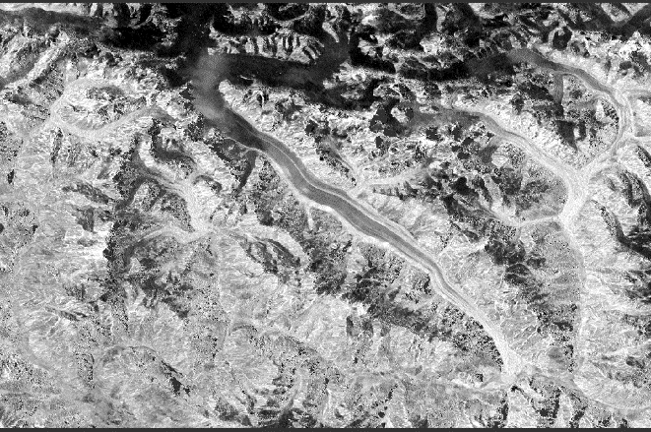
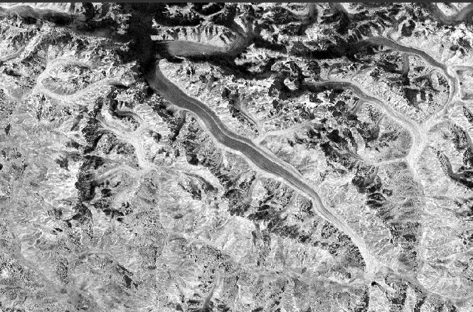
Wet snow cover mapping for stream discharge modeling
Time series of Sentinel-1 SAR data indicating changes in the wet snow cover
Wet snow mapping spring through fall 2015 using Sentinel-1.

Slide 23
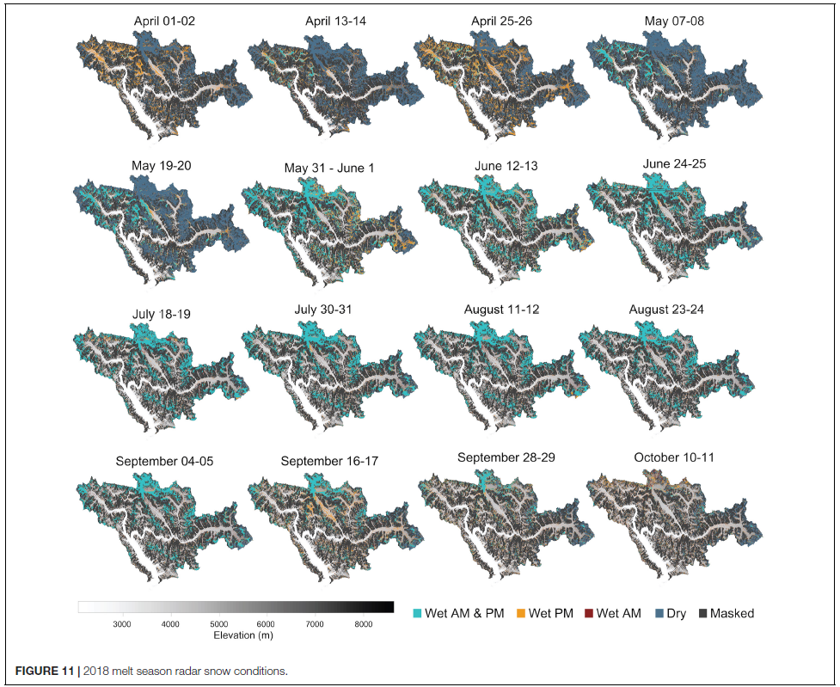
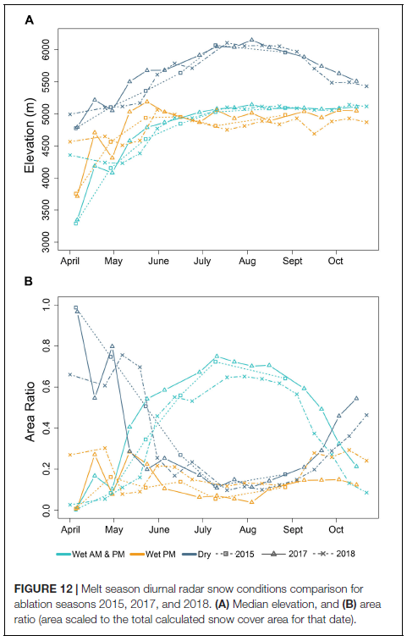
Lund J, Forster RR, Rupper SB, Deeb EJ, Marshall HP, Hashmi MZ and Burgess E (2020) Mapping Snowmelt Progression in the Upper Indus Basin With Synthetic Aperture Radar. Front. Earth Sci. 7:318. doi: 10.3389/feart.2019.00318

Slide 24

Science Users’ Handbook
Describes:
Science and Applications
Mission Science Requirements
Mission Design and CONOPS
Flight System Characteristics
Radar and Measurement Principles
Data Products
Will be revised prior to launch or as necessary
Other major documents:
Cal/Val Plan
Utilization Plan
Application Workshop Reports
21 science and applications white papers
https://nisar.jpl.nasa.gov/files/nisar/NISAR_Science_Users_Handbook1.pdf

Slide 25
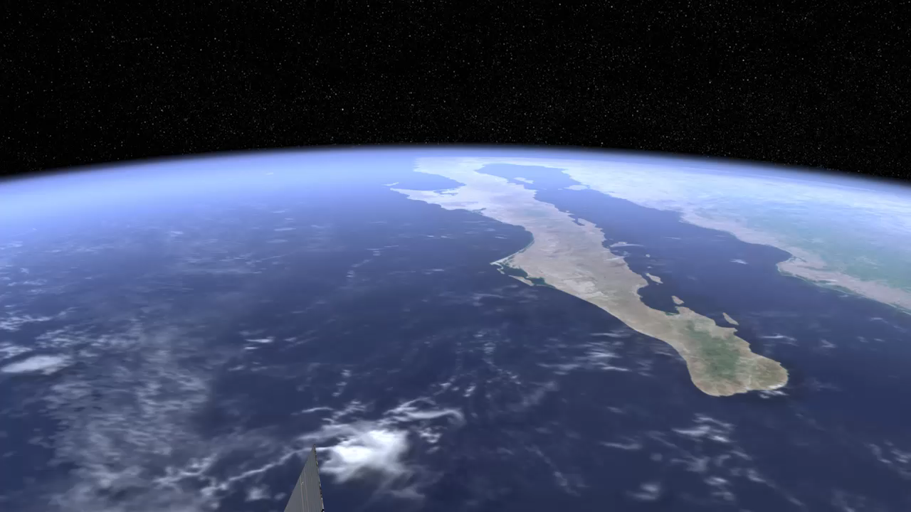
Questions?

