Slide 1
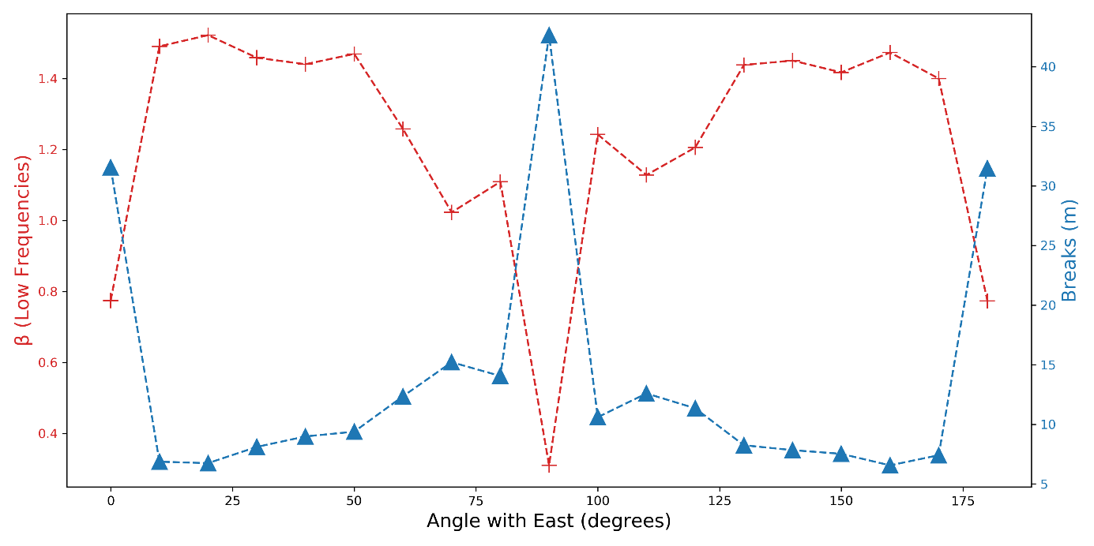
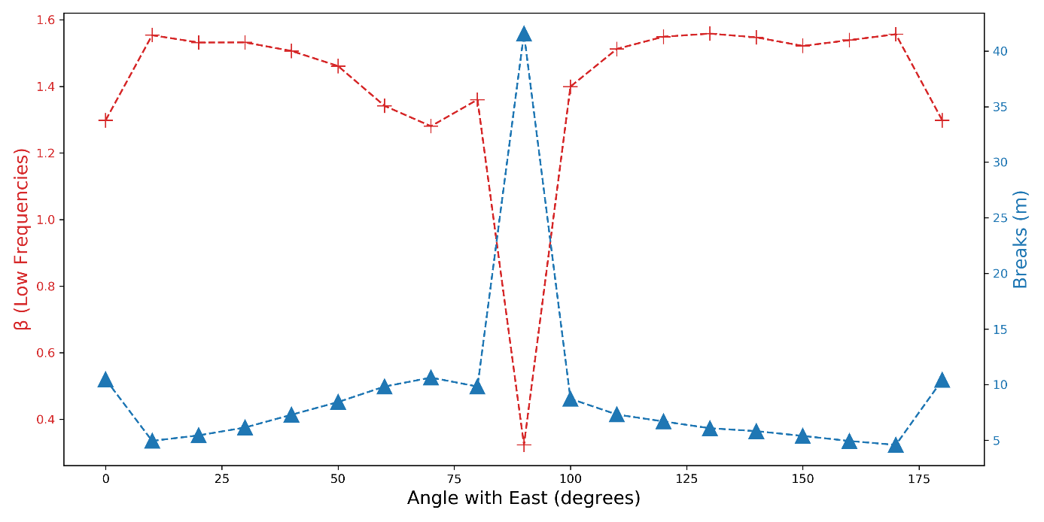
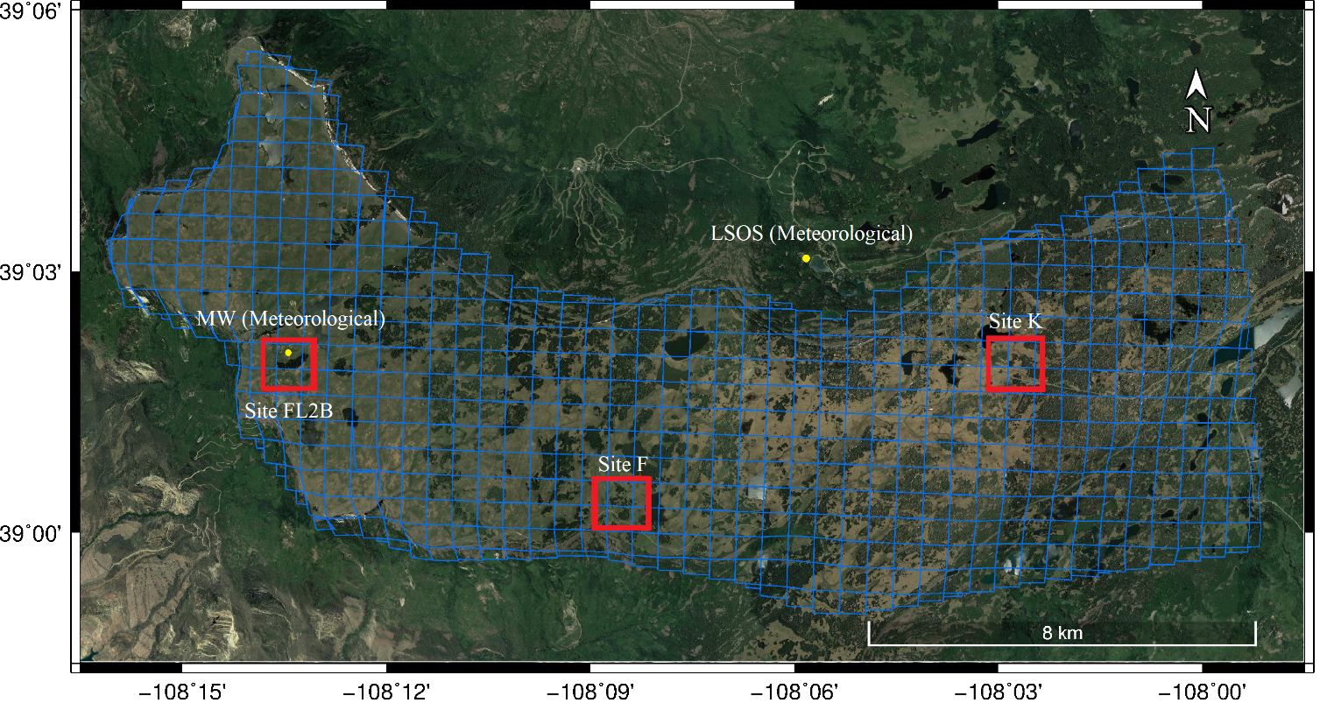
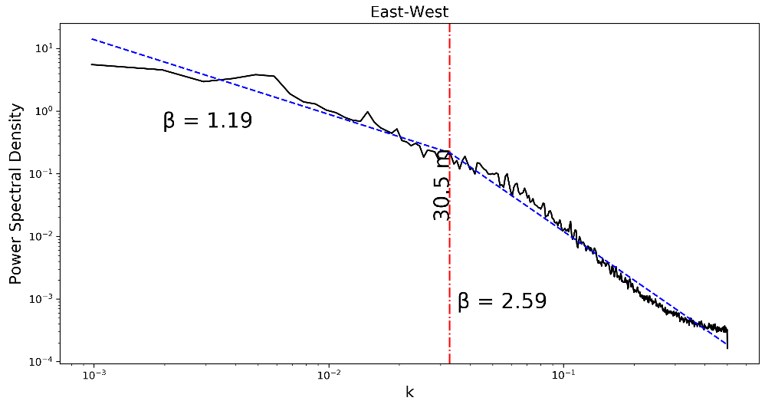
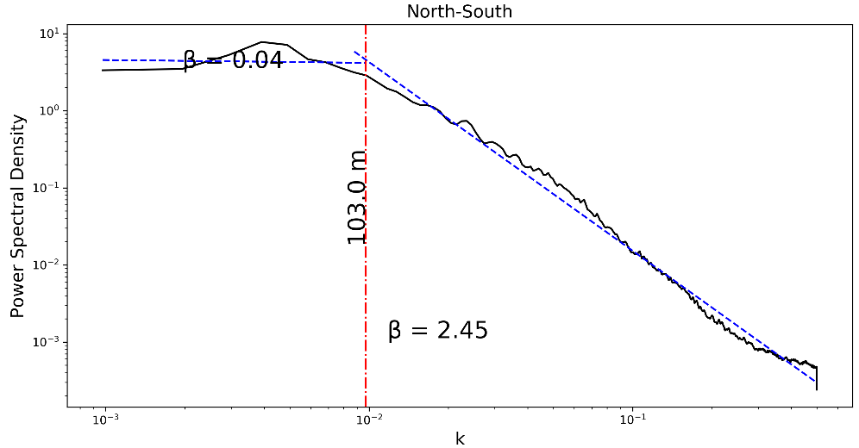
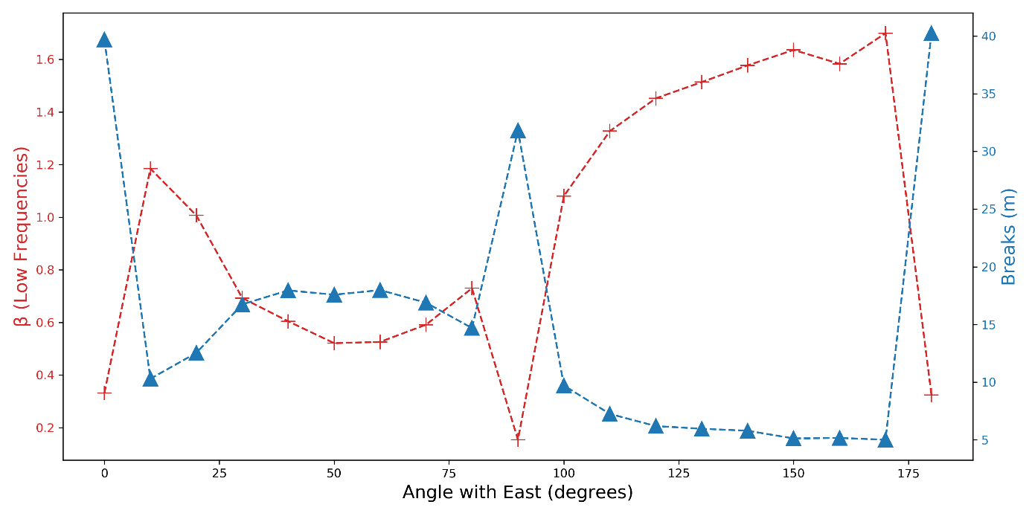
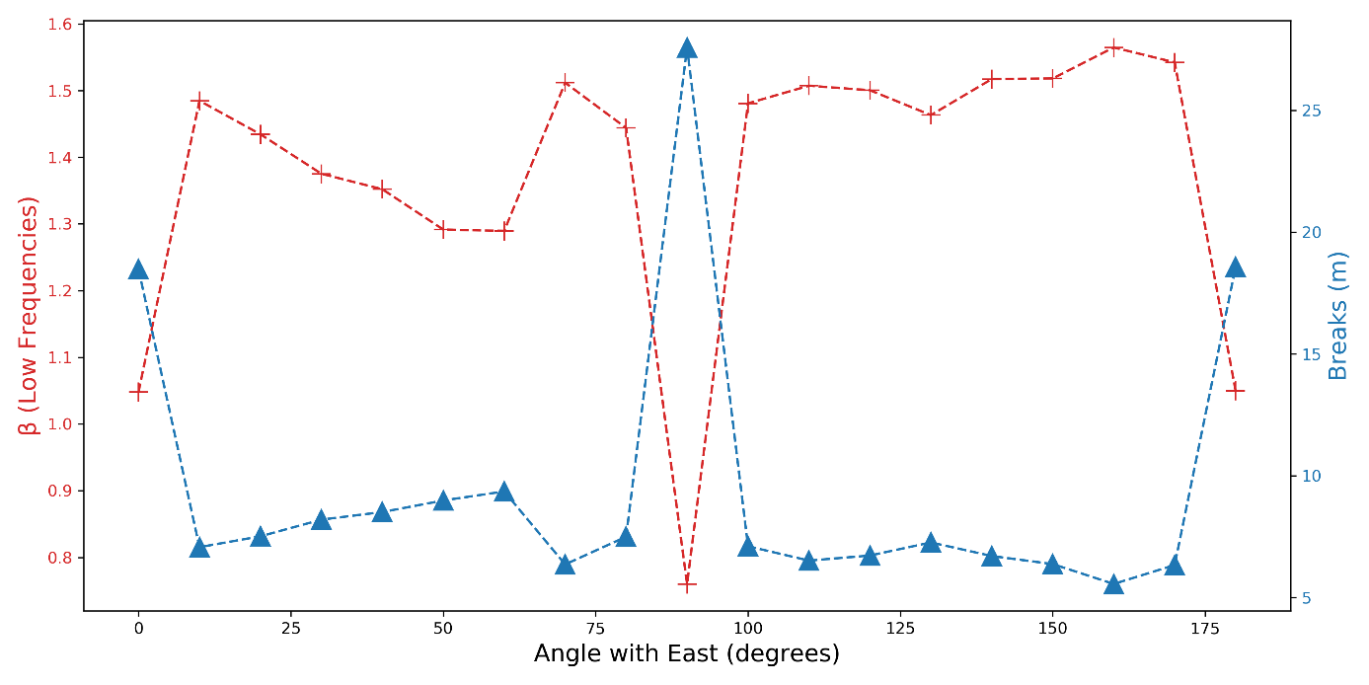
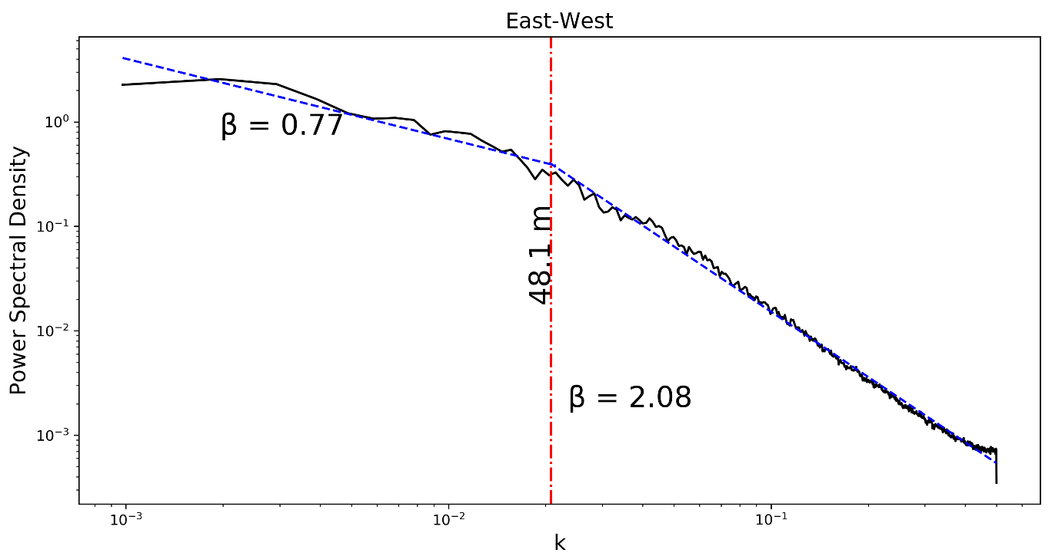
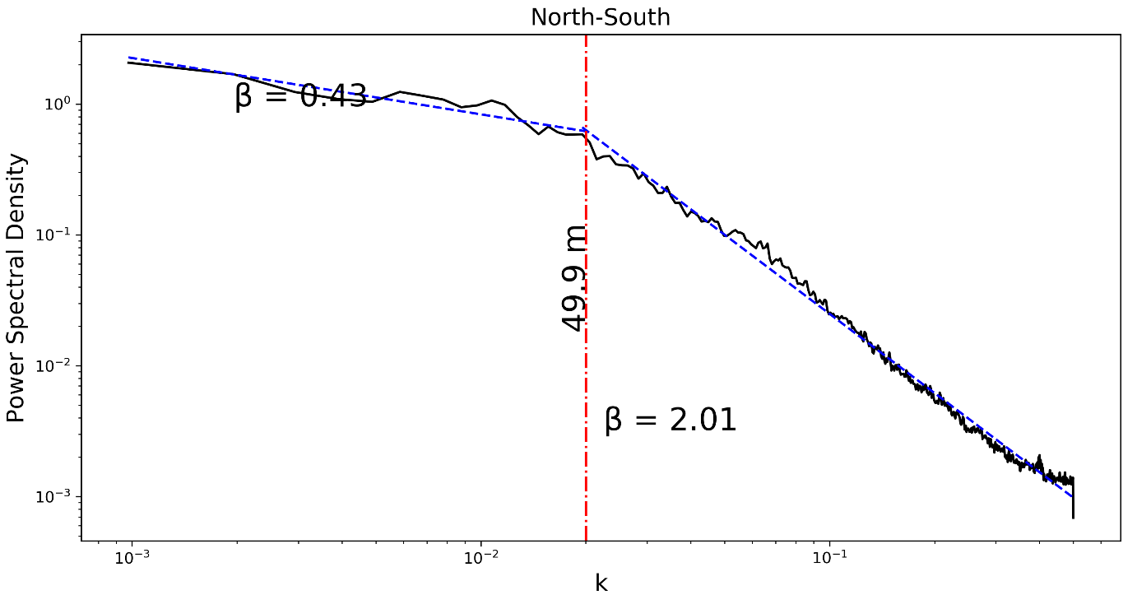
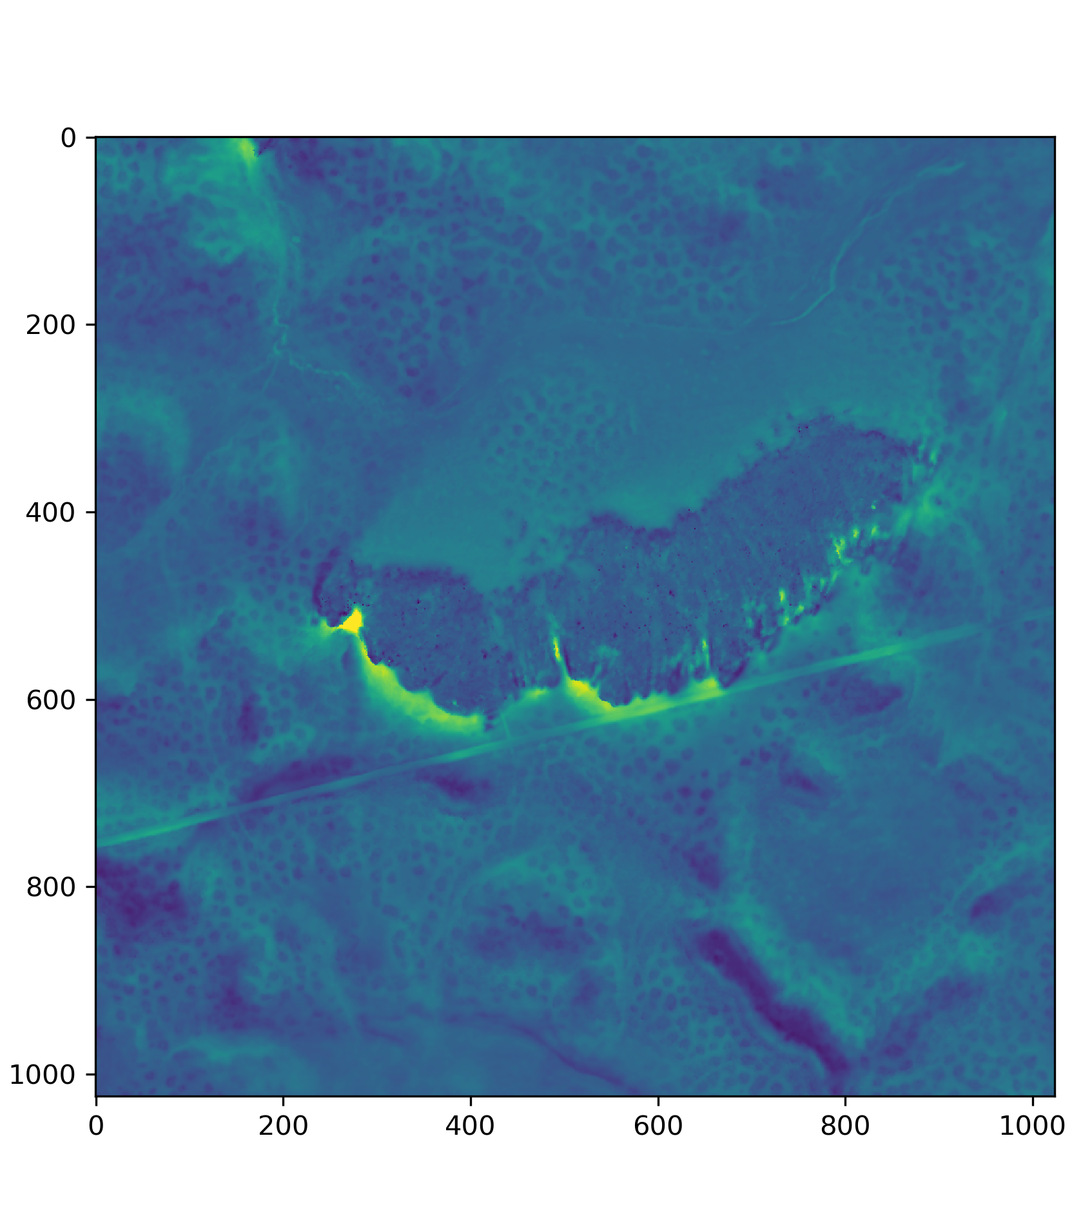
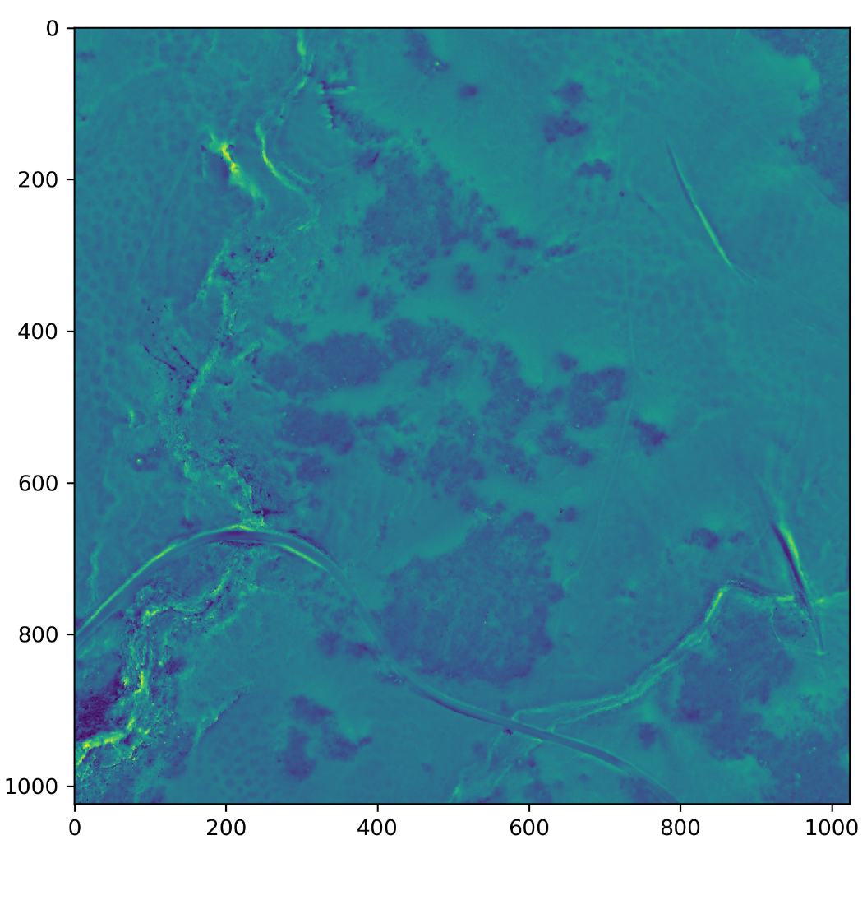
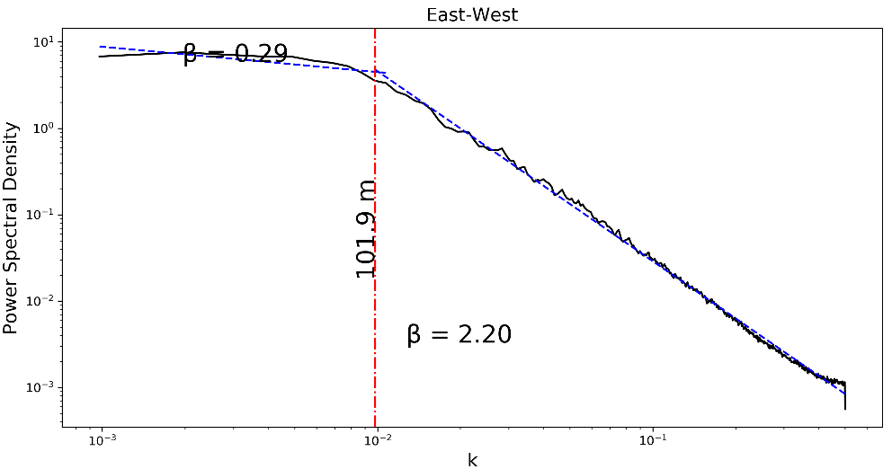
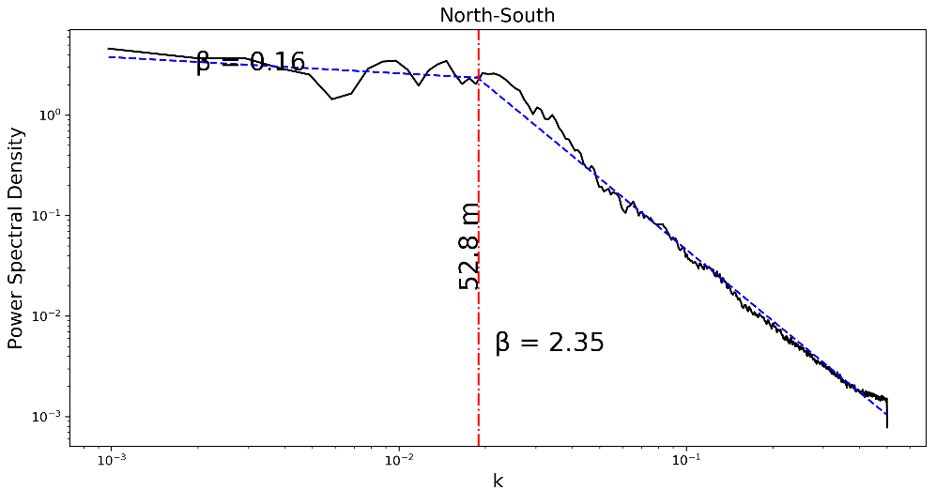
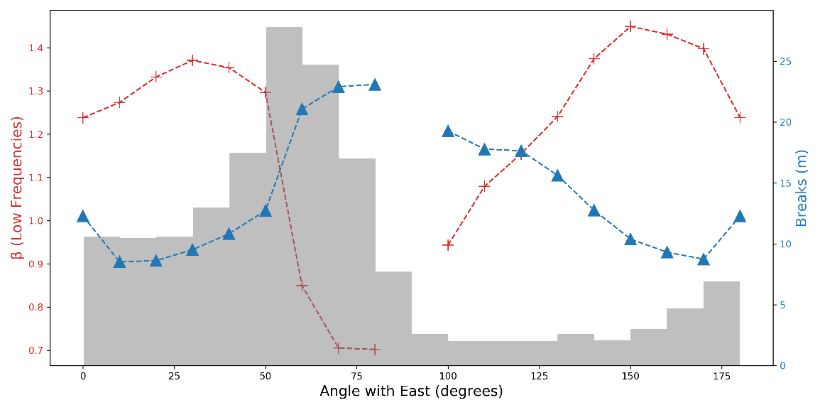
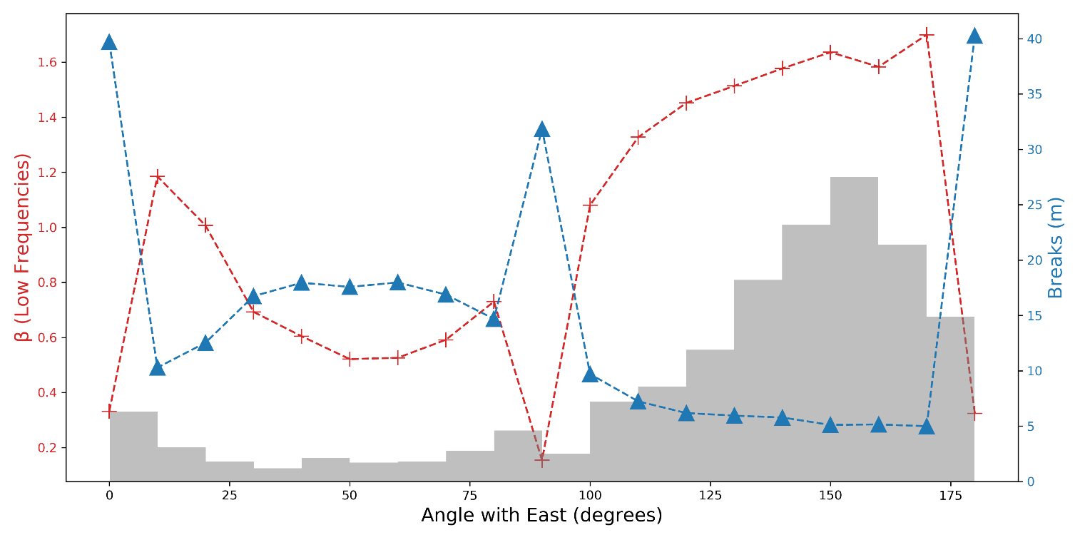
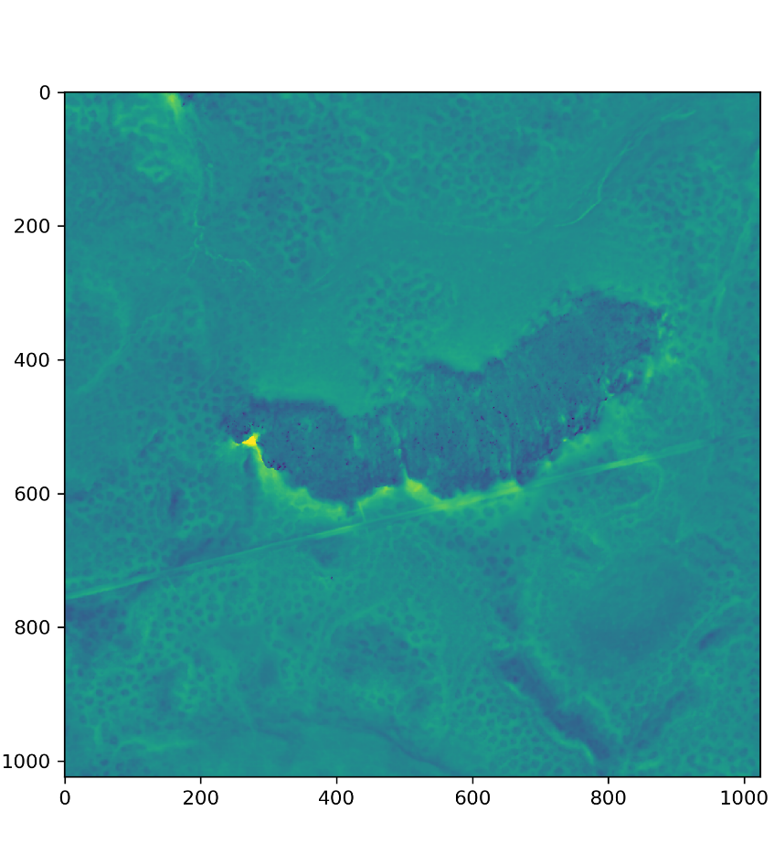
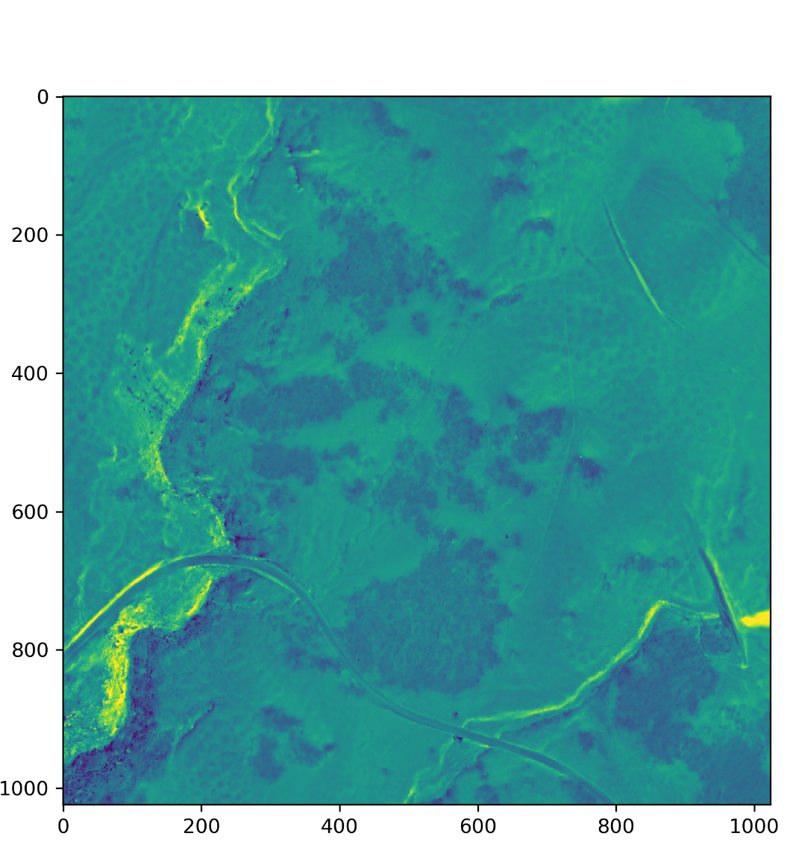
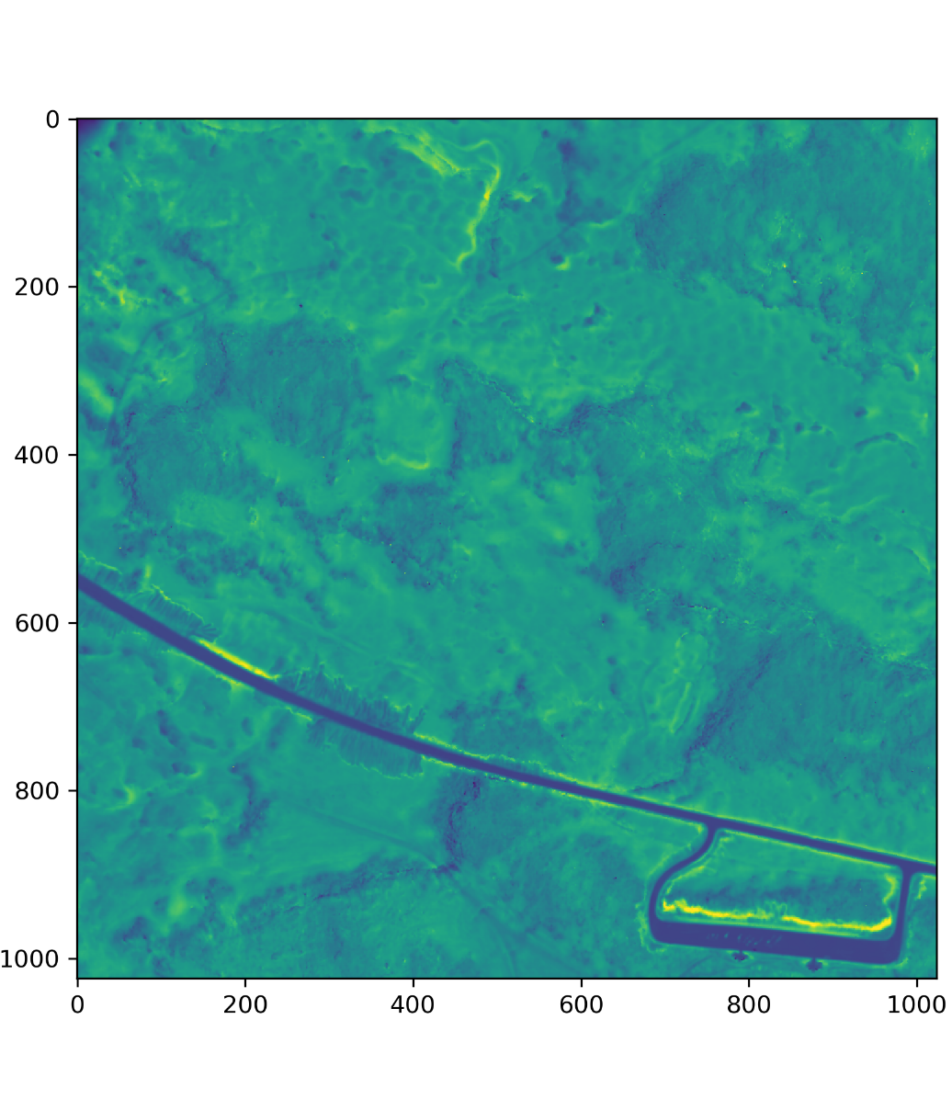
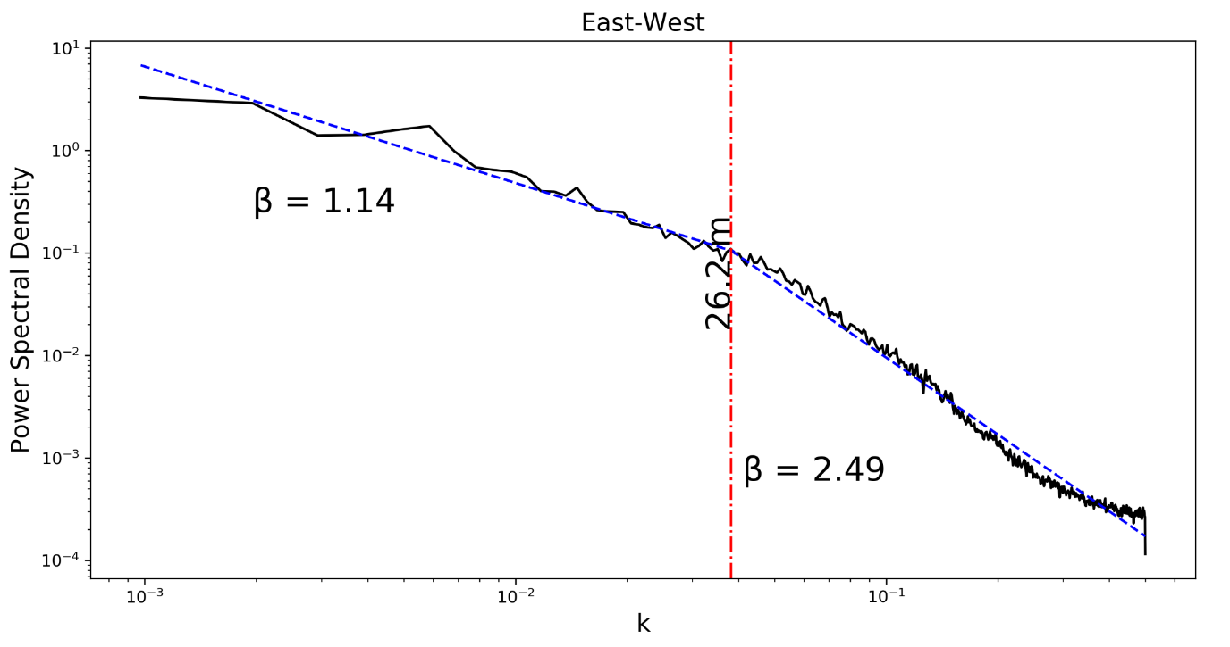
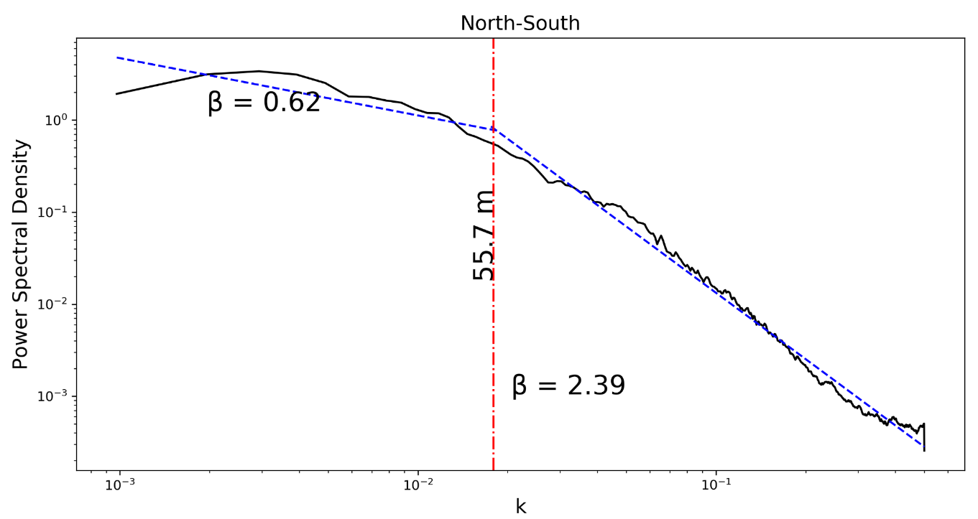
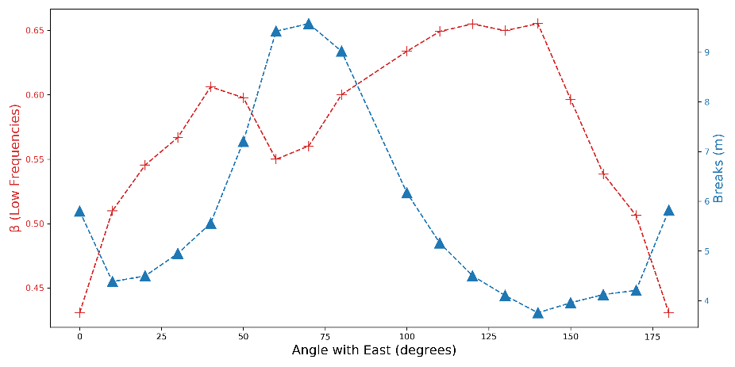
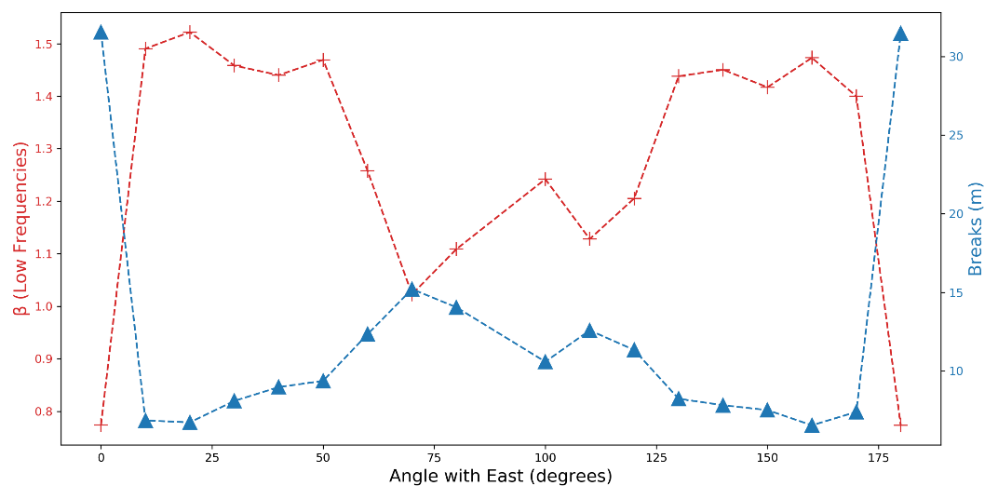
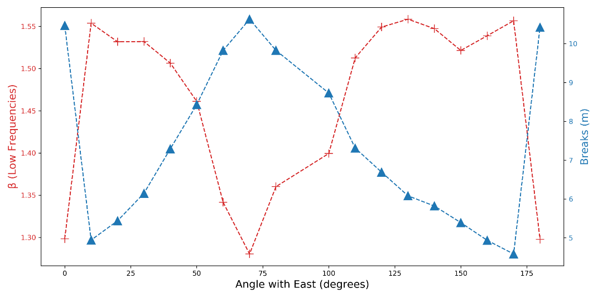
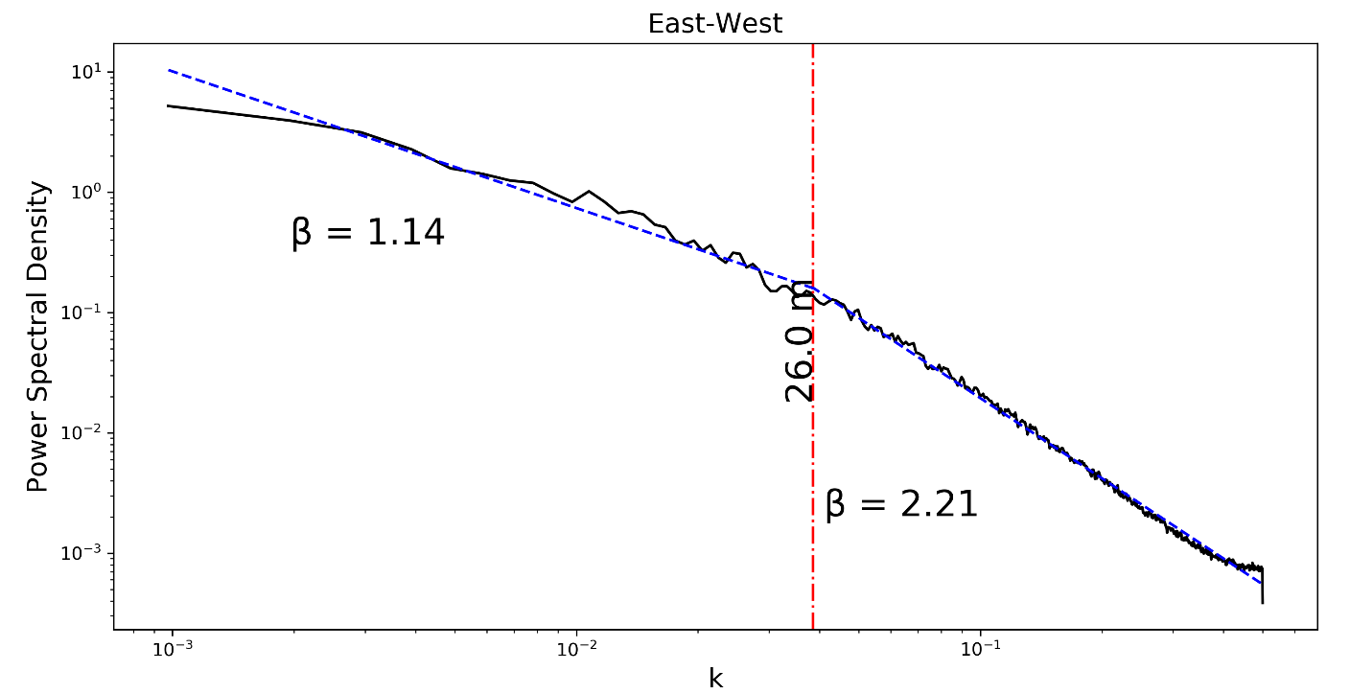
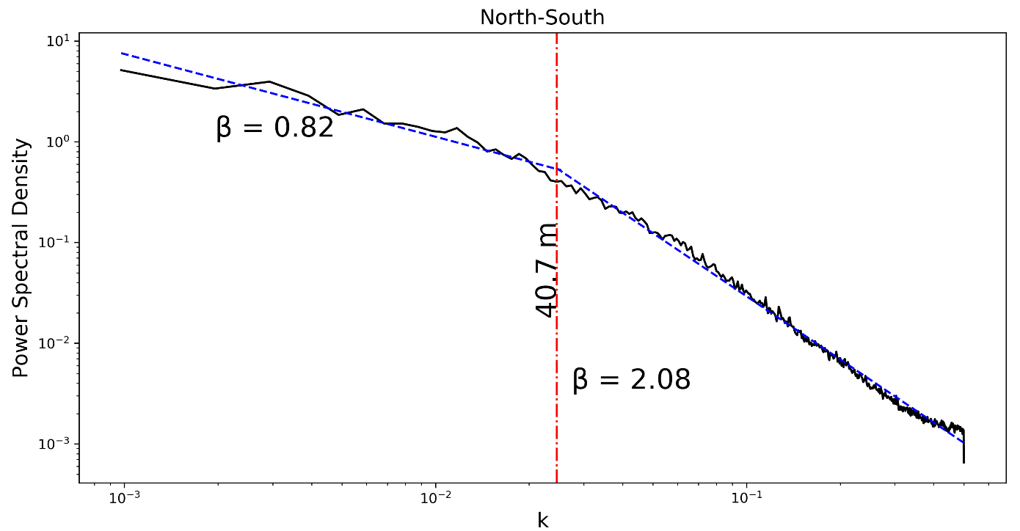
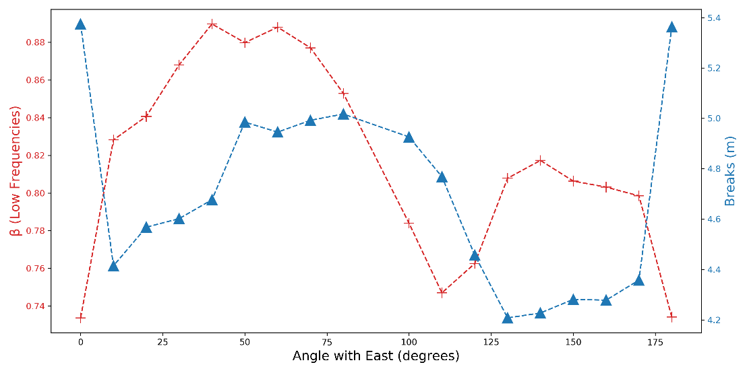
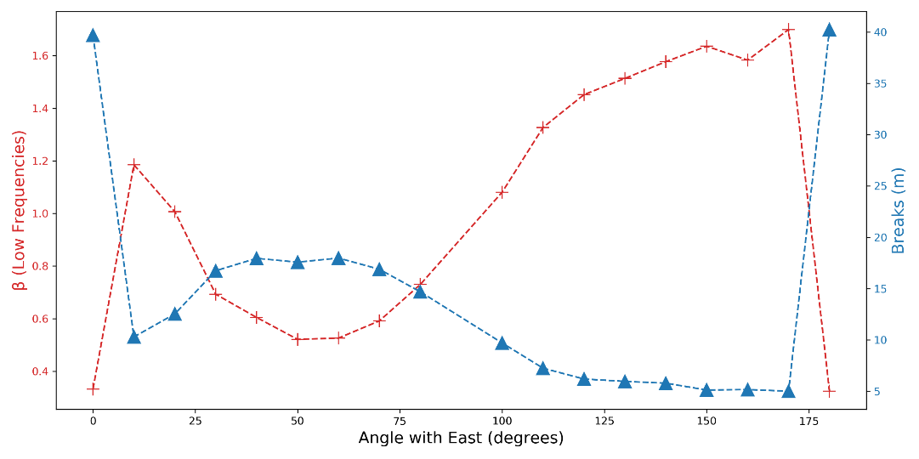
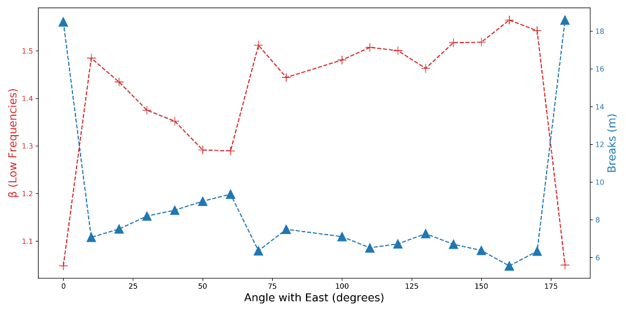
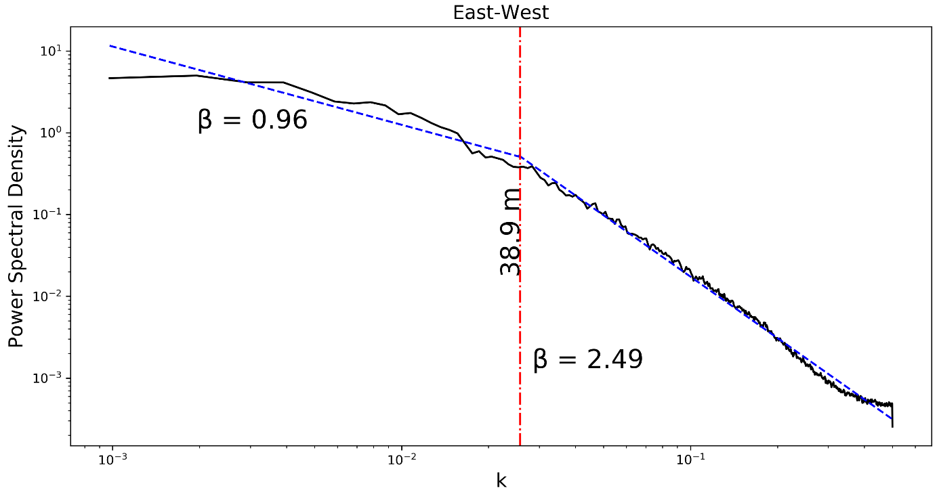
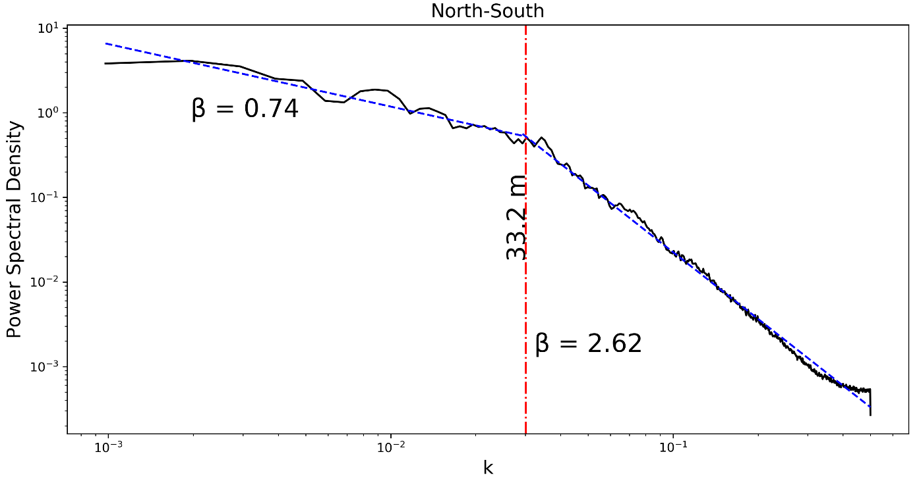
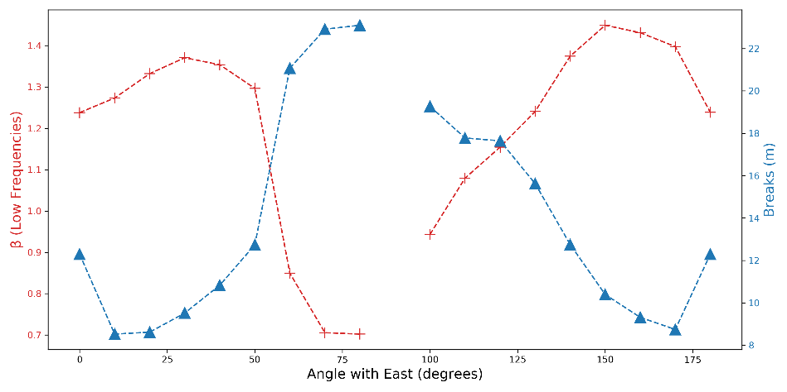
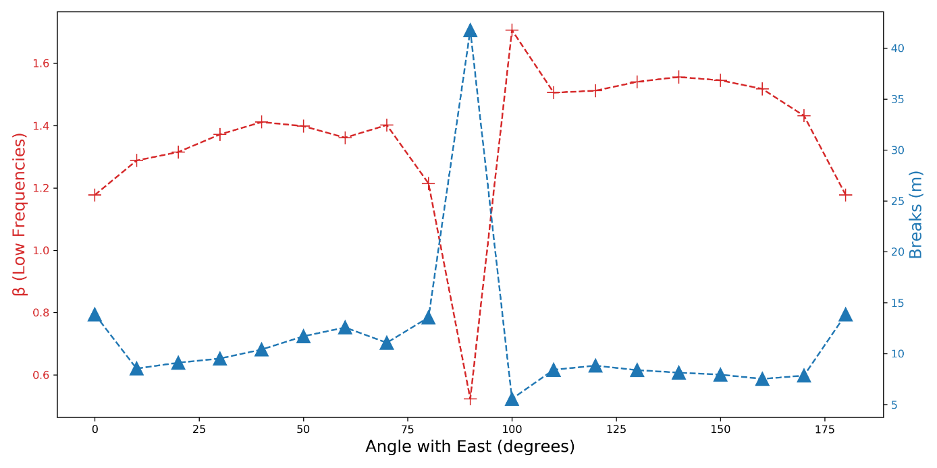
Assessing canopy and wind controls on snow depths using scaling properties with the 2020 SnowEx airborne lidar data Grand Mesa, Colorado
Josh Enterkine¹, Ahmad Hojati Malekshah¹, Nancy F. Glenn¹, Jake Graham¹
¹Boise State University, Department of Geosciences, Boise, Idaho
https://bcal.boisestate.edu/@BCAL_Boise; Contact: ahmadhojatimalek@u.boisestate.edu
Data and Methods
Results
2017
2020
East-West and North-South Scale Breaks for 2017 and 2020
F
Figure 1. Sites FL2B, F and K collected during SnowEx Grand Mesa, 2016-2017 and 2019-2020.
FL2B (2017)
K
Spectral technique for scaling characteristics of snow depth.
F (2017)
Figure 4. Snow depth breaks and low frequency power spectrum at different directions
Site FL2B
Site F
Site K
Dominant wind direction vs. break points at different directions
Site FL2B (2017)
Site K (2017)
2017
K (2017)
Figure 5. Break points vs. wind direction for the two closest sites to meteorological stations in 2017.
(we did not have access to 2020 wind dataset)
2020
FL2B (2020)
Vegetation Contribution
Vegetation Min Height
Snow Depth (2017)
Snow Depth (2020)
F
meters
F (2020)
Figure 2. Snow depth raster of (1024*1024) with 1m resolution For sites: FL2B, F and K, during 2017 and 2020.
Veg Height Range < 1m
Snow Depth (2017)
Snow Depth (2020)
East-West and North-South PSD
We computed the PSD spatially for each row (E-W) and column (N-S) of the raster
We fitted a broken power law to the PSDs
Two spectral exponents are computed and break points are estimated
Scale breaks divide the power spectrum into low frequency and high frequency
K
K (2020)
Figure 6. Snow depth break points vs. minimum vegetation height and vegetation height < 1m at Sites F and K.
Directional PSD
N
Conclusion
We computed directional PSD by rotating the raster file by 10 degree steps (half of the size of raster)
Figure 3. East-West and North-South break scales at 2017 and 2020.
Directional Analysis
East-west breaks for snow depth are the same for both 2017 and 2020 (30m). North-south direction break scales for snow depth in 2017 are twice as large as in 2020
We hypothesize that the changes in break scales in the north-south direction are due to changes in wind and precipitation patterns.
We found that vegetation controls the higher frequency variations in snow depth patterns at sites where wind contribution is not dominant.
Wind and vegetation Contribution
E
45ᵒ
2017
2020
We used wind data from the start of the snow season to the data collection date (02-16-2017). Wind speed and direction for temperature over zero degrees are removed from the data and wind speed and direction for speeds > 4m/s are selected.
In addition we investigated 7 different vegetation metrics (max height; height range < 1m; 1m < height range < 2.5m; minimum height; vegetation percent coverage; total vegetation density; canopy relief ration) for scale breaks at different directions and compared those with the snow depth break patterns and amounts.
FL2B
Citations
[1] Trujillo, E., J. A. Ramı´rez, and K. J. Elder (2007), Topographic, meteorologic, and canopy controls on the scaling characteristics of the spatial distribution of snow depth fields, Water Resour. Res., 43, W07409, doi:10.1029/2006WR005317

