Slide 1
Mind the Gaps: How SnowEx campaigns are contributing to snow remote sensing measurement science identified in the Science Plan
Mike Durand, Ohio State | Byrd Polar
THP Snow Virtual Meeting
September 11, 2020

Slide 2
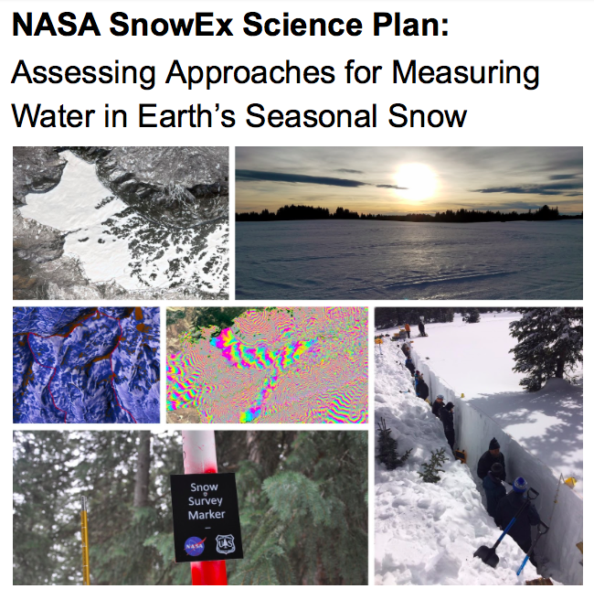
Science Plan Rationale
As of today, we do not have a technology ready to advance for a global SWE mission…
… because there are critical gaps in our knowledge of the capability of various methods
One objective of SnowEx SWE activities is to develop the basis for technology selection based on a series of airborne campaigns

Slide 3
Gaps in our measurement science
Ku-X SAR scattering Gaps Substrate: How to deal with the effect of the substrate (soil freeze thaw state, and submerged vegetation) on retrievals? Microstructure: How to best include prior information in the retrieval algorithms? E.g. how to understand how snow grain size properties scale spatially in tundra environments? Forest Cover: To what extent do these measurements penetrate various types of canopies? | L-band InSAR Gaps Coherence: How well do L-band InSAR scenes retain coherence? How does forest cover and other factors lead to loss of coherence? Unwrapping: To what extent do phase ambiguities lead to inability to retrieve SWE change? Layover: To what extent does radar layover limit retrieval in steep terrain? Wet Snow: To what extent does presence of liquid water limit retrieval? | LiDAR & SfM Gaps Substrate: How accurately can depth be measured via differencing two surface elevation models when the substrate elevation changes and snow is shallow, as is the case in arctic tundra environments?

Slide 4
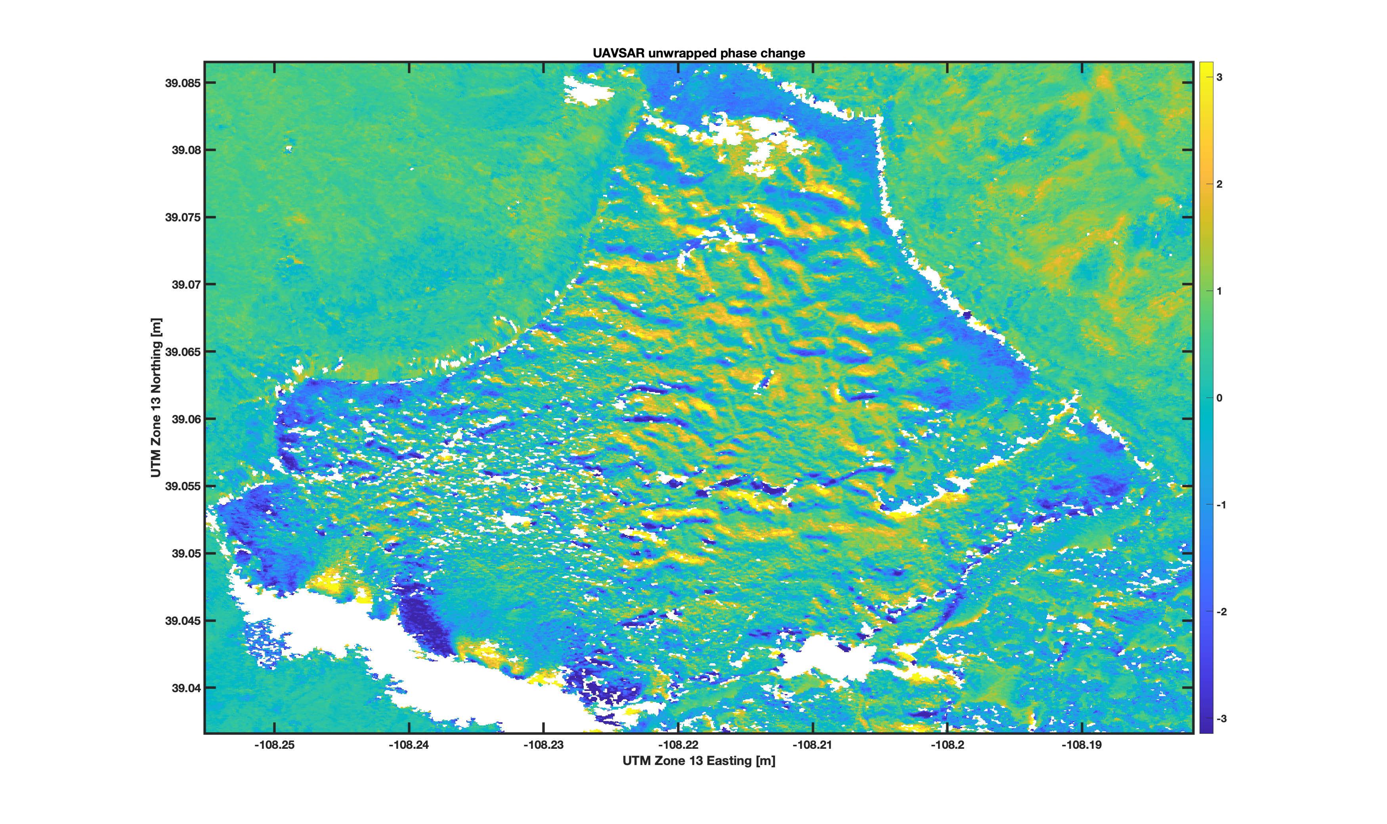
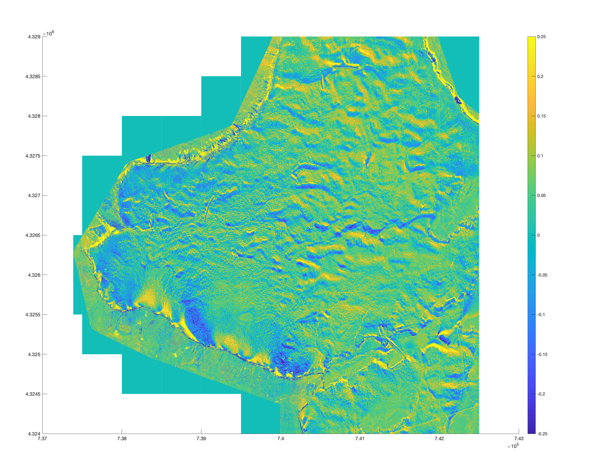
SnowEx 2017-21: L-band InSAR
Feb 1-12, 2020 L-band phase change
SnowEx2017: Limited UAVSAR flights over Grand Mesa showed correlation between phase change and total depth. Indications of correlation with depth change, but observed change was very small, and flights over only 2 weeks
SnowEx2020: UAVSAR time series 13 sites, 6 flight periods (Dec 20-March 12). 1-2 week intervals show good coherence, 3+ weeks is challenging. Vegetation, topography, sensor geometry influences. 50% complete due to COVID-19
SnowEx2021 target: UAVSAR time series continued, 4-6 high priority sites. Capture large SWE change, transition from dry-wet, short temporal baselines. Investigate causes of decorrelation.
Feb 1-13, 2020 Lidar depth change
Slide courtesy HP Marshall & Eli Deeb

Slide 5
Ku-SWE retrievals
SWESARR data from Grand mesa 2020 will help refine our knowledge of three important gaps: microstructure, substrate, and forest cover
Possible that a single flight in Alaska could advance our knowledge of penetration in sparse and intermediate forest canopies, in Spring 2022
Important to note that Ku-band SWE retrievals are being actively developed by ECCC (see C Derksen’s talk), Trail Valley Creek, as part of ongoing space mission development. Significant new datasets to come online in the near term

Slide 6
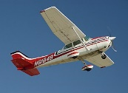
Boreal
Arctic
Snow
^
^
^
Snow
^
^
^
^
^
^
^
^
^
Void
^
^
Organic Layer
Organic Layer
Active Layer
Active Layer
Permafrost
Permafrost
Themes
Measurement Science
Snow-on and snow-off surface accuracies
Radar scattering and land cover/permafrost
Integrating datasets and models
Snow Science
Snow grain size characteristics
Vegetation-snow-permafrost interactions
Tools
Core: lidar, SfM (satellite to drone)
Proposal for SnowEx Activities: Alaska 2021-2022 for snow depth and SWE: Chris Hiemstra & Mike Durand
Notes:
May want to mention that it is not true that we see doing Boreal with satellites only, and Arctic with aircraft only. Not a critique of this glorious diagram!

Slide 7
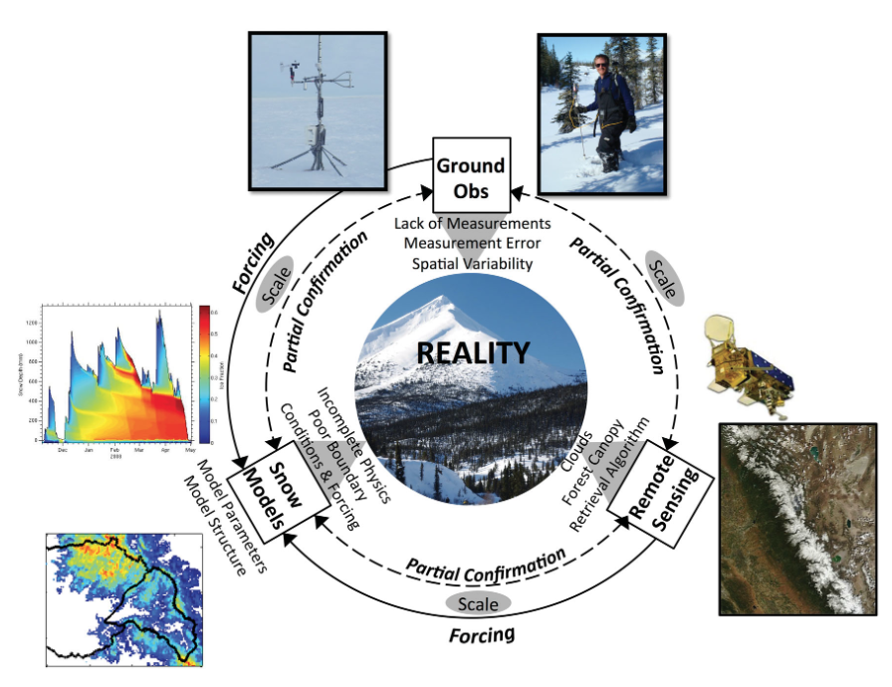
Integrated strategies
No one mission measurement technology can do everything, highlighting the need for modeling and assimilation.
How is SnowEx field campaigns advancing these areas? Melissa Wrzesien’s talk (this afternoon) highlights SEUP efforts.
Measurements of surface energy balance can lead to synthesis with measurements of depth and SWE.
Chart by Mark Raleigh

Slide 8
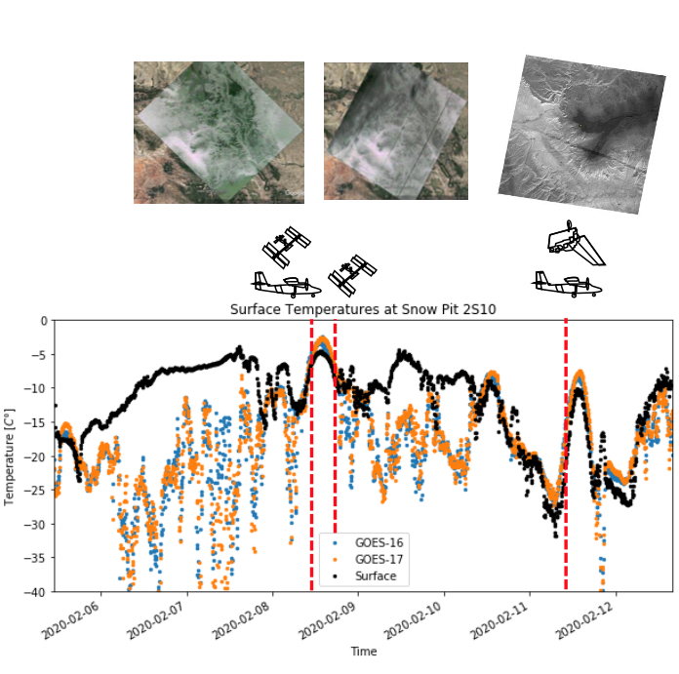
Energy balance observables
Albedo Proposal by Charles Gatebe, Anne Nolin and others focuses for Alaska 2021-2022 will answer questions on the spatiotemporal variability of albedo, and (thus) the optimal combination of sensors required to measure it. In part, this supports the SBG mission These are critical to global climate science in the boreal and arctic | Surface Temperature Given the high temporal resolution, but low spatial resolution of GOES, how can GOES be spatially downscaled? SnowEx 2020 activities contribute directly to this question. Surface temperature measurements provides the key to constrain many parts of the energy balance
Courtesy Steven Pestana, UW

Slide 9
Science Plan: Status
Despite the challenges of 2017, the difficulties of government shut down in 2019, new SnowEx datasets are pouring in!
These datasets will substantially advance measurement science state of the art (L-band, Ku-SWE, albedo, surface temperature, lidar et al.), creating knowledge about technology tradeoffs for a future Explorer proposal
Alaska 2021-2022 has the potential to answer major questions about both albedo and surface elevation technologies in globally critical snowpack types
Modeling and assimilation more important now than ever: - Melissa’s talk to come next
Must continue collaboration with other agencies (e.g. Canadian TSMM)
May be wise to produce state-of-the-art papers where possible. E.g. the Microwave Scattering working group is leading a collaborative effort now.

