Slide 1
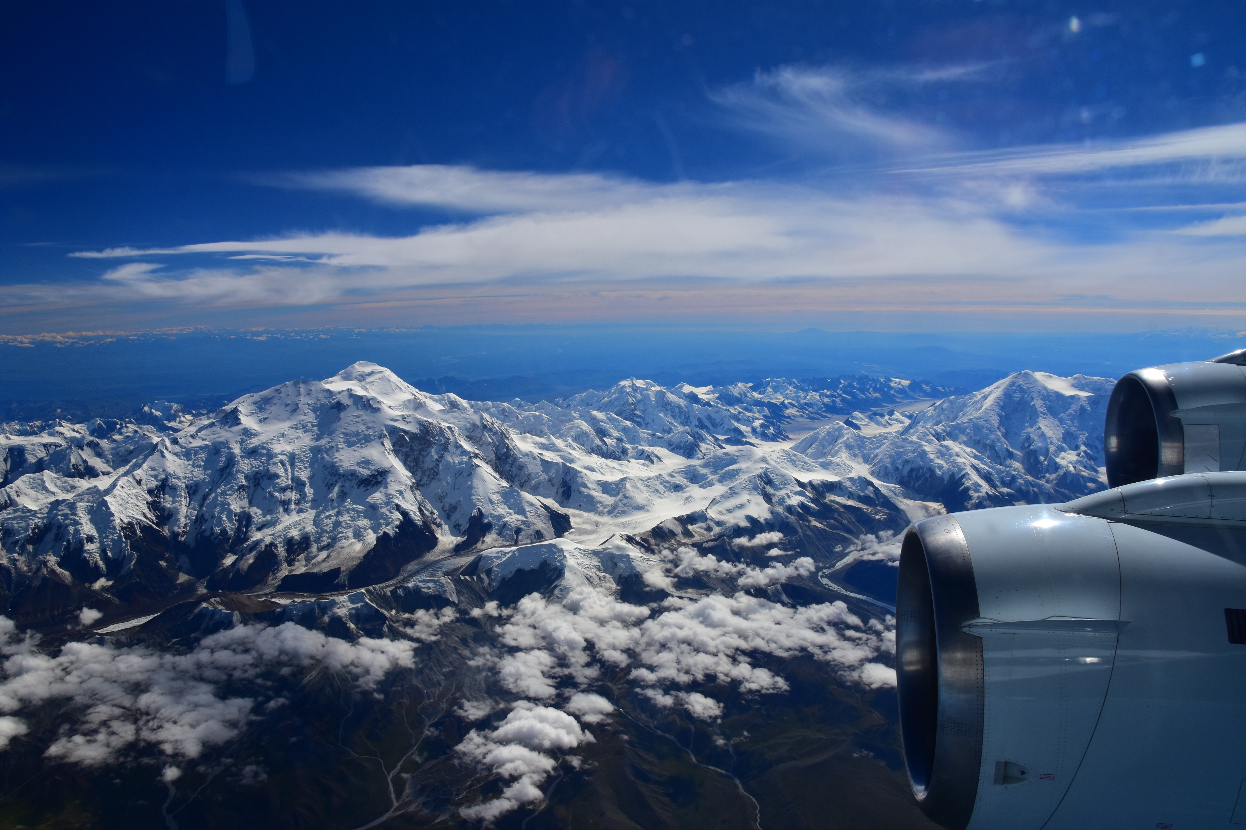
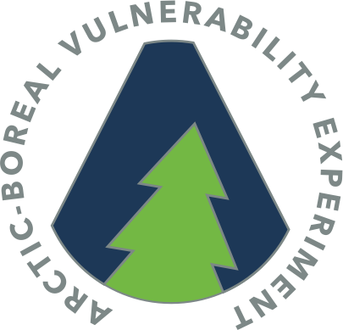
SnowEx - ABoVE 2022
Campaign in Alaska and NW Canada
A1
B1
C1
Charles Miller
Jet Propulsion Laboratory
Peter C. Griffith, Liz Hoy
NASA Goddard Space Flight Center
And the ABoVE Science Leadership
A2
B2
C2
A3
B3
C3

Slide 2
Summary
A1
B1
C1
Opportunity for a SnowEx-ABoVE Campaign January – May 2022 to cover
Boreal forest (Fairbanks, Delta Junction)
Bering Tundra (Seward Peninsula)
North Slope Tundra (Toolik Lake – Deadhorse; Barrow)
Arctic Tundra (Trail Valley Creek, Inuvik)
Leverage ABoVE infrastructure, logistics and established snow-off flight lines
Engage ABoVE SnowScapes WG, NGEE-Arctic, Northern Water Futures, GNWT
A2
B2
C2
A3
B3
C3

Slide 3
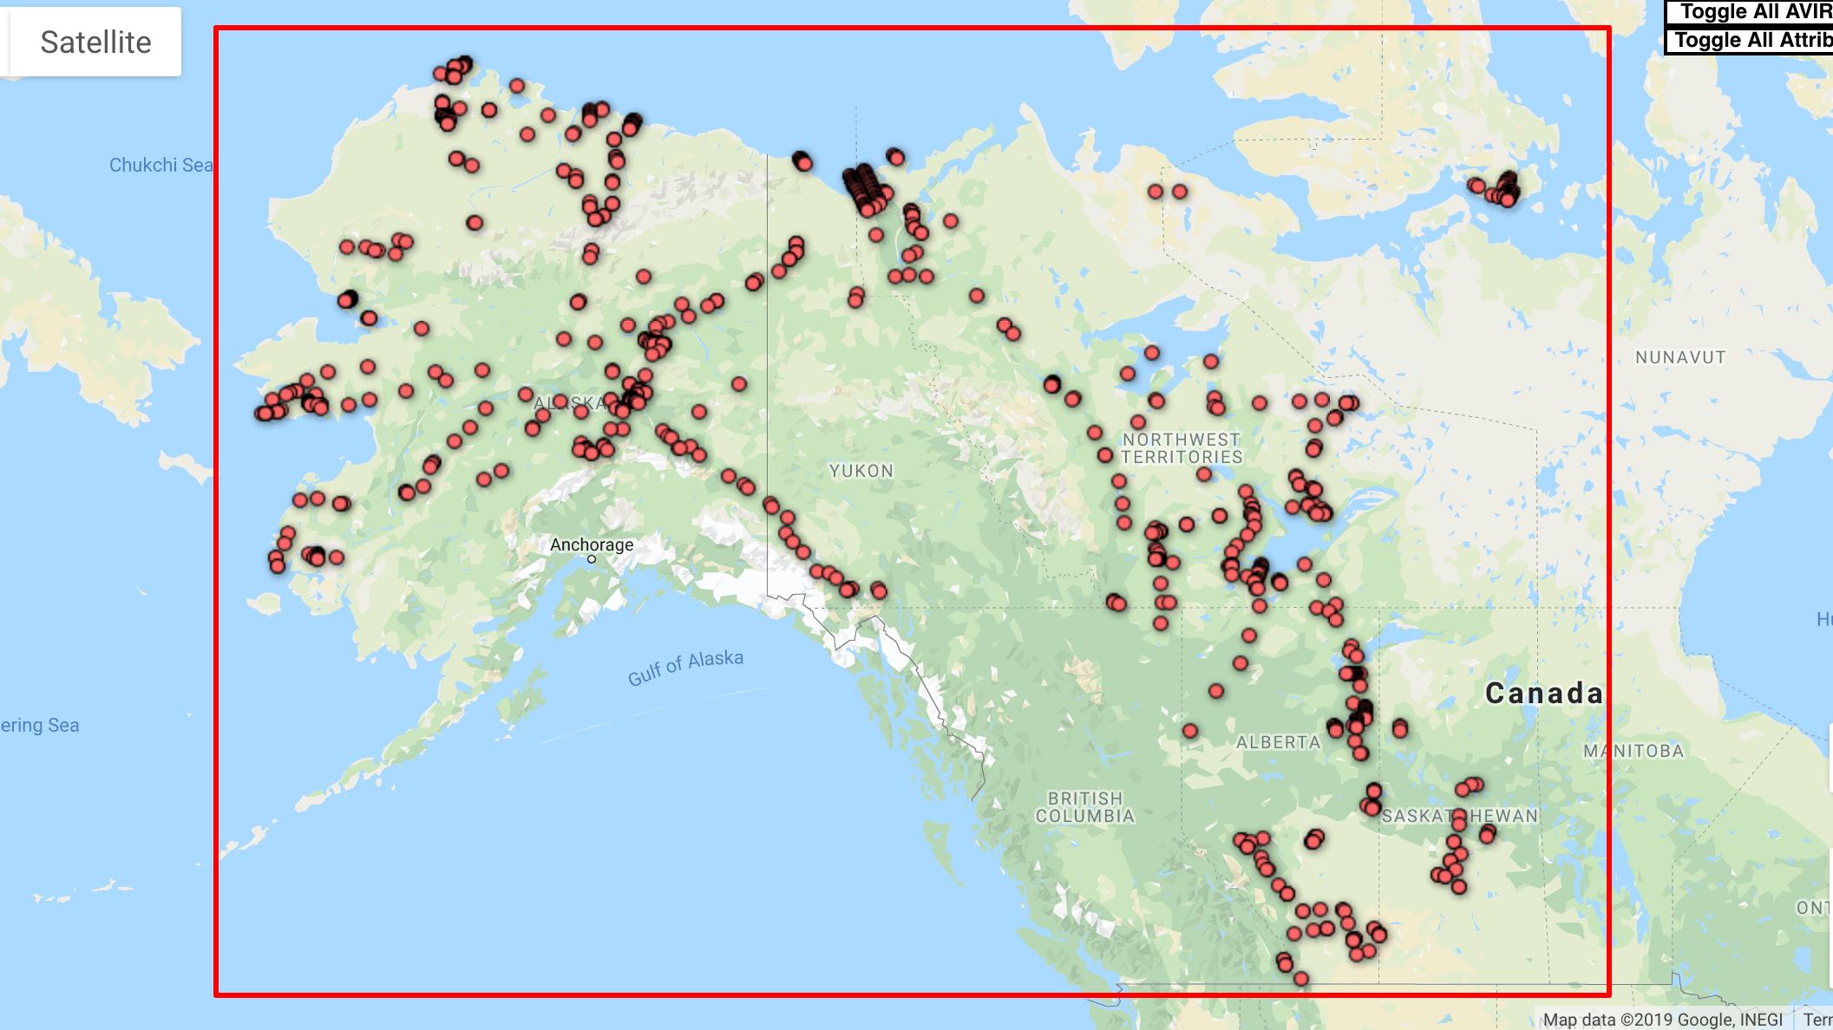
2018 AVIRIS-NG Flight Lines
ABoVE AVIRIS-NG
Data Acquisitions
2017-2019

Slide 4
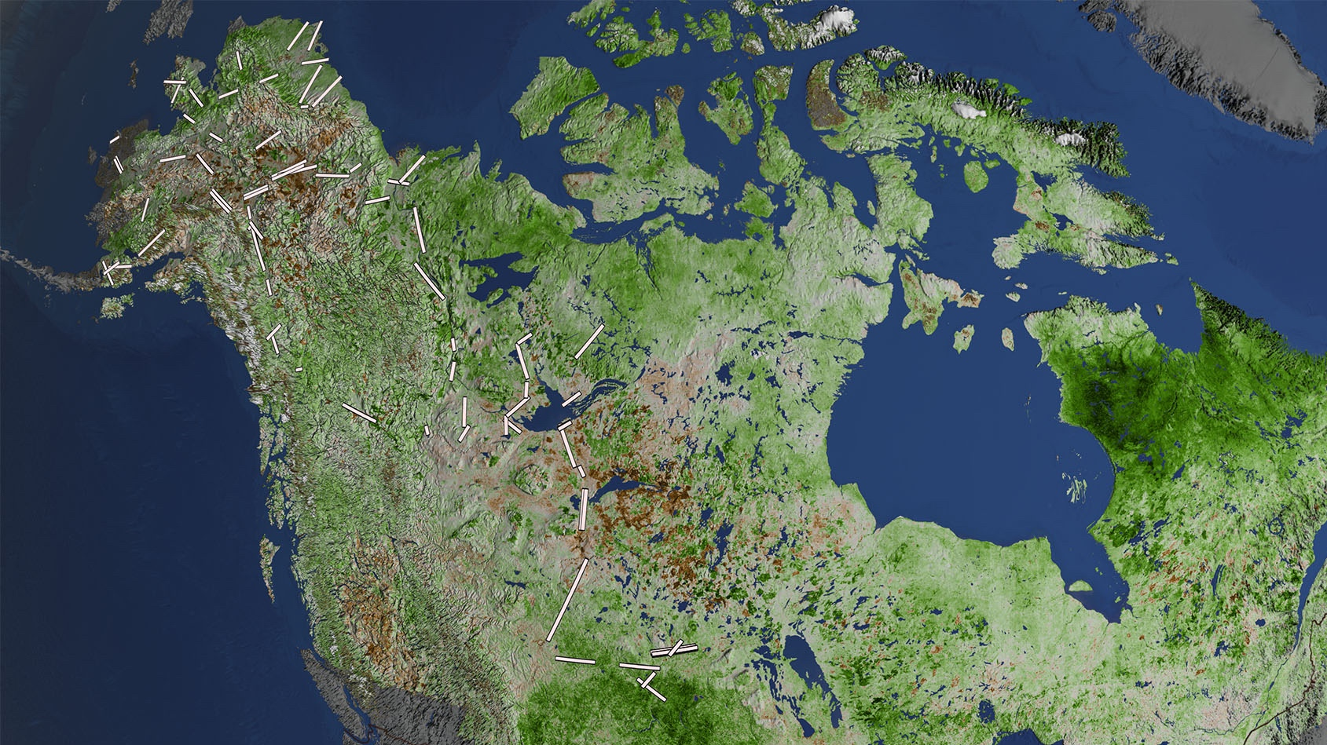
L-band SAR 2017-2019
A1
B1
C1
A2
B2
C2
A3
B3
C3
Data: Ju and Masek
Notes:
Vegetation Greening Trend in Canada and Alaska: 1984-2012: High-latitude regions have been warming rapidly since the last century, at a rate higher than the global average. At continental scales, satellite data since the 1980s have indicated increased vegetation productivity (greening) across northern high latitudes, and a productivity decline (browning) for certain areas of undisturbed boreal forest of Canada and Alaska. These remote sensing results have been corroborated by in-situ evidence.
White rectangles mark sites with repeat overflights of L-Band Synthetic Aperture Radar (SAR) during 2017, 2018, and 2019.
https://svs.gsfc.nasa.gov/4452

Slide 5
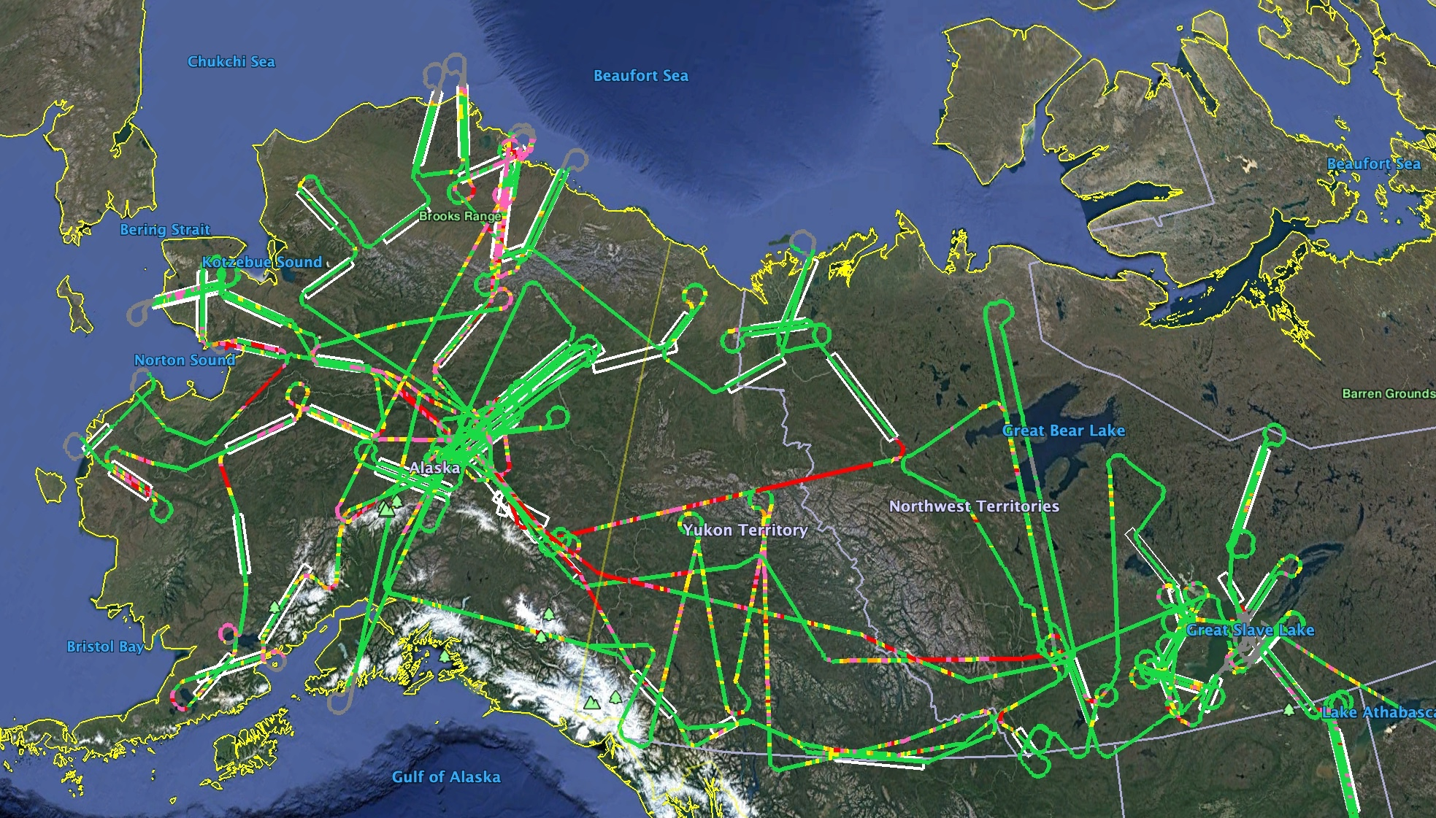
2019 LVIS Flight Lines & QA/QC
Color key:
Red = zero
Pink = 1 to 10%
Orange >10 to 20%
Yellow >20 to 50%
Green >50% surface returns
Notes:
NASA5 and the LVIS team conducted science sorties (91 flight hours), including during the two transit legs, between 12 July and 7 August 2019 for the Arctic-Boreal Vulnerability Experiment. Targets requested by the Science Team included TomoSAR swaths at BERMS and Delta Junction for NISAR; underflights of IceSAT-2 Reference Ground Tracks; first-time observations and revisits of L-ban SAR swaths across the ABoVE domain for the Active Layer Working Group; opportunistic data acquisition of the Shovel Creek fire perimeter near Fairbanks, including reflights of an line flown in 2014 by G-LiHT; NGEE-Arctic sites in Barrow and the Seward Peninsula; and numerous burn scars around Yellowknife/Great Slave Lake for the Phase 2 Wildfire projects. Weather provided daily challenges to acquisition, but due to the excellent performance of the LVIS instruments and NASA5’s extended range and duration, in the end, the only targets not acquired were the Anaktuvuk Burn Scar on the North Slope of Alaska, and two SAR swaths on the Yukon-Kuskokwim Delta.

Slide 6
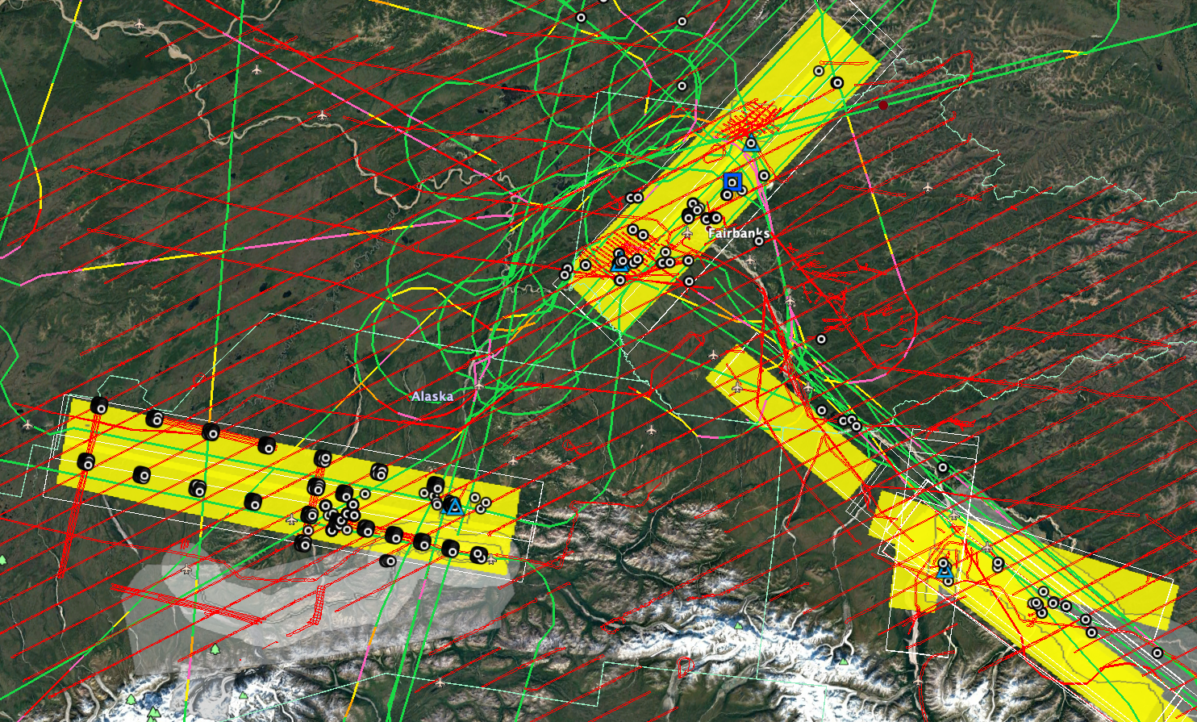
Fairbanks
Boreal Forest
NEON
BNZ LTER
CRREL sites
Fairbanks Region:
Road Accessible
L-Band SAR
LVIS
AVIRIS
G-LiHT
NEON Airborne
Various lidar
Healy
Alpine Tundra
Eight Mile Lake NSF
NEON
NPS Denali Plots
Snow removal experiments
Delta Junction
Boreal Forest
Biggest trees
NEON
TomoSAR
Burn History

Slide 7
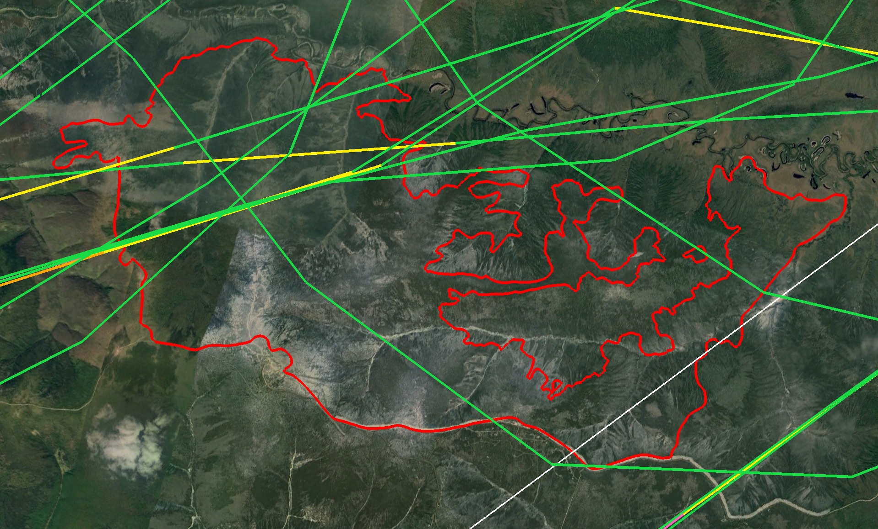
Approximate 2015 G-LiHT track
LVIS Acquisitions across
2019 Shovel Creek Fire Perimeter
Near Fairbanks
Road Accessible

Slide 8
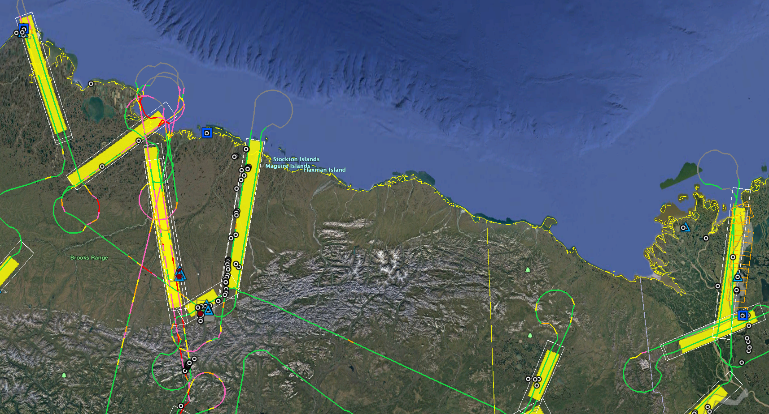
Trail Valley
Tundra & Taiga
Accessible by road
from Inuvik
Utqiagvik (Barrow)
Tundra
NGEE-Arctic
NEON
BEO & Lagoon
Toolik (road)
Tundra
LTER
NEON
Anaktuvuk (snow machine)
Deadhorse (road)

Slide 9
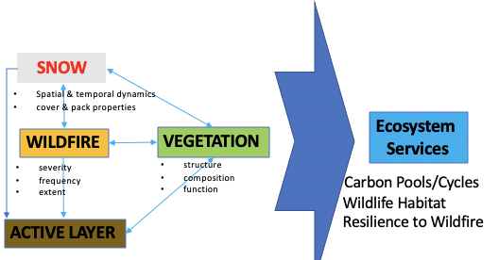
1. Integrative Study: Brainstorming ‘Snow Ecology’ questions
Can the amount of spring snowmelt water (=end-winter SWE) from the snowpack predict the number of wildfires occurring over the course of the following summer?
What is the significance of the vegetation protruding the snow surface in spring; something like quantifying the inter-annual variability of the amount of vegetation available above the snow surface to browsers, e.g., moose, within the ABoVE domain.
Historically, is the insulating effect of the snowpack (combined snow thermal resistance and air temperature during winter) a significant driver of the summer active-layer thickness? If yes, how is a warmer and snow-rich or snow-poor future climate going to affect the active-layer thickness.
I think it's well established that the black char from recent burns decrease albedo, which should increase spring melt rates. I'm not sure if it's known how long this effect persists. Eg., does veg recovery in year 1 after fire do away with this effect, or does it persist for a few years? Also, do we already know how fire affects depth? Seems depth should be higher in absence of canopy interception?
Could shrub expansion lead to later snow-off dates, or increase spatial heterogeneity in snowmelt dynamics through their creation of snow "fences"? Implications for growing season water availability--potential positive feedback that increases shrub growth
There has been a recent flurry of ABoVE papers indicating that cold-season soil respiration is higher than previously recognized, high enough to turn tundra from carbon source to sink, with especially high rates during shoulder seasons. For this question I'd perhaps be more interested in fall than spring. Does fall temp/precip have a disproportionately large impact on soil ALT/respiration for the rest of the cold season? Fall conditions may determine insulative properties more-so than winter/spring, and the basal snow layer may also have a large impact on spring melt dynamics.
How will changing in snow cover and snowpack properties influence (a) forest growth/recovery/regeneration rates, and (b) successional trajectories (i.e. functional type dominance), of boreal forest stands following fire disturbance?
How are snow properties influenced by wildfire
&
how they in turn do they influence ecosystem recovery
and vulnerability to fire?

Slide 10
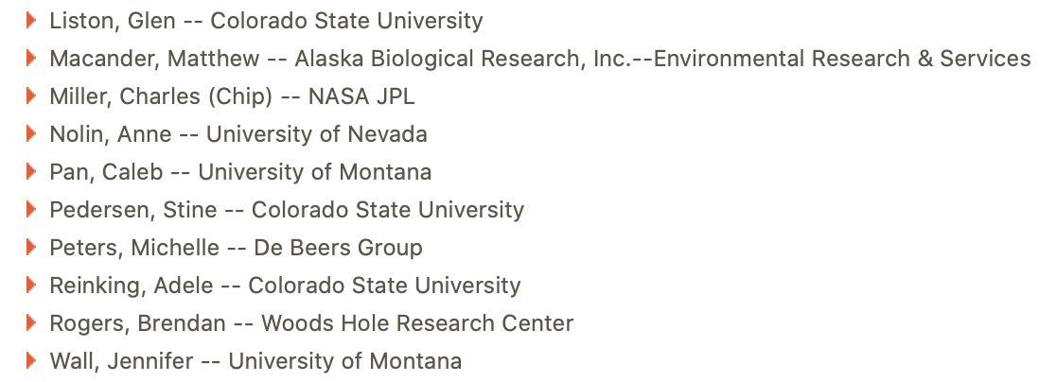
Snowscapes Working Group
focus on how spatial & temporal dynamics of snowscape properties
influence ecosystem dynamics including:
soil active layer development
winter soil respiration
soil-plant-atmosphere carbon exchange
vegetation community dynamics
disturbance regimes
wildlife habitat & movement
Email to join:
above_wg_snowscapes@cce.nasa.gov

Slide 11
Summary
A1
B1
C1
Opportunity for a SnowEx-ABoVE Campaign January – May 2022 to cover
Boreal forest (Fairbanks, Delta Junction)
Bering Tundra (Seward Peninsula)
North Slope Tundra (Toolik Lake – Deadhorse; Barrow)
Arctic Tundra (Trail Valley Creek, Inuvik)
Leverage ABoVE infrastructure, logistics and established snow-off flight lines
Engage ABoVE SnowScapes WG, NGEE-Arctic, Northern Water Futures, GNWT
A2
B2
C2
A3
B3
C3

