Slide 1
Proper Use of NextView Licensed DigitalGlobe Imagery for ABoVE researchers

Slide 2
DigitalGlobe Imagery
US National Geospatial-Intelligence Agency (NGA) licenses DigitalGlobe imagery which can be used for US federal government purposes
NASA ABoVE researchers are able to access and analyze this imagery pursuant to the NextView license agreement NGA has developed with DigitalGlobe
ABoVE researchers must sign the NASA-NGA data use policy acknowledging they understand the NextView license agreement terms

Slide 3
NextView License Summary
US Federal Government may provide imagery to organizations (State, Local, Foreign, Inter-governmental, NGO, and Non-profit) as temporary licensed users
Image sharing must support a US Government purpose, with a direct benefit for the US Government
New imagery or imagery derived products must contain copyright and NextView license notice (see next slides for further details)
When sharing imagery and data the US Federal Government must minimize the effects on commercial sales for DigitalGlobe
Sponsoring Federal Agencies must maintain US Government oversight of imagery distributed, end users, and downstream use
US Federal Government employee or person authorized by a US Federal Government agency must authorize contractors, temporary users, and volunteers registering to use imagery

Slide 4
Imagery and Imagery Derived Products
Any new DigitalGlobe imagery or imagery derived products must contain copyright and NextView License notice
Imagery Example:
Barrow Shoreline
Product Type | Subject to:
 | Copyright | NextView License
Imagery
Imagery Derived Product (e.g. image-based maps, reduced resolution images)
Derived Products* (e.g. maps, line drawings, DEM) | N/A | N/A
© 2015 DigitalGlobe
NextView License
*Derived product methodology should attribute initial imagery to DigitalGlobe

Slide 5
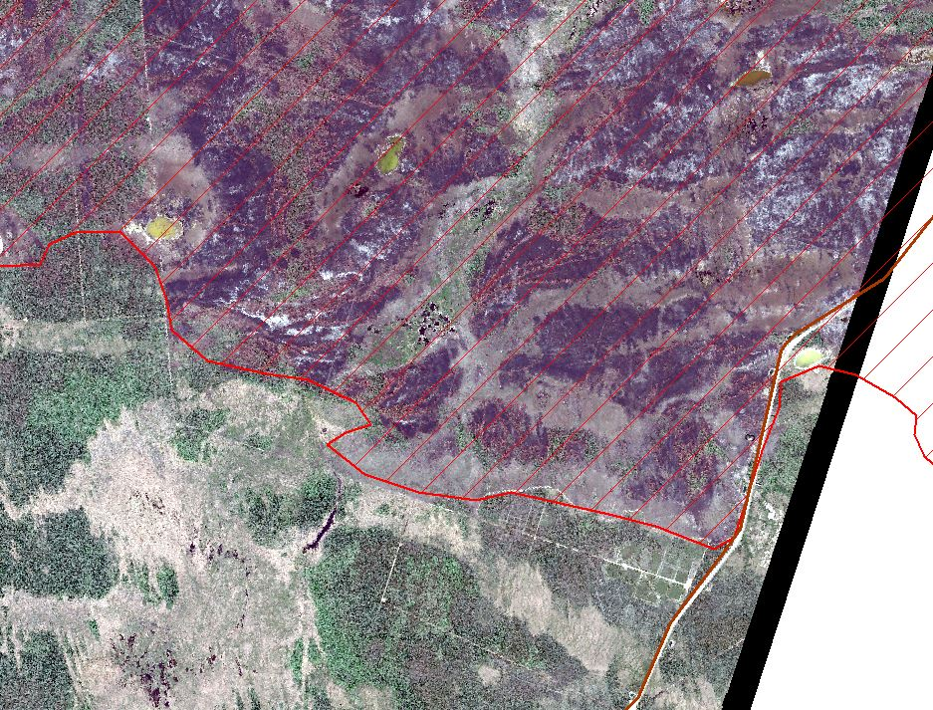
Imagery Derived Product
Imagery Derived Product Example:
Fire perimeter with imagery
Subject to the DigitalGlobe Copyright and Nextview License notice
Examples: a map of a fire perimeter underlain by imagery, road names and lines underlain by imagery, reduced resolution imagery
ZF020
© 2015 DigitalGlobe
NextView License
Rt. 3
2014 NWT Fire ZF020

Slide 6
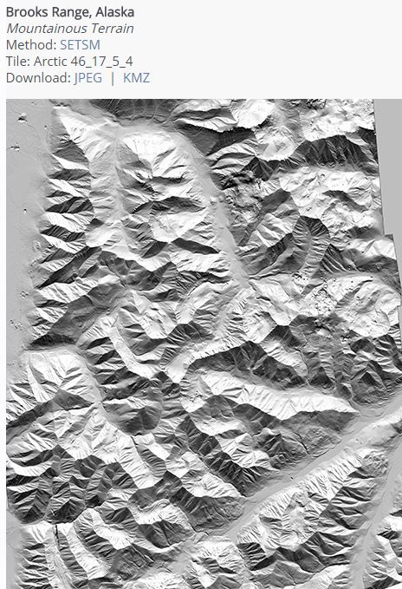
Derived Product
Derived Product Example:
DEM
Not subject to the DigitalGlobe Copyright or Nextview License notice
However, methodology describing the product should attribute initial imagery to DigitalGlobe
Examples: fire perimeter digitized from DigitalGlobe imagery, water mask derived using DigitalGlobe imagery, DEMs derived using DigitalGlobe image stereo pairs
DEM developed by the Polar Geospatial Center using DigitalGlobe imagery.

Slide 7
Restrictions and Additional Guidance
Do Not:
Publish imagery in printed reports without direct US Government benefit
Transfer imagery to commercial entities for commercial use or non-US Government use
Release imagery to third parties for non-Government use
Host reports on web sites containing NextView imagery without copyright or license
Seek Additional Guidance from NASA (and/NGA) when considering:
Sharing imagery with non-licensed users, foreign governments, or for crowdsourcing
Authorizing the release of imagery to the media
Releasing imagery to the public
Posting imagery on Non-Governmental Organization or US Government systems
Overall Goal: Continue broad US Government use of NextView licensed imagery and minimize the commercial impact on DigitalGlobe.

Slide 8
NextView Imagery End User License Agreement (EULA)
a. General Terms
This clause applies to all unprocessed sensor data and requirements-compliant processed imagery, imagery services, imagery-derived products and imagery support data licensed under this Contract. No other clauses related to intellectual property or data rights of any sort shall have any effect related to the unprocessed sensor data and requirements-compliant processed imagery, imagery services, imagery-derived products and imagery support data delivered under this Contract.
All license rights for use of the unprocessed sensor data and requirements-compliant processed imagery, imagery services, imagery-derived products and imagery support data provided to the U.S. Government purchased under this NGA contract are in perpetuity.
Licensed users may generate an unlimited number of hardcopies and softcopies of the unprocessed sensor data and requirements-compliant processed imagery, imagery services, imagery-derived products and imagery support data for their use.
(i) Licensed users may generate any derived product from the licensed unprocessed sensor data; and requirements-compliant processed
imagery, imagery services, imagery-derived products and imagery support data.\
(ii) Unprocessed sensor data and requirements-compliant processed imagery, imagery services, imagery-derived products and imagery
support data licensed under this NGA contract have no restrictions on use and distribution, but shall contain the copyright markings.
b. Licensed Users
The imagery may be used by the U.S. Government (including, all branches, departments, agencies, and offices).
The U.S. Government may provide the imagery to the following organizations: State Governments, Local Governments, Foreign Governments and inter-governmental organizations, NGO's and other non-profit organizations
In consideration for the flexibility afforded to the U.S. Government by allowing unprocessed sensor data and requirements-compliant processed imagery, imagery services, imagery-derived products and imagery support data to be shared, the United States Government shall use its reasonable best efforts to minimize the effects on commercial sales. Acquisition and dissemination of imagery and imagery products collected within the United States shall be restricted in accordance with law and regulation.

Slide 9
Questions?
Contact Elizabeth Hoy in the NASA Carbon Cycle and Ecosystems Office for further details related to use of DigitalGlobe imagery by the ABoVE field campaign:
Elizabeth Hoy
elizabeth.hoy@nasa.gov
301-614-6494

