Slide 1
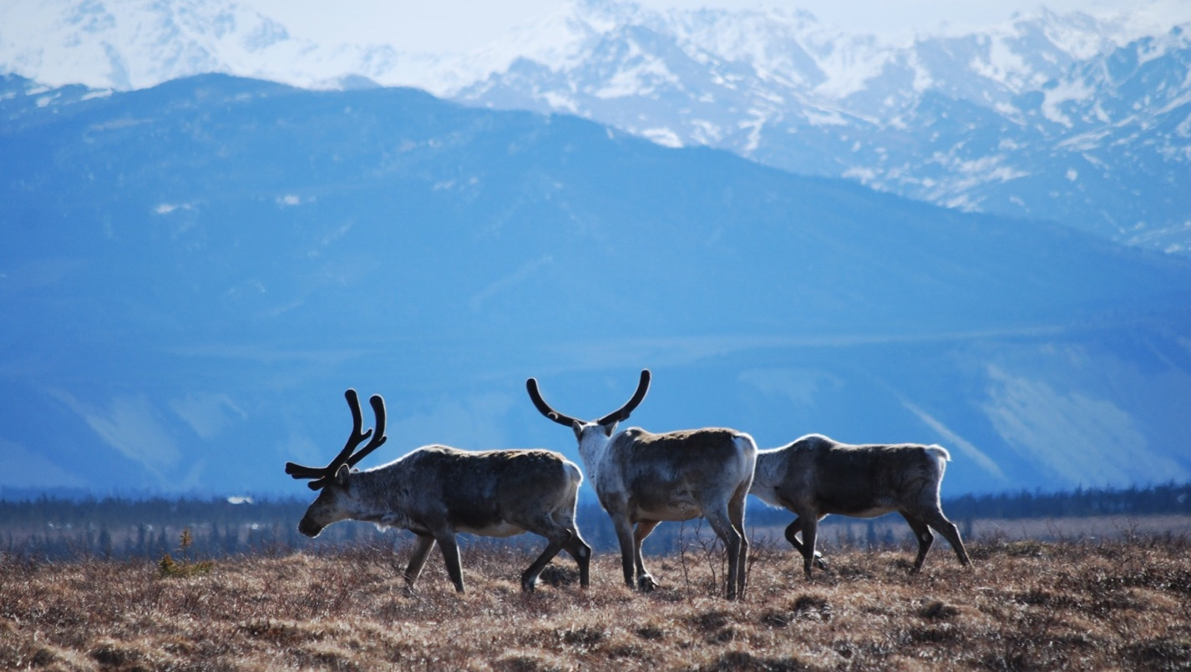
Arctic Boreal Vulnerability Experiment (ABoVE)
2019 ABoVE Airborne Flights
16 August 2019 (DOY 228)
L-Band SAR: Sortie 1: Ontario CA – Great Falls MT
Sortie 2: BERMS Lines
Charles Miller, Deputy Science Lead
Jet Propulsion Laboratory, California Institute of Technology
and the ABoVE Science Team For Hank Margolis, Mike Falkowski, Bruce Tagg, Jack Kaye
NASA HQ
2019

Slide 2
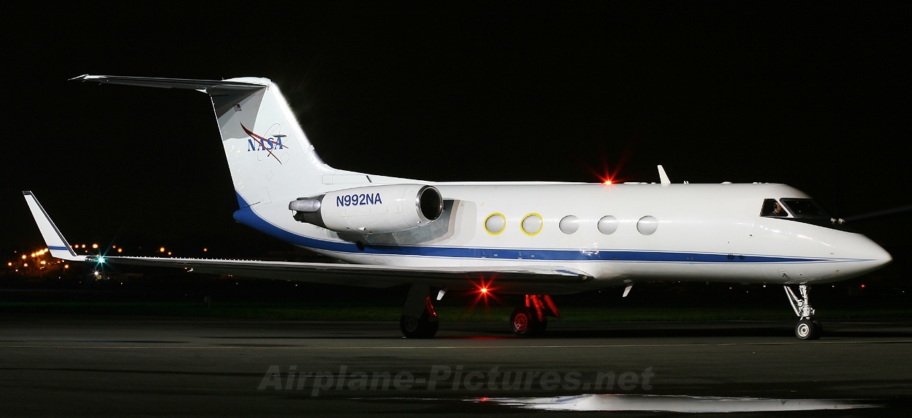
16 August 2019/DOY 228 Ontario CA – Great Falls MT; BERMS
Daily Summary:
NASA2 (N992NA) L-band SAR ABoVE CAMPAIGN
REPORT DATE: 16 August 2019
Current Status of Aircraft: GREEN
Current Status of SAR: GREEN
Current Status of PPA: GREEN
Current Deployment Location: Great Falls MT(KGTF)
Crew: Kingery, Klein, Smith, Austerberry, Pinto, Miller
Mechanics: M Brown, J Scott
Science Coordinator: N Pinto
Science Lead: C Miller
Project Manager: Y Lou

Slide 3
16 August 2019/DOY 228 Ontario CA – Great Falls MT; BERMS
Daily Summary:
Sortie #1: Transit – Ontario CA (KONT) to Great Falls MT (KGTF) – approx. 3.0 hrs
Sortie #2: KGTF – BERMS area – KGTF approx. 2.5 hrs
Modified version of Flight Plan 1472v01 – acquire only 4 BERMS area lines
Collected 4 of 4 planned lines lines
Real-time data display set up for SOBs via onboard ethernet; screen captures
Quicklook data products processed in-air and transferred prior to end of flight
Thumbnail PNG
KMZ
PNG and KMZ files did not process for Line 1 30704
80-100% cloud cover over BERMS lines, but little to no reported precipitation

Slide 4
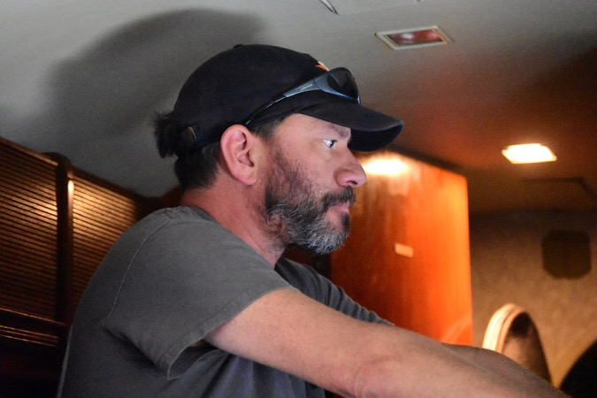
16 August 2019/DOY 228 Ontario CA – Great Falls MT; BERMS
Notes:
AVIRIS & NEON teams in Barrow

Slide 5
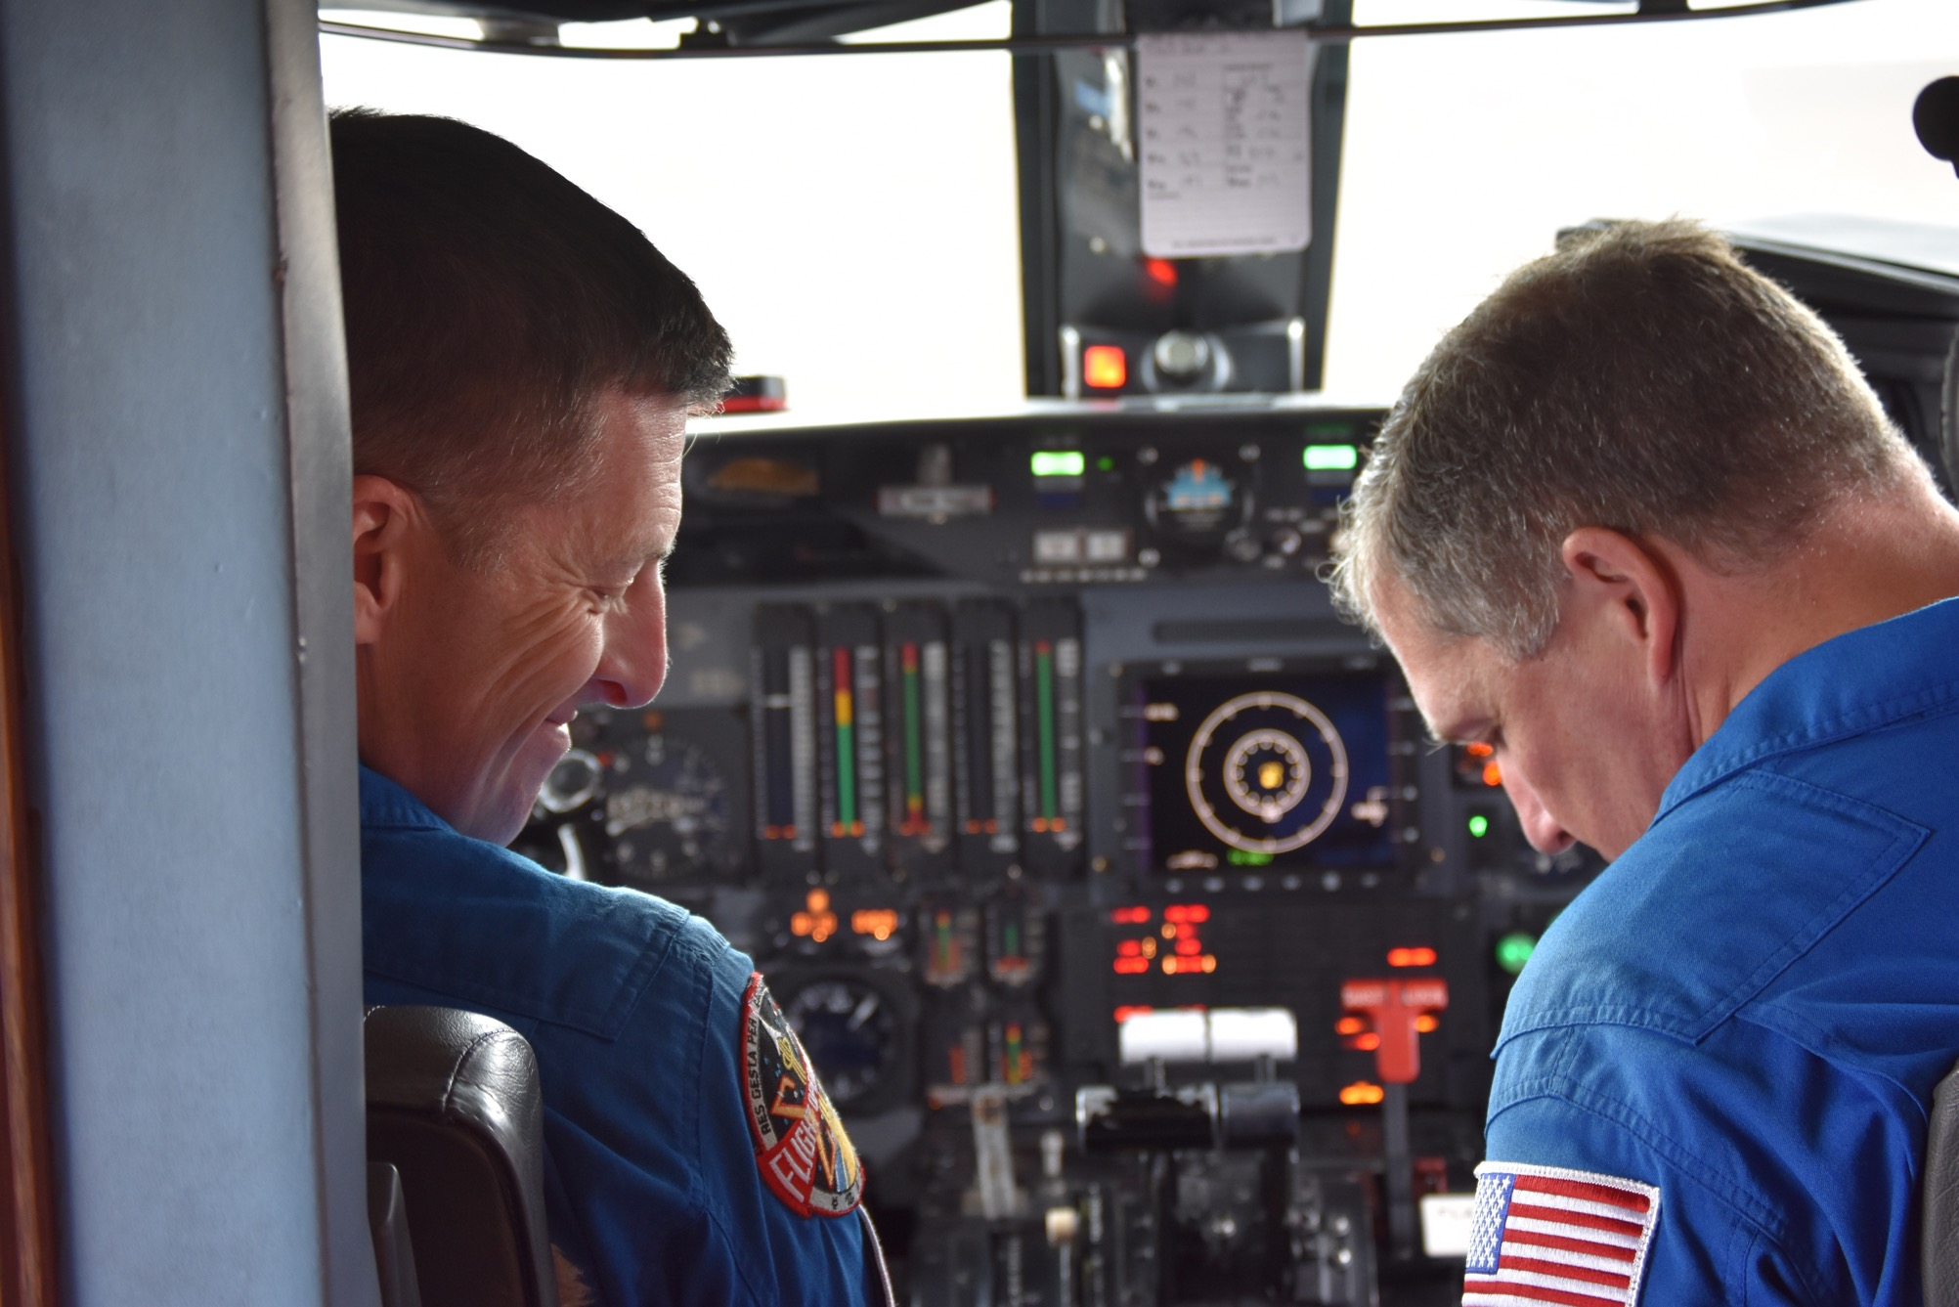

Slide 6
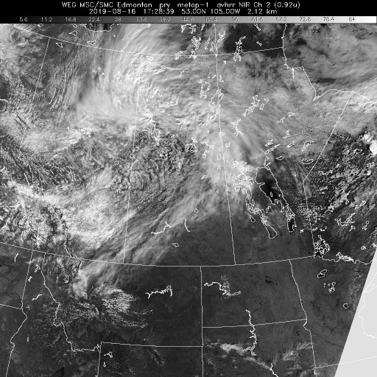
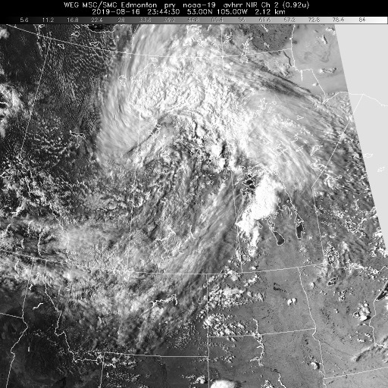
16 August 2019/DOY 228 Ontario CA – Great Falls MT; BERMS
3 um 1728Z
3 um 2344Z
Notes:
80-100% cloud cover over the BERMS/BOREAS sites during data acquisition, but no significant precip

Slide 7
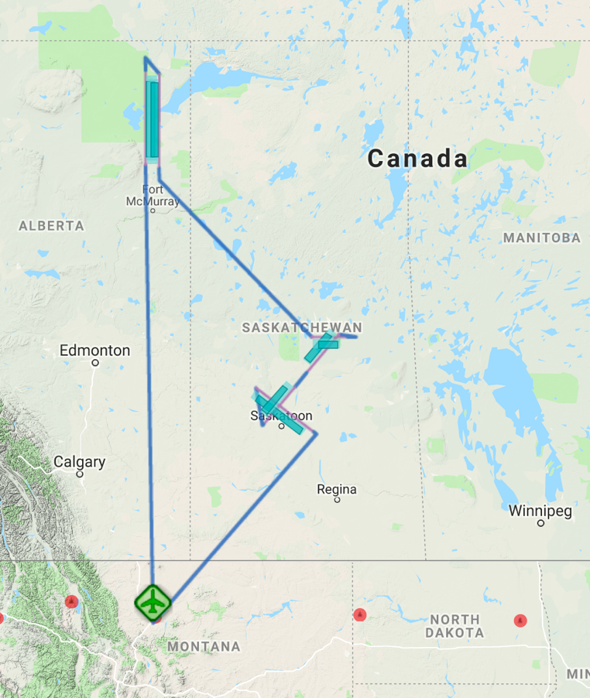
16 August 2019/DOY 228 Ontario CA – Great Falls MT; BERMS
Flight Plan Report: PLAN_1472_v01 (KGTF-KGTF)
https://uavsar.jpl.nasa.gov/cgi-bin/report.pl?planID=PLAN_1472_v01#map
8/16/19 Planned flight lines & acquisition segments
Data Acquisitions:
Line 1, ID 30704: redber
Line 2, ID 04016: saskaS
Line 3, ID 04018: saskaN
Line 4, ID 27037: bermsR
Line 5, ID 36000: padelE
Line 6, ID 18035: padelW
These flown flight plans contain at least one flight line from this flight plan: PLAN_18047, flown Aug 21, 2018 PLAN_18046, flown Aug 19, 2018 PLAN_17093, flown Sep 8, 2017 PLAN_17092, flown Sep 7, 2017 PLAN_17062, flown Jun 13, 2017
18035
36000
27037
04018
04016
30704
Notes:
Lines 5 & 6 dropped due to flight plan > 2000 naut miles
Peace-Athabasca Delta lines 5 & 6 will be flown on 8/17/19 with Yellowknife (Hearn Lake) line 22801 from Plan 1746

Slide 8
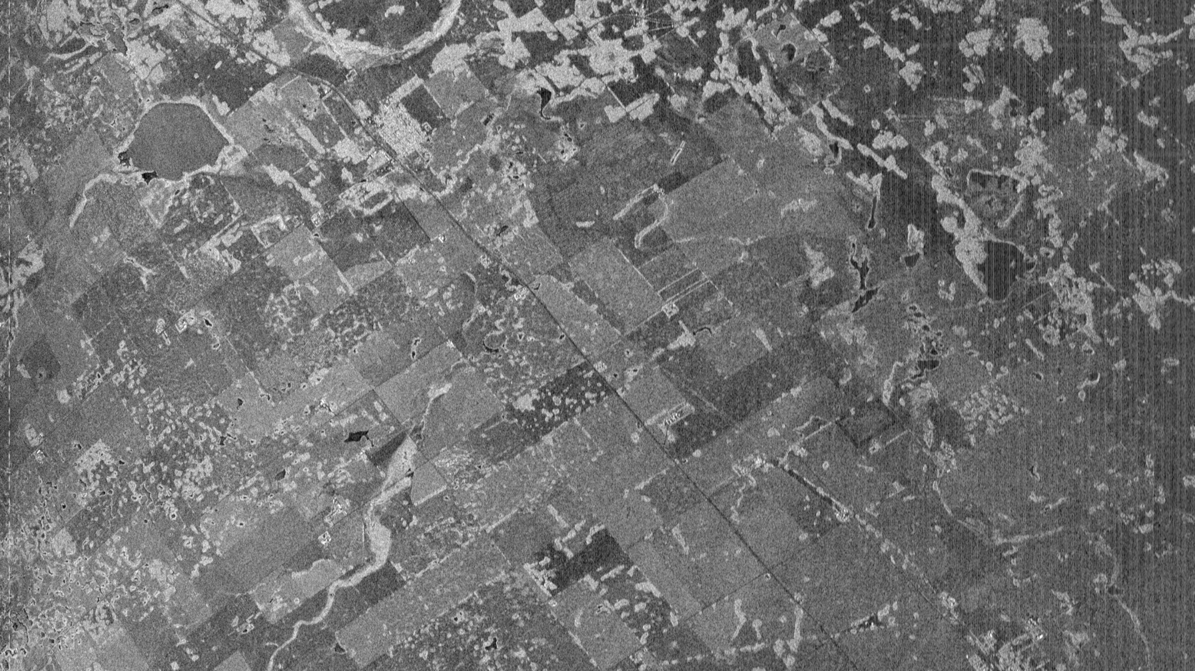
Line 1, ID 30704: redber – screen shot
Notes:
Configure browser IP Address to 192.168.8.19
Then use http://192.168.8.17:8080/
To see scrolling real-time HH imagery. Must use ethernet hardline

Slide 9
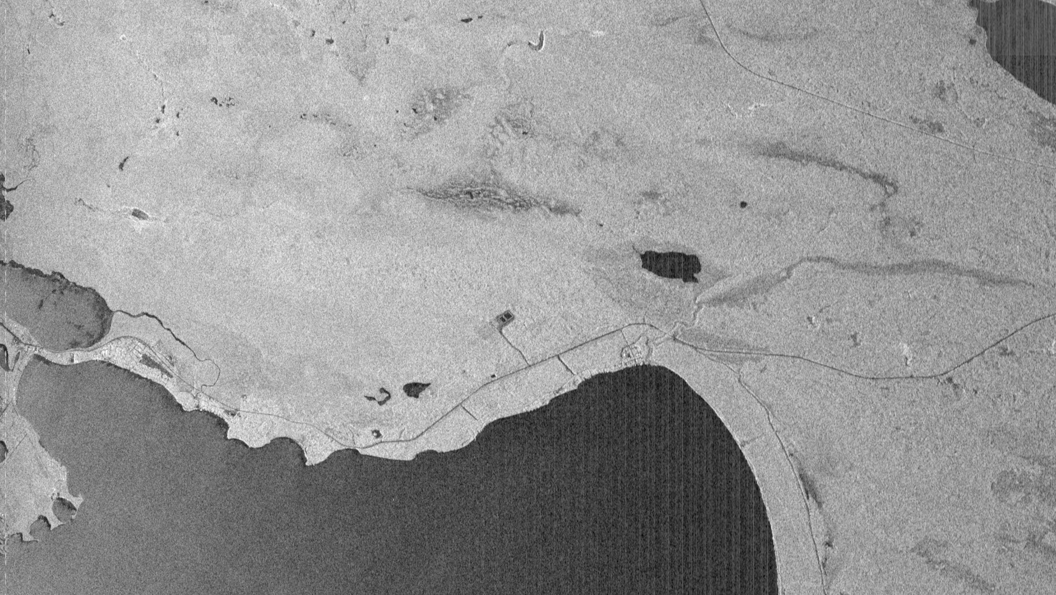
Line 3, ID 04018: saskaN – screen shot

Slide 10
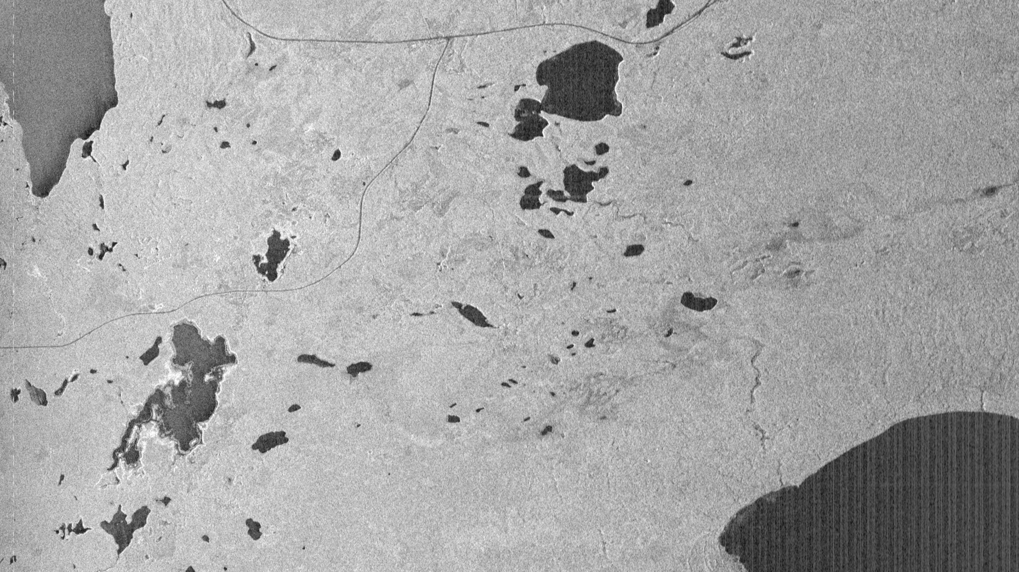
Line 4, ID 27037: bermsR – screen shot

Slide 11
16 August 2019/DOY 228 Ontario CA – Great Falls MT; BERMS
UAVSAR Quick-look products
Line 1, ID 30704: redber
Line 2, ID 04016: saskaS
David Elliott, JPL
B
A
Notes:
http://192.168.8.17:8080/flight19057/
provides access to Quick Look files (TIFF, PNG), kmz

Slide 12
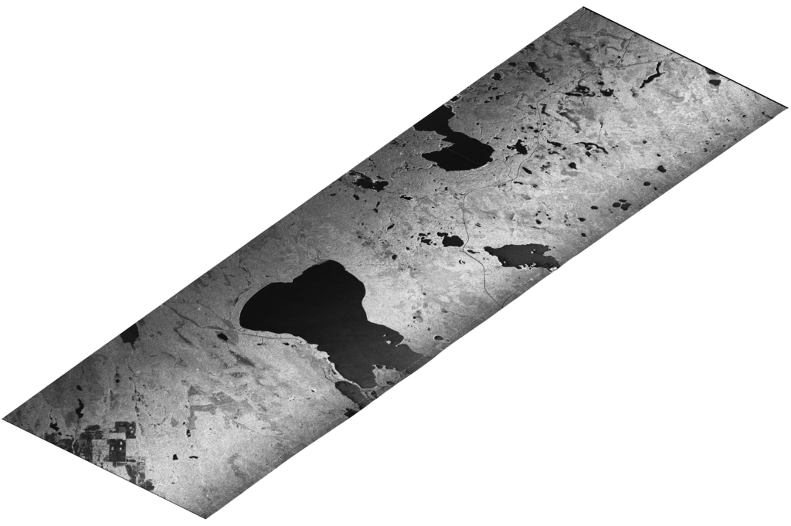
16 August 2019/DOY 228 Ontario CA – Great Falls MT; BERMS
UAVSAR Quick-look products
Line 3, ID 04018: saskaN
Line 4, ID 27037: bermsR
David Elliott, JPL
A
B
Notes:
Thumbnail.png

Slide 13
16 August 2019/DOY 228 Ontario CA – Great Falls MT; BERMS
UAVSAR Quick-look products
Line 4, ID 27037: bermsR
David Elliott, JPL
A
Notes:
Thumbnail.png

Slide 14
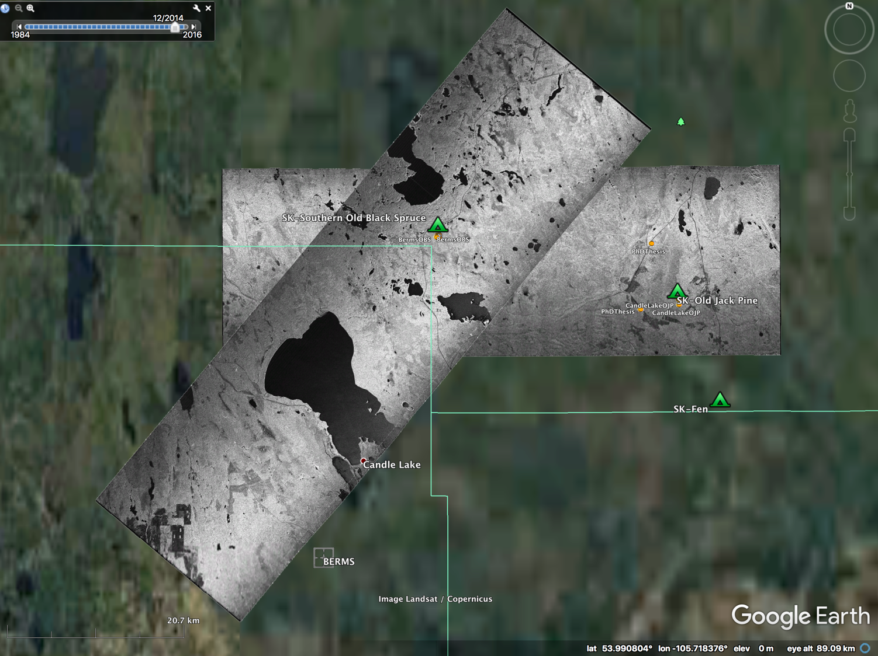
A
Line 3, ID 04018: saskaN
Line 4, ID 27037: bermsR
B
Notes:
KMZs showing L-Band HH imagery over Old Black Spruce (OBS) and Old Jack Pine (OJP) flux towers

Slide 15
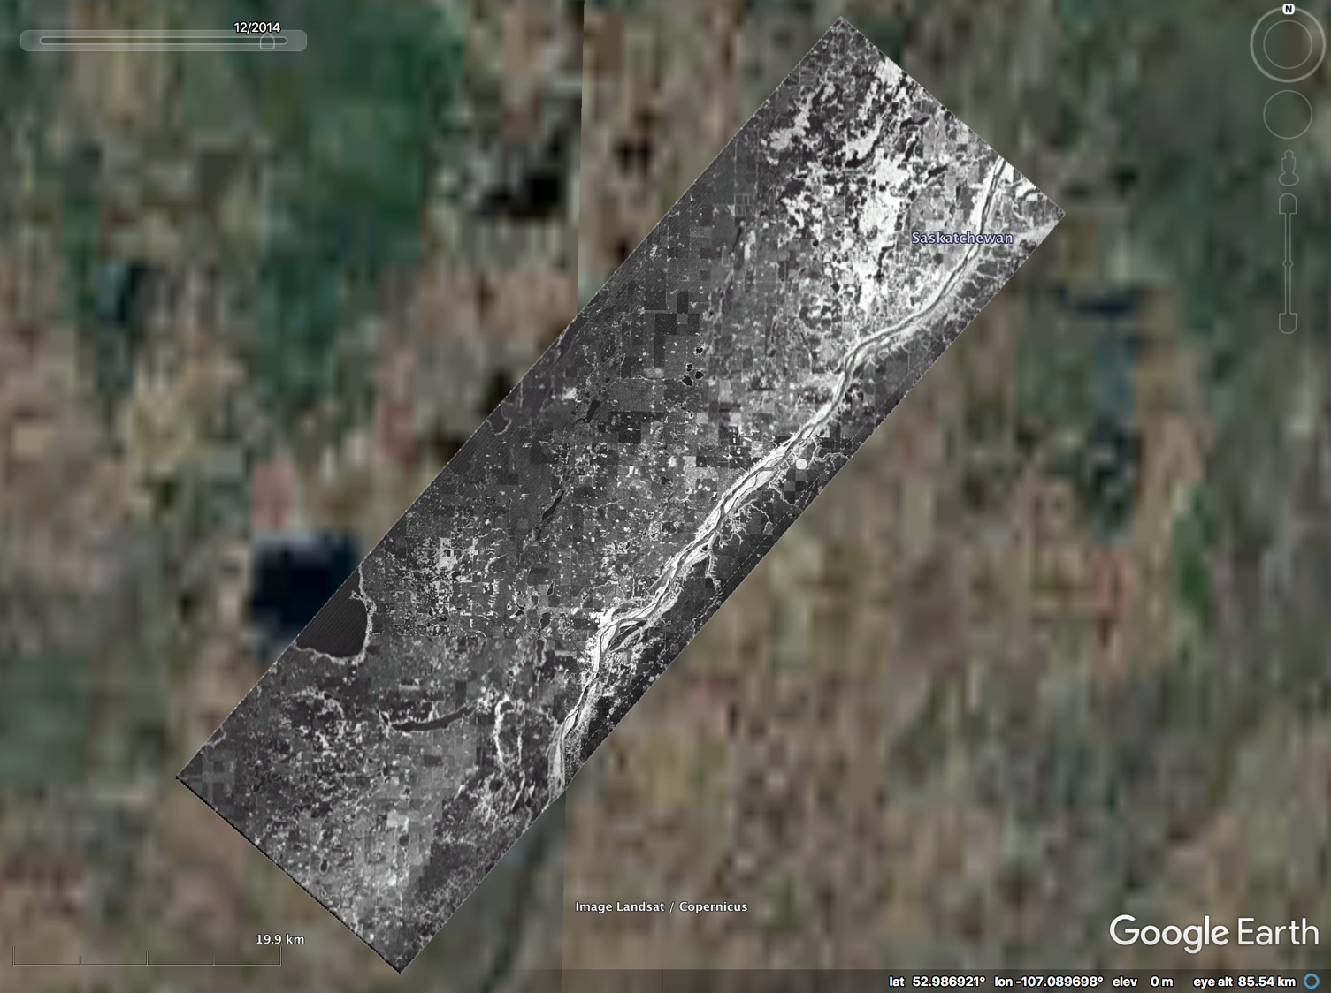
Line 2, ID 04016: saskaS

Slide 16
Backup

Slide 17
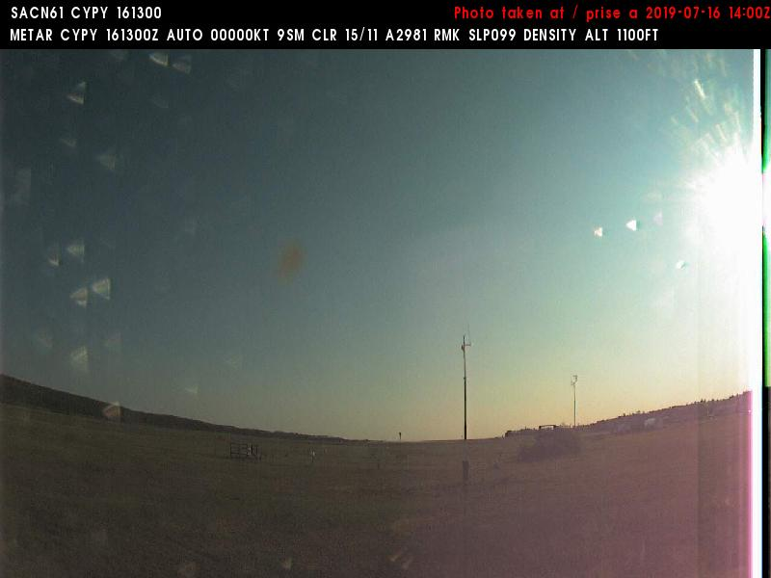
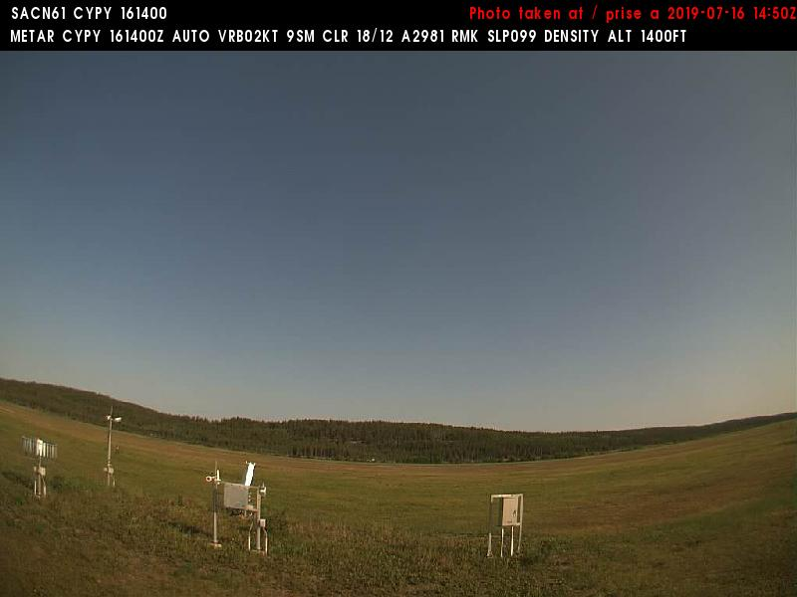
16 August 2019/DOY 228 Ontario CA – Great Falls MT; BERMS
Fort Chipewyan (CYPY) N58 46 02 W111 07 02
0800 MDT/1400 UTC
Northeast
Northwest

