Slide 1
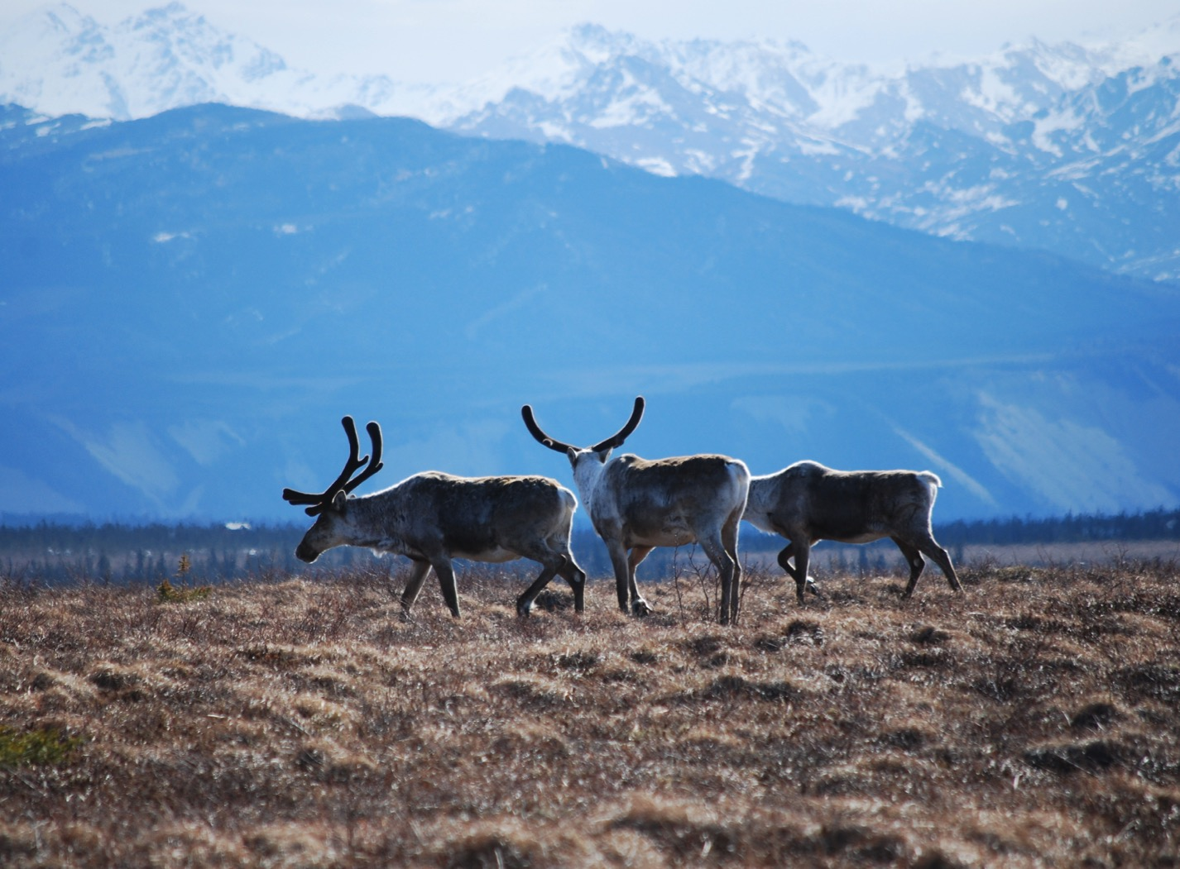
Arctic Boreal Vulnerability Experiment (ABoVE)
2018 ABoVE Airborne Flights
21 July 2018 (DOY 201)
AVIRIS-NG: Old Crow YT/Fairbanks Area
Charles Miller, Deputy Science Lead
Jet Propulsion Laboratory, California Institute of Technology
and the ABoVE Science Team
For Hank Margolis, Eric Kasichke, Bruce Tagg
NASA HQ
2018

Slide 2

21 July 2017/DOY 201
Old Crow YT/Fairbanks Area
Daily Status:
AVIRIS-NG / Dynamic Aviation B-200 (N53W)
REPORT DATE: 21 July 2018
Current Status of Aircraft: GREEN
Current Status of AVIRIS: GREEN
Current Deployment Location: Fairbanks AK (PAFA)
Crew: Heidt, Jones, Nolte, Sullivan
Science Planning: A Thorpe
Data Processing: W Olsen-Duvall
Instrument Managers: M Eastwood, I McCubbin
Instrument PI: R Green
Science Lead: C Miller

Slide 3
21 July 2017/DOY 201
Old Crow YT/Fairbanks Area
Daily Summary:
Fairbanks – Old Crow – Fairbanks Area - Fairbanks
Excellent flight
Lines B59, 60, 62, 86, 89, 90, and 92 with minimal cloud contamination.
Lines B61, 64, and 74 had some clouds

Slide 4
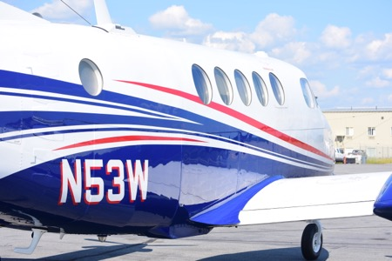
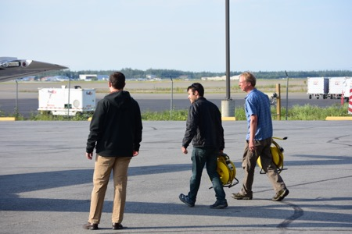
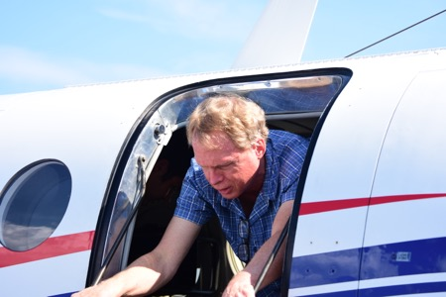
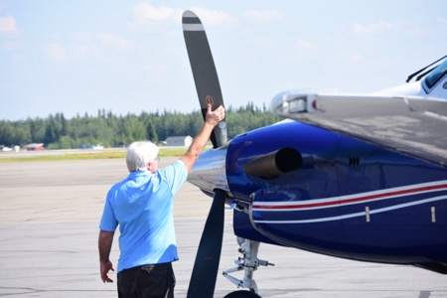
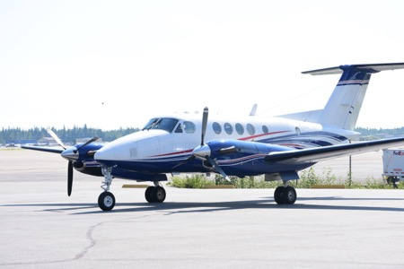
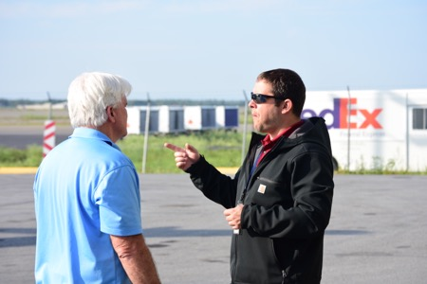
21 July 2017/DOY 201
Old Crow YT/Fairbanks Area

Slide 5
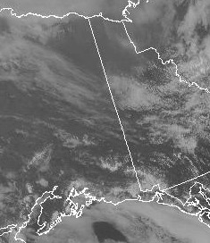
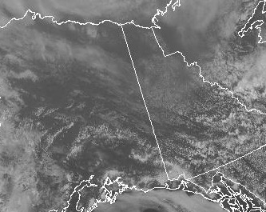
21 July 2017/DOY 201
Old Crow YT/Fairbanks Area
GOES-West Vis 2130Z
GOES-West Vis 1800Z
Satellite imagery shows mostly clear skies over Old Crow Flats in early morning (1800Z) and over Fairbanks area in the afternoon (2130Z)

Slide 6
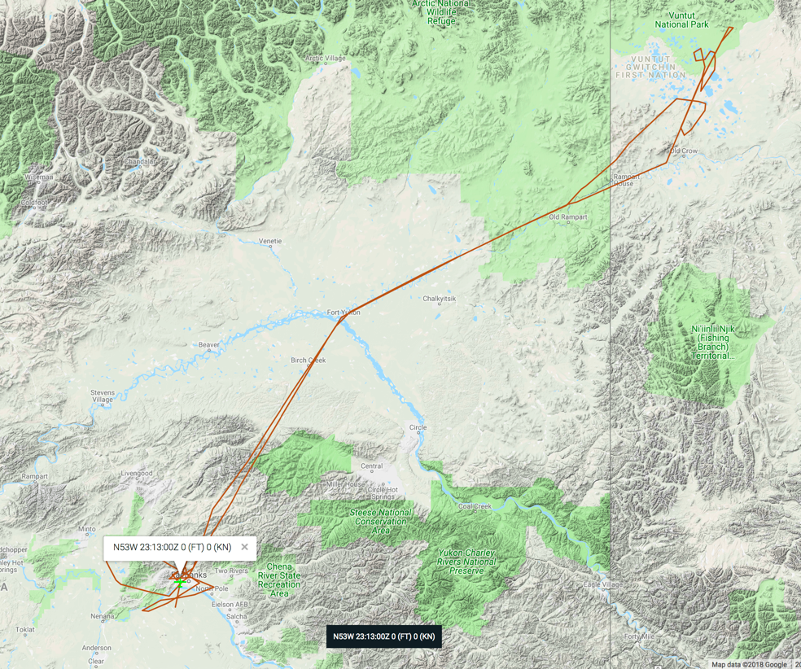
21 July 2017/DOY 201
Old Crow YT/Fairbanks Area
As-flown Lines
Actual
Flight Lines

Slide 7
21 July 2017/DOY 201
Old Crow YT/Fairbanks Area
Old Crow
Planned Lines
Fairbanks Area
Planned Lines

Slide 8
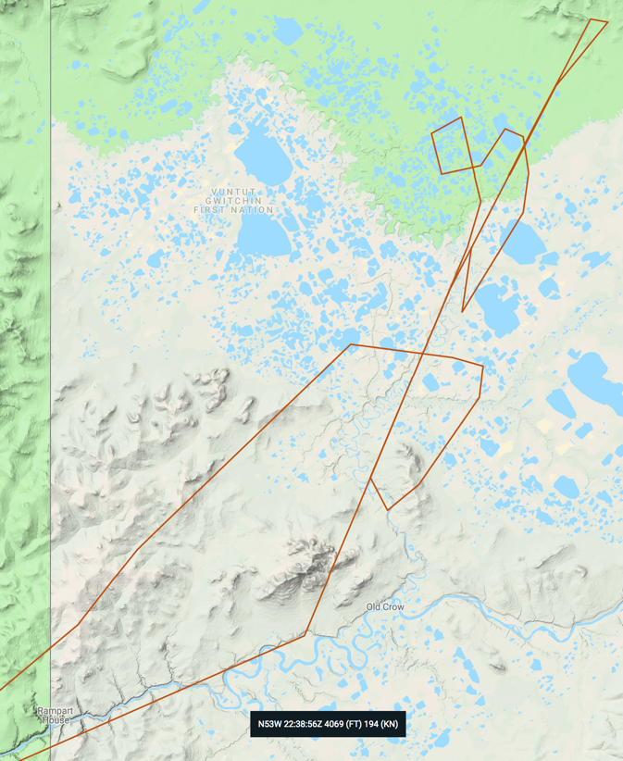
21 July 2017/DOY 201
Old Crow YT/Fairbanks Area
Old Crow
Planned Lines
Old Crow
Actual Lines

Slide 9
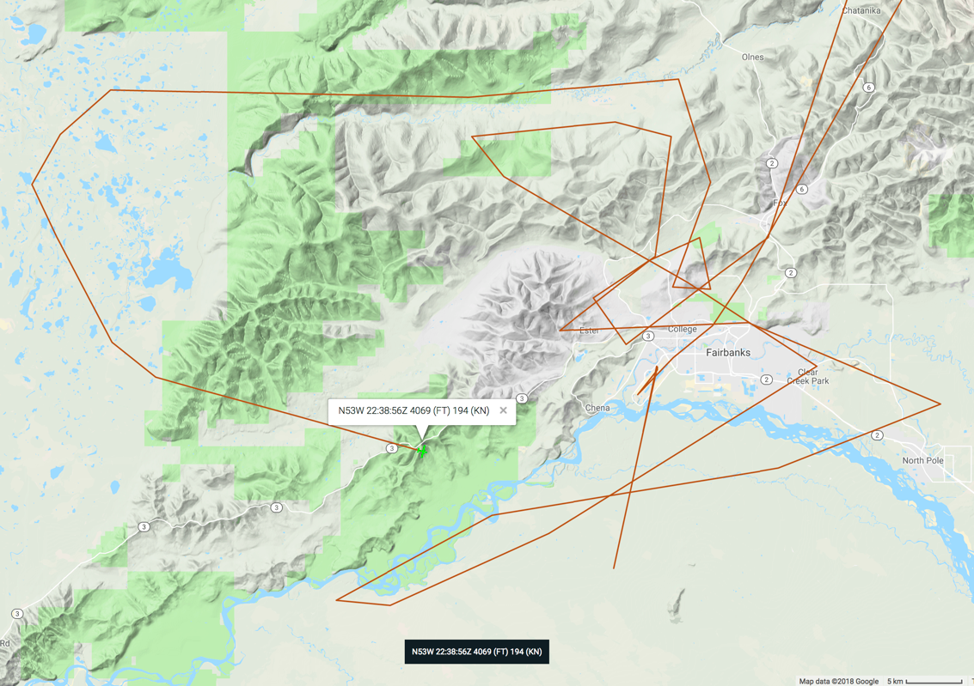
21 July 2017/DOY 201
Old Crow YT/Fairbanks Area
As-flown Lines
Fairbanks Area
Planned Lines
Fairbanks Area
Actual Lines

Slide 10
21 July 2017/DOY 201
Old Crow YT/Fairbanks Area
AVIRIS-NG Quick-look products
https://avirisng.jpl.nasa.gov/cgi/flights.cgi?step=view_flightlog&flight_id=ang20180721t
A. Line 325A-D, FL183, Run ID 183446: Chalkyitsik – Porcupine River
B. Line 325A-D, FL183, Run ID 201426 : Chalkyitsik – Porcupine River - reverse
Winston Olson-Duvall, JPL
A
B
A. Lakes and wetlands along the Mackenzie River Valley
B. Significant cloud cover encountered before getting to Scotty Creek flux towers – will need to refly

Slide 11
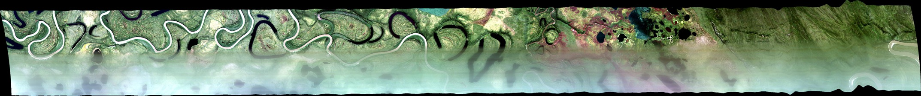
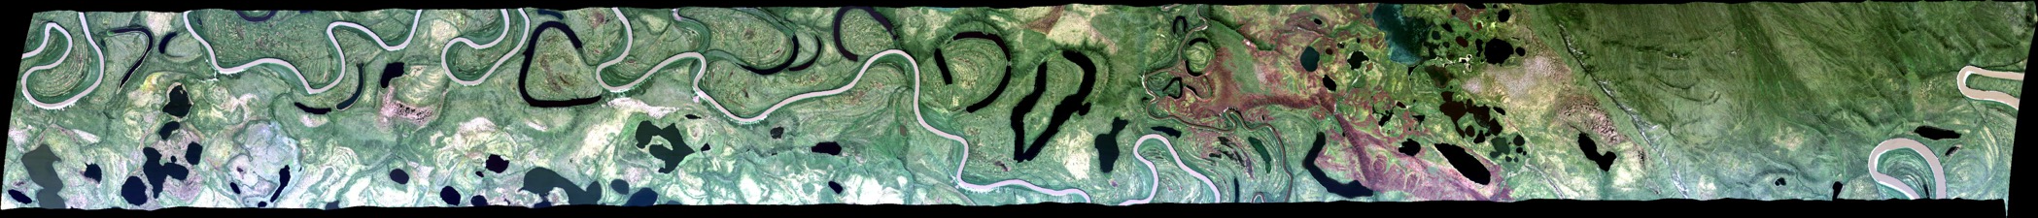
21 July 2017/DOY 201
Old Crow YT/Fairbanks Area
AVIRIS-NG Quick-look products
https://avirisng.jpl.nasa.gov/cgi/flights.cgi?step=view_flightlog&flight_id=ang20180721t
A. Line 311A-Z, FL184, Run ID 190644 : Old Crow Flats
B. Line 311A-Z, FL184, Run ID 194449 : Old Crow Flats
Winston Olson-Duvall, JPL
A
B
A. Lower half of frame unresolved – condensation on nadir window
B. Better image; K Turner Lakes

Slide 12
21 July 2017/DOY 201
Old Crow YT/Fairbanks Area
AVIRIS-NG Quick-look products
https://avirisng.jpl.nasa.gov/cgi/flights.cgi?step=view_flightlog&flight_id=ang20180721t
A. Line 312A-Z, FL185, Run ID 192935 : Old Crow Flats
B. Line 312A-Z, FL185, Run ID 193822 : Old Crow Flats
Winston Olson-Duvall, JPL
A
B
A. Lakes in the Old Crow Flats
B. Retake; K Turner Lakes

Slide 13
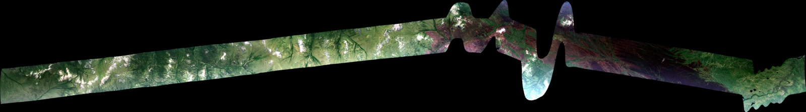
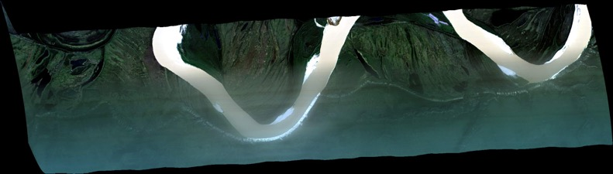
21 July 2017/DOY 201
Old Crow YT/Fairbanks Area
AVIRIS-NG Quick-look products
https://avirisng.jpl.nasa.gov/cgi/flights.cgi?step=view_flightlog&flight_id=ang20180721t
A. Bonus Line, Run ID 185956 : Old Crow Flats
B. Bonus Line, Run ID 200319 : Old Crow Flats
Winston Olson-Duvall, JPL
A
B
A. Yukon River
B. TBC

Slide 14
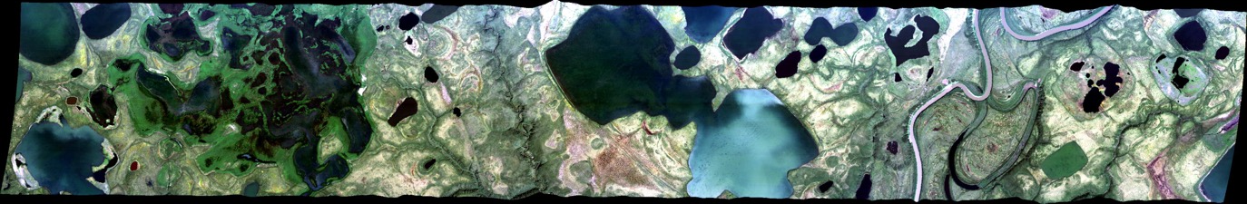
21 July 2017/DOY 201
Old Crow YT/Fairbanks Area
AVIRIS-NG Quick-look products
https://avirisng.jpl.nasa.gov/cgi/flights.cgi?step=view_flightlog&flight_id=ang20180721t
A. Line 313A-Z, FL184, Run ID 195600 : Fairbanks area
B. Line 325A-D, FL183, Run ID 201426 : Fairbanks area
Winston Olson-Duvall, JPL
A
B
A. Interesting lake mixing
B. Scattered clouds

Slide 15
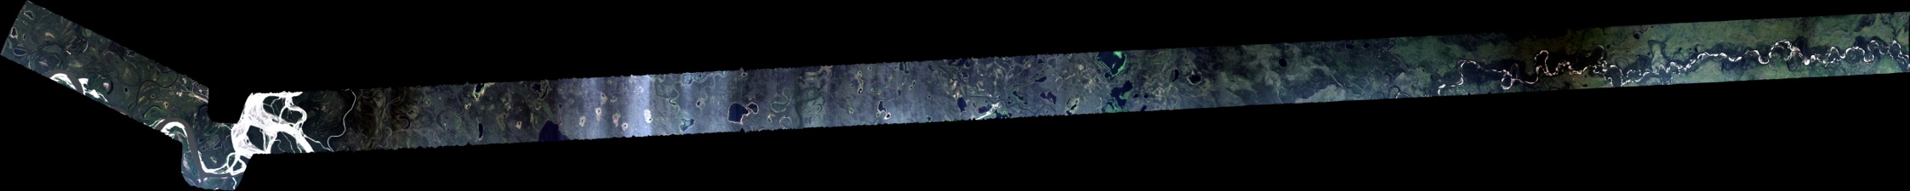
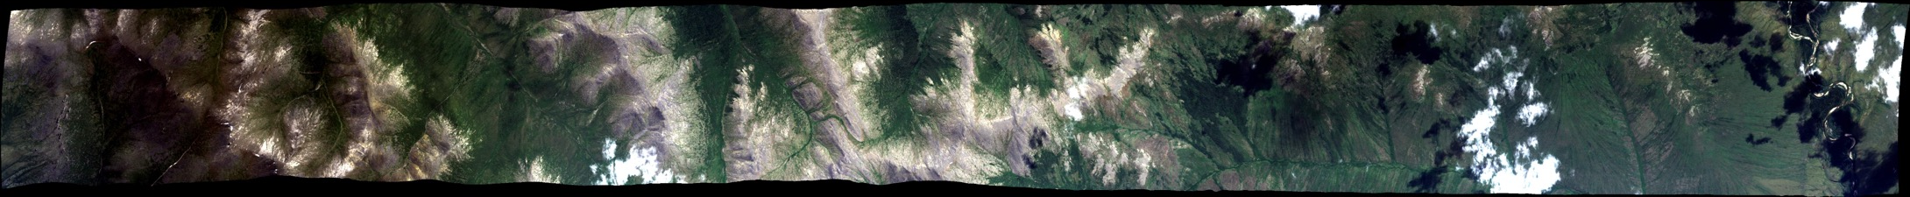
21 July 2017/DOY 201
Old Crow YT/Fairbanks Area
AVIRIS-NG Quick-look products
https://avirisng.jpl.nasa.gov/cgi/flights.cgi?step=view_flightlog&flight_id=ang20180721t
A. Bonus Line, Run ID 204253 : TBC
B. Bonus Line, Run ID 200319 : TBC
Winston Olson-Duvall, JPL
A
B
A. Ortho-rectification challenge at beginning
B. Scattered clouds

Slide 16
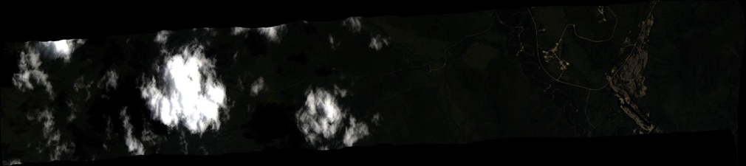
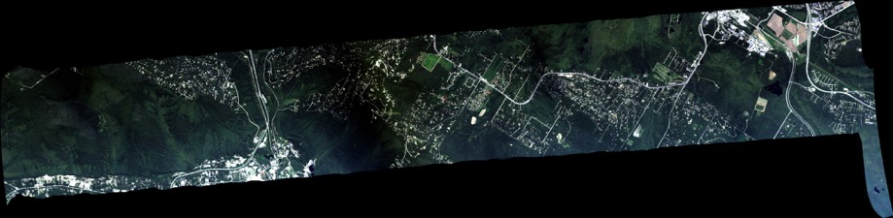
21 July 2017/DOY 201
Old Crow YT/Fairbanks Area
AVIRIS-NG Quick-look products
https://avirisng.jpl.nasa.gov/cgi/flights.cgi?step=view_flightlog&flight_id=ang20180721t
A. Line 258A-Z, FL190, Run ID 211126 : Fairbanks
B. Line 254A-Z, FL183, Run ID 201426 : Fairbanks
Winston Olson-Duvall, JPL
A
B
A. Cloud interference
B. Scattered clouds

Slide 17
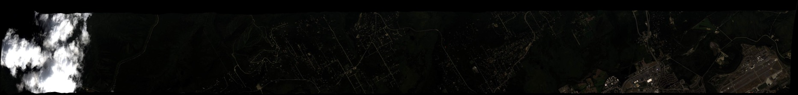
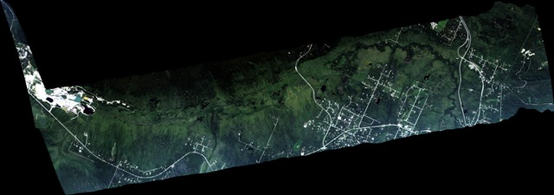
21 July 2017/DOY 201
Old Crow YT/Fairbanks Area
AVIRIS-NG Quick-look products
https://avirisng.jpl.nasa.gov/cgi/flights.cgi?step=view_flightlog&flight_id=ang20180721t
A. Line AB_CH4, FL183, Run ID 212319 : Fairbanks
B. Line 253A-Z, FL183, Run ID 213123 : Fairbanks
Winston Olson-Duvall, JPL
A
B
A. Cloud interference
B. Large cloud interference at beginning

Slide 18
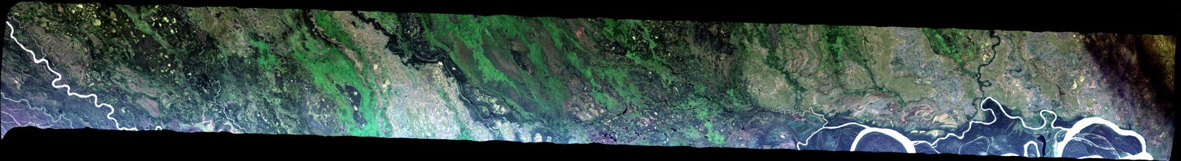
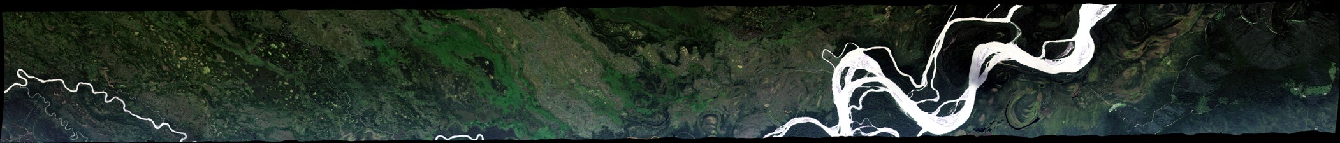
21 July 2017/DOY 201
Old Crow YT/Fairbanks Area
AVIRIS-NG Quick-look products
https://avirisng.jpl.nasa.gov/cgi/flights.cgi?step=view_flightlog&flight_id=ang20180721t
A. Line 252A-Z, FL179, Run ID 213924 : Fairbanks - BNZ
B. Line 251A-Z, FL179, Run ID 214721 : Fairbanks - BNZ
Winston Olson-Duvall, JPL
A
B
A. Yukon River at far right
B. Yukon River at right

Slide 19
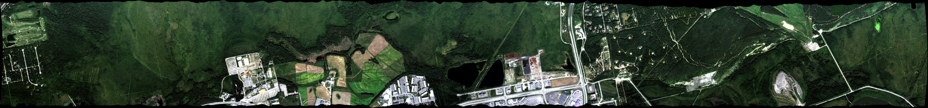
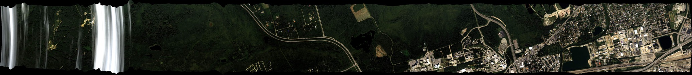
21 July 2017/DOY 201
Old Crow YT/Fairbanks Area
AVIRIS-NG Quick-look products
https://avirisng.jpl.nasa.gov/cgi/flights.cgi?step=view_flightlog&flight_id=ang20180721t
A. Line AB_CH4_L005, FL072, Run ID 220102 : Fairbanks
B. Line AB_CH4_L004, FL072, Run ID 220552 : Fairbanks
Winston Olson-Duvall, JPL
A
B
A. Fairbanks CH4 ebullition lakes
B. Smeared cloud at left hand edge

Slide 20
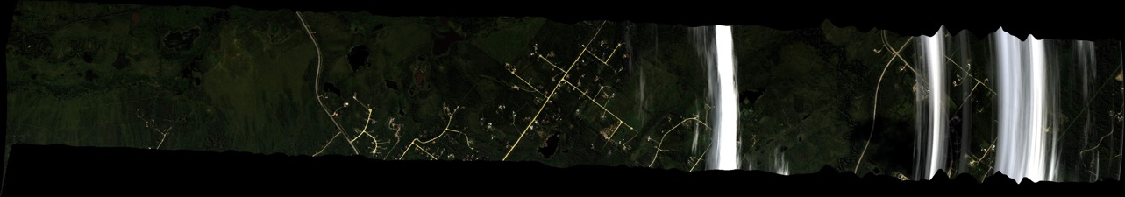
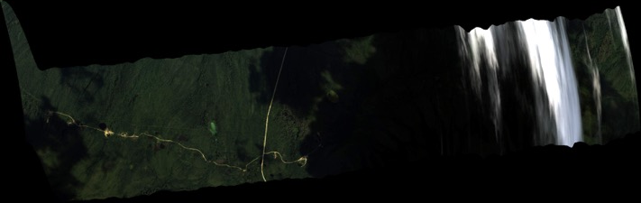
21 July 2017/DOY 201
Old Crow YT/Fairbanks Area
AVIRIS-NG Quick-look products
https://avirisng.jpl.nasa.gov/cgi/flights.cgi?step=view_flightlog&flight_id=ang20180721t
A. Line AB_CH4_L003, FL072, Run ID 221025 : Fairbanks
B. Line AB_CH4_L002, FL072, Run ID 221814 : Fairbanks
Winston Olson-Duvall, JPL
A
B
A. Smeared cloud at right hand edge
B. Smeared cloud at right hand edge

Slide 21
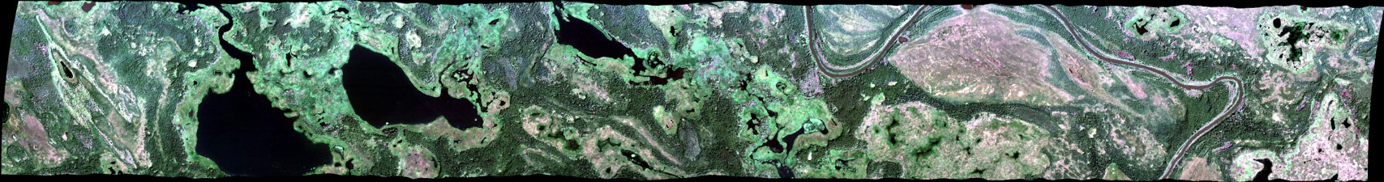
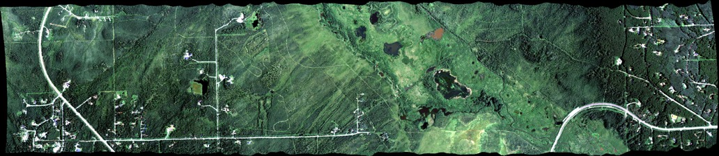
21 July 2017/DOY 201
Old Crow YT/Fairbanks Area
AVIRIS-NG Quick-look products
https://avirisng.jpl.nasa.gov/cgi/flights.cgi?step=view_flightlog&flight_id=ang20180721t
A. Line TBD, FL072, Run ID 221437 : Fairbanks
B. Line AB_CH4_L007, FL072, Run ID 223058 : Fairbanks
Winston Olson-Duvall, JPL
A
B
A. CH4 ebullition lakes at center of image
B. Smeared cloud at right hand edge

Slide 22
Backup

Slide 23
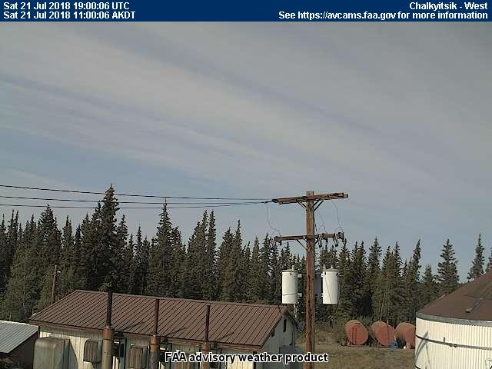
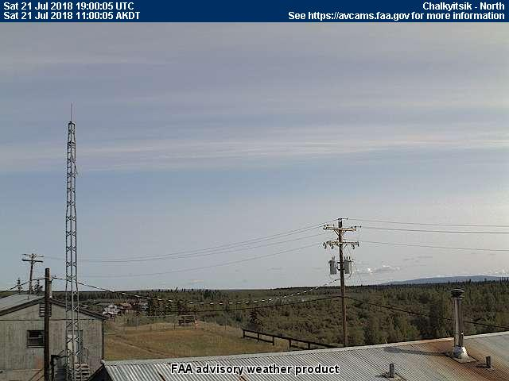
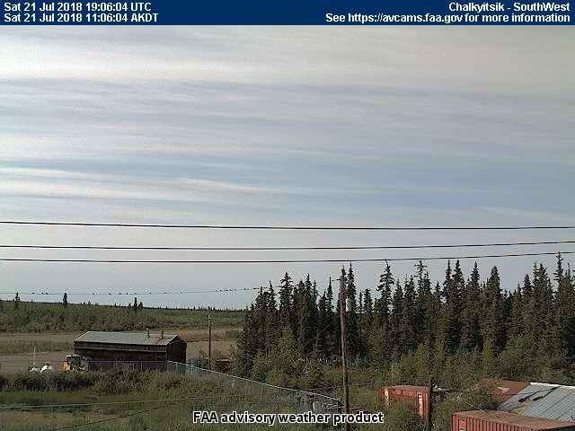
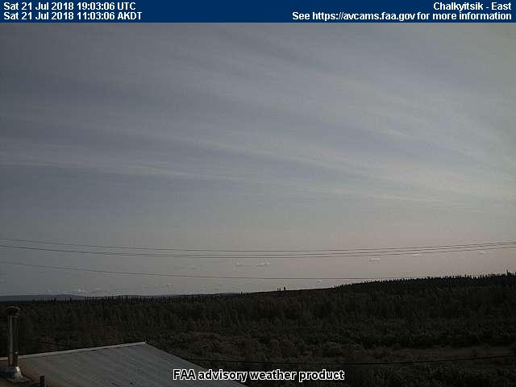
21 July 2017/DOY 201
Old Crow YT/Fairbanks Area
Chalkyitsik – 1100 AKDT/1900 UTC
Notes:
Images recorded as N53W flew over on its way to Old Crow Flats

Slide 24
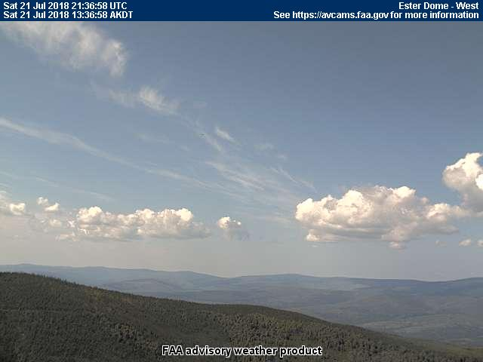
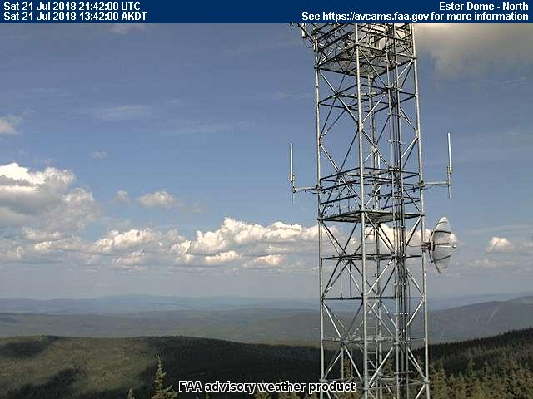
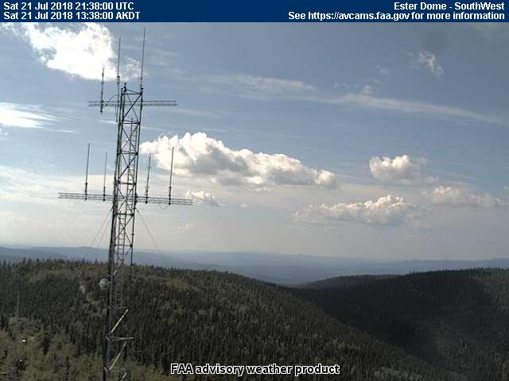
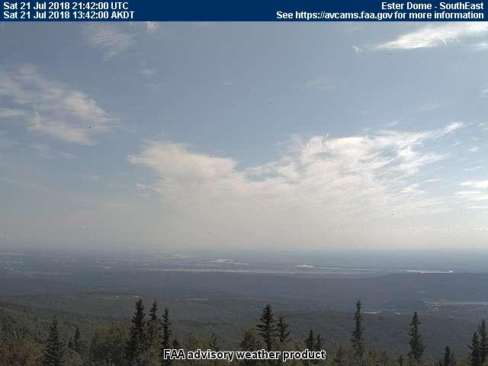
21 July 2017/DOY 201
Old Crow YT/Fairbanks Area
Esther Dome – 1342 AKDT/2142 UTC
Notes:
Images from Fairbanks area while AVIRIS/N53W acquired data

