Slide 1
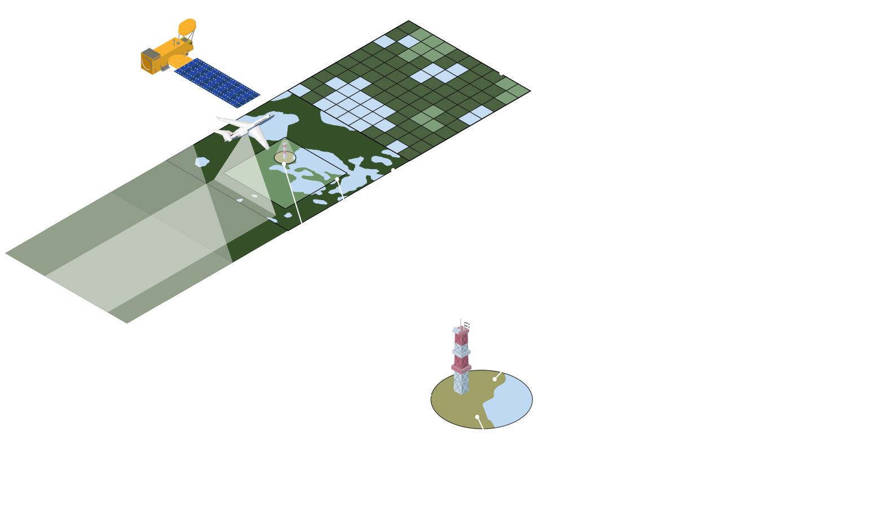
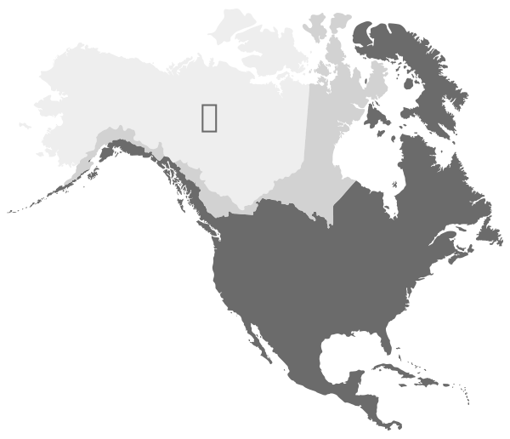
SCALING DIAGRAM
Credit: “Leaf to Orbit” by Piers Sellers, as adapted for ABoVE by NASA’s Carbon Cycle & Ecosystems Office.

