Slide 1
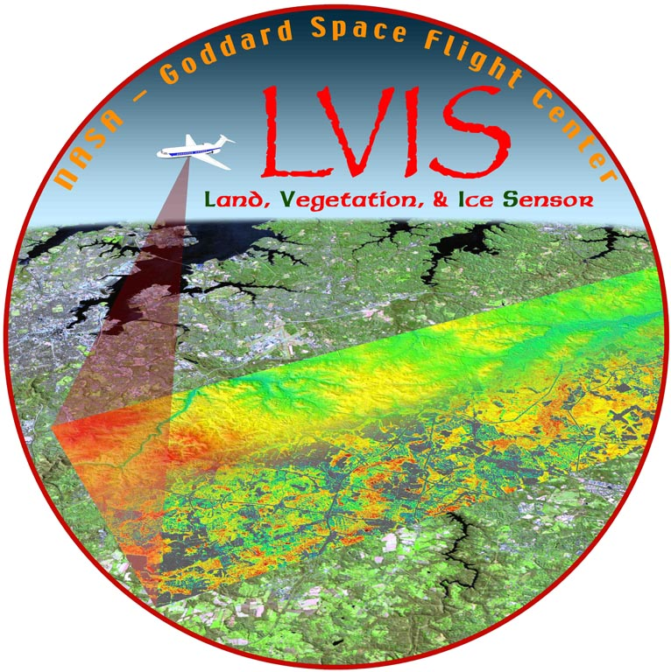
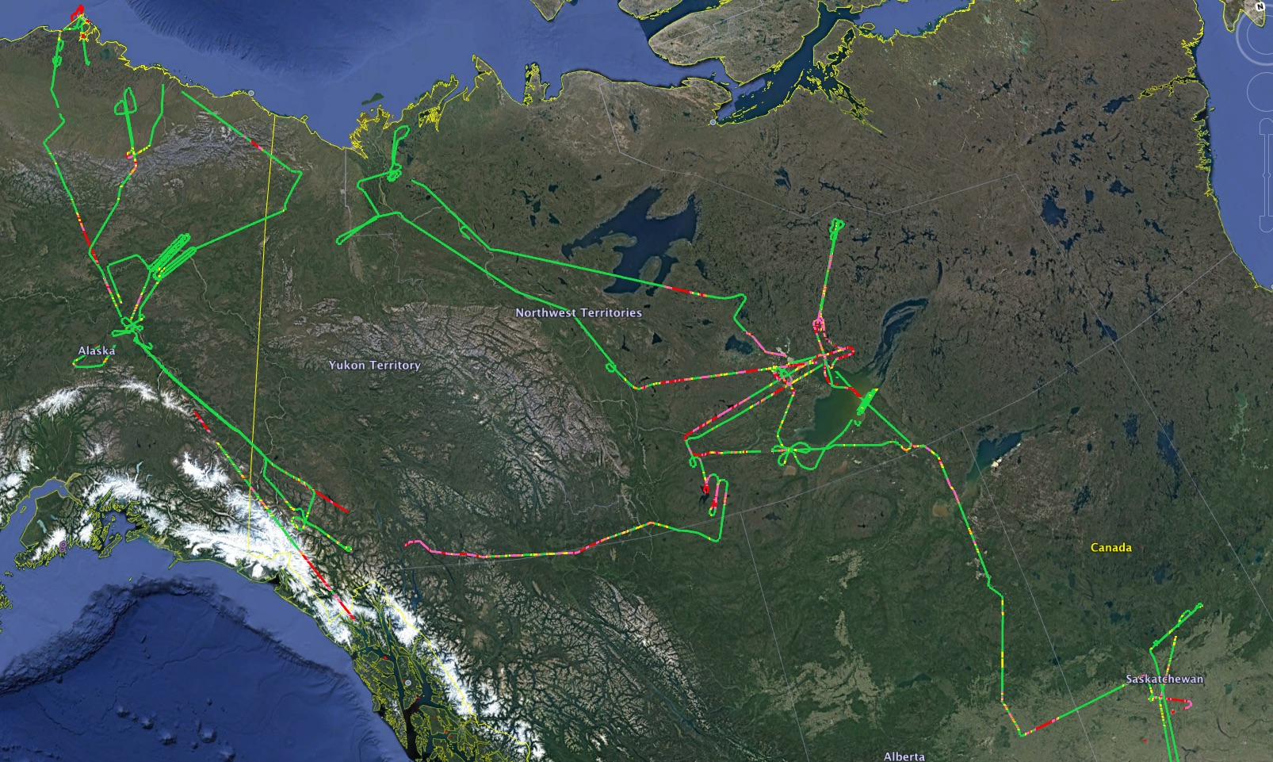
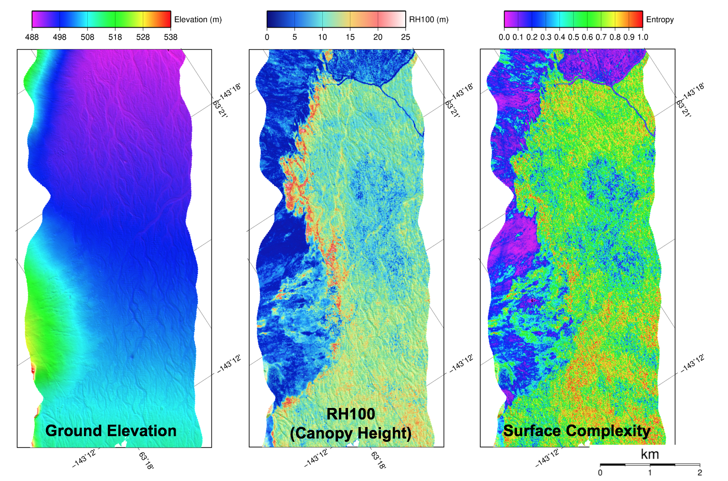
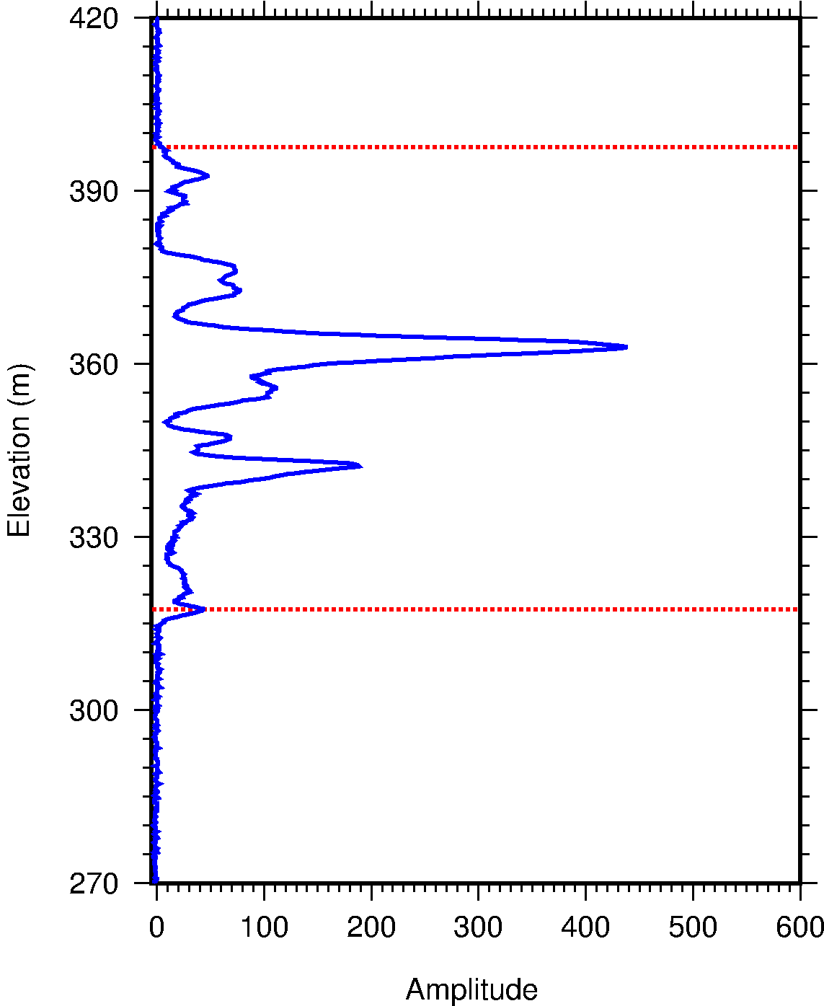
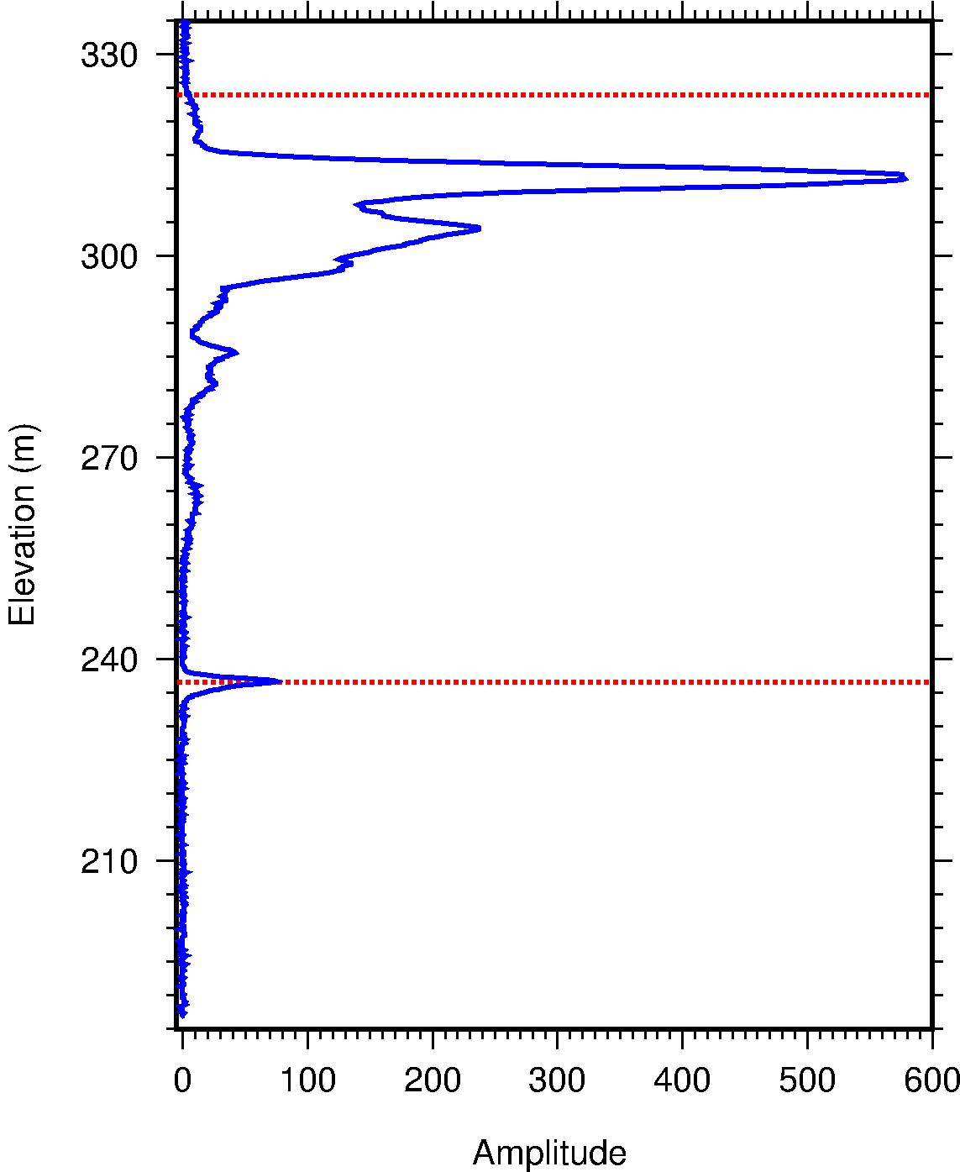
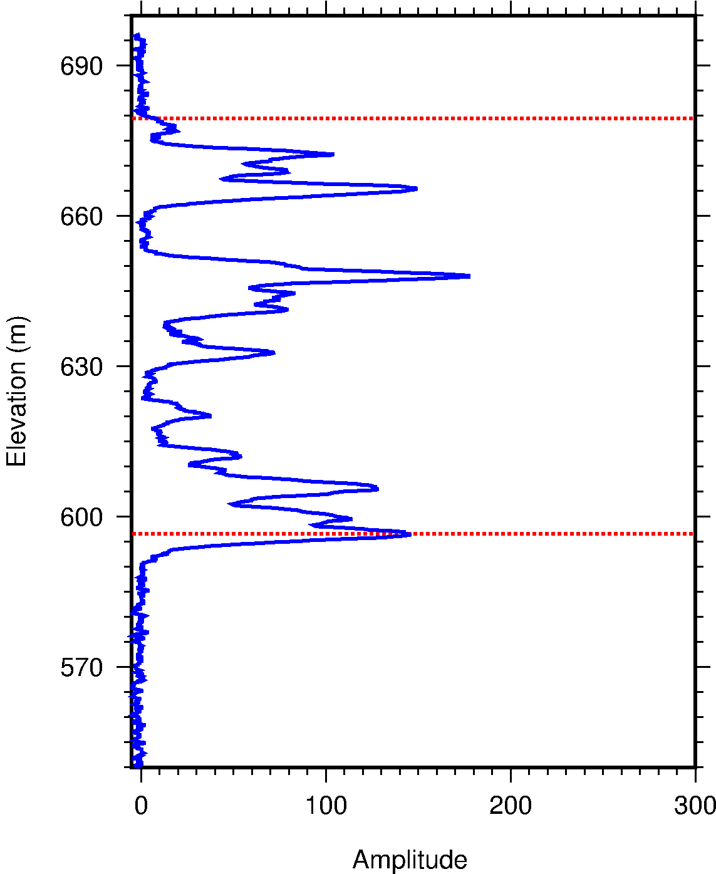
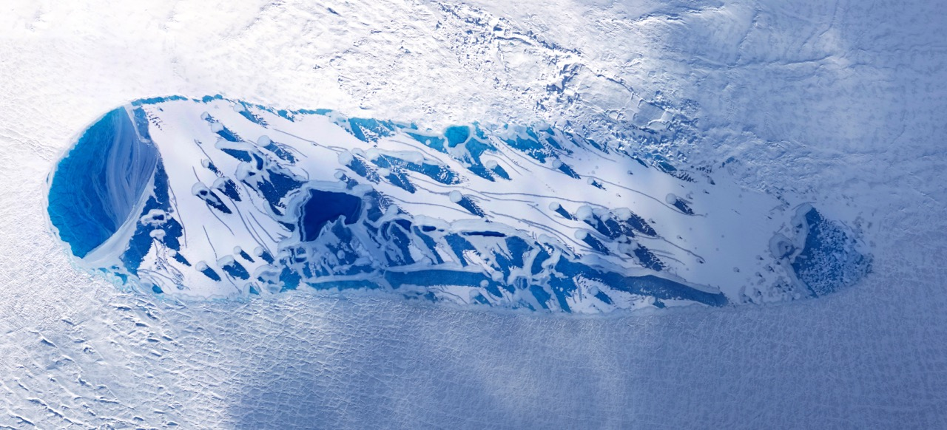
NASA’s LVIS Lidar Mapping Facility
NASA’s Land, Vegetation and Ice Sensor (LVIS) is a high-altitude (10+km), medium-footprint (5-25m) waveform-digitizing lidar, now operating as a NASA laser altimeter facility.
Measures surface topography and topographic extent (e.g., canopy height, crevasse depth), and structure for every footprint.
High sensitivity waveforms can see through dense canopies
Digitally records the shape of each outgoing and returning pulse.
Nominal mode: 7m footprint/2km swath from 10km above ground (note: footprint, swath sizes selectable based on science application).
1064 nm wavelength, 5 ns (FWHM) laser.
Geolocated, coincident camera imagery also collected.
LVIS Level1b (geolocated waveform vector) and Level2 (elevations heights) files distributed via NSIDC DAAC.
2017 NASA-ABoVE Coverage
https://lvis.gsfc.nasa.gov
Bryan Blair (bryan.blair@nasa.gov). Code 61A NASA/GSFC

Slide 2
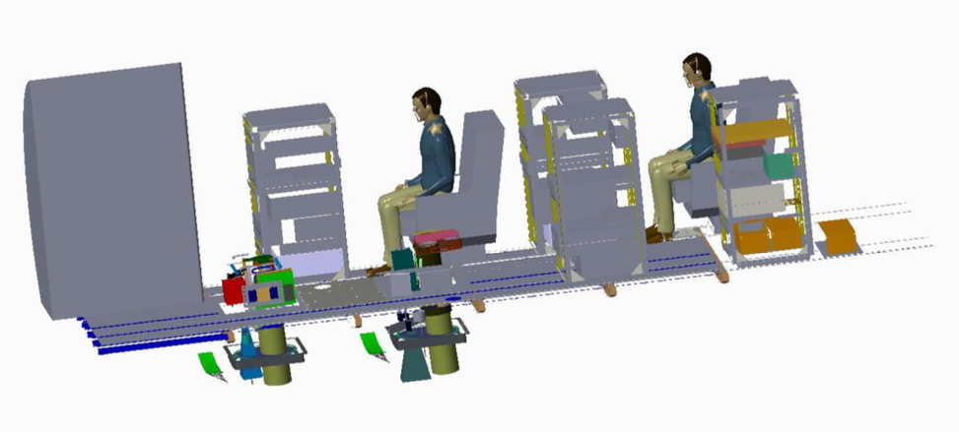
LVIS-Facility and LVIS-Classic on the G-V
Plan to fly both the LVIS-Facility and LVIS-Classic instruments on NASA G-V
FOV of both instruments will be pointed so the data swaths overlap
50 Mpixel Cameras mounted on both sensors – along-track image overlap
Imagery can be georeferenced and can be used to produce stereo DEMs at high resolution
Pixel size at 10 km altitude is ~30 cm
G-V capabilities: 8-10 hour flights (we can consider double crews for longer flights), 440 KTAS, 10-12 km altitude nominally
Coverage per hour once at altitude: ~1,650 km² per flight hour
LVIS-Facility Instrument
Swath width: 2.0 – 2.4 km
Footprint diameter: 7-10 m @ 10-12 km altitude
Footprint spacing: 7-10 m along and across track
Laser Rep-Rate: 4,000 Hz
1064 nm wavelength, 5 ns laser.
LVIS-Classic Instrument
Swath width: 2.0 – 2.4 km
Footprint diameter : 20-24m @ 10-12 km altitude
Footprint spacing: 7-10 m along and across track
Laser Rate: 1,000 Hz
1064 nm wavelength, 9 ns laser.
https://lvis.gsfc.nasa.gov
Bryan Blair (bryan.blair@nasa.gov). Code 61A NASA/GSFC

Slide 3
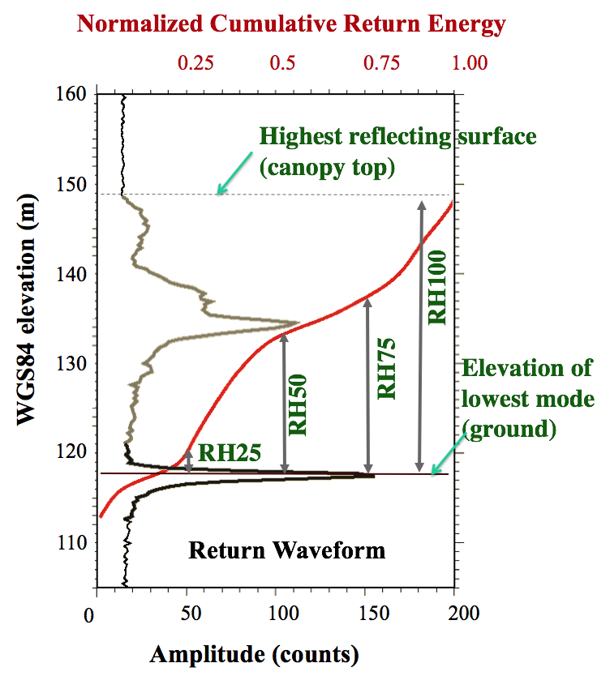
LVIS-Facility and LVIS-Classic Data Products
Identical footprint-level data products generated for both LVIS instruments:
Level1B: Geolocated return waveform vector Enables end user to derive elevation/other products if they so desire. Maintains full accuracy of system and allows end-user interpretation and precise re-analysis.
Level2: Surface Elevation, Heights and Structure products derived from the waveform using LVIS standard algorithms.
Lat/lon/elevation of center of lowest mode in waveform (mean ground elevation)
Lat/lon/elevation of highest reflecting surface
Vertical structure metrics (RH10 thru’ RH100 at 5% intervals) based on energy quartiles, energy in lowest mode, waveform complexity, etc.
Data files are in HDF (Level1b) and ascii (Level2) formats
https://nsidc.org/data/lvis https://lvis.gsfc.nasa.gov/
https://lvis.gsfc.nasa.gov
Bryan Blair (bryan.blair@nasa.gov). Code 61A NASA/GSFC

Slide 4
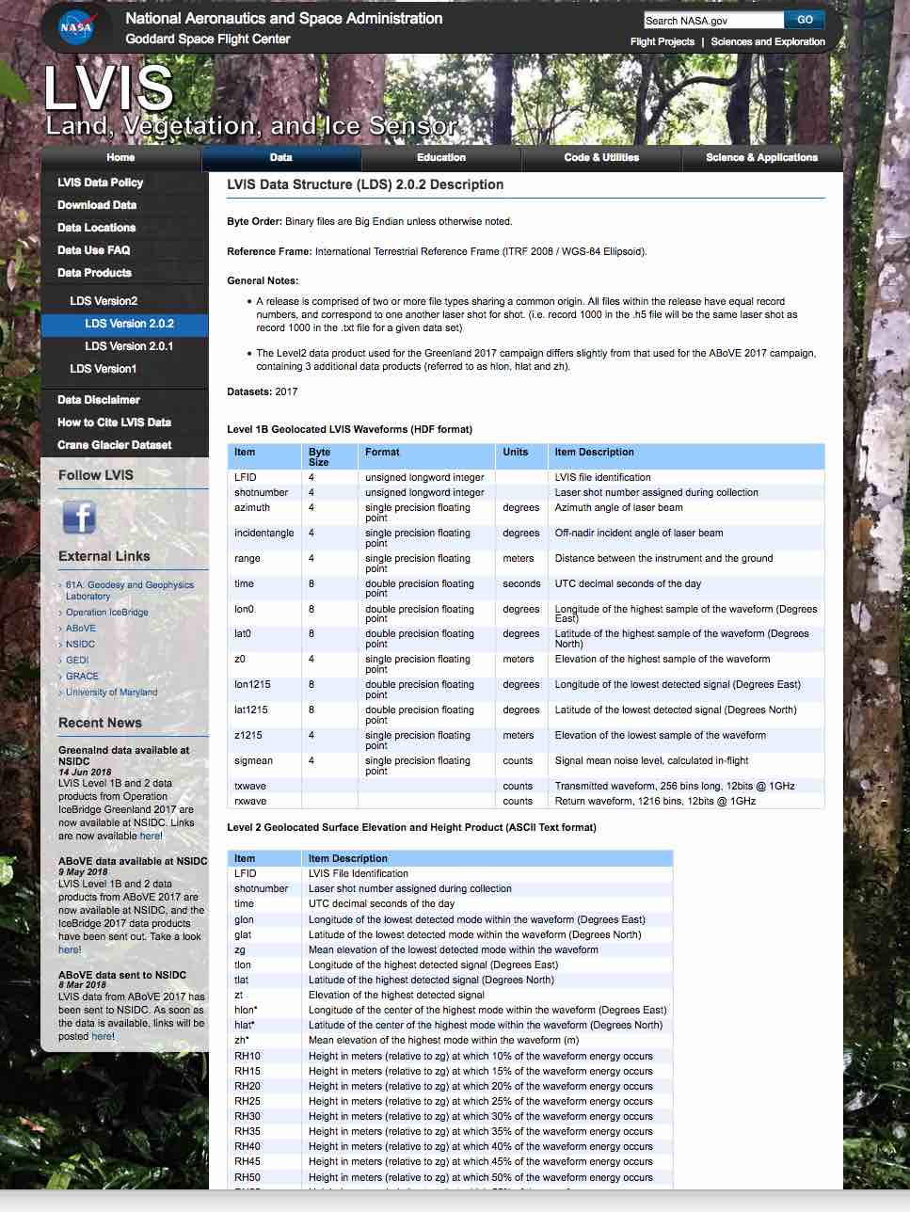
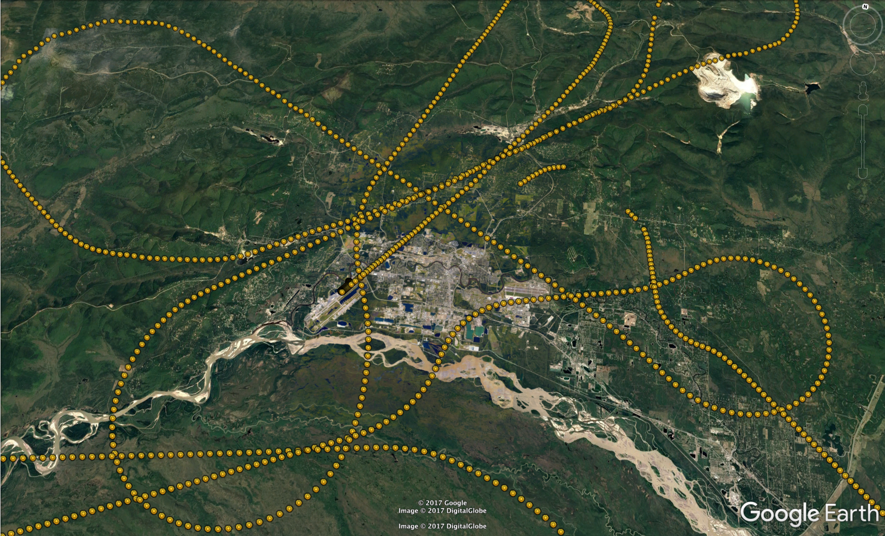
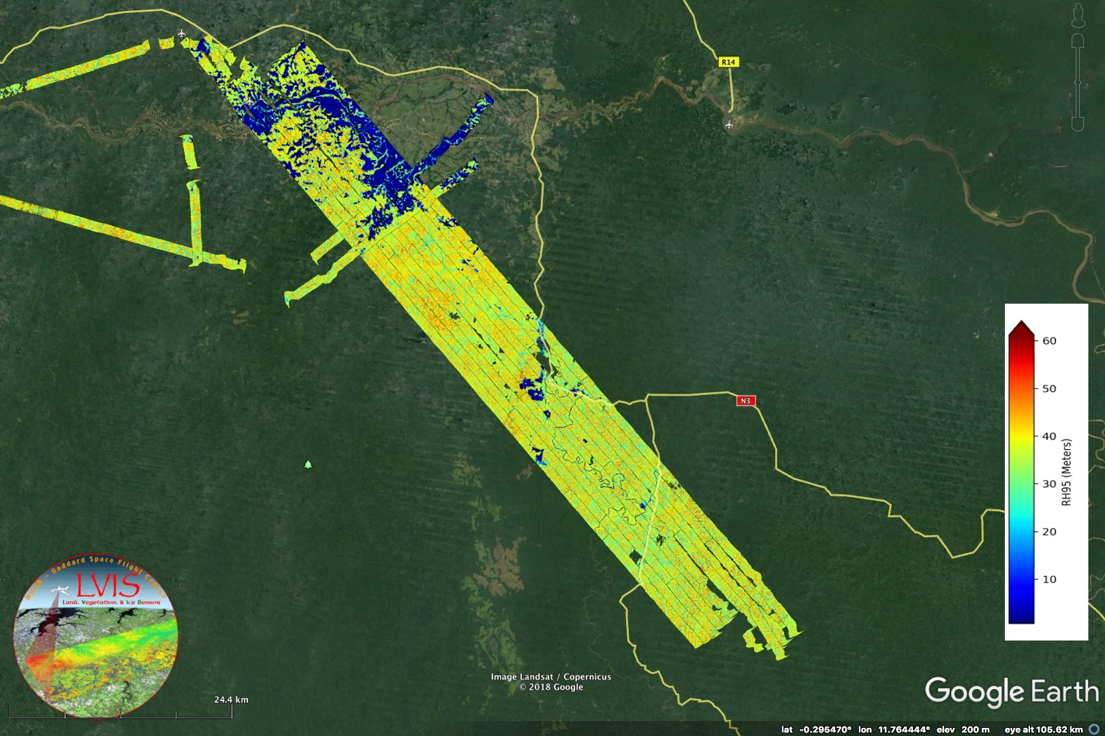
Data Products Timeline
Identical products generated for both LVIS instruments
LVIS-Facility Quicklooks generated in field (rough coverage %, initial processing to inform us if target sites need revisiting)
On return: L0 to NSIDC
2-4 months after return: L1b and L2 LVIS data and L1A Geolocated camera imagery to NSIDC
Supporting info on LVIS website: kmz supporting info for flight trajs, coverage dems, camera photo locations
https://nsidc.org/data/lvis and https://lvis.gsfc.nasa.gov/
https://lvis.gsfc.nasa.gov
Bryan Blair (bryan.blair@nasa.gov). Code 61A NASA/GSFC

